Slide 1



Public finance consolidation and The labor market in Hungary
Ágnes Orosz, Institute of World Economics MTA KRTK, Hungary
3 June 2016

Slide 2
Layout
Economic environment during 2000s
Public finance balance, public debt
Current challenges
Main labor market trends 1990-2015
Emigration and the labour market
Policy recommendations

Slide 3
Background
  Fiscal consolidation started before the outbreak of the crisis (2006 – deficit level 9.4% of GDP)
  EDP 2004-2013
  2008: Stand-By Arrangement (-7% growth rate)
    IMF: € 12.3 billion,
    EU: € 6.5 billion,
    World Bank: € 1.0 billion
  2012: deficit level below 3% threshold (successful consolidation)

Slide 4
Figure 1 General government deficit/surplus in Hungary 2000-2017
)
Source: Eurostat, * Note: forecast based on European Commision Spring 2016 Economic Forecast

Slide 5
Public finance balance
Hungarian public finance balance performance has been among the worst ones in the EU before the crisis
2008: successful consolidation but! the outbreak of the crisis
Several consolidation packages
Since 2012 general government deficit below 3% threshold (2017 forecast: 2%), structural budget balance expected to deteriorate to 3%,

Slide 6
Figure 2 Public finance balance in Hungary (% GDP)
Forrás: AMECO database

Slide 7
Consolidation packages
2008: expenditure-side (pay cuts for public-sector employees, elimination of the 13th monthly pension for early retirees and a cap on the 13th monthly pension for other pensioners, other spending cuts)
2009-2010: expenditures were reduced by the equivalent of 1.6% and 3.6% of GDP, respectively (cuts in social benefits,
2010: 2010 the government reduced the personal income tax effective to a flat rate system at 16 percent (revenue-side, but no increase)

Slide 8
Consolidation packages cont.
2011: nationalising private pension funds, drifting away the Hungarian mixed pension system from private insurance, reinstalling the pay-as-you-go scheme (9% of GDP), Szell-Kalman Plan
2012-2013: mainly expenditure-based consolidation (areas: health, education, social transfers, pensions, local administrations, and transport)
2013: two additional fiscal consolidation packages, one targeting the expenditure side and the other mainly raising and redesigning sector-specific taxes (bank, telecommunications)

Slide 9
Consolidation packages cont.
2015-2018: gradually improve the headline deficit to 2.4% of GDP in 2015 and further to 1.6% in 2018
broadly plausible macroeconomic scenario until 2016 and becomes favourable thereafter
2016 tax cuts! (flat income tax rate of 16% was reduced by 1 percentage point and the family tax allowance (two children) will double between 2016 and 2019, reducing taxes and social security contributions by 3% of GDP, to below 36% of GDP by 2019)

Slide 10
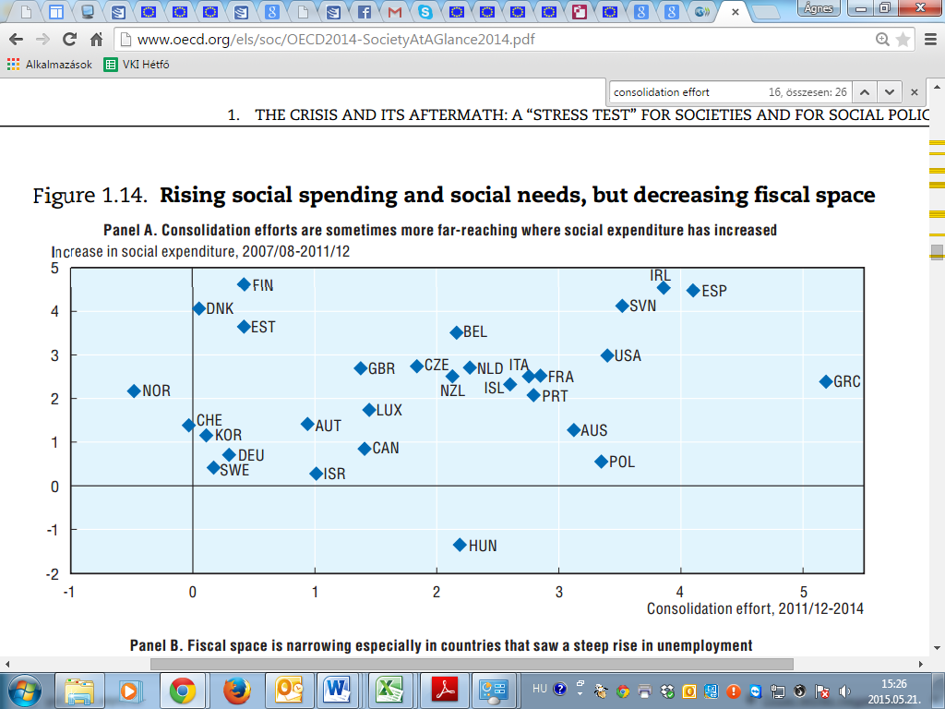
Figure 3 Relationship between consolidation efforts and change in social expenditure
)
Source: OECD (2014): Society at a glance 2014. OECD Social Indicators: The crisis and its aftermath. pp. 41.

Slide 11
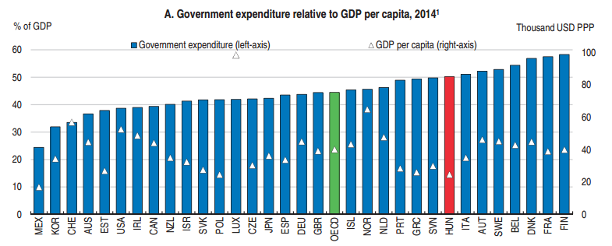
Figure 4 Hungary's public sector is relatively large and tilted towards general public services
Source: OECD (2016a): Economic Survey of Hungary 2016 pp. 33.

Slide 12
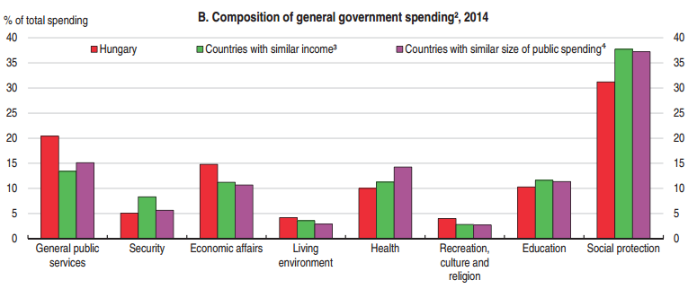
Figure 5 Hungary's composition of general government spending
Source: OECD (2016a): Economic Survey of Hungary 2016 pp. 33.

Slide 13
Public debt
Exceptional high initial level – 2008 – (within ECE)
Modest recovery – debt level around 80%
preventive arm of the Stability and Growth Pact
government plans to gradually reduce the debt-to-GDP ratio to 74.9% in 2015 and to 73% in 2017
Broadly plausible macroeconomic scenario
delays in the receipt of EU funds are assumed are to have a debt-increasing effect

Slide 14
Figure 6 General government gross debt for Hungary
Source: Eurostat, * Note: forecast based on European Commision Spring 2016 Economic Forecast

Slide 15
Current challenges
No risk of fiscal stress in the short term
Low risks to fiscal sustainability in the medium and long term perspective
Future challenge: reducing government debt
Sustainability of PAYG pension system in the long run
Debt brake not in practice (implementation when?)
Putting the debt-to-GDP ratio firmly on a downward path will require further consolidation efforts
Importance of EU funds in fiscal policies

Slide 16
Main labor market trends after 1990*
Dramatic rise in unemployment in the early 1990s due to the transformatinal recession.
Significant drop in the participation rate. Early age and disabled retirement used as a social policy tool.
Structural change of the economy: dual economy created.
FDI-dominated high value added manufacturing industries play an increasing role in production since the mid-1990s. Low labor intensity, high capital and technology intensity.
Domestic based SMEs generate limited jobs because of low competitiveness.
Large part of unskilled labor become inactive or long-term unemployed.
*Based on the presentation of Zoltán Ádám within the Hidden triggers project.

Slide 17
Main labor market trends after 2010*
  Public employment programs become an even more important active labor market policy tool (at some points 200+ thousand). Increase in employment rate significantly with questionable social and economic impacts.
  Restrictions on social benefits, cut of public employment wage, introduction of flat 16% income tax from the 1st forint of income – a significant hike in the tax wedge of low wage incomes (up to 49% on minimum wage in 2013). Rise in social inequalities.
  Large wave of outward labor migration.
  Some employment incentives in backward regions and in case of low productivy labor such as subsidized travel and employment, and reduced social security costs. But the minimum wage rises further.
*Based on the presentation of Zoltán Ádám within the Hidden triggers project.

Slide 18
Unemployment rate in regional comparison
Source: Eurostat

Slide 19
Employment rate in regional comparison
Source: Eurostat

Slide 20
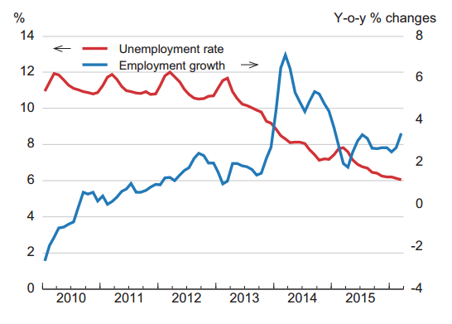
Labor market developments after 2010
Source: OECD (2016b): Economic Forecast Hungary

Slide 21
The impact of out-migration on the labor market*
Difficult to estimate, official data probably under-report it.
In 2013: 21580 persons left Hungary on a long term bases. In 2014: 31500 (46% increase)
44% of out-migrants are under 30 years old. 77% are under 40, 54% are male, close to 2/3 of them single.
In 2013 the number of Hungarians who had left the country since 1989 was estimated 350 thousand. Today their number is probably closer to 500 thousand or even more.
Migrants’ remittances to Hungary in 2013 USD 2.4 billion (second largest after Romania within the region)
Sustainability of helath care systems, the issue of wage competition, labor shortages of several sectors
*Based on the presentation of Zoltán Ádám within the Hidden triggers project.

Slide 22
Policy recommendations*
  Low participation rates are difficult to increase without public employment. Unemployed persons are easier to (re-)integrate into the labor market than the economically inactive.
  High share of inactive population gives strong incentives for populist economic policies.
  Internationally competitive, technologically advanced manufacturing industries directly generate few new jobs. Linkages between domestic firms and multinationals are crucial.
  High minimum wages are dangerous for the employment of low productivity labor.
*Based on the presentation of Zoltán Ádám within the Hidden triggers project.

Slide 23
Thank you for your attention!

