Slide 1
European Union support to the Ukraine
Bratislava, 3 June 2016
Livia Vasakova, EC Representation in Slovakia

Slide 2
EU support for SK and other candidate countries
EU support for reforms and acquis communautaire crucial also for Central and Eastern Europe
Significant push towards democratisation and modernisation

Slide 3
EU – Ukraine relations
Ukraine is a priority partner country within the European Neighbourhood Policy and the Eastern Partnership
EU holds with Ukraine yearly Summits at Presidential level
The current legal framework is provided by the Association Agreement, which replaced Partnership and Co-operation Agreement in 2014

Slide 4
Association Agreement
support to core reforms, economic recovery and growth, and governance and sector cooperation in areas such as energy, transport and environment protection, industrial cooperation, social development and protection, equal rights, consumer protection, education, youth, and cultural cooperation.
a strong emphasis on values and principles: democracy and the rule of law, respect for human rights and fundamental freedoms, a market economy and sustainable development.
it includes a Deep and Comprehensive Free Trade Area, which goes further than classic free trade areas, as it will both open up markets but also address competitiveness issues and the steps needed to meet EU standards and trade on EU markets.

Slide 5
Macroeconomic situation
Ukraine - geopolitical instability significantly affecting economic conditions
 | 2013 UA | 2013 EU | 2014 UA | 2014 EU | 2015 UA | 2015 EU
Real GDP growth % | 0.0 | 0.0 | -6.6 | 1.4 | -9.9 | 2.0
Unemployment % | 7.3 | 10.9 | 9.3 | 10.2 | 9.5 | 9.4
Inflation % | -0.3 | 1.5 | 12.1 | 0.5 | 48.7 | 0.0
Deficit % | -4.8 | -3.3 | -4.5 | -3.0 | -1.2 | -2.4
Debt % | 40.7 | 85.5 | 70.3 | 86.8 | 80.2 | 85.2
Source: Eurostat, IMF

Slide 6
EU support for UA – important areas
Fiscal consolidation and macroeconomic management
Continuation of comprehensive reforms in the energy and banking sectors
Strengthening economic governance, transparency
Judicial reforms and the fight against corruption
Notes:
The EU is the largest donor to Ukraine. Since 1991, assistance provided by the European Community alone has amounted to over € 3.5 billion. EU financial assistance to Ukraine is on the rise. Annual bilateral funding (National Action Programme) has increased from €47 million in 2002 to €186 million in 2013 and €242 million in 2014.

Slide 7
Macroeconomic assistance
3 MFA programmes
  1st – 610m EUR
  2nd – 1bn EUR
  3rd – 1,8bn EUR conditionality
Macro-finance assistance is an exceptional EU crisis-response instrument available to the EU’s partner countries experiencing severe balance of payments problems. It is complementary to assistance provided by the IMF. MFA loans are financed through EU borrowings on capital markets. The funds are then on-lent with similar financial terms to the beneficiary countries.

Slide 8
Trade + visa free travel
Preferential access to EU markets for Ukrainian exporters
Temporary removal of customs duties on exports to the EU
  Unilateral steps
Annual value of this support measure = nearly €500 m, of which almost €400 m accrue to the agricultural sector.
EC proposed visa-free travel for citizens of UA (April 2016)
Notes:
The AA includes provisions for a Deep and Comprehensive Free Trade Area (DCFTA). The DCFTA offers Ukraine a framework for modernising its trade relations and for economic development by the opening of markets via the progressive removal of customs tariffs and quotas, and by an extensive harmonisation of laws, norms and regulations in various trade-related sectors. This will create the conditions for aligning key sectors of the Ukrainian economy to EU standards.
After signing the political chapters of the EU-Ukraine Association Agreement at the EU Summit of 21 March 2014, both parties signed the remaining sections of the Association Agreement on 27 June 2014. The Agreement was then simultaneously ratified by the Verkhovna Rada and the European Parliament on 16 September 2014. While several important parts of the Association Agreement entered provisionally into force on 1 November 2014, the DCFTA part started to be provisionally applied as of 1 January 2016. Today, almost all parts of the Agreement are provisionally applied.
The implementation of the EU-Ukraine Association Agreement, including the Deep and Comprehensive Free Trade Area, while not constituting the final goal of EU-Ukraine cooperation, will bring opportunities for sustainable economic development and prosperity to all the regions of Ukraine, as well as to its neighbours.

Slide 9
Budget support for reforms
€365 million Special Measure (in grants) approved in 2014, the highest annual amount ever committed for Ukraine
  to support public finance management, anti-corruption, public administration, budget transparency, judicial and constitutional reform and electoral legislation
Past support to Ukraine included support for infrastructure development in the areas of energy, transport, environment, border management.

Slide 10
Support in the energy sector
- Through Energy Community (member since 2010)
Goal: extends the EU internal energy market to South East Europe and enhances the overall security of supply
- Main instruments:
trilateral negotiations of winter gas packages
reverse flows
energy efficiency
market functioning of the gas sector (market opening, unbundling of main gas company, third party access, strengthening of independent regulatory authority)
Notes:
The Community extends the EU internal energy market to South East Europe and enhances the overall security of supply. The Protocol on the Accession of Ukraine to the Energy Community was signed today at the Energy Community Ministerial Council in Skopije (Macedonia).

Slide 11
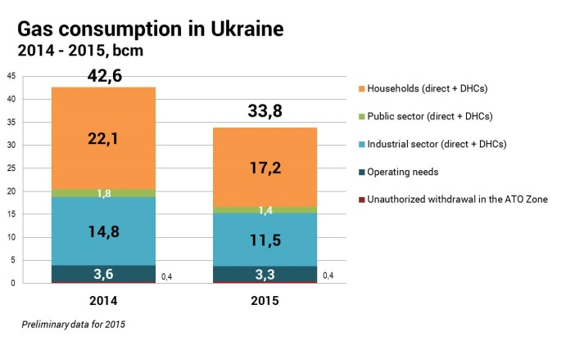
Reduction of domestic gas consumption
Notes:
Decrease by 22% in a year

Slide 12
Ukraine – gas imports & production
Notes:
Data NAK

Slide 13
Strong energy price increases – key for sector reform & burden for state budget

Slide 14
Thank you for attention. Questions?
E-mail: Livia.Vasakova@ec.europa.eu
TWITTER:@VasakovaLivia

