Slide 1




The Myths and Realities of the European Migration Challenge
Martin Kahanec
EU BA; Central European University (CEU); CELSI and IZA
Bratislava, 21/4/2016

Slide 2
Migrants/refugees as potential workers
Many perspectives on immigration
  humanitarian
  economic
  political
  …
My focus: labor market/economic

Slide 3
Do we need migration/mobility in the EU?

Slide 4
The demographic background
Demographic change presents nearly all EU states with formidable challenges:
  Ageing populations
  Scarcity of skilled labor
  Dynamic loss in the economy (innovation deficits)
  Financial risks in social security systems
Financial and economic crisis added to the difficulties:
  Rising risk aversion
  Economic decline
  Negative attitudes toward immigration and new Fortress Europe
And the immigration crisis has added xenophobic/nationalistic/racist fuel to the debates

Slide 5
Skill gaps and demand for migrants in the EU
Mobility and immigration are needed
Replacement and newly emerging jobs (both high skilled and low skilled)
Fill in shortages and skill gaps
IZA Expert Survey on High-Skilled Labor Immigration:
A survey of 234 labor market experts from Europe;
89.0% - the EU needs at least as many immigrants as it has now, and 57.7% - the EU needs more or many more immigrants
Less conviction that the EU needs additional low-skilled immigration (60.7 and 27.3%)
However, 96.7% - the EU needs at least as many high-skilled migrants, and 80.3 % - the EU needs more or many more high-skilled migrants
The EU needs migrants from outside

Slide 6
Great Recession in the EU and EMU:
Migration as an antidote?
Asymmetric shocks
  Deep recession (e.g. EL, ES) ….to.... no recession (PL)
Policy responses?
  Fiscal policy
    No fiscal union, tiny fiscal capacity.
    Unilateral responses led to sovereign debt crisis and austerity
  Monetary policy
    not available to EMU members individually
    internal depreciation – painful, risk of deflationary spiral
Mobility of labor and other factors is crucial!

Slide 7
What mobility do we have in the EU?

Slide 8
Mobility and migration in the EU
Relatively well educated:
EU15
EU12
EU12 migrants relatively well educated, EU15 migrants more educated than natives (EU LFS, 2010).

Slide 9
Unskilled immigrants? No, rather skilled!
Non-EU immigrants well-educated, especially in NMSs.
Tertiary education. Source: Kahanec, 2012. EU LFS 2010

Slide 10
Want to work, but difficulties in finding a job …and even if in a job, skill mismatch - downskilling
EU15
EU12
EU15 migrants doing well, but EU12 migrants downskilling

Slide 11
Educated…but brain waste!
Non-EU immigrants more often work in less-skilled occupations (especially ES, IT, AT, DE, SE, NL), except for some NMSs.
ISCO 1-3. Source: Kahanec, 2012. EU LFS 2010

Slide 12
What effects of EU mobility?

Slide 13
Educated but downskilled? Inefficient.
But perhaps even:
Take our jobs!
Lower the wages!
Abuse welfare systems!
Welfare tourism!
Increase crime!
Well ….. and how about evidence?

Slide 14
Take “our” jobs? No, they help to create jobs!
Lower “our” wages? Not really.
Mariel boatlift, within 2-3 months circa 125,000 Cuban refugees sailed to Miami. Unemployment up, wages down? No! (Card, 1990)
Post-enlargement mobility in the EU, circa 3 million migrants 2004-2009. Same lessons: no negative impacts on unemployment rates or wages. (Kahanec and Zimmermann, 2016)
300 million immigrants in the US, 20 million in Australia, etc. No jobs at all? Low wages?
Constant (2014) summarizes evidence, in the long run job creation

Slide 15
Abuse the welfare state?
In most EU member states lower or similar take up rates

Slide 16
Let us now expose them! Ratio of proportions of immigrants and natives in unemployment support

Slide 17
Estimated impact of immigrant status on support receipt: unemployment, sickness and disability

Slide 18
Ratio of proportions of immigrants and natives: Unemployment support for the unemployed
So NOT abuse, but
LACK OF ACCESS

Slide 19
Welfare shoppers?
Theory - possibly
  Welfare reduces the volatility and increases the level of expected income of migrants, this in theory leading to the welfare magnet hypothesis (e.g. Heitmueller 2005)
Empirics – rather not
  Borjas (1999): welfare magnet marginally significant among the US states
  De Giorgi and Pellizzari (2009): not too large but statistically significant welfare magnet in EU15
  Pedersen, Pytlikova and Smith (2008): Social expenditures/GDP not significant within countries
  Kahanec et al (2013) – no effects if endogenity accounted for
Rather:
Contribute to public finances (Dustmann and Frattini, 2013)

Slide 20
Any macro impacts of migration?
For post-enlargement migration we find positive effects on
  GDP
  GDP per capita
  Employment rate
And negative effects on
  output per worker
(Kahanec and Pytlikova, 2016)

Slide 21
But they are criminals! No, not more than the natives
Immigration does not increase crime (Bell, 2014)
Lack of labor market integration may increase property crime – but equally for immigrants and natives! (Bell, 2014)

Slide 22
Conclusions
Europe/Slovakia needs immigrants, mainly qualified ones
We have some, but we are also losing the best
Our migration and integration policies are problematic
In spite of this, immigrants in the EU contribute to GDP, taxes, labor market efficiency, no negative effects on wages or employment
Migrants respond to labor market skill gaps more fluidly than the natives
So we need more, and not less mobility; we need more and not less integration

Slide 23
Migration policy options
Demand-driven employer-led systems (re-active, short-term needs)
  Free movement
  Sectors/occupations clearance
  Labor market tests
Human-capital-accumulation focused, government-led (pro-active, win talents, but possibly mis-matched)
  Points-based systems
  Provisions for graduates
  Intergovernmental agreements
Hybrid systems
  Combine best of the two
  e.g. points-based with heavy weight on existing job offer

Slide 24
Bottom line
The current migration crisis in Europe offers a potential for a triple win:
  Provide humanitarian help to refugees - a moral victory
  Revamp our migration, asylum, and integration policies
  Benefit from the new hands and brains that can boost our labor markets
Otherwise we risk a triple loss

Slide 25
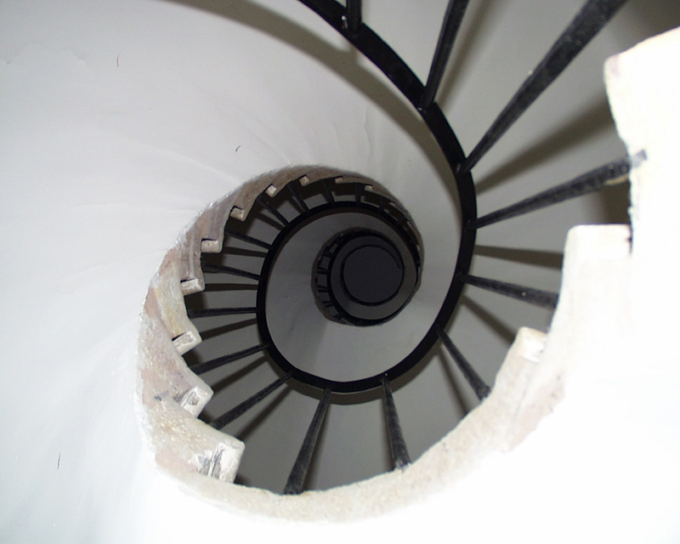
Martin Kahanec
Tel/Fax: +36 1 235 3097
Email: kahanecm@spp.ceu.edu
School of Public Policy
Central European University
Nador utca 9
Budapest 1051
Hungary publicpolicy.ceu.hu
        Spp.

