Slide 1


Solutions to High Unemployment Rate – Case of Czech Republic
Michal Hejl
CETA analyst, Czech Republic
January 29, 2016
Webinar on Solutions to high unemployment rate

Slide 2
Unemployment by year

Slide 3
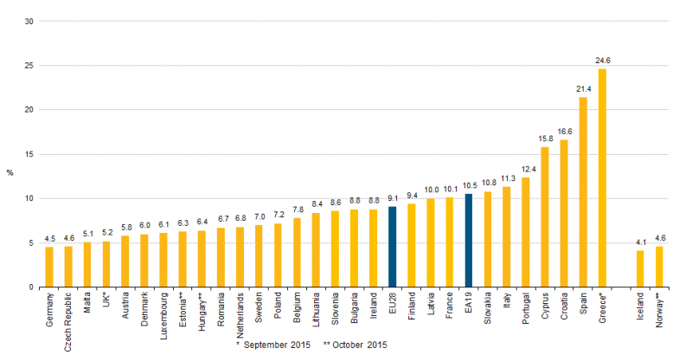
Latest unemployment data

Slide 4
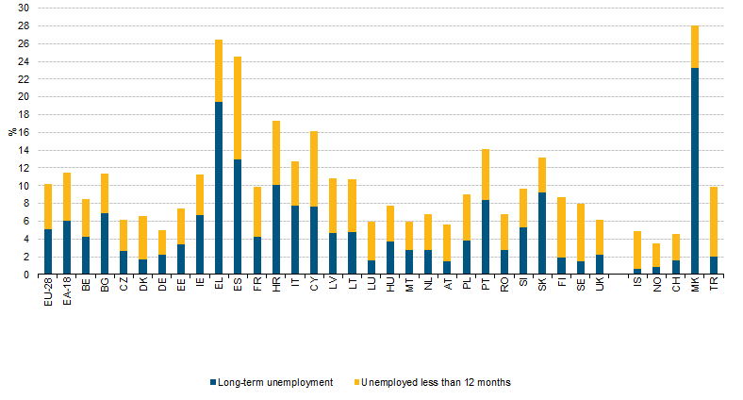
Duration of unemployment

Slide 5
Overall situation
Czech republic has had relatively low unemployment rate in comparison with the rest of EU, in November 2015 it was the second lowest
Unemployment was going down steadily until the economy crisis after which it increased significantly
In 2015 unemployment rate has dropped significantly, latest data from Q3 show it at only 4,8 %
However this drop has not been spread evenly around the country

Slide 6
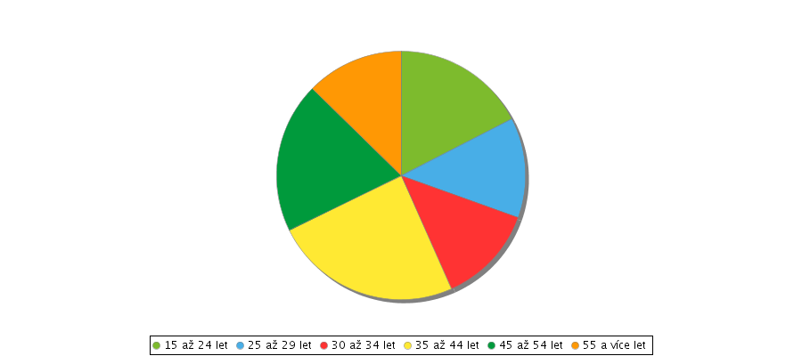
Unemployment rate by age
There are two groups that are problematic, the young after leaving schools and people over 55 years of age
Amongst the young, the ones with lower educational attainment are especially vulnerable
The numbers for old seem low because many take preliminary or disability retirement

Slide 7
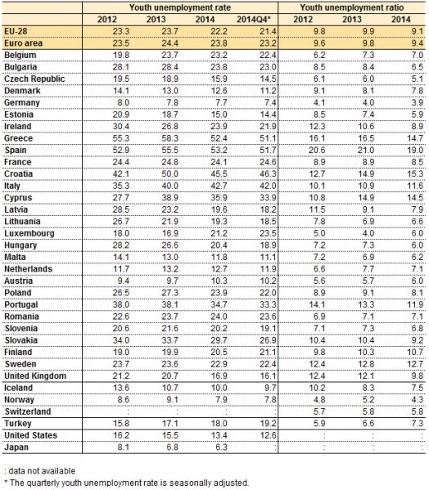
Youth unemployment

Slide 8
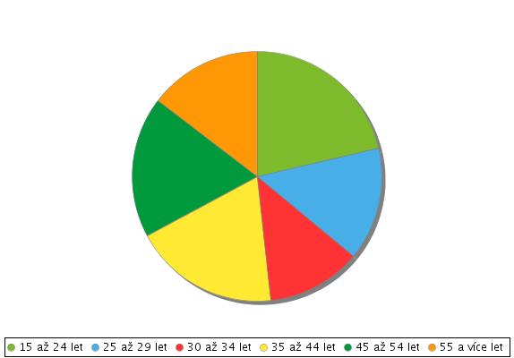
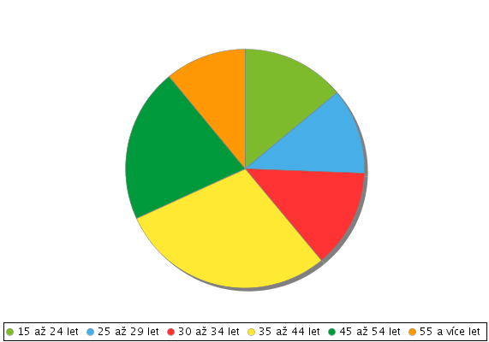
Unemployment rate by sex
Men
Women

Slide 9
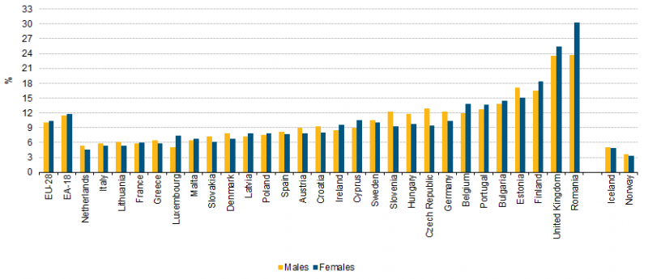
Unemployment rate by sex

Slide 10
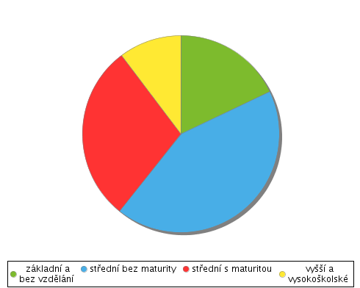
Unemployment rate by education
The higher the education, the lower the overall unemployment rate
Especially in 2., great differences between individual fields of study
This data is in conflict with claims of employers who clamor for more vocational students
1 – Primary
2 – Secondary without maturita
3 – Secondary with maturita
4 - Tertiary

Slide 11
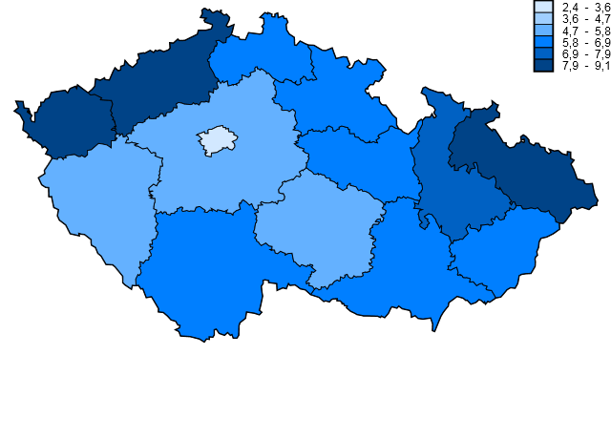
Regional unemployment rate 2014

Slide 12
Regional unemployment rate
The area around capital has least unemployment (Prague and Středočeský kraj)
Especially problematic are the old mining regions in northern Bohemia and Moravia-Silesia
While there have been quite a few attempts to remedy this, so far there was little success
Generally speaking, the farther away from big cities, the greater the unemployment rate is, this is made worse since Czechs are reluctant to move to get work

Slide 13
Social Security system
Labor offices – theoretically supposed to find work for the unemployed, not very effective
These offer various requalification courses in addition to trying to offer employment
Unemployment assistance – available to those who worked for at least 1 year in the last 2, 5-11 months depending on age, payout is a % of last wage capped at 58 % of the average wage, not means tested

Slide 14
Key Challenges according to the government
Demand outstripping supply due to economy not being strong enough
Great difficulties that the disadvantaged groups have in finding employment
Position of women in the labor market, the difficulties they have due to maternity leave
Insufficient flexibility of both employers and employees, insufficient professional flexibility

Slide 15
Governmental initiatives to curb unemployment 1
„Forced labor“ – Initiative of the previous government to make the unemployed do community service, very controversial from the start, found unconstitutional by the constitutional court
Increasing the minimal wage incrementally
Tax breaks for foreign investment
There are also various regional initiatives

Slide 16
Governmental initiatives to curb unemployment 2
Duty for bigger companies to employ the disabled, buy products of companies that employ them or pay a fine
Subsidies, typically paying a portion of new workers wage for some time,
  Used typically in regions with high unemployment
Kurzarbeit – An idea that keeps appearing every few years, never actually implemented so far
Increase of pre-school care to make it easier for mothers to return to work

Slide 17
Notes
Government spends only half the EU27 average on active employment policies
Since Czech republic is an export based economy with one dominant trading partner, the degree of influence the Czech government has on the unemployment rate is not all that great

Slide 18
Thank you for your attention!

