Slide 1


Solutions to high unemployment rate – Case of Slovakia
Peter Goliaš
INEKO Director, Slovakia
January 29, 2016
Webinar on Solutions to High Unemployment

Slide 2
Key numbers as of Q3/2015
Total population: 5.421 million
Population in productive age: 3.834 million
Working population: 2.435 million
Unemployed: 0,310 million
Employment rate 20-64: 67.9%
Unemployment rate: 11.3%
Working abroad: 0.154 million
Employed in public works: 0.018 million
Working foreigners (December 2015): 0.025 million from Romania, V3, Ukraine and Serbia

Slide 3
Unemployment in V4 and EU
Unemployment rate (in %, monthly averages, seasonally adjusted, Labour Force Survey)
Source: Eurostat

Slide 4
Employment in V4 and EU
Employment rate 20-64 years (in %, annual averages, seasonally adjusted, Labour Force Survey)
Source: Eurostat

Slide 5
Employment vs Unemployment
It seems that in PoIand and Hungary, compared to Slovakia, there are more people in the active age (20-64) who do not work and, at the same time, do not belong to the unemployed.
These may be people taking social benefits such as old-age pensions, disability pensions, sickness benefits, people on maternity leave; or students; or discouraged people who do not believe there is a job for them.
According to the OECD statistics for 2014, there were 1.7% marginally attached people as a share of the labor force in Slovakia, compared to 3.7% in Poland, 4.0% in Hungary and just 0.9% in the Czech Republic.

Slide 6
Unemployed by duration
Unemployed by duration of unemployment (thousands)
Source: Statistical Office of the SR

Slide 7
International comparison
Source: Eurostat

Slide 8
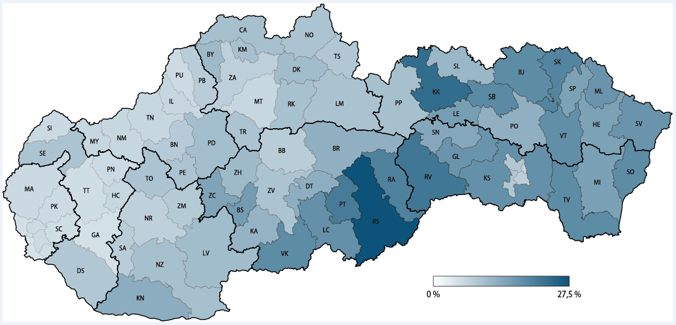
Unemployment rate by regions
Unemployment rate in different Slovak regions (December 2015)
Source: INEKO based on data from the Central Office of Labour, Social Affairs and Family

Slide 9
Roma factor
“Estimates suggest there are approximately 400 thousand Roma in Slovakia, while about 130 thousand of Roma are registered as jobseekers.“
“If the Roma population on the labour market achieved the average results of the majority population, the overall unemployment rate would be approx. 4 percentage points lower.“
  Source: Unemployment in Slovakia, Institute for Financial Policy at the Ministry of Finance of the SR, November 2014, http://www.finance.gov.sk/Default.aspx?CatID=9888

Slide 10
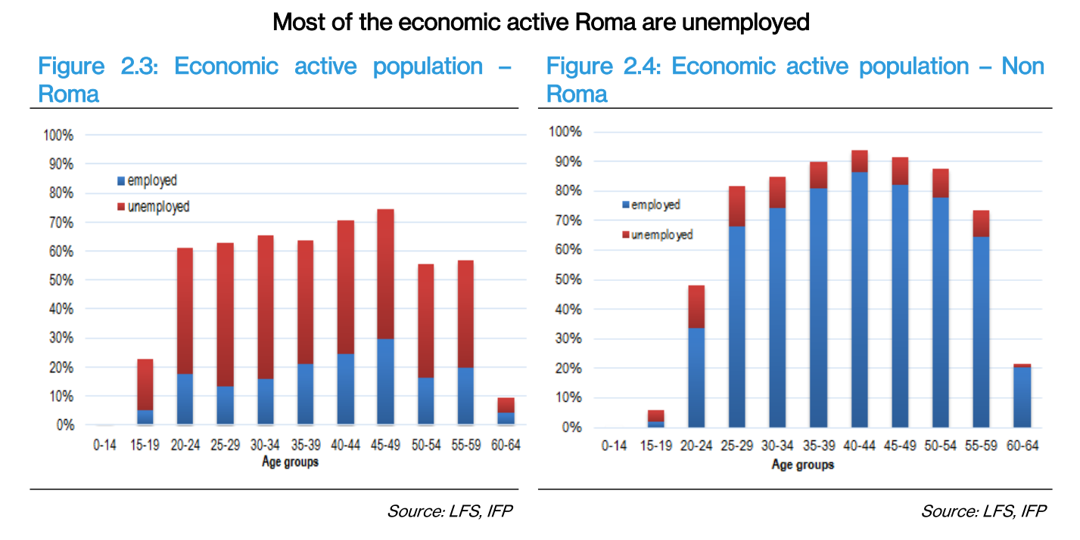
Roma factor
Source: Unemployment in Slovakia, Institute for Financial Policy at the Ministry of Finance of the SR, November 2014

Slide 11
Tax burden on low income
 | Employment |  | Self-employment
 | Employee | Employer
Gross monthly income | 405 € |  | -
Labor costs (monthly) | 514.55 € |  | 514.55 €
Sickness insurance | 5.67 € | 5.67 € | 18.87 €
Old-age insurance | 16.20 € | 56.70 € | 77.22 €
Disability insurance | 12.15 € | 12.15 € | 25.74 €
Unemployment insurance | 4.05 € | 4.05 € | 0.00 €
Solidarity reserve fund | 0.00 € | 19.23 € | 20.38 €
Guarantee fund | 0.00 € | 1.01 € | 0.00 €
Accident insurance | 0.00 € | 3.24 € | 0.00 €
Social insurance total | 38.02 € | 102.05 € | 142.20 €
Health insurance | 3.00 € | 7.50 € | 60.06 €
Insurance total | 150.57 € |  | 202.26 €
Tax on income | 8.92 € |  | 0.00 €
Net income | 355.01 € |  | 312.29 €
Net income/Labor costs | 69% |  | 61%
Difference | 42.72 € in favor of Employment
Net income can be higher depending on number of children of the working person. There is a Tax Bonus increasing net income by 21,41 € monthly for every child.

Slide 12
Applied solutions 1/2
Subsidizing part of labor costs of employing young, old and long-term unemployed
  Intensive use of EU Funds; mixed results
Temporary payroll-tax allowance for employing long-term unemployed (since November 2013)
  Lower than expected usage
Health Insurance Allowance (since 2014)
  For employees with low income; so far weak results, probably because it is not automatic
More generous temporary social benefits for long-term unemployed who find a job (since 2015)
  Good results

Slide 13
Applied solutions 2/2
Public works (since 2004)
  At municipalities or other private entities
  Up to 20 hours per week; up to 198.10 € monthly
  From 2013 not counted as “registered“ unemployed
Dual education (since September 2015)
  Based on tax reliefs; so far weak results, probably due to weak financial motivation
Special law on regions with high unemployment (effective from December 15, 2015)
  More generous investment stimulus for SMEs: 50% in case of investing at least 200 thousand € and creating at least 10 new jobs in industrial production or 5 jobs in tourism
  More generous state aid for construction of social rental housing
  Extra public funds for municipalities in the region on projects aimed at reducing the unemployment

Slide 14
Efficient solutions
INEKO survey among 18 economic analysts (September 2015), three most efficient measures to sustainably increase employment in Slovakia:
  “Measure and publish the efficiency of adopted measures; phase-out inefficient and support the most efficient measures”
  “Reduce the administrative burden especially for small firms, e.g. ease the employment regulations, the hygiene and security requirements and mandatory reporting to official authorities”
  “Link the public funding of secondary vocational and tertiary schools to graduate´s success in joining the labor market”

Slide 15
Inefficient solutions
INEKO survey among 18 economic analysts (September 2015), three most inefficient measures to sustainably increase employment in Slovakia:
  More intensive construction of rental housing in regions with high unemployment rate
  More intensive support of employing young people by subsidizing labour costs
  Introduction of permanent inclusive employment for long-term unemployed – subsidizing/creating permanent jobs by state

Slide 16
Other discussed solutions
Broader use of Health Insurance Allowance
Social enterprises/Inclusive employment
Integration of marginalized Roma
  Higher pre-school enrollment
  Inclusion in standard (non-special) schools
  Collecting ethnic data about unemployed and inactive people
More frequent use of pre-school facilities
Improving the transport infrastructure
Regional minimum wages

Slide 17
Other INEKO recommendations
Further reduction of tax burden for people with low income
  Include self-employed and all low-income people working on Agreements
  Include Social Insurance Allowance
Slow down the reduction of social benefits with rising income
  Currently for every 1 € of increased income 0.75 € of social benefits is taken away
More money on training and less on direct job creation
Benchmark the Employment Offices; gradually outsource the employment services

Slide 18
Thank you for your attention! http://www.ineko.sk/

