Slide 1


Transparent, financially healthy and competitive municipalities in Ukraine
Peter Golias
INEKO Director
November 12th, 2015
Project kick-off seminar in Kyiv, Ukraine

Slide 2
About the project
Title: Transparent, financially healthy and competitive municipalities in Ukraine
Period: October 15th 2015 – March 15th 2017
Funded by: Slovak Aid
Implemented by: INEKO and ICPS
Goal: To support regional development in Ukraine through know-how transfer of successful projects implemented in Slovakia

Slide 3
Projects to be transferred
Open local government – Transparency International Slovakia, http://mesta2014.transparency.sk/en
Portal on financial health of Slovak municipalities – INEKO, http://municipalities.ineko.sk/
Competitive regions 21 – Business Alliance of Slovakia, http://www.regiony21.sk/

Slide 4
Transparent municipalities
Objective: Developing anti-corruption measures pack for self-governments in Ukraine and monitoring of its implementation
  Survey and definition of anti-corruption priorities in Ukrainian self-governments (July 2016)
  Description of the best Slovak practices, e.g. publishing public contracts on internet, public presence at meetings of self-government bodies, public recording of these meetings (August 2016)
  Developing proposals of anti-corruption measures for Ukrainian self-governments (October 2016)
  Monitoring of anti-corruption pack implementation rate in 50 biggest Ukrainian towns (December 2016)
  Publishing the measures and transparency rankings of the biggest municipalities (February 2017)

Slide 5
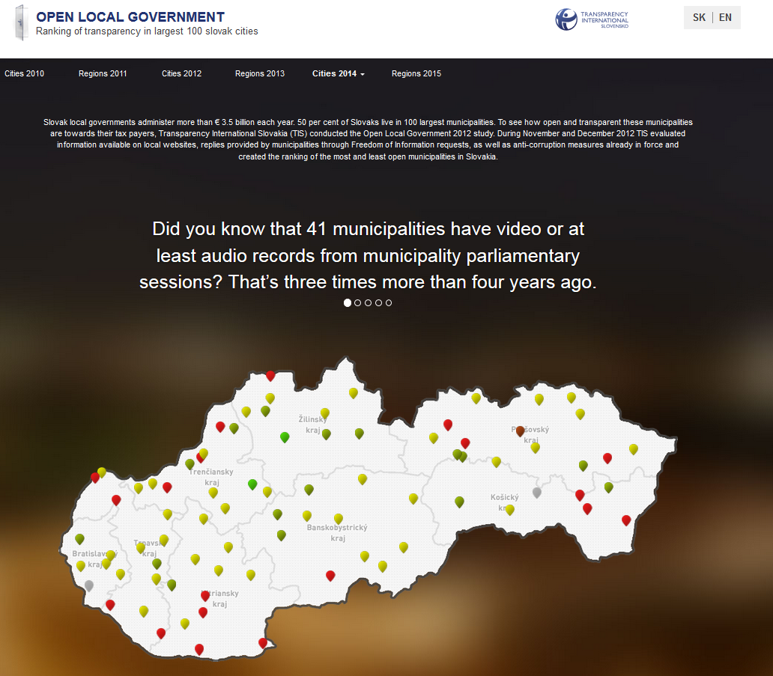
Twin-project in Slovakia (1/3)

Slide 6
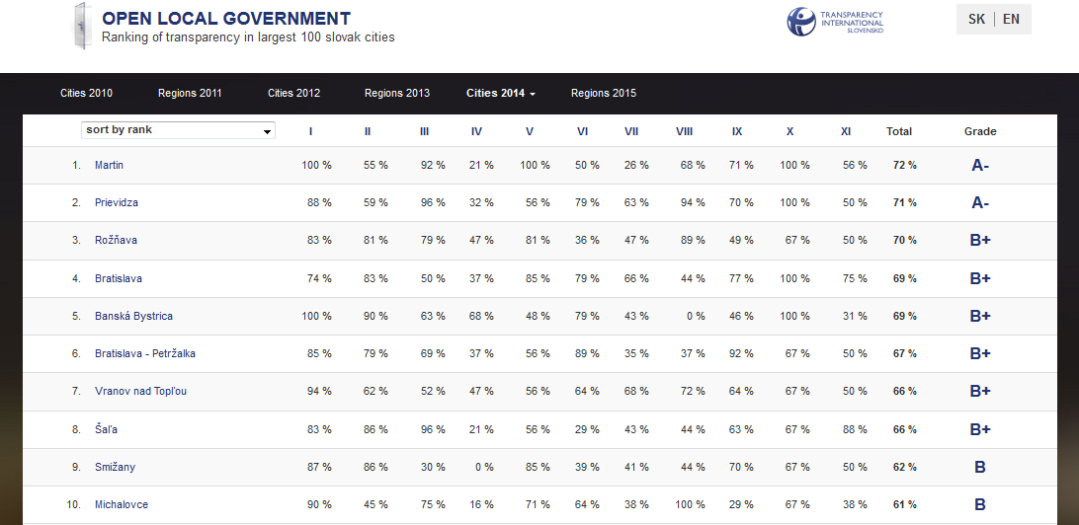
Twin-project in Slovakia (2/3)

Slide 7
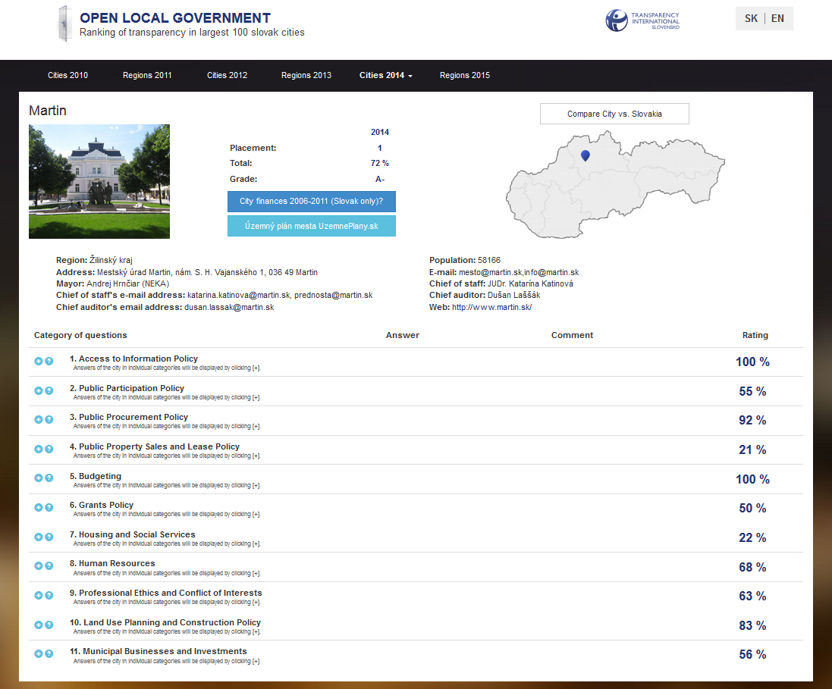
Twin-project in Slovakia (3/3)

Slide 8
Financially healthy municipalities
Objective: Developing online portal on financial management of Ukrainian municipalities
  Data identification and availability (November 2015)
  Processing assessment methodology of financial management of self-governments (November 2015)
  Data collection and processing into required form/database (March 2016)
  Creation of interactive internet portal (May 2016)
  Publishing the portal and related analyses (June 2016)

Slide 9
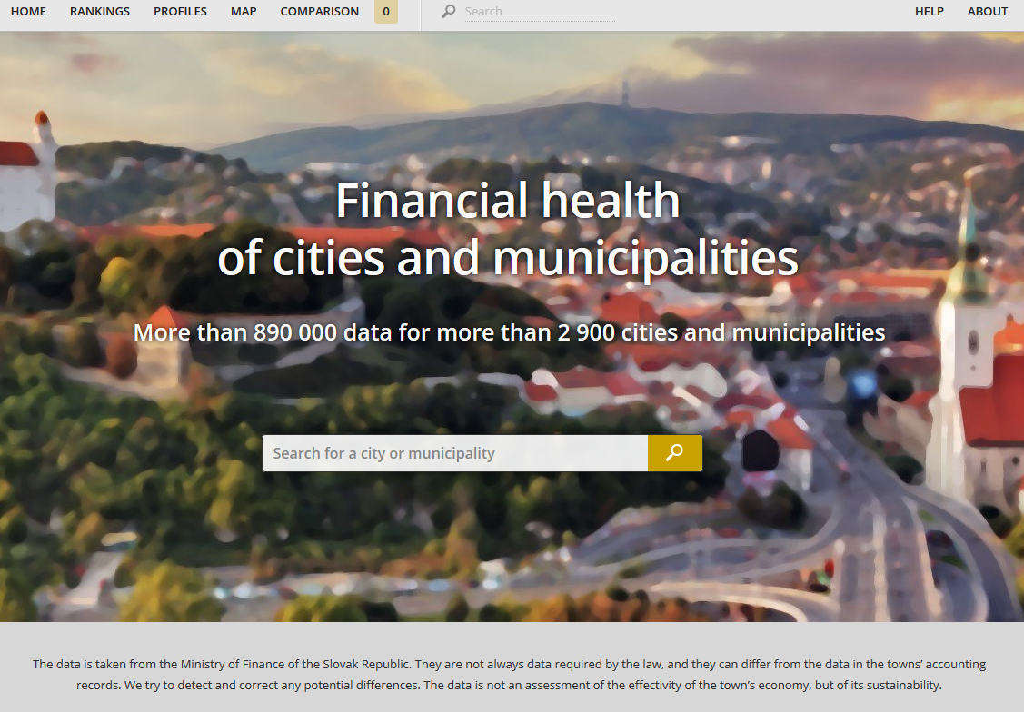
Twin-project in Slovakia (1/3)

Slide 10
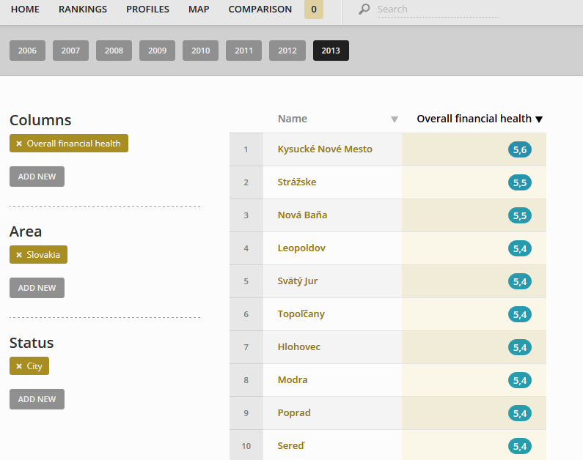
Twin-project in Slovakia (2/3)

Slide 11
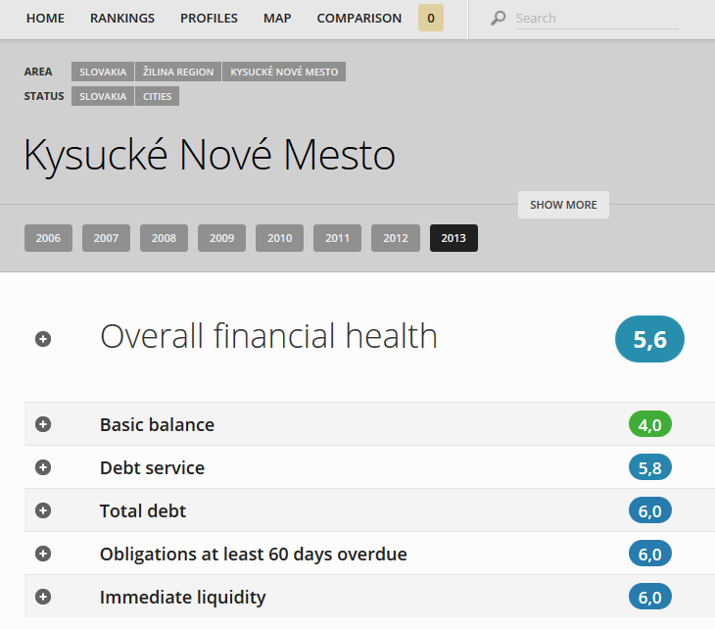
Twin-project in Slovakia (3/3)

Slide 12
Competitive municipalities
Objective: Introducing interactive model of Ukrainian regional competitive advantages
  Data identification and availability – statistical indicators concerning the economic activity, infrastructure, human resources and public administration in Ukrainian regions (November 2015)
  Developing assessment procedure of region competitiveness (November 2015)
  Survey among businessmen in regions to obtain soft data (February 2016)
  Data collection and their processing by mathematic model of region competitiveness, writing a list of competitive advantages and disadvantages of UA regions (August 2016)
  Publishing the results (November 2016)

Slide 13
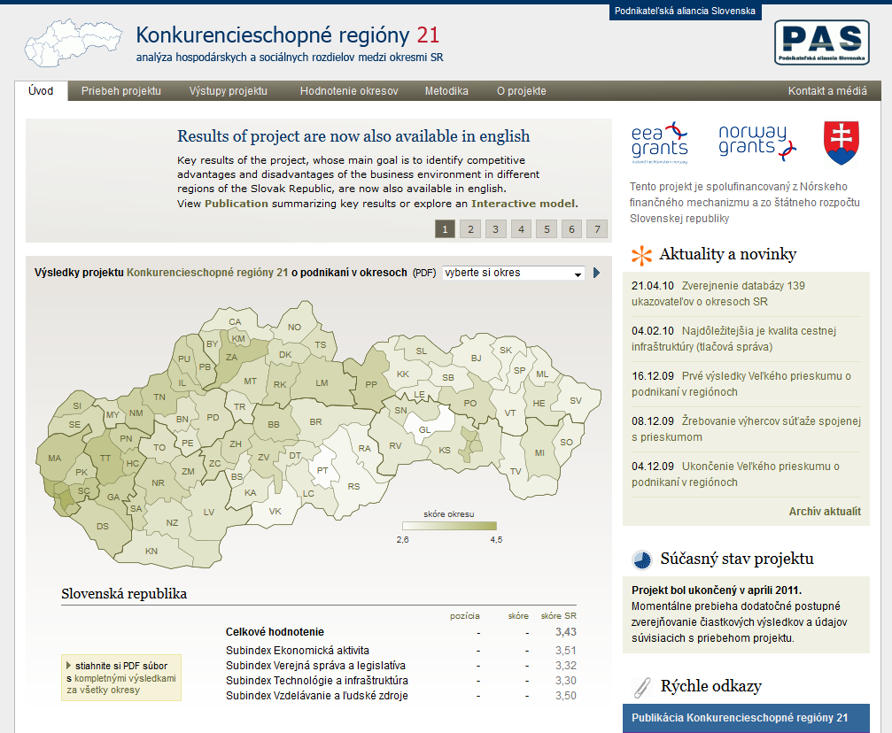
Twin-project in Slovakia (1/2)

Slide 14
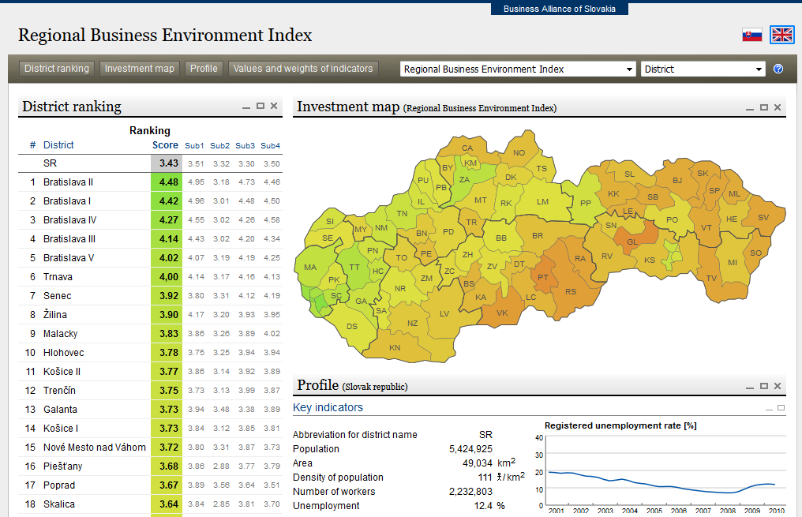
Twin-project in Slovakia (2/2)

Slide 15
Thank you for your attention!

