Slide 1
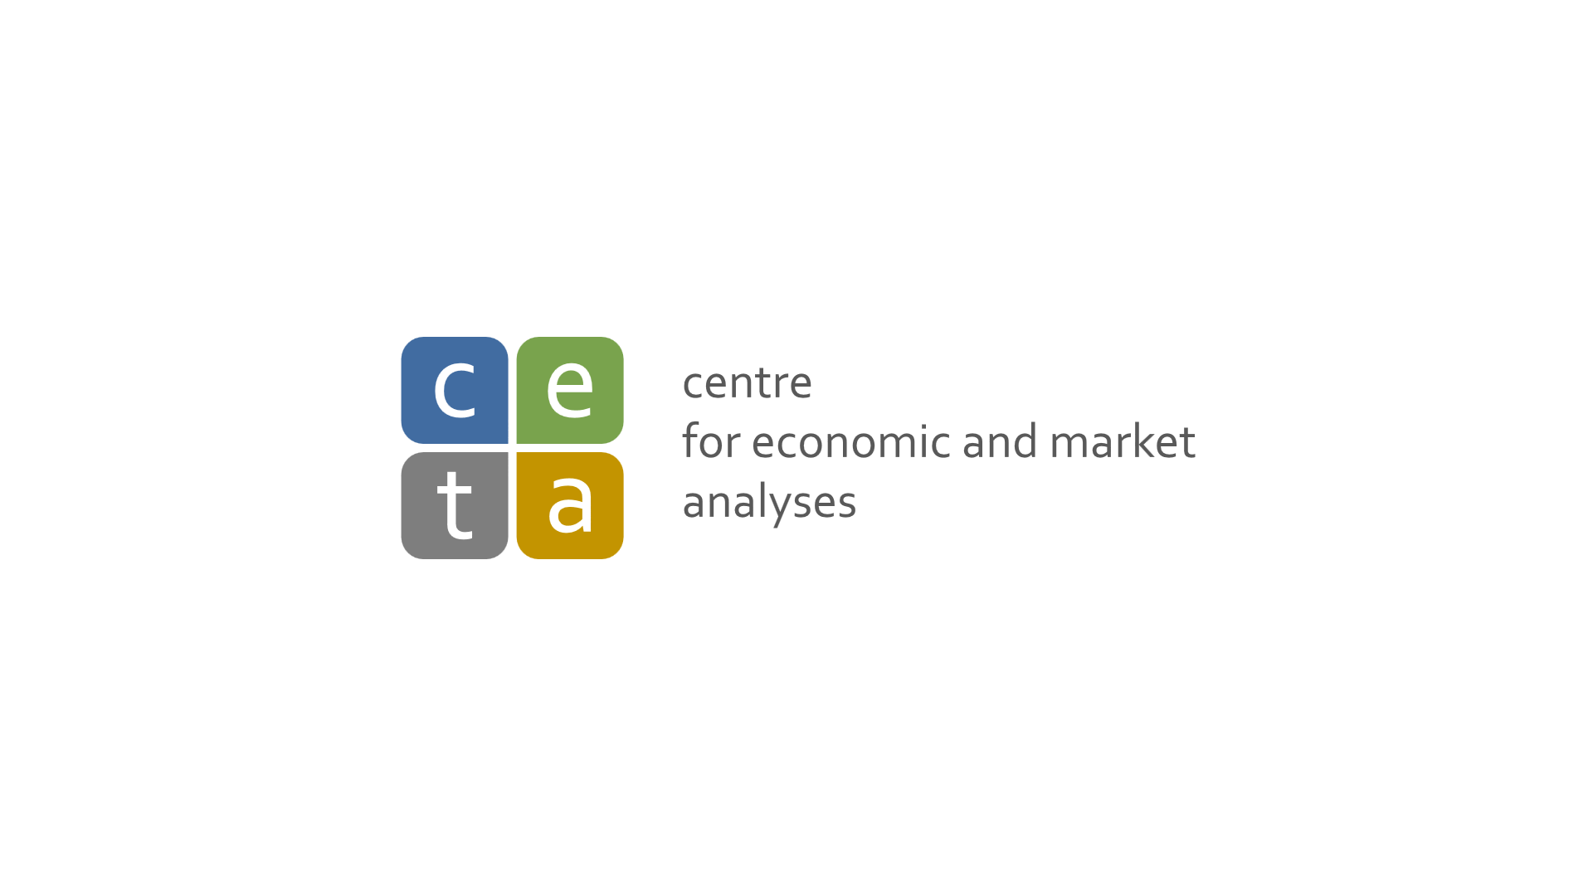

Measuring the quality and labor market results in education – Case of Czech Republic
Michal Hejl
CETA analyst, Czech Republic
October 2, 2015
Webinar on Measuring Results in Education

Slide 2
Simplified diagram of Czech Educational system
Primary schools
Secondary schools with maturita
Universities
Secondary schools without maturita
Colleges
Czech school inspectorate
Commission of accreditation

Slide 3
Czech school inspectorate
Evaluates the quality of education at primary secondary schools and at colleges
Also monitors the use of state grants and compliance with laws
While the results of individual inspections are now public, they are meant to be primarily a feedback for the school
It does not have direct power over schools, it can make suggestions (ranging from dismissing the headmaster to closing the school) to other education authorities

Slide 4
Secondary schools without maturita
Certificate of aptitude (výuční list)
  Usually awarded after passing both theoretical and practical examination
  A person with this certificate is supposed to be ready to work in his given field, but there are numerous complaints from employers about poor quality of this education

Slide 5
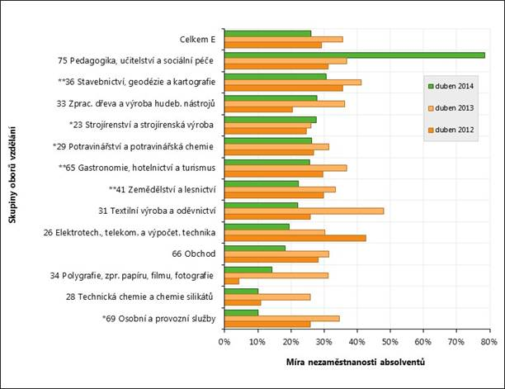
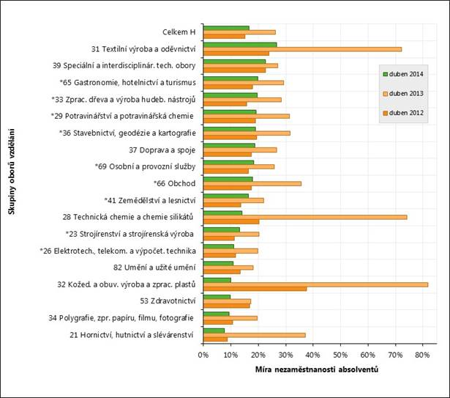
Secondary schools without maturita unemployment rates

Slide 6
Secondary schools with maturita
This encompasses a wide variety of schools, ranging from vocational schools to elite grammar schools which are meant to only prepare their students for tertiary studies.
Since 2010 the final examination (maturita) has been split between state and school parts

Slide 7
Maturita
The state part is administered by state agency called CERMAT
Students can choose between two difficulties, very few choose the harder one because of poor risk vs. reward ratio
Czech and a foreign language are mandatory, there are discussions about adding mathematics to it, students must also choose two more subjects

Slide 8
Maturita
Results are published online on CERMATs website, the percentage of students failing one of the exams is widely discussed in newspapers every year
  However, the website is intentionally made in a way to limit the ability to compare schools (you can only compare two schools, one school with the regional average etc.) in order to prevent the creation of what CERMAT calls misleading top lists

Slide 9
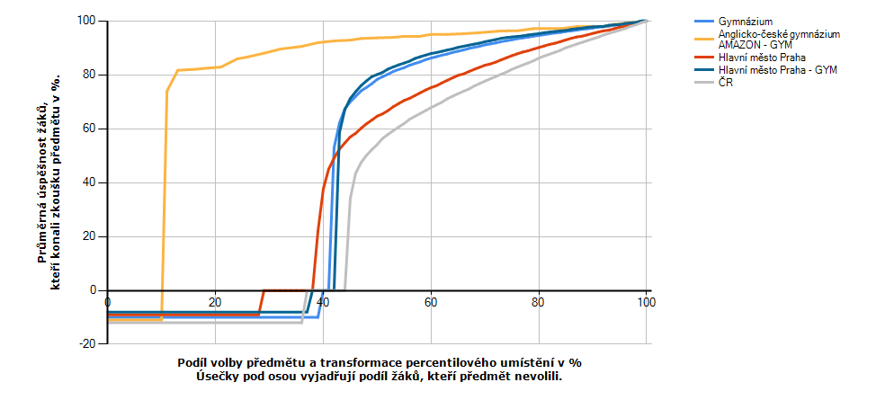
Example of a (bad) maturita result
Entita | REDIZO/Kód | Název | Město | Kraj | Průměrná úspěšnost | Medián | Směrodatná odchylka | Počet přihlášených | Počet konajících | % přihlášených
Skupina oborů v kraji | AGYM | Hlavní město Praha - GYM |  | Hlavní město Praha | 90,07 | 92,83 | 8,87483 | 2 189 | 2 041 | 61,75
Kraj | A | Hlavní město Praha |  |  | 80,19 | 83,42 | 15,0449 | 7 791 | 6 593 | 71,25
Skupina oborů | GYM | Gymnázium |  |  | 88,70 | 91,45 | 9,68012 | 12 799 | 12 341 | 60,45
Škol-obor | 600004791GYM | Arcibiskupské gymnázium - GYM | Praha 2 | Hlavní město Praha | 94,64 | 96,01 | 5,50933 | 26 | 26 | 50,98
Celkem | CR | ČR |  |  | 77,40 | 79,76 | 15,6928 | 46 944 | 41 131 | 63,05

Slide 10
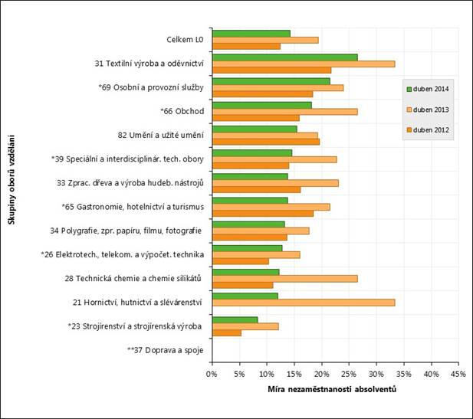
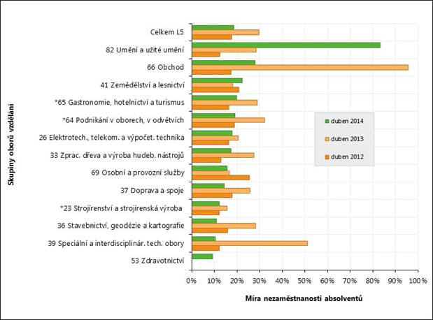
Secondary schools with maturita unemployment rates

Slide 11
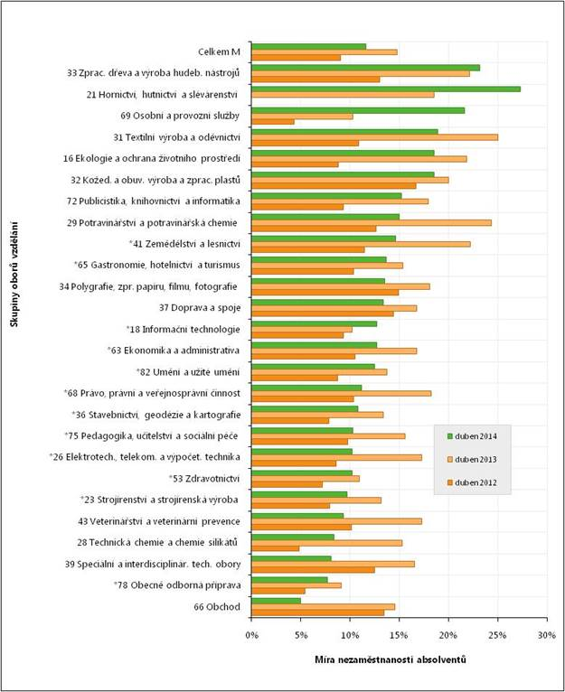
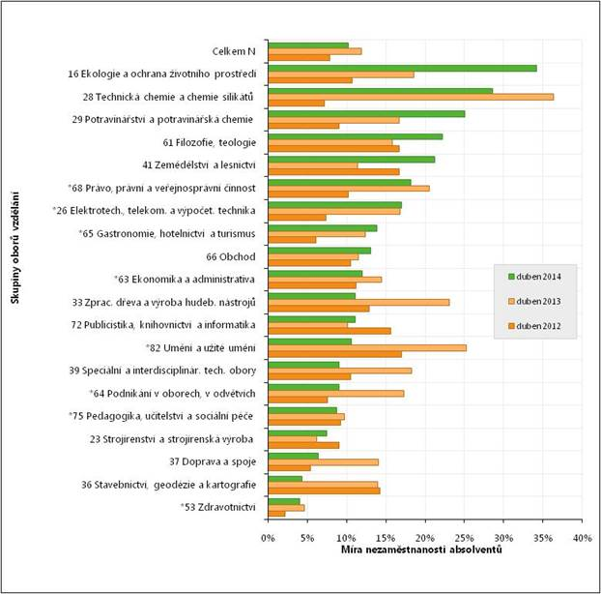
Secondary schools with maturita unemployment rates
College

Slide 12
Unenmployment rates secondary schooling
Kategorie vzdělání | 2010 | 2011 | 2012 | 2013 | 2014
Střední odborné s výučním listem - H | 17,7% | 17,1% | 15,1% | 26,2% | 16,5%
Nižší střední odborné vzdělání - E | 32,1% | 31,3% | 29,2% | 35,6% | 26,0%
Střední odborné s MZ a odborným výcvikem - L/0 | 17,0% | 16,0% | 12,4% | 19,3% | 14,2%
Nástavbové vzdělání – kategorie L/5 | 21,7% | 20,6% | 17,6% | 29,6% | 18,5%
Střední odborné s MZ - M | 10,6% | 11,4% | 9,0% | 14,8% | 11,6%
Gymnaziální vzdělání - K | 3,0% | 3,2% | 3,1% | 4,1% | 4,4%
Vyšší odborné vzdělání - N | 8,9% | 9,4% | 7,9% | 11,9% | 10,2%
Secondary schools without maturita
Secondary schools with maturita
Colleges

Slide 13
Tertiary schooling admissions
Maturita is a legal requirement
There is no centralized system, some faculties do their own admissions, some accept everyone for different reasons
National comparative exams
  The most widely used admission exam
  Run by a private company called Scio
  Several different test variants, most commonly used is the study aptitude test which is supposed to test the ability to study, not knowledge, results are in percentile rank

Slide 14
Tertially schooling ending exams
Thesis creation and defense
  Written and oral
State examination (státnice)
  Oral examination depending on branch of study, test the students knowledge of his chosen field
Rigorous examination – Czech oddity
Both grades received here and during previous study are of very little consequence to alumni's employability

Slide 15
Commission of accreditation
Monitors compliance of schools with various laws and ministerial edicts
Also does some quality monitoring, but mostly on formal grounds
Very influential institution, its decisions cannot be appealed
Has the power to decide which branches of study a particular university is allowed to offer
Results of inspections are published on commissions website

Slide 16
Employment data for tertiary education
Compiled by Center for education politics at pedagogical faculty of Charles University
  By and large getting any degree decreases unemployment rate
  Despite poor reputation, private schools alumni have lover unemployment rate than their public school peers, which is probably caused by different student demographics
  Law and Medical faculties have best results

Slide 17
Employment data examples
While the system should also be able to give employment data by faculties, it is unable to do so at the present

Slide 18
Public funding
Performance on the job market plays no role in funding
Primary and secondary schools
  Financed both by regional and central government
  Public school awarded more money than private or church schools
  Constitution forbids tuition for public schooling at both primary and secondary schools

Slide 19
Public funding
Universities
  Based on a complex formula involving most importantly number of students, then research outcomes, coefficient of the branch of study etc.
  Public schools are entitled to state money, private schools may apply for grants
  One of the previous governments attempted to introduce tuition but was forced to back off

Slide 20
Challenges
Political instability
  The average tenure of minister of education is only 17 months
  There are very different visions of different ministers, even ones from same political party
  Most ministers also desire to leave a „monument to themselves“ which causes sometimes drastic changes

Slide 21
Challenges
Public considers only postgraduate study as real university study which leads to wasting peoples time and states money
Lack of consensus on future direction
  Private companies are pushing hard for more vocational and practical training
  Many educators oppose this

Slide 22
Challenges
The devaluation of university degrees
  Many people share the sentiment that degrees do not mean what they used to
  This is driven both by individual desire for prestige and increasing requirements from both public and private sectors (job adverts requiring university degrees from secretaries for example)

