Slide 1
Information on the sources of information on the quality of education
Hungary
Daniel Horn
research fellow
MTA KRTK KTI and ELTEcon
10.02.2015.

Slide 2
Outline
Databases for research in education
The National Assessment for Basic Competencies –NABC
  What it is
  What it produces
Educational indicators/reports
Some further thoughts
Daniel Horn
Hungary

Slide 3
The most important databases on education
Hungarian
KIRstat (KIR – Közoktatási Információs Rendszer = Public Education Information System)
OKM (Országos Kompetenciamérés = National Assessment of Basic Competencies)
Felvi (Felsőoktatási felvételi adatbázis = Tertiary enrollment database)
KiFIR (Középiskolai Felvételi Információs Rendszer = Secondary enrollment information system)
Diplomás pályakövetés - Graduate Career Tracking (very low and biased response rate)
Daniel Horn
Hungary

Slide 4
The most important databases on education
International
PISA (Programme for International Student Assessment - OECD)
TIMSS/PIRLS (Trends in Mathematics and Science Study/Programme for International Reading Literacy Study - IEA)
TALIS (Teaching and Learning International Survey - OECD)
EaG (Education at a Glance – OECD)
EuroStat
See also MTA KRTK databank
Daniel Horn
Hungary

Slide 5
National ABC – what it is
Since 2006 (system testing in 2001, 2003, 2004)
Grades 6, 8 and 10 – full cohorts
Since 2008 individual panel (with individual IDs)
Reading and mathematical literacy
Extensive family background questionnaire (parental education, wealth, aspirations etc.)
School marks
etc.
Low stakes individually - it does NOT affect individual progression
Medium stakes for schools - school reports are public
Annual national and school level reports
(e.g. Budaörsi Ilyés – 2014/10, 4-year-long academic location level)
Daniel Horn
Hungary

Slide 6
National ABC – what it is
Daniel Horn
Hungary

Slide 7
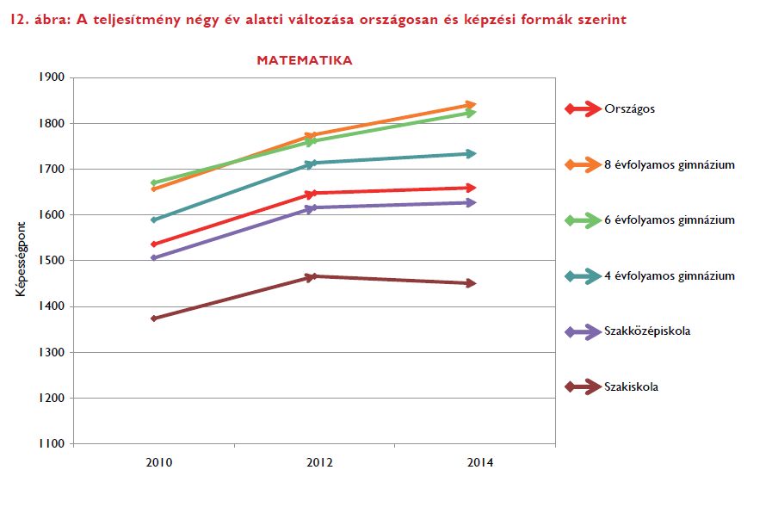
National ABC – what it produces
(example from the) National Report
Daniel Horn
Hungary

Slide 8
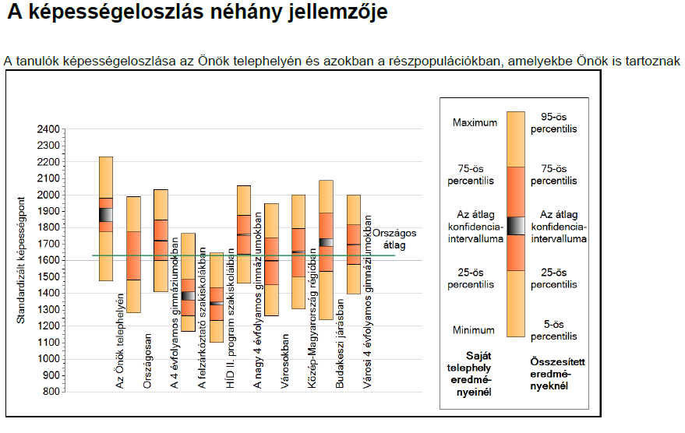
School level report - example
Daniel Horn
Hungary

Slide 9
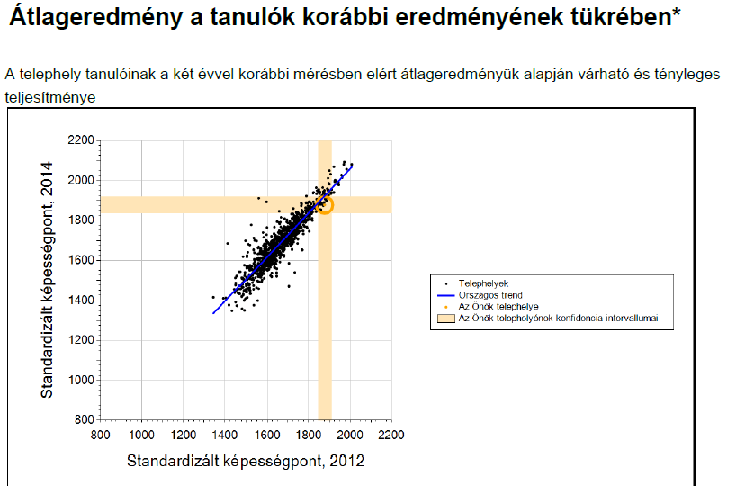
School level report - example
Daniel Horn
Hungary

Slide 10
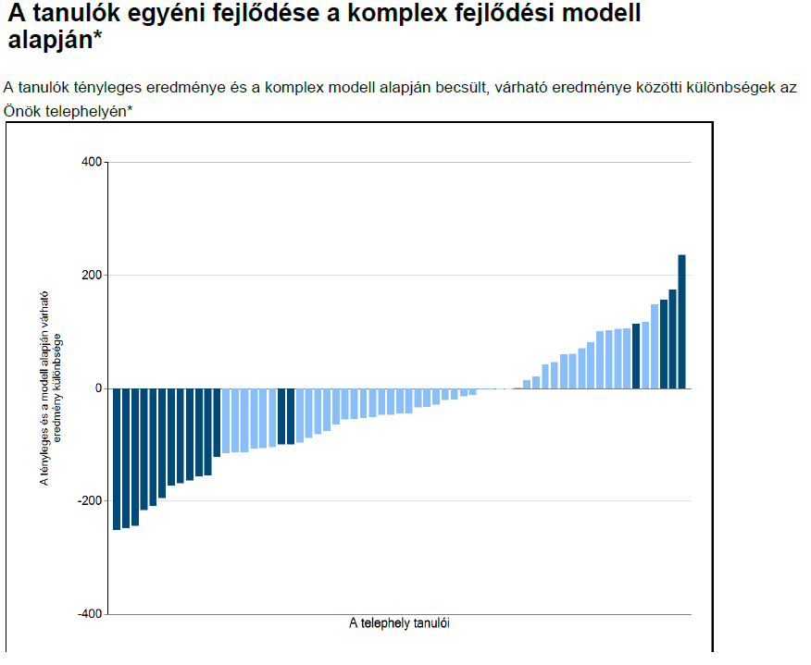
School level report - example
Daniel Horn
Hungary

Slide 11
Educational indicators/reports
School league-tables between 2001-2006 (Gábor Neuwirth: A középiskolai munka néhány mutatója)
Annual education statistics (Statisztikai tájékoztató – Oktatási évkönyv)
Report on the Hungarian public education (Halász and Lannert: Jelentés a magyar közoktatásról) 1995, 1997, 2000, 2003, 2006, 2010 (in a short version English: Education in Hungary 2000, 2003, 2006)
System of indicators in public education (Varga, Hajdu, Hermann and Horn 2015: A közoktatás indikátorrendszere)
Daniel Horn
Hungary

Slide 12
Some further thoughts
Large reforms within the Hungarian public education system in the last couple years
Re-centralization (and now de-concentration)
Little focus on quality – but re-introduction of school inspectorate (in progress)
Recognition that school-league tables (probably) do more harm than justice (even the „value-added” ones).
Daniel Horn
Hungary

Slide 13
Thank you for the attention
Daniel Horn
horn.daniel@krtk.mta.hu
http://mwpweb.eu/DanielHorn
"Hidden Triggers..." webinar October 2. 2015.

