Slide 1


Measuring the quality and labor market results in education – Case of Slovakia
Peter Goliaš
INEKO Director, Slovakia
October 2, 2015
Webinar on Measuring Results in Education

Slide 2
Content
Key performance indicators (KPI)
  Primary, secondary, tertiary education
KPI´s impact on public funding of schools
Tools informing about the results
Current challenges and lessons learned

Slide 3
KPI – primary education
National exit testing:
  Pupils of the 9th grade (at the age of 15);
  Mathematics, Slovak language, ethnic minority languages (Hungarian, Ukrainian)
Exceptional results:
  Rewards from the Ministry of Education for results in specific competitions (including national Olympic Games) and international projects
State School Inspection:
  Controls and evaluation at selected schools in following areas: school management, education conditions, process of education, tests from Slovak language, physics, etc.

Slide 4
KPI – primary education
Private testing and competitions:
  On voluntary basis, up to 9 tests and competitions
Self-evaluation:
  Annual school reports on their education activities
Other indicators:
  Number of teachers per 100 pupils
  Share of teachers using the information and communication technology regularly in the process of education
  Share of qualified teachers

Slide 5
KPI – secondary education
National exit testing (maturita):
  Pupils at the age of 18/19
  Mathematics, Slovak language, foreign languages, ethnic minority languages (Hungarian, Ukrainian)
Exceptional results:
  Rewards from the Ministry of Education for results in specific competitions (including national Olympic Games) and international projects
State School Inspection:
  Controls and evaluation at selected schools in following areas: school management, education conditions, process of education

Slide 6
KPI – secondary education
„Value added“:
  Since 2015, measured by Ministry of Education
  Based on comparing exit tests in primary and secondary education
  Not public information, schools informed internally
Unemployment rate of graduates:
  Labour offices, situation approximately 16 months after leaving the school
  Regional adjustment necessary
Admission to higher education:
  Admitted/Total; Admitted/Applying
  Limited reliability due to missing info from foreign schools

Slide 7
KPI – secondary education
Private testing and competitions:
  On voluntary basis, up to 2 competitions
Self-evaluation:
  Annual school reports on their education activities
Other indicators:
  Number of teachers per 100 pupils
  Share of teachers using the information and communication technology regularly in the process of education
  Share of qualified teachers

Slide 8
KPI – tertiary education
Unemployment rate of graduates:
  Since 2012, Labour Offices, situation 6-16 months after leaving the school
  Regional adjustment desirable
Time to get employment:
  Since 2015, average time the graduates need to get their first employment after leaving the school
Salaries of graduates:
  Since 2012, database of the Social Insurance Agency

Slide 9
KPI – tertiary education
Scientific, research and artistic results:
  Ministry of Education, Accreditation Commitee, NGO ARRA
Admission rates:
  Admitted/Applying; Entering/Admitted; Entering/Applying
  Attractiveness index: (Applying/Admitted)*(Entering/Admitted)
Student mobility
Feedback from students

Slide 10
KPI – tertiary education
Feedback from graduates:
  Would they choose the school/program again?
  Suitability for current work/professional career?
  Adherance to 26 skills and competences required in the labor market?
Research grants
Other indicators:
  Bachelors continuing in Mastres at the same school; teacher/student ratio; qualification of teachers, etc.

Slide 11
KPI and public funding
Primary and secondary education:
  No direct impact
  Financing based on „normative“
  Indirect impact via changes in numbers of pupils
  Need for reducing the information asymmetry
Tertiary education:
  Two main criteria: (1) number of students, (2) scientific, research and/or artistic results
  Small fraction of the state subsidy is dependent on the unemployment rate of graduates of particular school
  Indirect impact via changes in numbers of students
  Need for reducing the information asymmetry

Slide 12
Tools informing about results
Primary and secondary education:
  National Institute for Certified Educational Measurements: http://www.nucem.sk/
  INEKO portal http://skoly.ineko.sk/ displaying a set of 32 indicators (including national testing results) and ranking the schools by rating
Indicator (primary schools) | Weight
National tests´ results in mathematics and Slovak (or Hungarian – for the ethnic minority schools) language | 80%
Exceptional results rewarded by the Ministry of Education | 20%

Slide 13
Tools informing about results
Primary and secondary education:
  INEKO portal http://skoly.ineko.sk/
Indicator (secondary schools) | Weight
 | Grammar schools | Vocational schools
National tests results in mathematics, Slovak (or Hungarian) language, English and German languages | 60% | 40%
Unemployment rate of graduates compared to the regional unemployment rate | 25% | 50%
Exceptional results rewarded by the Ministry of Education | 15% | 10%

Slide 14
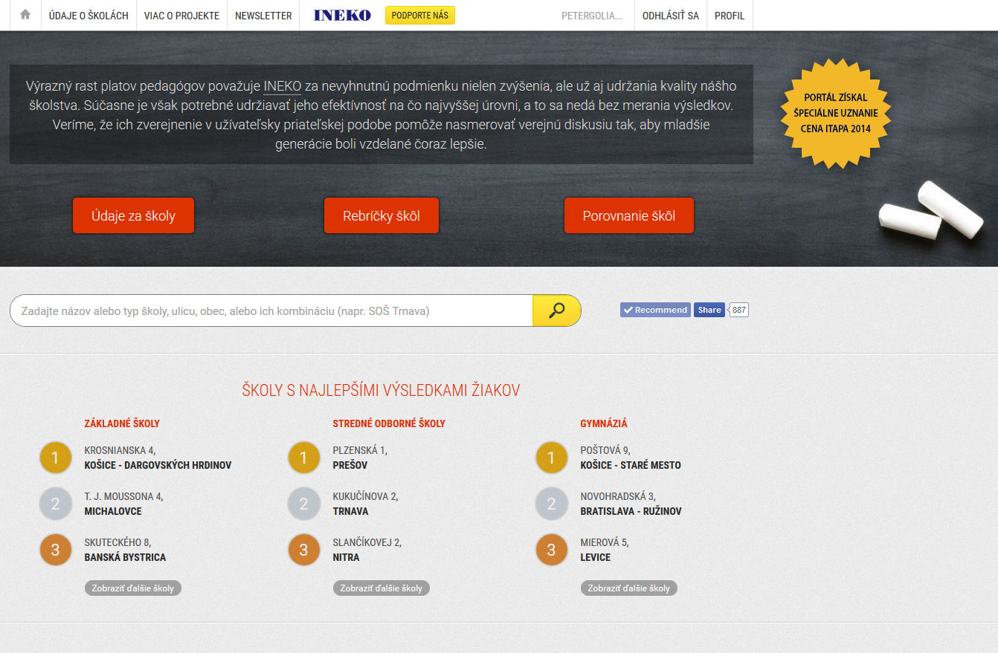
Tools informing about results

Slide 15
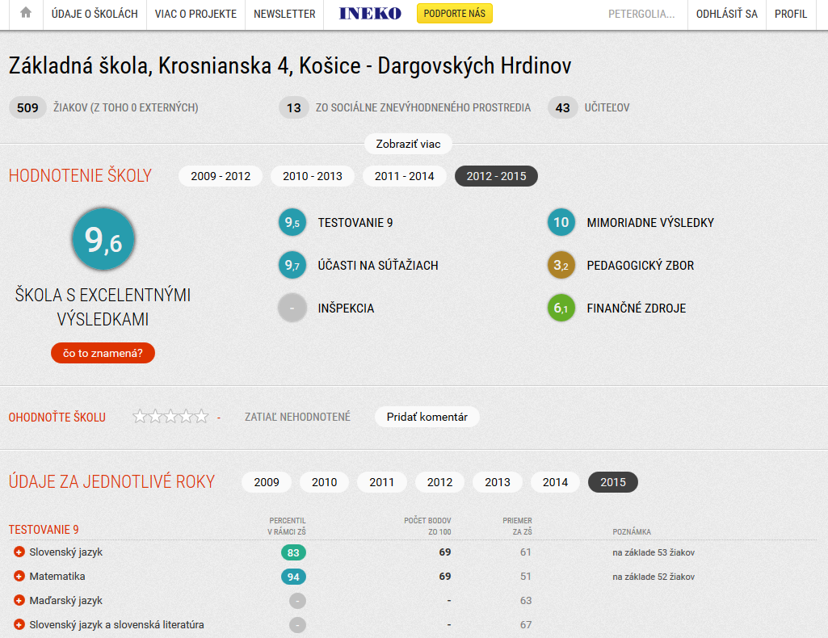
Tools informing about results

Slide 16
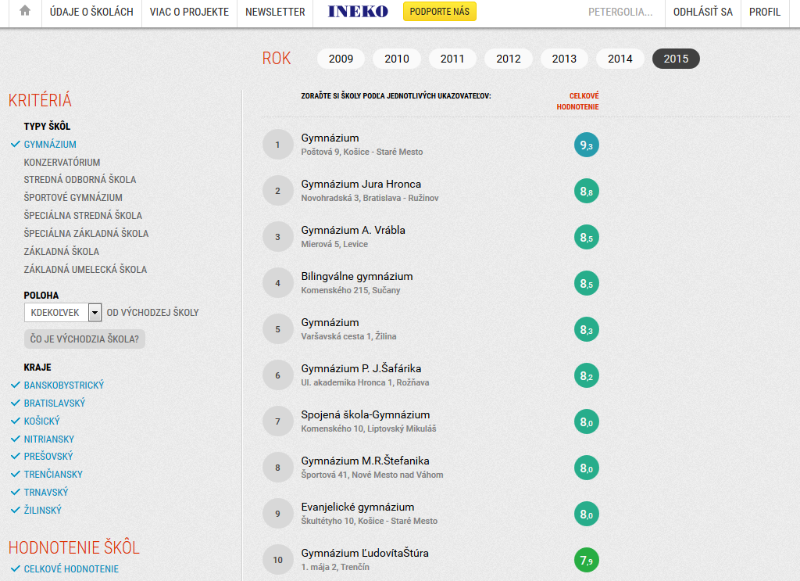
Tools informing about results

Slide 17
Tools informing about results
Tertiary education:
  NGO ARRA rankings and ratings since 2005: http://arra.sk/
1. Education: Teachers/Students, Professors and PhD Teachers/Teachers
2. Study attractiveness: Applying students/Students planned to admit, Entering/Admitted, share of foreign students, shares of students sent out to study abroad, unemployment rate of graduates: 3-year average
3. Science and research: Number and impact of publications and quotations, quotations per publication, impactful artistic results
4. PhD study: Share of PhD graduates on PhD first-year students, scientific performance divided by the number of PhD students, etc.
5. Success in obtaining grants: Domestic & Foreign grants divided bz number of creative staff

Slide 18
Tools informing about results
Tertiary education:
  Ministry of Education, 2012: http://vs.iedu.sk/
  Ministry of Education, 2015: http://www.lepsieskoly.sk/

Slide 19
Current challenges
Mostly teachers´ criticism:
  Lack of measuring the “value added”; it is impossible to talk about the school quality based only on the exit results. There are factors beyond education process: socio-economic background of pupils, family situation, differences in quality of students at the entry
  The measurements reflect just a fraction of the education process (tests do not cover most of subjects, interpersonal skills, values, attitudes towards society, etc.), risk of teaching to the test
  Risk of cheating at the test

Slide 20
Current challenges
Ministry of Eduction recent steps:
  2015: Measuring „value added“ at secondary schools
  November 2015: Launch of national testing at 5th grade of primary schools will enable to measure “value added” for ISCED 2
  Developing methodology for evaluating the success of tertiary graduates in the labor market

Slide 21
Current challenges
INEKO recommendations:
  Monitoring and publishing the salaries and the unemployment rates of tertiary graduates separately for specific sectors of the economy as well as for specific regions
  Measuring and publishing “value added” based on national testing for every education level of ISCED 1-3
  Monitoring and publishing average salaries of graduates of secondary schools
  Tracking the individual pathways from primary to secondary and tertiary schools
  Measuring and publishing efficiency, i.e. results divided by public subsidies in given period, and/or rate of return of public investment in case of secondary vocational and tertiary facilities
  Etc.

Slide 22
Thank you for your attention! http://www.ineko.sk/

