Slide 1

Budget consolidation in Ukraine
Vasyl POVOROZNYK,
senior economist, ICPS
Angela BOCHI,
senior economist, ICPS

Slide 2

1.Introduction
Budget consolidation (BC) is a very important issue for Ukraine because of the very dramatic economic situation.
But Ukrainian legislation does not provide for budget consolidation in EU terms. However, Ukrainian legislation provides for some measures which can be treated as BC.
An important aspect of institutional and technical capabilities to consolidate finances is Ukraine’s cooperation with the IMF.

Slide 3
2.Current economic tendencies / «New» threats
For the last year, the Ukrainian economy has been influenced by a broad spectrum of negative factors:
annexation of Crimea,
war in Donbass,
sharp devaluation of the national currency,
trade war with Russia
rapid inflation,
the worsening of the investment climate,
drop in GDP,
increased defense expenditures
a significant increase in the deficit of the Pension Fund
the exhaustion of FX reserves
the increased debt burden of “Naftogaz of Ukraine”,

Slide 4
3.Current economic tendencies / «Old» threats
«New» threats imposed and interlaced whith «old» problematic factors:
economic stagnation dragging on since 2012,
the lack of reforms,
pervasive corruption in the executive and judicial branches,
an unbalanced external government borrowing policy
lack of public financial management strategy
unbalanced structure of economy

Slide 5
4.Current economic tendencies / Figures
In 2014 Ukraine's GDP fell by 6.8%, while inflation was 24.9%. The deepest fall in 2014 was recorded in industry, trade and construction (over 10% in all these sectors)
Consumer expenditures of households decreased more significantly than GDP as a whole – by 9.6% y/y.
Reduction in gross accumulation was 29.2%, including GFCF by 23%. The weight of GFCF in GDP declined from 18% in 2010 to 14% in 2014
There was a significant drop in exports (14.5%), which was caused by decrease in trade with Russia and problems of operation of enterprises in the east. Imports fell by 22.1% due to weakening of the hryvnia and deterioration of relations with Russia
By the end of 2014, state debt and state guaranteed debt amounted to more than 62% of GDP.
Fall of GDP at 1Q of 2015 amounted to 17.6%.
In April consumer prices rose by 14 % m/m. From the start of the year, the growth reached 34.3%. Annual inflation accelerated to 60.2% y/y

Slide 6
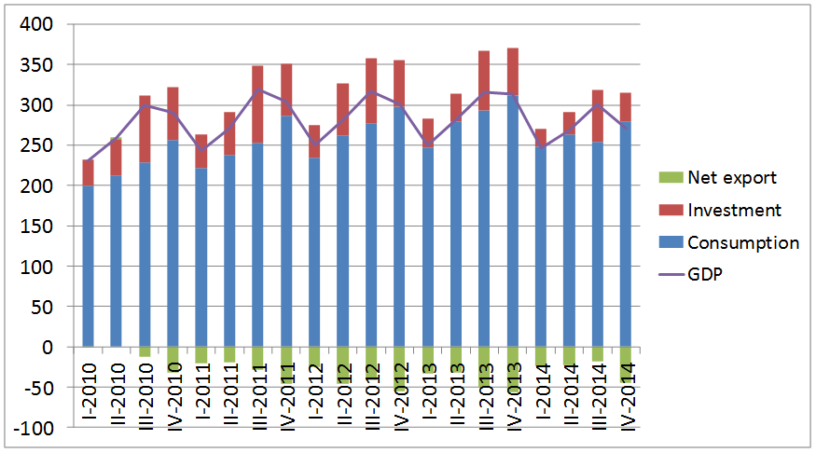
5.Current economic tendencies / Quarterly GDP in constant prices of 2010, billion UAH

Slide 7
6.Current economic tendencies / Annual (rolling) change in the CPI and the PPI in 2004-2015

Slide 8
7.Current economic tendencies / Public Debt
In line with the agreement with the IMF, Ukraine should restructure more than USD 15bn of debt in years 2015-2018, including USD 5.4bn in 2015. Currently the government continues negotiations with creditors (but details of the proposed conditions are unknown)
After the adoption of the EFF program Ukraine received the first tranche of about USD 5bn. Access to global capital markets remains very limited for the state, and the influx of foreign borrowing this year will be mainly from international organizations, not private investors
In the domestic market in the first quarter the government sold bonds totaling UAH 27.18bn (compared to UAH 25.3bn in the first quarter of 2014), of which UAH 9.98bn were for the budget deficit financing (compared to UAH 14.21bn in the first quarter of 2014)
The largest monthly borrowing – UAH 17.2bn, of which the budget received only UAH 0.043bn, – was made in February. In March there were no debt placements

Slide 9
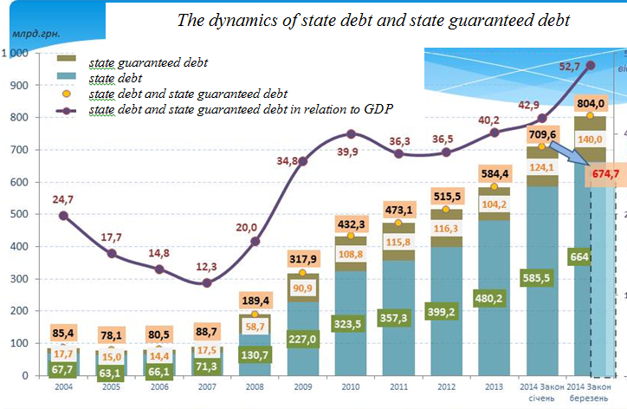
8.Current economic tendencies / State debt

Slide 10
9.Ukrainian Budget System
Ukrainian budget and tax system is characterized by a significant re-distribution through - it amounts to 55% of GDP.
Under Ukrainian budget legislation, the budget system includes state and local budgets. An aggregate of all budgets (the total number of budgets in Ukraine is more than 12 000) comprising the budget system makes the consolidated budget. The consolidated budget is used for the state regulation of the economic and social development.
The major sources of budget revenues are as follows:
value added tax charged on goods and services made and provided in Ukraine:
value added tax charged on imported goods and services;
corporate tax;
excise tax;
rent on subsoil assets;
import duty.

Slide 11
10.Ukrainian Budget System
In 2014, a share of consolidated budget revenues in GDP amounted to 29.1% (against 29.0 % in 2013), indicating the absence of important changes despite a gradual reduction in corporate tax rates as well as reduction in tax preferences. The excess burden of taxation adversely affects the investment climate in Ukraine in particular and the economic development in general.
In 2014, a share of consolidated budget expenditures in GDP amounted to 33.4 % (in 2013, the figure was 34.5 %), indicating the preservation of a high level of state obligations in connection with social services.

Slide 12
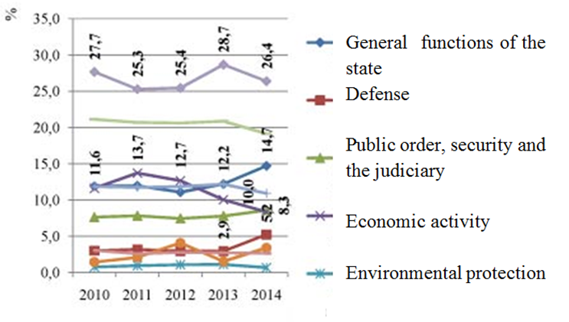
11. Ukrainian Budget System / The dynamics of consolidated budget and state budget expenditures in 2010-2014, %

Slide 13
12.Ukrainian Budget System / Problems
1) Consolidated budget expenditures continue to increase, which resulted from the increase in spending on debt service, including due to the hryvnia depreciation, as well as spending on defense, public order, security and the judiciary.
2) The Pension Fund of Ukraine needs significant contributions from the state budget – budget spending on Pension Fund transfer payments continues to increase.
3) A share of official transfer payments in local budgets has increased over the last ten years. In 2002, it was 31.2 %, in 2010 - 49.5 %, in 2013 – 52.4 %, and in 2014 – 56.4 %

Slide 14
13.Ukrainian Budget System / The main indicators of revenues, expenditures and budget deficit (in % to GDP)
Subject Descriptor | 2009 | 2010 | 2011 | 2012 | 2013 | 2014 | 2015 | 2016 | 2017 | 2018 | 2019
General government revenue | 42.298 | 43.249 | 42.870 | 44.457 | 43.631 | 42.631 | 42.621 | 42.713 | 42.433 | 42.093 | 41.798
General government total expenditure | 48.554 | 49.004 | 45.627 | 48.744 | 48.449 | 48.404 | 46.556 | 45.428 | 44.538 | 43.614 | 42.980
General government net lending/borrowing | -6.255 | -5.755 | -2.757 | -4.287 | -4.818 | -5.773 | -3.934 | -2.715 | -2.105 | -1.521 | -1.181
General government structural balance | -2.231 | -3.859 | -3.154 | -4.397 | -4.555 | -3.490 | -2.324 | -1.985 | -1.817 | -1.521 | -1.181
General government primary net lending/borrowing | -5.090 | -4.129 | -0.791 | -2.374 | -2.351 | -2.362 | 0.638 | 2.397 | 2.908 | 3.121 | 3.100
General government net debt | 31.936 | 38.416 | 34.455 | 35.169 | 38.709 | 65.327 | 71.429 | 69.338 | 64.923 | 57.593 | 49.875
General government gross debt | 35.380 | 40.505 | 36.817 | 37.367 | 40.939 | 67.615 | 73.417 | 71.130 | 66.414 | 58.932 | 51.083

Slide 15
14.Fiscal consolidation / 2013
In March-April 2013, the Ukrainian government declared its intentions to take specific measures for fiscal consolidation. In fact, the following steps have been taken:
a decision was taken to reduce non-priority expenditures;
populist decisions of the previous government, not backed with real financing, have been revised;
a realistic macro forecast has been made;
amendments to tax legislation have been introduced, which would allow for additional budget revenues worth UAH 22.5 billion;
amendments to the budget have been introduced, which decreased revenues by UAH 22.4 billion and expenditures by UAH 25.4 billion based on the realistic macro forecast.

Slide 16
15.Fiscal consolidation / 2013
Strategy for the Development of Public Finance Management was elaborated and subsequently adopted in 2013.
According to the Strategy, the main measures regarding budget and tax consolidation were:
The abolishment of tax preferences for individual enterprises and sectors
increase in tax rates for the emission of carbon dioxide
The application of the system of taxation of immovable property items according to their value
The balancing of interests of controlling bodies and taxpayers
The introduction of legal instruments for the execution of the principle of commercial activities (arm’s length principle).

Slide 17
16.Fiscal consolidation / 2014
According to the 2014 Public Financial Management Performance Report, the following key measures have been implemented:
The regime of tax exemption for operations on medicines and medical products supplies have been cancelled;
Property tax changes have been introduced as a basis for immovable property tax;
Preferential taxation of UCITS with the enterprise profit tax have been limited;
Taxation of income derived from operations with securities and derivatives at a reduced rate (10%) have been abolished;
Income tax exemption for the hotel businesses, electricity industry enterprises, which produce electricity exclusively from renewable energy sources, have been abolished;
A number of activities were excluded from the list of activities covered by the special tax regime in agriculture, forestry, and fishery;
Ineffective income tax exemptions which did not lead to the development of relevant industries have been abolished.
Reduction of the number of taxes, their consolidation

Slide 18
17.Fiscal consolidation / Problems
At the present stage, there are following problems related to the fiscal consolidation:
• structural imbalances in the economy and untimely and ineffective implementation of structural changes;
• inefficient mechanism of taxation of market participants;
• a significant number of unprofitable state enterprises receiving subsidies;
• the budget expenditure structure inadequate to the existing financial possibilities of the state;
• a significant amount of shadow economic activities;
• misuse and inefficient use of public funds;
• inefficiency of finance and credit relations;
• constant increase in public debt

Slide 19
18.Fiscal consolidation / Main solutions
Reduction and changes to the structure of public spending;
Rationalizing and improving the structure of budget crediting of market participants;
Enlargement of tax base;
Streamlining the structure of subsidies for market participants changing the terms and conditions of their granting use;
Reforming energy prices and bringing them in line with the market prices; limiting subsidies for losses cover;
Reorganization of subsidizing for agriculture enterprises and enterprises that produce goods or provide services in the non-trading sectors;
Improving (reforming) mechanisms on the provision and use of social transfers;
Pension system reform (to ensure long-term sustainability of fiscal policy);
Strengthening the focus of monetary policy on economic growth and budget revenues increase;
Limiting quasi-fiscal operations (with the huge amount of fiscal operations in the real sector, in particular, “Naftogaz of Ukraine”).

Slide 20
19.Fiscal consolidation / Cooperation with IMF
According to Memorandum with IMF, over 2016-2018, it is planned to continue the gradual expenditure-based fiscal consolidation. Measures to be taken:
Expenditure reforms
а. Parametric pension reform
b. Size and efficiency of government
c. Healthcare.
(і) Change the basis of public financing of the secondary healthcare by moving from hospital bed to service-based financing and for primary healthcare from infrastructure-based to capita-based financing.
(іі) Allow medical facilities to legally generate own revenue.
(iii) Change public procurement regulation to allow purchasing medicines and medical supplies through direct, multi-year procurement involving UN based organizations.
d. Education. The reform in education sector, aiming to improve the quality and efficiency of education spending, will continue
e. Social assistance
f. Investment. To support growth, it is planned to increase and maintain capital investment levels, from 1 percent of GDP in 2014 to over 3 percent of GDP by 2018, to fund Ukraine’s immediate reconstruction needs and long-term infrastructure development objectives.

Slide 21
19.Fiscal consolidation / Conclusions
In order to achieve fiscal sustainability, a state legislatively defined budget strategy is required.
The fiscal consolidation programs are being accepted in Ukraine. However, due to the internal and external challenges, implementation of measures in the context of fiscal consolidation has mainly feebly marked positive effect.
During further implementation of fiscal consolidation plans in Ukraine, it is reasonable to take into account the positive and negative experiences in order to improve its socio-economic effectiveness and avoid possible negative impacts.

