Slide 1

Fiscal decentralization and transparency of municipalities in Slovakia
Peter Golias
INEKO Director
May 28th, 2015
Chisinau, Moldova
Seminar on “Financial health of municipalities from Moldova using Slovak experience”

Slide 2
Government expenditure
EUR, millions
Fiscal decentralization reform:
Transfer of competencies
Transfer of money (tax system reform)
Source: OECD

Slide 3
Funding of local governments
2015 revenues | Municipalities (2926 towns, town districts, and villages) | Higher Territorial Units (8 HTUs) | Total
In EUR million | 4,044 | 1,254 | 5,298
In % of state budget revenues | 27.9% | 8.7% | 36.6%
In % of public finance revenues | 14.2% | 4.4% | 18.6%
In % of GDP | 5.2% | 1.6% | 6.8%
Source: Ministry of Finance of the SR

Slide 4
Financing principles
Original competencies to be financed from tax revenues depending on real tax collection and/or hard data (number of citizens & pupils, etc.)
Transferred competencies to be financed from state budget transfers depending on hard data (number of citizens & pupils, etc.)
Other mostly one-off needs to be financed from grants based on a request for financing (projects)
  Regional development, environment
  Building industrial parks, etc.

Slide 5
Competencies
Original
  Education: Primary arts schools, language schools, pre-primary schools, school facilities (dormitories, clubs, canteens, etc.)
  Transport: Intra-city (municipalities); inter-city (HTUs)
  Care services (munic.), social affairs (homes for pensioners) & culture (HTUs)
  2nd and 3rd class roads (HTUs)
  Communal waste disposal, etc.
Transferred
  Education: Primary schools (municipalities), secondary schools (HTUs)
  Health care: Regional hospitals, polyclinics, health centers (HTUs)
  Construction permits (municipalities)
  Citizens´ registration offices (municipalities), etc.

Slide 6
Revenues of municipalities
 | 2015 (EUR million) | 2015 (%)
Tax revenues | 1,954 | 48%
- Share on personal income tax revenues | 1,442 | 36%
- Real estate taxes | 327 | 8%
- Other local taxes and fees (e.g. tax on dogs, fees for waste disposal, etc.) | 185 | 5%
Non-tax revenues | 573 | 14%
- Business activities, rent | 156 | 4%
- Administrative and other fees | 253 | 6%
- Sale of capital (land, buildings, etc.) | 80 | 2%
- Other (e.g. interest on deposits) | 84 | 2%
Grants and transfers | 1,177 | 29%
Other (transfers from previous years, loans, etc.) | 340 | 8%
Total | 4,044 | 100%
Source: Ministry of Finance of the SR

Slide 7
Revenues of municipalities
 | 2015 (EUR million) | 2015 (%)
Tax revenues | 1,954 | 48%
Non-tax revenues | 573 | 14%
Grants and transfers | 1,177 | 29%
- Subsidies to fund primary schools | 679 | 17%
- Subsidies to (co)fund Eurofunds projects (Environment + Regional development + Business subsidies + Education) | 344 (=183+116+29+16) | 9%
- Subsidies to fund social policies | 54 | 1%
- Other (Environment Fund, Subsidy to fund flats restitution, Subsidies to fund Registry and other offices, etc.) | 100 | 2%
Other (transfers from previous years, loans, etc.) | 340 | 8%
Total | 4,044 | 100%
Source: Ministry of Finance of the SR

Slide 8
Revenues of 8 HTUs
 | 2015 (EUR million) | 2015 (%)
Tax revenues | 625 | 50%
- Share on personal income tax revenues | 614 (up from 426 in 2014) | 49%
- Tax on motor vehicles | 12 (down from 147) | 1%
Non-tax revenues | 123 | 10%
- Business activities, rent, interest on deposits | 9 | 0.7%
- Administrative and other fees | 80 | 6%
- Sale of capital (land, buildings, etc.) | 8 | 0.6%
- Other | 26 | 2%
Grants and transfers | 421 | 34%
Other (transfers from previous years, loans, etc.) | 85 | 7%
Total | 1,254 | 100%
Source: Ministry of Finance of the SR

Slide 9
Revenues of 8 HTUs
 | 2015 (EUR million) | 2015 (%)
Tax revenues | 625 | 50%
Non-tax revenues | 123 | 10%
Grants and transfers | 421 | 34%
- Subsidies to fund secondary schools | 412 | 33%
- Subsidies to (co)fund Eurofunds projects (Education) | 7 | 0.6%
- Subsidies to fund emergency repair of schools | 3 | 0.2%
Other (transfers from previous years, loans, etc.) | 85 | 7%
Total | 1,254 | 100%
Source: Ministry of Finance of the SR

Slide 10
Financial balance
EUR million
Fiscal consolidation
Elections
Debt of municipalities: 3% of total public debt
Source: Ministry of Finance of the SR

Slide 11
Division of PIT
Municipalities‘ share on personal income tax revenues:
  2011: 70.3%
  2012: 65.4% (fiscal consolidation)
  2013: 65.4%
  2014: 67.0%
  2015: 68.5% (EUR1.44 billion)
  2016: 70.3% (EUR1.54 billion)
HTUs‘ share on personal income tax revenues:
  Until 2014: 21.9%
  2015: 29.2% (compensation for diverting revenues from tax on motor vehicles from HTU to state budget)

Slide 12
Computing PIT revenues
Criteria | Share on total revenues
Municipalities
Number of citizens | 23% (57% is adjusted for the munic. altitude)
Number of citizens adjusted for the size | 32%
Number of pupils | 40%
Number of citizens of the age 62+ | 5%
HTUs
Number of citizens | 15%
Number of citizens of the age 15-18 | 15%
Number of citizens of the age 62+ | 32%
Population density | 9%
Length of 2nd and 3rd class roads | 20%
Surface area | 9%
... plus special coeficients for HTUs and school facilities

Slide 13
Further reforms?
Reducing the number of municipalities?
  Slovakia: 2926 municipalities (including 17 districts in Bratislava and 22 districts in Košice)
    Two thirds below 1000 citizens
  Finland: 320 municipalities, plan to decrease to 100 (just like in Denmark)
In/de-creasing the tax-collection independence?
  2015: Diverting revenues from tax on motor vehicles from HTUs to state budget
  December 2015: Introduction of limits on taxes for agricultural (1.25%) and forest (2.5%) land

Slide 14
Transparency
  2000: Freedom of Information Act
  2011: All contracts, invoices and orders have to be published on internet, otherwise contracts are not valid
  „Open municipality“ project run by Transparency International Slovakia monitors above-the-law transparency:
    Computing transparency rating for 100 biggest municipalities based on a set of 102 indicators grouped in following areas:
      Access to information (documents from city board meetings, information about board members, evidence of dogs, etc.)
      Public participation in decision making
      Public procurement; Sale and rent of property
      Budget; Grants & Subsidies; Flats & Social facilities
      Human resource management
      Ethics & Conflicts of interests (incl. accessibility of property declarations)
      Land planning & Construction authority; Firms co-owned by municipality

Slide 15
Financial transparency
INEKO portal computing financial health of all municipalities and HTUs (to be transferred to Moldova): http://www.obce.ineko.sk/

Slide 16
Problems
Weak control & violation of law
  Unpublished contracts (especially in small villages)
  5% of mayors active in business, etc.
Low above-the-law transparency:
  Average „Open municipality“ rating in 2014: 47 points of 100; the best city: 72; the worst: 23
  The worst results in sale and rent of property
  Minimum accessibility of property declarations of both mayors and deputies
Hidden debts: PPP projects, subsidiaries

Slide 17
Project in Moldova
Title: Improving Oversight of Local Governments in Moldova
Supported by the National Endowment for Democracy (NED)
Timeframe: May 2015 – January 2016
Partners: INEKO & IDIS
Goal: To increase the financial accountability of local governments in 50 municipalities in Moldova
Tools:
  Transfer of INEKO knowledge on computing financial health of municipalities
  Creating a portal/dataset of financial indicators of at least 50 Moldovan biggest cities

Slide 18
Activities
May 2015:
    Opening seminar
  May – June 2015:
    Data identification
    Creating a methodology for assessing the financial health of local governments in Moldova
July – September 2015:
    Data collection and processing
    Creating the dataset/portal
  November 2015 – January 2016:
    Analysis of the financial health of the biggest towns and municipalities of Moldova
  January 2016:
    Seminar and press conference in Chișinău; project conclusion

Slide 19
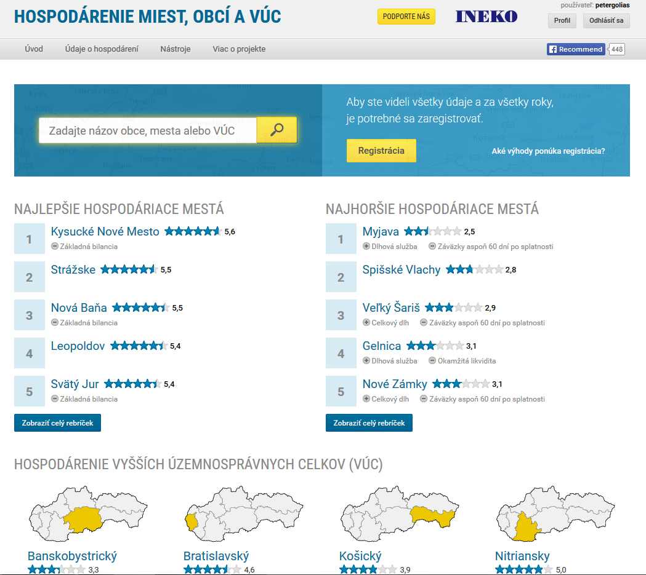
INEKO portal
Main page:

Slide 20
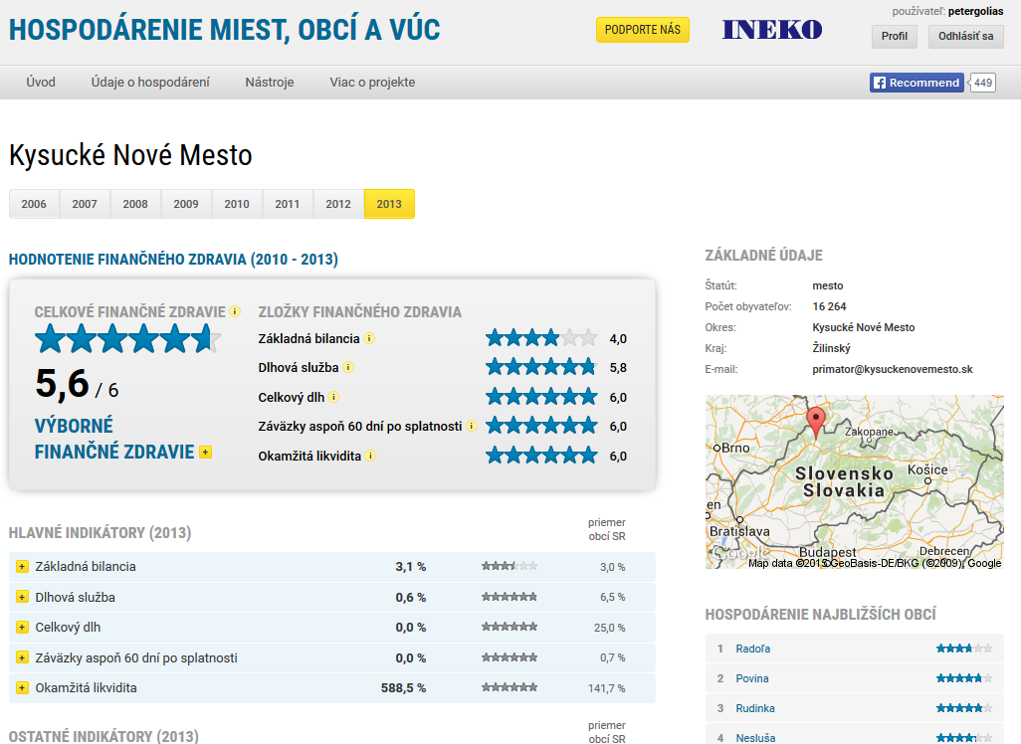
INEKO portal
Profiles of municipalities and HTUs:

Slide 21
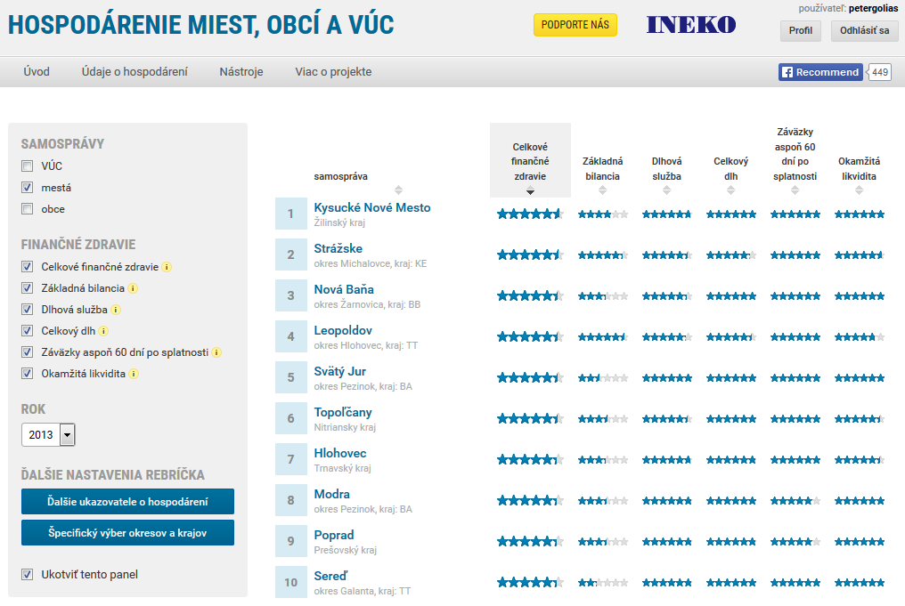
INEKO portal
Financial health rankings:

Slide 22
Financial health indicators
Indicators entering final rating | Weight
Overall debt over current revenues | 2
Debt service (interest plus principle) over current revenues | 1
Current and capital account balance over current and capital revenues | 1
Liabilities overdue at least 60 days over current revenues | 1
Immediate liquidity on financial accounts over short-term liabilities | 1
All indicators are transformed to the scale {0, 6}
Overall debt is computed based on data from the most recent year
Other four indicators are computed based on data from the 4 most recent years with following weights:
  Year t: 4
  Year t-1: 3
  Year t-2: 2
  Year t-1: 1

Slide 23
Underlying data
Current account revenues
Current account expenditures
Capital account revenues
Capital account expenditures
Debt service – principal
Debt service – interest
Short-term liabilities
Long-term liabilities
Bank loans
Loans from the state
Overdue liabilities
Liabilities overdue at least 60 days
Short-term receivables
Financial assets (e.g. cash, bank deposits)
Number of citizens

Slide 24
Thank you for your attention! http://ineko.sk/; http://www.obce.ineko.sk/

