Slide 1


Public finance consolidation in Slovakia
Peter Goliaš
INEKO Director, Slovakia
May 22, 2015
Webinar on Public Finance Consolidation

Slide 2
Most important problems
Most important issues faced by the country (Eurobarometer, Nov-2014)
Czech Republic | Hungary | Poland | Slovakia
Unemployment (40%) | Unemployment (50%) | Unemployment (54%) | Unemployment (57%)
Government debt (27%) | Economic situation (30%) | Health care system (25%) | Economic situation (31%)
Rising prices/Inflation (24%) | Health care system (21%) | Rising prices/Inflation (19%) | Health care system (23%)
Economic situation (20%) | Rising prices/Inflation (20%) | Pensions (19%) | Rising prices/Inflation (21%)
Crime (20%) | Government debt (13%) | Economic situation (17%) | Pensions (13%)
Pensions (17%) | Pensions (13%) | Government debt (11%) | Government debt (11%)
Gross public debt (% GDP, 2014, Source: Eurostat)
42.6 | 76.9 | 50.1 | 53.6

Slide 3
Public finance balance (% GDP)
Entering EDP
Sources: Ministry of Finance (MF SR), Council for Budget Responsibility (CBR SR)

Slide 4
Consolidation effort (% GDP)
Sources: INEKO based on data from the European Commission (EC) and from the Council for Budget Responsibility (CBR SR)

Slide 5
Public debt (% GDP)
Source: INEKO based on data from the Ministry of Finance (MF SR)

Slide 6
Long-term sustainability (% GDP)
Source: INEKO based on data from the Ministry of Finance (MF SR) and the Council for Budget Responsibility (CBR SR)

Slide 7
Reform of the PAYG
Prolonging retirement age
  2004: Gradually up to 62 years for both genders
  Since 2017 retirement age will be linked to life-expectancy
Indexing pensions:
  Since 2004: Automatic (average of wage growth and inflation)
  2012-17: Increase by a fixed sum (based on weighted average of wage growth and inflation)
  Since 2018: Indexed purely by inflation for pensioners‘ basket of goods
Result: Stabilization of the pension system (halving long-term deficit)

Slide 8
Fully-funded pension pillar
Reducing contribution rate:
  2012: The rate was decreased from 9% to 4% (increasing public budget revenues by around 0.6% of GDP annually)
  The rate is expected to grow up gradually to 6% by 2024
Re-opening of the second pillar:
  In 2008, 2008/09, 2012/13, 2015
  Approximately 15% people returned fully to the PAYG
Re-introduction of voluntary entry for young people
  In 2008 and 2013
Impacts on the public finance balance:
  Positive or neutral until 2060, negative afterwards

Slide 9
Debt brake
2012: Constitutional Act on Budget Responsibility introducing the debt brakes and the Council for Budget Responsibility
Debt brake levels:
  50%: Minister of Finance informs the Parliament
  53%: The government proposes measures to reduce the debt, the salaries of government members are frozen
  55%: The government has to cut 3% of expenditure immediately and freeze expenditure for the next year
  57%: The government and municipalities have to propose balanced budgets for the next year
  60%: The vote on government confidence in the Parliament
Transition period from 2018 until 2027:
  Gradual decreasing of limits to final 40% to 50%

Slide 10
Hidden debts
PPP (highway): 2.7% of GDP
Conditioned liabilities (court processes, guarantees): 16.4% of GDP as of 2013 (out of which 3.0% of GDP is EFSF)
Off-balance debt of state and half-state firms (e.g. debt taken to pay superdividends, old debts of hospitals – 0.4% of GDP)

Slide 11
Improved tax collection
Around 50 measures since 2012:
  Disclosing fraud cases
  Electronic central evidence of invoices (cross controls)
Source: MF SR
  Tax transparency: Publishing taxes paid by firms
  Extending „reverse charge“ (VAT paid by buyers)
  Extended use of registration machines (hotels, physicians, taxi drivers, etc.)
  Control of transfer prices, etc.

Slide 12
Other consolidation measures
2011:
  Expenditure cuts (wages, procurement)
  VAT up from 19% to 20%
2013:
  Higher payroll-taxes for people with high income
    Re-introduction of higher 25% personal income tax rate
    Increase of maximum payroll-tax base
    Reduction/Elimination of tax deductible
  Corporate income tax up from 19% to 23% (since 2013 decreased to 22%; new tax licences )
  Special tax levies on banks and regulated monopolies
  Higher payroll-taxes for self-employed and non-standard contracts
  Lower capital investment of municipalities

Slide 13
Current challenges
Health care and long-term care
Pensions (not imminent)
Eurofunds corrections
Tax collection (real estate, deepening tax transparency)
The need for public finance stability is becoming less imminent. The highest priorities are:
  Unemployment (especially long-term)
  Low quality of public services (especially in health care and education)

Slide 14
Lessons learned
Local debt brakes and external pressure (EC SGP, Fiscal Compact, ESA 2010, Eurostat – disclosing hidden debts) work well
High quality people guarding public finances is crucial
Supportive public debate helps a lot (media, think-tanks, economic analysts)

Slide 15
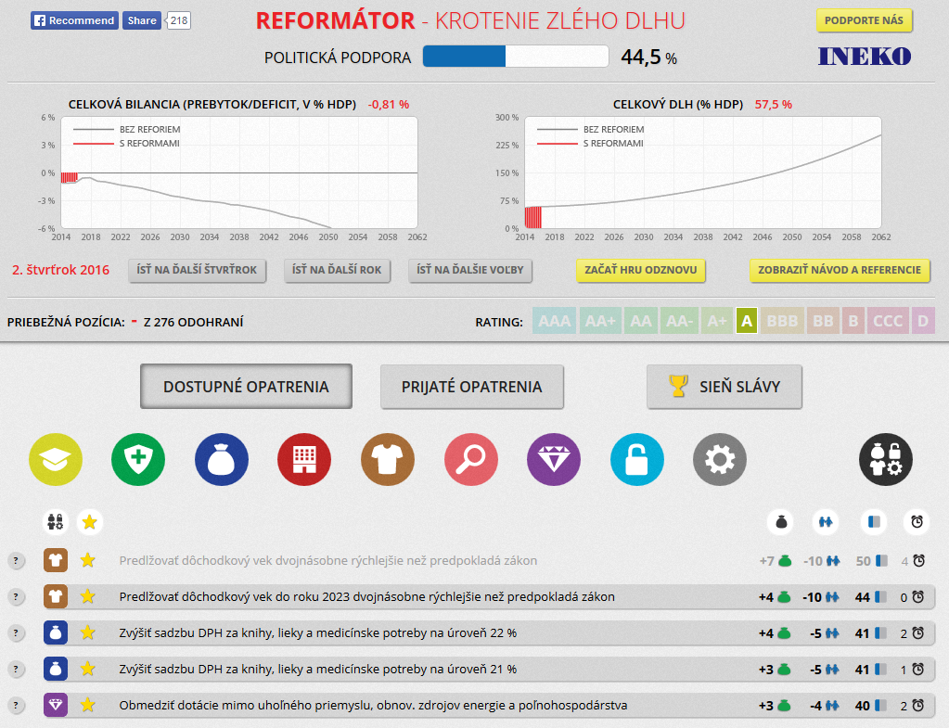
INEKO computer game
Long-term public debt projections
Over 200 consolidation measures
Measuring political support
Threat of bankruptcy
Goal: To have the lowest debt by 2062
Source: http://hra.ineko.sk/

Slide 16
Thank you for your attention! http://www.ineko.sk/

