Slide 1


If the Eurozone fails
Peter Golias
INEKO Director, Slovakia
March 26th, 2015
Workshop “If the Eurozone Fails: Scenarios for the Future“
Sofia, Bulgaria

Slide 2
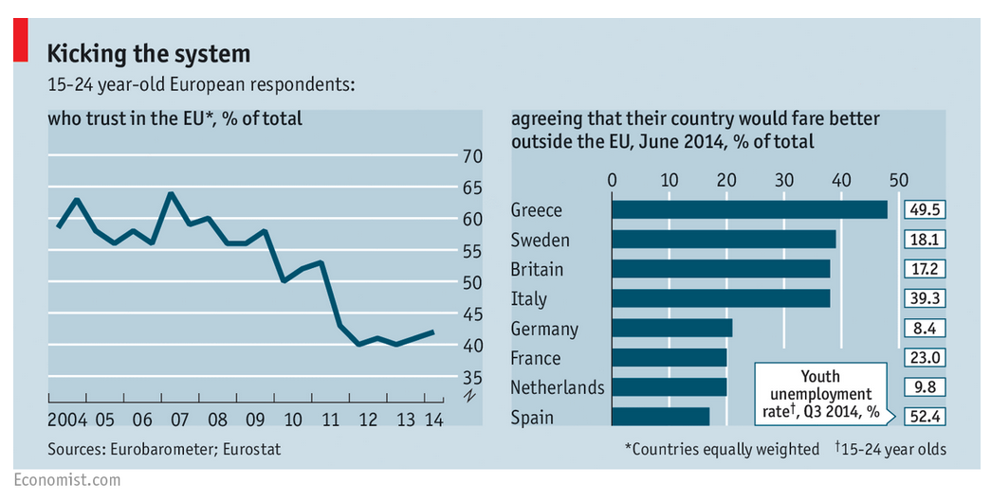
Key risks
Eroding trust to the EU

Slide 3
Key risks
Growing popularity of extremist anti-European, anti-immigrant and/or anti-austerity parties:
  National Front in France
  UK Independent Party in Great Britain
  Jobbik in Hungary
  People’s party in Danemark
  Syriza, Golden Dawn in Greece
  Alternative for Deutchland in Germany
  Freedom party in Netherlands and Austria
  Etc.

Slide 4
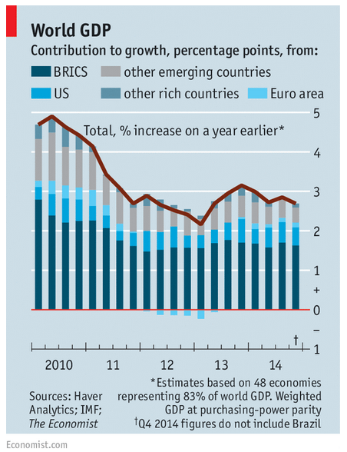
Key reasons
Poor economic performance

Slide 5
Key reasons
Populism of traditional parties resulting in growing public debt, rigid labor markets, lower competitiveness, etc.
Insufficient institutional integration:
  Unattended public finances; moral hazard in times of low gvt bonds‘ risk premiums (Greece, Italy, Belgium, etc.)
  Weak/non-existing banking & fiscal union, rescue mechanisms
  Barriers to free movement of services, etc.
2009 crisis aftermath: Higher unemployment, economic weakness, impossibility of exchange rate depreciation
Inappropriate (public) education about EU integration, democracy, economic and social development (including globalization)
Islamic terrorism

Slide 6
What if Eurozone fails?
Another (probably smaller) “Eurozone“ would soon be created because:
  Deepening economic integration makes it advantageous to have common currency (higher stability in trade, lower transaction costs, symmetric cycles, etc.)
  The threat of EU disintegration and potentially disastrous economic downturn would be imminent
  Note: Regional differences do not play a role

Slide 7
Lessons to be learnt
Implementing reforms to secure:
  Sustainable public debt, flexible labor market, higher competitiveness, high quality and efficient public services
Strengthening institutions:
  Adopting and respecting rules to guard public finance stability (Fiscal Compact, SGP)
  Completing banking & fiscal union
  Creating common market for services, etc.
Better education about EU integration, democracy, globalization, etc.

Slide 8
How to implement reforms
Many reforms are unpopular, in conflict with vested interests or technically difficult
How to overcome these barriers? In Slovakia we were lucky to have:
  Strong NGO sector, think-tanks
  Free media
  Experts (e.g. bank analysts) willing and able to comment in media
  Well educated politicians and policy makers
Current challenges:
  Reducing populism in politics (popular but inefficient measures)
  Improving professionalism of public servants
External pressure is important (e.g. Troika, EC)

Slide 9
How to handle extremists
Keep explaining to the public why extremism is dangerous and why reforms are necessary
Create and support influential pro-reform group of people (think-tanks, experts, media, etc.)
Avoid making concessions when requiring reforms in highly indebted countries
If reform effort is insufficient, withdraw financial support even if this would mean a debt haircut
Do not sack countries out of the Eurozone, but if they wish to go out, let them go

Slide 10
Thank you for your attention!

