Slide 1


Democratic consciousness and economic growth in V4 countries and Ukraine
Peter Goliaš
INEKO Director, Slovakia
December 16, 2014
Conference on democracy in Ukraine, Budapest

Slide 2
Democracy vs Economy
Mutual interactions:
  Democracy supports economic development
  Economic development supports democracy
  GFK Hungária, Democratic attitudes in Ukraine, 2014:
  Dalton (1994): Widespread support of democracy requires economic development
  (1) The actual economic situation, (2) the perception of change in the financial situation over past 10 years as well as (3) the expected future financial development significantly affects the support of democracy in Ukraine

Slide 3
Democracy vs Economy
Satisfaction with the functioning of democracy by respondents economic expectation (%)
The financial situation of your household in the next 10 years will … | HU (11) | PL (11) | SK (11) | UA (14)
improve | 40 | 63 | 60 | 37
not change | 36 | 52 | 42 | 26
worsen | 19 | 28 | 23 | 9
Source: GFK Hungária, 2014

Slide 4
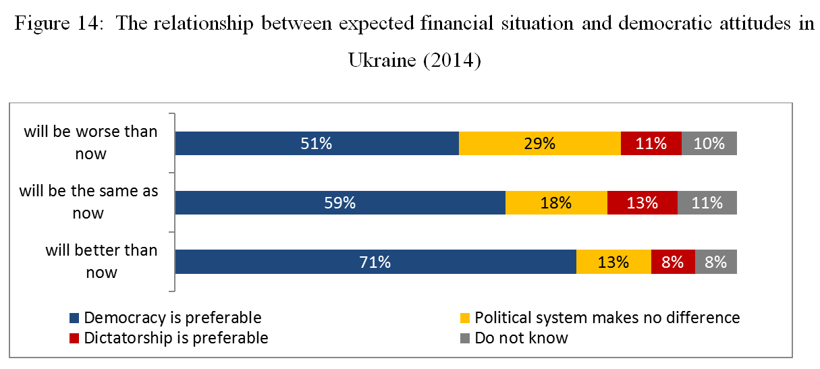
Democracy vs Economy
Source: GFK Hungária, Democratic attitudes in Ukraine, 2014

Slide 5
Economic growth in V4+U
GDP per capita in V4 and Ukraine (in PPP, as % of EU28 average)
Source: INEKO based on data from Eurostat (for V4 and EU28) and the World Bank (for Ukraine)

Slide 6
Eroding trust to politicians
Feelings generated by politics (%)
 | HU | PL | SK | A | UA (14)
Distrust
2011 | 28 | 26 | 26 | 25 | 46
1995 | 26 | 19 | 33 | 26
1991 | 17 | 20 | 36 | 25
Disgust
2011 | 11 | 9 | 25 | 6 | 10
1995 | 8 | 8 | 5 | 4
1991 | 4 | 12 | 3 | 4
Anger
2011 | 20 | 15 | 17 | 21 | 10
1995 | 12 | 10 | 12 | 20
1991 | 16 | 11 | 13 | 14
 | HU | PL | SK | A | UA (14)
Indifference
2011 | 19 | 14 | 14 | 9 | 8
1995 | 21 | 28 | 19 | 13
1991 | 25 | 26 | 12 | 17
Boredom
2011 | 7 | 20 | 6 | 3 | 2
1995 | 8 | 12 | 6 | 3
1991 | 8 | 7 | 4 | 4
Positive feelings (sympathy, interest, enthusiasm)
2011 | 13 | 14 | 9 | 33 | 19
1995 | 24 | 23 | 26 | 30
1991 | 31 | 22 | 31 | 37
Source: GFK Hungária, 2014

Slide 7
Support for opinions about democracy (%)
 | HU | PL | SK | UA (14)
Democracy is preferable to dictatorship under any circumstances
2011 | 70 | 66 | 62 | 62
1995 | 67 | 65 | 66
1991 | 69 | 60 | 67
In some cases, dictatorship may be preferable to democracy
2011 | 11 | 17 | 20 | 18
1995 | 11 | 15 | 12
1991 | 9 | 14 | 10
For people like me, it makes no difference, whether we live in a democracy or a dictatorship
2011 | 14 | 11 | 14 | 10
1995 | 17 | 17 | 22
1991 | 18 | 23 | 22
Source: GFK Hungária, 2014
Note: In 2011 the Slovak government collapsed and one of the biggest corruption scandals in post-communist era erupted.

Slide 8
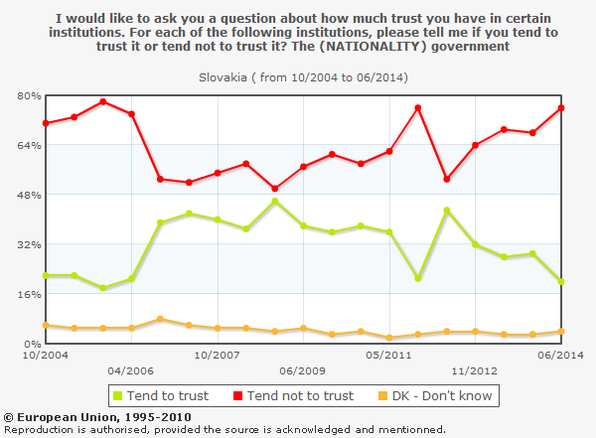
Source: Eurobaromater surveys

Slide 9
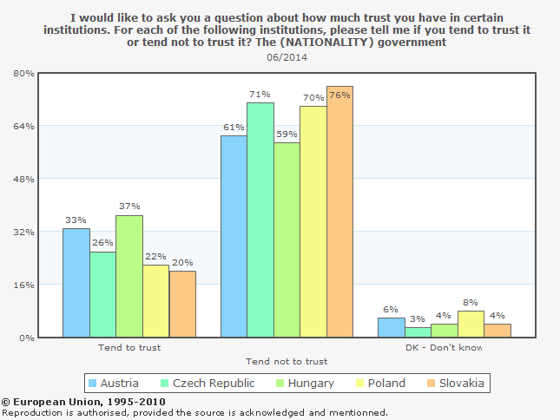
Source: Eurobaromater surveys

Slide 10
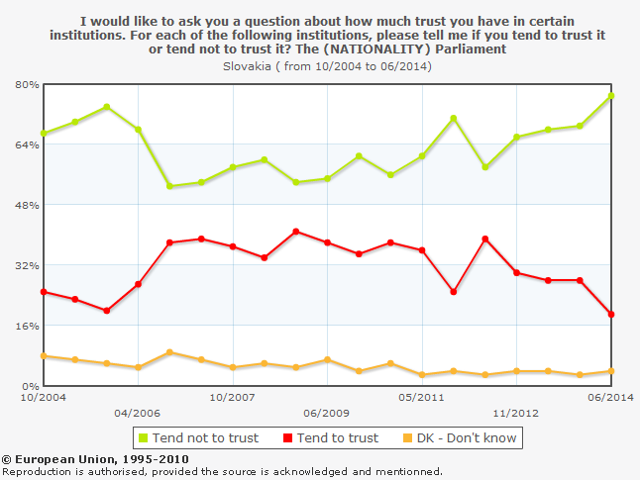
Source: Eurobaromater surveys

Slide 11
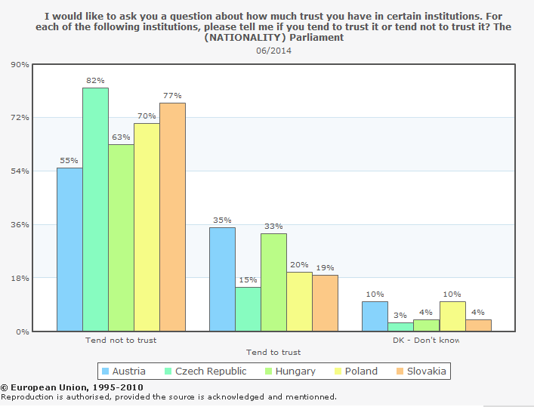
Source: Eurobaromater surveys

Slide 12
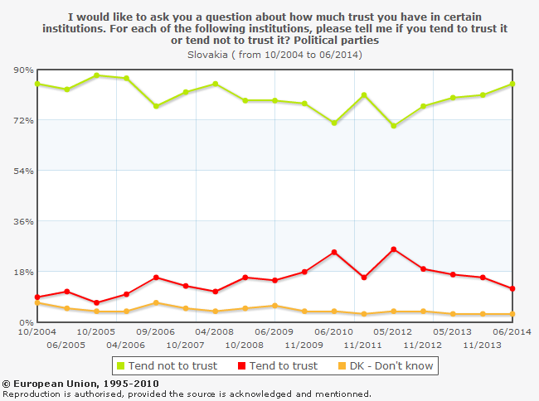
Source: Eurobaromater surveys

Slide 13
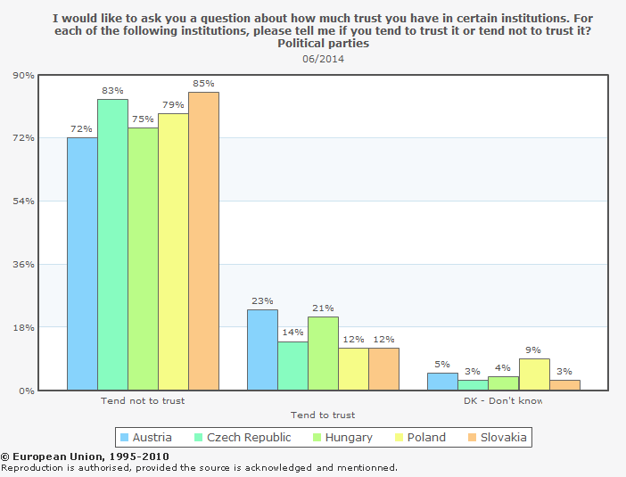
Source: Eurobaromater surveys

Slide 14
State paternalism vs Individualism
  GFK Hungária, Democratic attitudes in Ukraine, 2014:
  38% of people from the Visegrad countries and 56% of Ukrainians thought that the state should be responsible for the welfare of its citizens, which is much higher than in Western countries.
  Those people who think that the state should be responsible to guarantee welfare tend to be more antidemocratic than those who believe that individuals should be responsible for their own welfare.

Slide 15
Support for individualist and collectivist views (%)
 | HU (11) | PL (11) | SK (11) | UA (14)
Individuals should be responsible for their own welfare | 40 | 46 | 52 | 34
The state should be responsible for everyone's economic security | 52 | 46 | 45 | 56
State ownership is the best way to run an enterprise | 50 | 35 | 46 | 56
An enterprise is best run by private entrepreneurs | 35 | 53 | 46 | 31
Source: GFK Hungária, 2014

Slide 16
Opinions about the statement “We do not really need a parliament. Rather we need a strong leader who can make decisions quickly and implement them” (%)
 | HU | PL | SK | UA (14)
2011 | 24 | 42 | 35 | 59
1995 | 20 | 32 | 17 | -
1993 | 18 | 39 | 19 | -
Source: GFK Hungária, 2014

Slide 17
Closing remarks
It is crucial to implement pro-democratic, anti-corruption and pro-market reforms. Many reforms are unpopular, in conflict with vested interests or technically difficult.
How to overcome these barriers? In Slovakia we were lucky to have:
  Strong NGO sector, think-tanks
  Free media
  Experts (e.g. bank analysts) willing and able to comment in media
  Well educated politicians and policy makers implementing reforms
There is still much work to be done
Fight against corruption is never-ending story

Slide 18
Thank you for your attention! http://ineko.sk/

