Slide 1

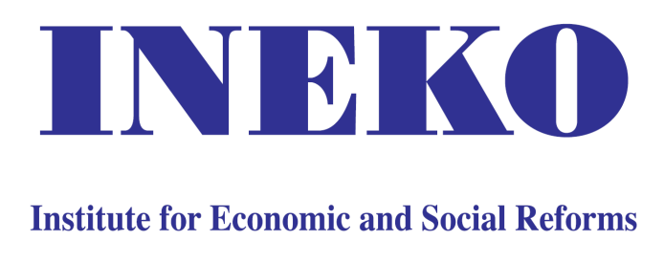
Eurozone Accession: Benefits and Costs – the Slovak case
Peter Golias
INEKO, Slovakia
October 30, 2014
Budapest Business School, Hungary

Slide 2
Overview
Benefits
  Lower transaction costs (permanent; 0.3% of GDP)
  Nominal exchange rate stability – better planning; higher investment, trade and growth (difficult to calculate)
  More attention to public finance stability
  Since 2010: Real exchange rate undervaluation
  Outright Monetary Transactions (OTM); European Stability Mechanism (ESM)
Costs
  Currency conversion costs (one-off; 0.3% of GDP)
  Loss of national monetary policy
  2008-2009: Real exchange rate overvaluation
  Unexpected costs of resolving the Eurozone public debt crisis

Slide 3
Important factors
Onset of financial crisis in 2009
Real exchange rate volatility (important trading partners kept local currency)
Flexibility of labor market, prices and wages
Redistribution effects
Conversion rate
Shaping new Eurozone (banking union, Fiscal compact, etc.)

Slide 4
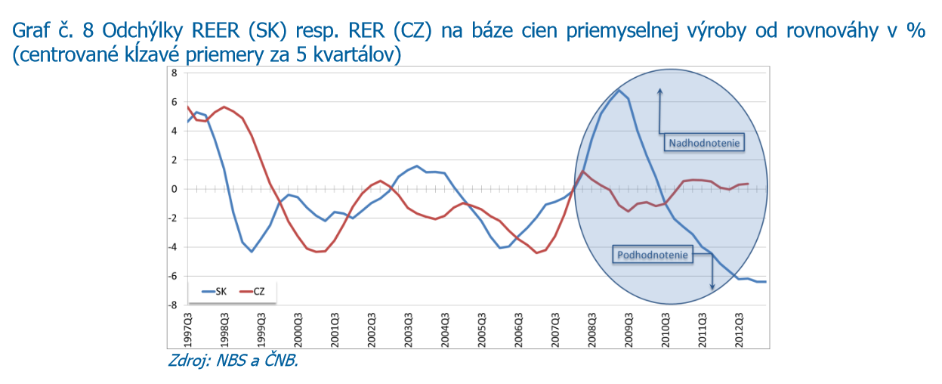
Real exchange rates
Source: NBS, 2014

Slide 5
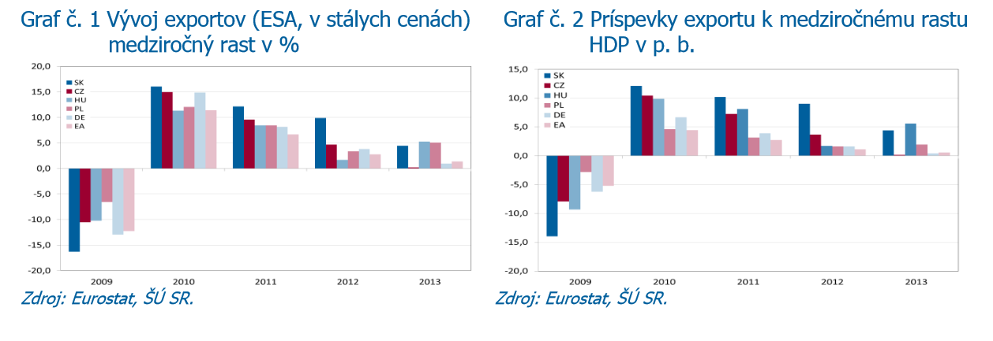
Export dynamics
Source: NBS, 2014

Slide 6
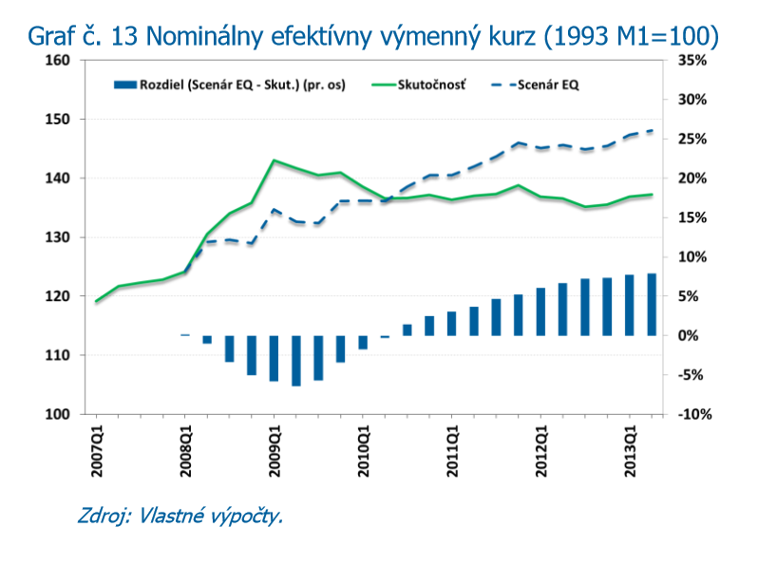
Scenario without euro
Source: NBS, 2014

Slide 7
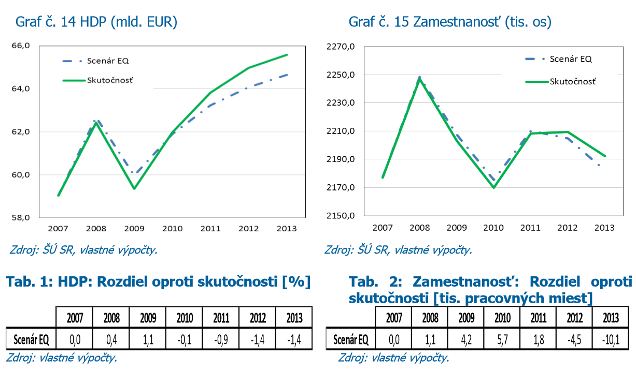
Scenario without euro
Source: NBS, 2014

Slide 8
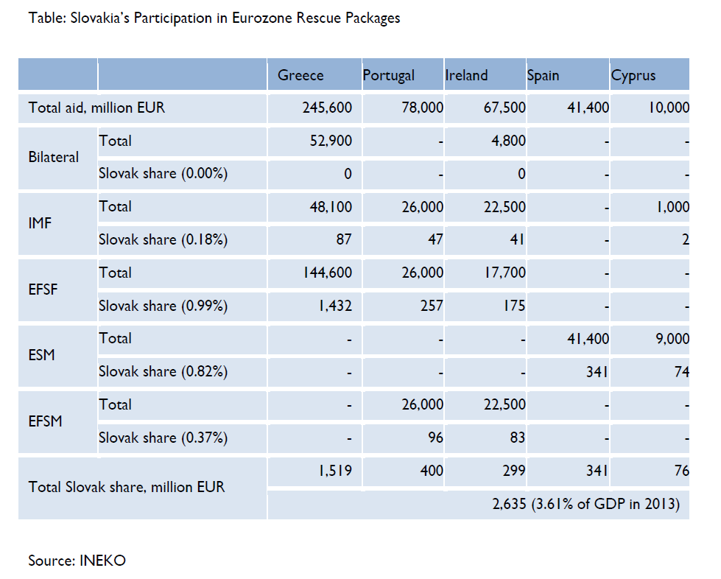
Resolving Euro-crisis
  Total ESM: 700 billion EUR
  Slovak share: 0,824%, i.e. 5,77 billion EUR (8% of GDP), of which 0,66 billion EUR paid in cash

Slide 9
Thank you for your attention!

