Slide 1


Banking sector consolidation in a post-communist economy
- the case from the Czech Republic
Aleš Rod
Project EU Hidden Triggers
Kyiv, 24th October, 2014

Slide 2
Why this topic?
According to the theory, the banking sector provides basic functions (hearth and lungs) of the economy
No market economy can operate without stable, healthy and trustworthy banking sector
All post-soviet countries have shared similar conditions after the fall of central-planning systems
However, not all of them have consolidated their banking sectors in the same (or similar) way
Looking back, the Czech case brings several important conclusions, that are important, interesting and also applicable on various state interventions nowadays

Slide 3
Capital funding before 1989
Operation of banking sector in the Czechoslovakia was completely different before 1989
Since 1967, a system of operational funding of enterprises through credits for constantly revolving working capital had been applied by legislation
The key role = THE PLAN
  The outcome of enterprises was given by the Plan
  According to the planned outcome, enterprises’ financial needs were covered by special credits provided by the State Bank of Czechoslovakia (SOCIALIST MONOBANK)
  After assigned finances were spent on production in the given year, the Plan created the reality for the next year

Slide 4
Capital funding before 1989
The Plan
The State Planning Committee
Firm C
Firm B
Firm A

Slide 5
Capital funding before 1989
The Plan
The State Planning Committee
Firm C
Firm B
Firm A
SBCS
SBCS
SBCS

Slide 6
The Revolution
After 1989, the ongoing liberalization (market principles) has brought serious problems
All enterprises had commitments to the SBCS
These assets were transferred to brand new banks, but most of credits were classified
Banks administered more than 110 billions CSK of financial assets (loans) with no expectation to be repaid by new debtors

Slide 7
The process of consolidation
This heritage of post-socialist assets with a low probability to be repaid was called “a block of bad loans” or “old bad loans”
Therefore, the Czechoslovak government decided to establish a brand new institution

Slide 8
The Consolidation Bank
Less costly operational funding for firms
Removing of bad loans from banks‘ balance sheets

Slide 9
The process of consolidation
In 1993, the Czechoslovakia has been split into two sovereign states (The Czech Republic and Slovakia), so was the Consolidation Bank (into the Consolidation Bank Prague and the Consolidation Bank Bratislava)
In 2001, political circumstances (e.g. CBP couldn’t get majorities in subsidiaries and managed firms) led to a need of establishing of the Czech Consolidation Agency by special Law
In 2004, “The Project 2007” was passed, which factually meant to finish all goals of the CCA till 2007

Slide 10
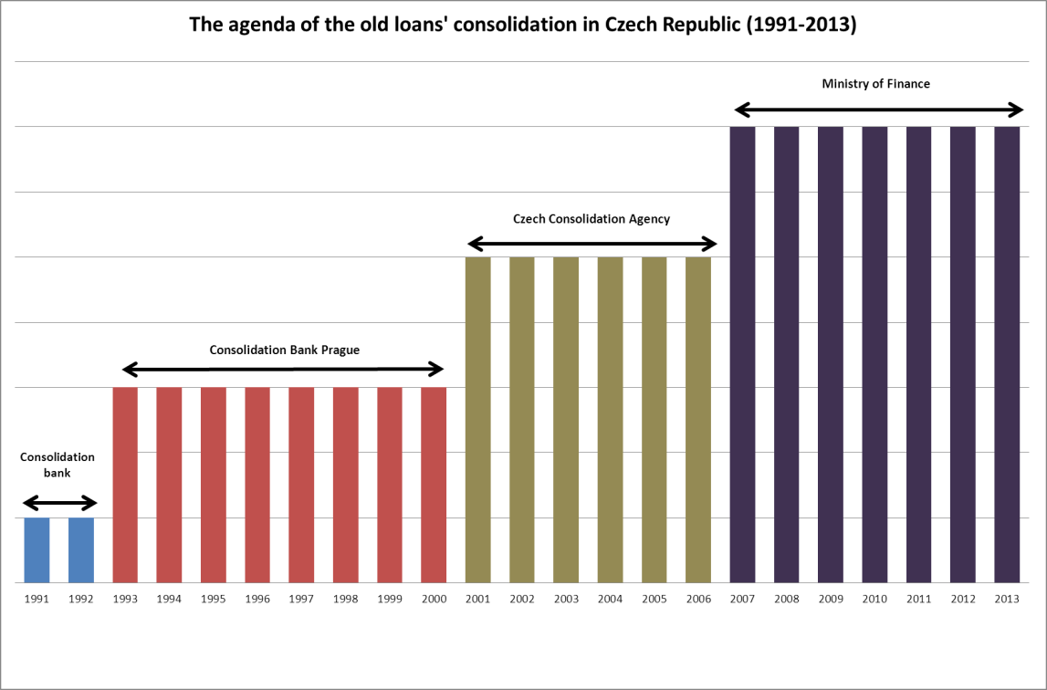

Slide 11
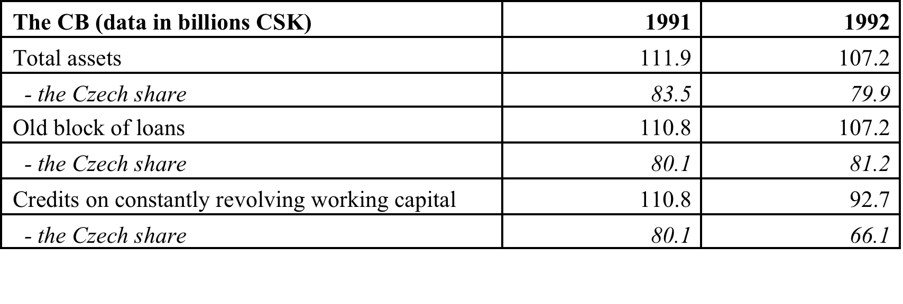
The Consolidation Bank

Slide 12
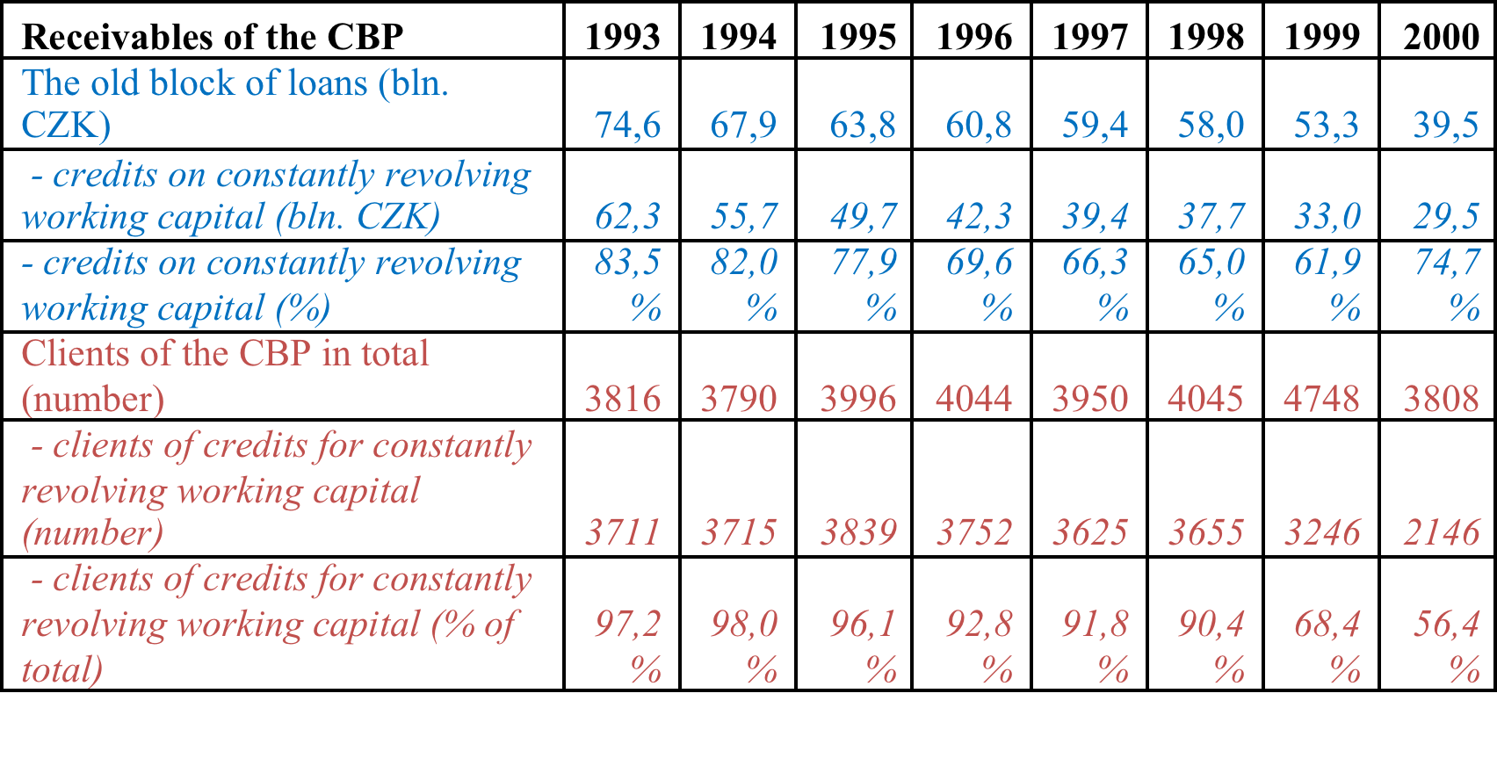
The Consolidation Bank Prague

Slide 13
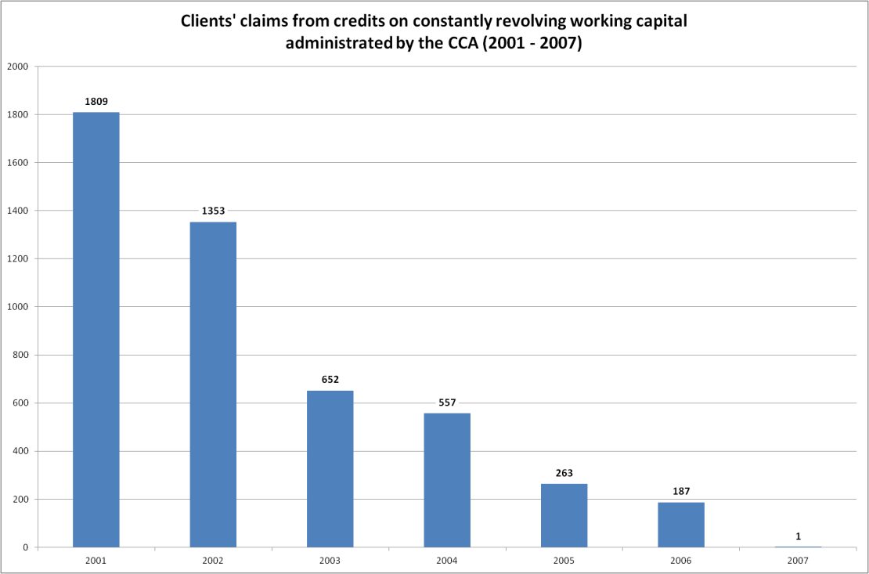
The Czech Consolidation Agency

Slide 14
Goals of consolidation agencies
Main goals:
  To clean up the Czech banking sector from bad assets and to facilitate privatization of new banks
  To manage these assets under the special regime and help them to develop in the market economy
Additional goals:
  To provide special transactions during the the process of privatization for the government
  To bail out other institutions (not just banks)
  To organize block sales of assets to the public

Slide 15
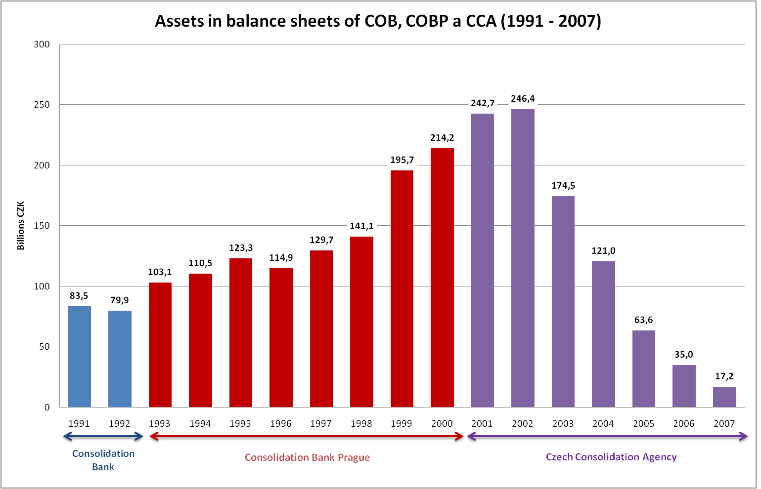

Slide 16
Problems related to the Czech way
Management of assets had not been controlled by regulators as it should be
Czech consolidation agencies were under undesirable influence of politicians
Institutions were misused by politicians for other goals than originally intended
Many debtors re-bought their debts in block sales for a small part of the original amount
The legislation passed during early 1990’ was not prepared for attacks of rent-seekers which costs additional tax-payers’ money

Slide 17
Problems related to the Czech way
Management of assets had not been controlled by regulators as it should be
Czech consolidation agencies were under undesirable influence of politicians
Institutions were misused by politicians for other goals than originally intended
Many debtors re-bought their debts in block sales for a small part of the original amount
The legislation passed during early 1990’ was not prepared for attacks of rent-seekers which costs additional tax-payers’ money

Slide 18
Re-buying of own debts
Firm A DEBT
SBCS
Consolidation agency
Block sale
Anonymous buyer
Private bank
Owner of the firm A = anonymous buyer of assets in a public tender

Slide 19
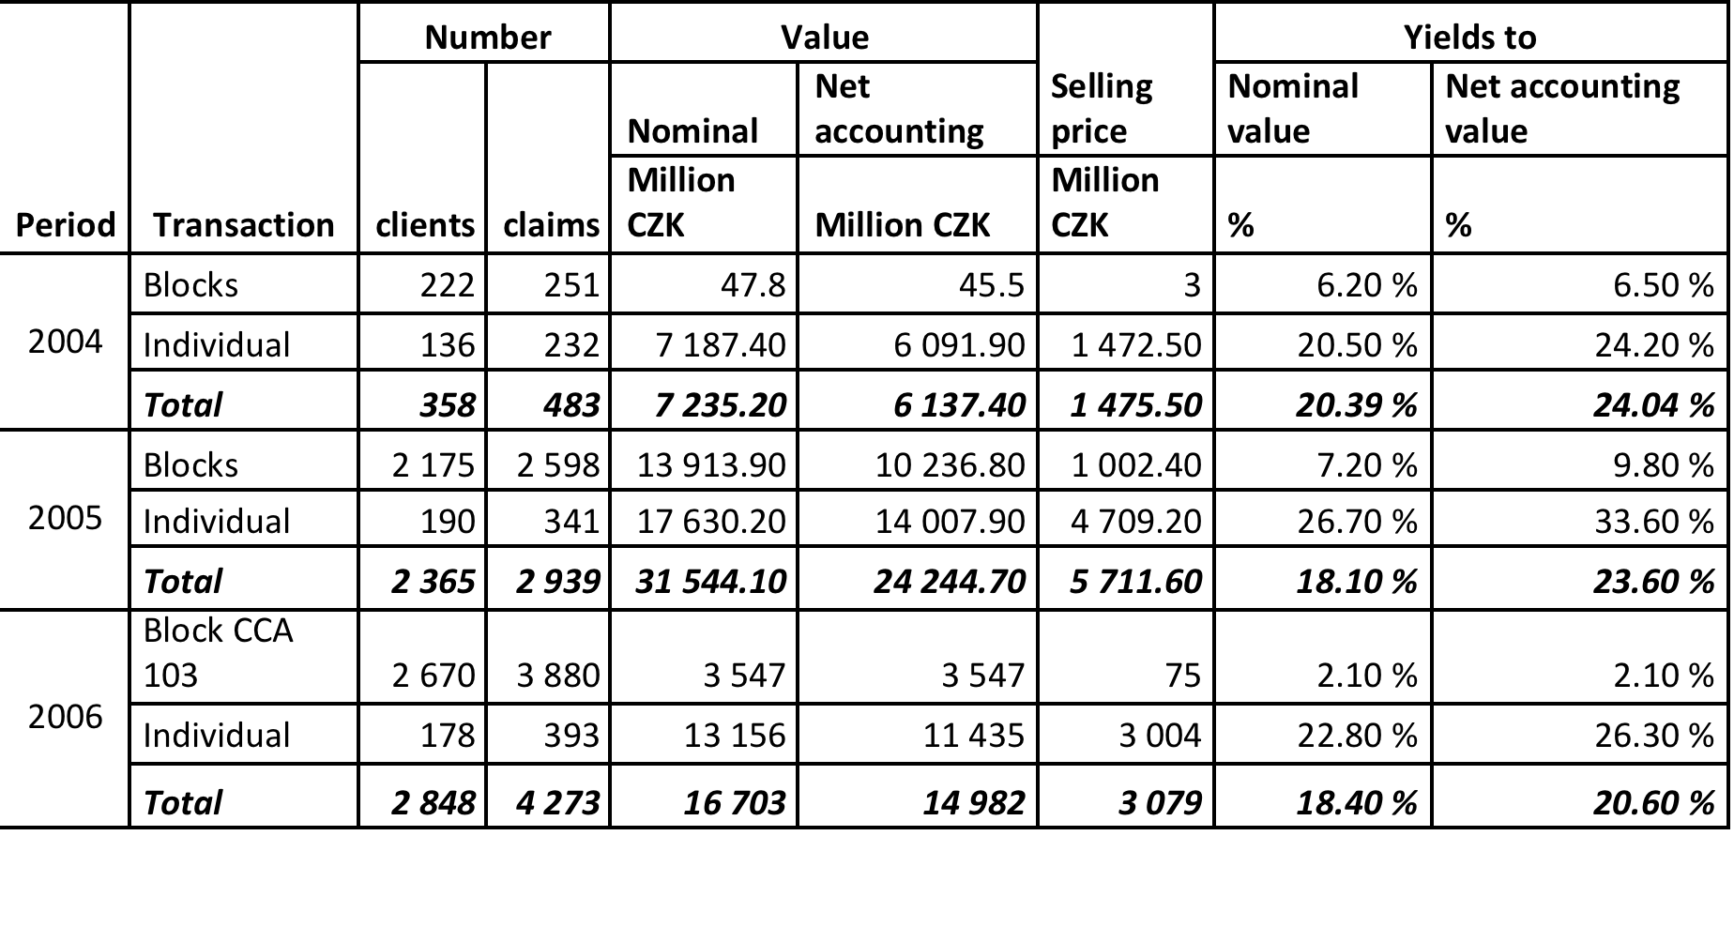
Public sales of assets

Slide 20
Problems related to the Czech way
Management of assets had not been controlled by regulators as it should be
Czech consolidation agencies were under undesirable influence of politicians
Institutions were misused by politicians for other goals than originally intended
Many debtors re-bought their debts in block sales for a small part of the original amount
The legislation passed during early 1990’ was not prepared for attacks of rent-seekers which costs additional tax-payers’ money

Slide 21
Problems related to the Czech way
Management of assets had not been controlled by regulators as it should be
Czech consolidation agencies were under undesirable influence of politicians
Institutions were misused by politicians for other goals than originally intended
Many debtors re-bought their debts in block sales for a small part of the original amount
The legislation passed during early 1990’ was not prepared for attacks of rent-seekers which costs additional tax-payers’ money

Slide 22
Rent-seeking
Base: The law No. 92/1991 Coll., about conditions for transfer of state property to other subjects (passed in February 1991)
“The state has taken the full guarantee and responsibility for economic costs (damages) made before 1989 which would negatively influence a value of a private property restituted and privatized after 1990.”

Slide 23
Rent-seeking
Intention of rent-seekers:
  Receivables emerged from bad loans were hold against companies primarily owned by the state which have been restituted or privatized into private hands.
  The core of relationship originated before 1989.
  The fact that they haven’t been repaid is economically harmful for a holder.
  The state has taken the full responsibility for damages originated before 1989.
  Therefore, the State should compensate actual holder of assets.

Slide 24
Rent-seeking
Old loans transferred to Consolidation Bank
State Guarantee
Block sales of assets
Buying assets by rent-seekers
Application of the Law 92/1991

Slide 25
Rent-seeking
This legal intention really works!
More than 160 legal suits against the state had been initiated (sum: 13 billion CZK)
Negotiation between new owners of assets and the Ministry of Finance begun
In 2013, the MF reacted on several lost lawsuits and offered a compensation
In Oct 2013, the contract providing 1.38 billion CZK off-court reimbursement was agreed

Slide 26
Conclusion
The total costs of the Czech way of consolidation are estimated in hundreds of billions CZK.

Slide 27
Comparison - the Slovak case
In 1993, 26.6 billions CSK were transferred into the Consolidation Bank Bratislava
In 2001, a successor called Slovak Consolidation Limited has been established
Slovak institutions chose another way of consolidation – without externalization of the problem.
  The enforcement of receivables continued with all available tools – restructuring, repayment schedules, and available legal instruments
  Failed claims to be recovered were subsequently managed under bankruptcies and liquidation proceedings and – accounted by depreciation or written-off.
The Slovak way of bad loans consolidation was faster, cheaper, equitable, i.e. more efficient than the Czech one!

Slide 28
Today’s implications
If the state established a subject for consolidation, than:
  … it should be clear that taxpayers’ money are needed.
  … it should be secured that the legislation dealing with goals, tools and guarantees is impeccable.
  … all potential short term and long term scenarios should be taken into decision-makers’ account.
  … the deadline of the operation should be set as well as the cap of bailed out costs.
  … the externalization of the problem shouldn’t be approved unless it is really necessary.
  … no “bianco checques” or guarantees should be made.

Slide 29
Thank you for your attention.

