Slide 1


Structural reforms adopted in Slovakia – best practices
Peter Goliaš
INEKO Director, Slovakia
October 24, 2014
Workshop on enhancing Ukraine`s integration chances
Kyiv

Slide 2
Key success factors
Influential pro-reform group
Transparent privatization, international tenders
Tax reform bringing simplicity and lowering direct taxes
Labor market reform bringing flexibility
Pension reform linking benefits to contributions and introducing fully funded second pillar
Education reform (2003) introducing per-pupil financing of schools
Increasing transparency and fight against corruption

Slide 3
Influential pro-reform group
Many reforms are unpopular, in conflict with vested interests or technically difficult
How to overcome these barriers? In Slovakia we were lucky to have:
  Strong NGO sector, think-tanks
  Free media
  Experts (e.g. bank analysts) willing and able to comment in media
  Well educated politicians and policy makers implementing reforms

Slide 4
Key success factors
Influential pro-reform group
Transparent privatization, international tenders
Tax reform bringing simplicity and lowering direct taxes
Labor market reform bringing flexibility
Pension reform linking benefits to contributions and introducing fully funded second pillar
Education reform (2003) introducing per-pupil financing of schools
Increasing transparency and fight against corruption

Slide 5
Transparent privatization
Before 1999: Mostly non-transparent methods of privatization preferring local investors linked to politicians
After 1999: International tenders, direct selling to strategic investors, price as a single winning criteria
Key assumptions:
  Investors from democratic and developed countries would bring the advanced knowledge and the culture that would increase the speed of transformation and foster competitiveness
  The competition for the best price would ensure the highest possible revenues for the state budget

Slide 6
Brown-field investors
Banking and insurance (fully privatized)
  Erste, Raiffeizen, Intesa, UniCredit, Allianz, Generali, etc.
Telecommunications (majority or fully)
  Fixed line operator: Deutsche Telekom (51% majority)
  GSM: Orange, O2 (100%)
Energy (majority or 49% with managerial control)
  Electricity distributors (49%): E.ON, EDF, RWE
  Gas industry (49%): Gaz de France & Ruhrgas (in 2014 replaced by Czech energy holding EPH)
  Power producer (66%): Enel
  Oil pipeline (49%): Yukos (in 2006 bought back by government)

Slide 7
Important notes
The privatization of state monopolies required:
  Establishing new independent regulators
  Deregulation of prices with negative short-term impact on population particularly in energy sector

Slide 8
Key success factors
Influential pro-reform group
Transparent privatization, international tenders
Tax reform bringing simplicity and lowering direct taxes
Labor market reform bringing flexibility
Pension reform linking benefits to contributions and introducing fully funded second pillar
Education reform (2003) introducing per-pupil financing of schools
Increasing transparency and fight against corruption

Slide 9
Tax reform (2004) - assumptions
The investors welcome simple system and lower taxation on corporate profits.
Lower direct taxes have positive impact on work incentives and reduce tax evasion.
Lowering direct taxes requires higher indirect taxes, which is unpopular.
Therefore, referring to political economy, compensation for low income people is one of key preconditions for successful reform.

Slide 10
Key measures
Radical simplification of the Tax Code:
  The old system included 90 exceptions, 19 sources of un-taxed income, 66 tax-exempt items, and 37 items with specific tax rates. The reform abolished most of them.
  Abolishing three minor taxes – gift tax, inheritance tax and real estate transfer tax

Slide 11
Key measures
19% personal income tax instead of 5 progressive rates
  In 2013 a higher rate of 25% was reintroduced
19% corporate income tax istead of 25%
  In 2013 incresed to 23%, currently at 22%
0% dividend tax instead of 15%
The combined statutory corporate income tax rate and dividend tax rate dropped from 36.3% in 2003 to 19% in 2004 (lowest in the OECD)

Slide 12
Key measures
19% value added tax instead of lower rate of 14% and upper rate of 20%
  Later, lower 10% rate for books and drugs was introduced
Increase in the excise tax rates on mineral oils, tobacco, and tobacco products, spirits and beer
Compensation for low income cohorts:
  Increasing the basic personal allowance deductible from the tax base from €968 to €2,021 per taxpayer in 2004 (€3,803 in 2014)
  Everybody with wage below approximately 40% of the average wage in the economy (€317 in 2014) did not pay any income tax at all. Others paid 19% on the difference between their income and the tax-free income.

Slide 13
Green-field investors
Automobile and electronic industry (2005: Peugeot-Citroen, Kia; expanding production at Volkswagen; Sony, Samsung), later also IT sector (IBM, Dell)
Strong GDP growth mainly in 2006-08
Since 2012, Slovakia has been the biggest automobile producer per capita in the world

Slide 14
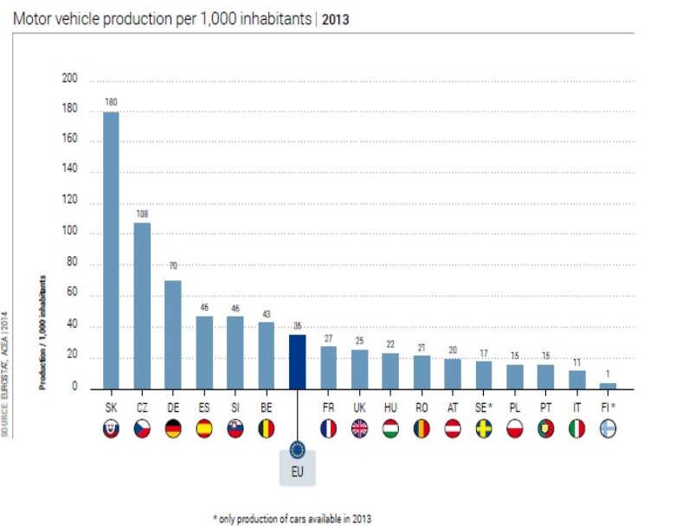
Source: http://www.acea.be/statistics/tag/category/per-capita-production

Slide 15
Key success factors
Influential pro-reform group
Transparent privatization, international tenders
Tax reform bringing simplicity and lowering direct taxes
Labor market reform bringing flexibility
Pension reform linking benefits to contributions and introducing fully funded second pillar
Education reform (2003) introducing per-pupil financing of schools
Increasing transparency and fight against corruption

Slide 16
Firing costs
Before the reform: 3 months notice period plus 2 months severance pay
Reform (2003): 3 or 3 (2 or 2 for contracts lasting shorter than 5 years)
2007: 2 plus 2 or 3 plus 3
2011: 1 or 1 (for contracts lasting less than 1 year); 2 or 2 (for contracts lasting over 1 year and under 5 years); 3 or 3 (for contracts lasting 5 years and over)

Slide 17
Firing costs
2013: Re-introduction of concurrence and gradual increase of protection:
  1 plus 0 (for contracts lasting shorter than 1 year);
  2 plus 0 (over 1 year and under 2 years);
  2 plus 1 (over 2 years and under 5 years);
  3 plus 2 (over 5 years and under 10 years);
  3 plus 3 (over 10 years and under 20 years);
  3 plus 4 (for contracts lasting 20 years and over)

Slide 18
Other measures
Increasing overtime limit from 150 hours to 400 hours yearly (40-hour working week, plus 8 hours overtime)
Practically indefinite extension of the fixed-term contracts; currently limited to 2 years (with exception of seasonal works) with possibility to sign a new temporary contract not sooner than 6 months after elapsing of this 2-year period.
Weaker Labor Unions
2009: Flexible working time account (Flexi-conto)

Slide 19
Key success factors
Influential pro-reform group
Transparent privatization, international tenders
Tax reform bringing simplicity and lowering direct taxes
Labor market reform bringing flexibility
Pension reform linking benefits to contributions and introducing fully funded second pillar
Education reform (2003) introducing per-pupil financing of schools
Increasing transparency and fight against corruption

Slide 20
Pension reform
Trade-off between Merits & Solidarity:
  Gradual linking of contributions to benefits
Long/term financial stability:
  Prolonging retirement age
    2004: Gradually up to 62 years for both genders
    2017: Retirement age will be linked to life-expectancy
  Indexing pensions:
      2004: Automatic (average of wage growth and inflation)
      2012-16: Transitional period: Increase by a fixed sum and/or inflation
      2017: Indexed purely by inflation for pensioners basket of goods

Slide 21
Pension reform
Introducing second fully-funded pension pillar
  2005: 9% contribution rate (of gross wage)
  Transformation cost of around 1.1% of GDP yearly was covered by privatization revenues (2005-2009), later directly from the state budget
  2012: The contribution rate was decreased to 4%, it is expected to grow up gradually to 6% by 2024
  Funds: Pension management companies (currently six) are obliged to administer two types of funds, a guaranteed bond fund and an unguaranteed equity fund. Voluntarily they also operate mixed and index funds.

Slide 22
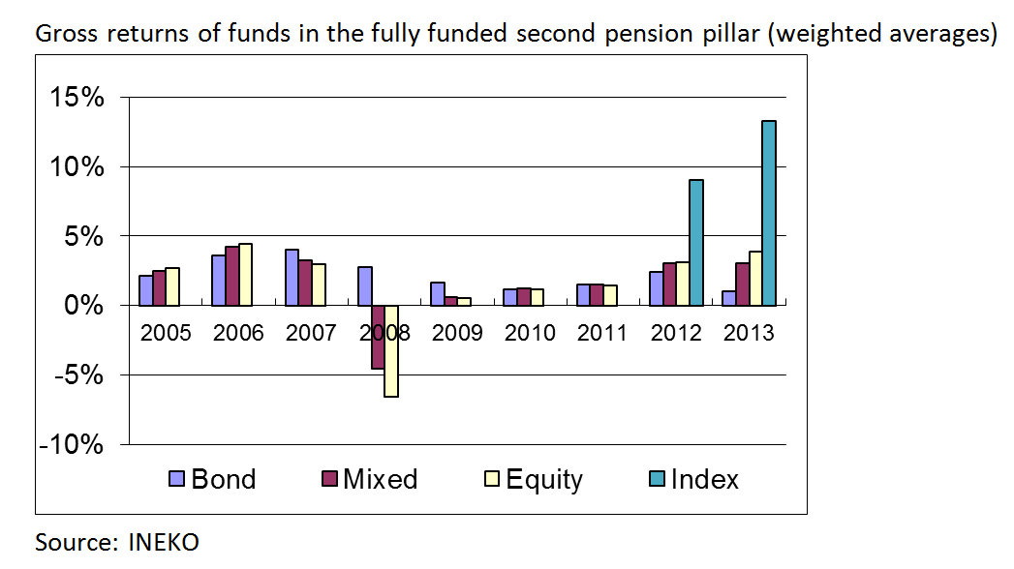
Returns in funds

Slide 23
Key success factors
Influential pro-reform group
Transparent privatization, international tenders
Tax reform bringing simplicity and lowering direct taxes
Labor market reform bringing flexibility
Pension reform linking benefits to contributions and introducing fully funded second pillar
Education reform (2003) introducing per-pupil financing of schools
Increasing transparency and fight against corruption

Slide 24
Education reform
2003: Introduction of “normative” financing based on number of pupils (i.e. normative = fixed amount of money per pupil) with equal financing of primary and secondary public and private schools
Objectives:
  To increase transparency in financing schools
  To increase pressure on their rationalization and efficiency – the quality should be guaranteed by free choice of school (students and their parents should choose the best).
Problem: Lack of information about quality

Slide 25
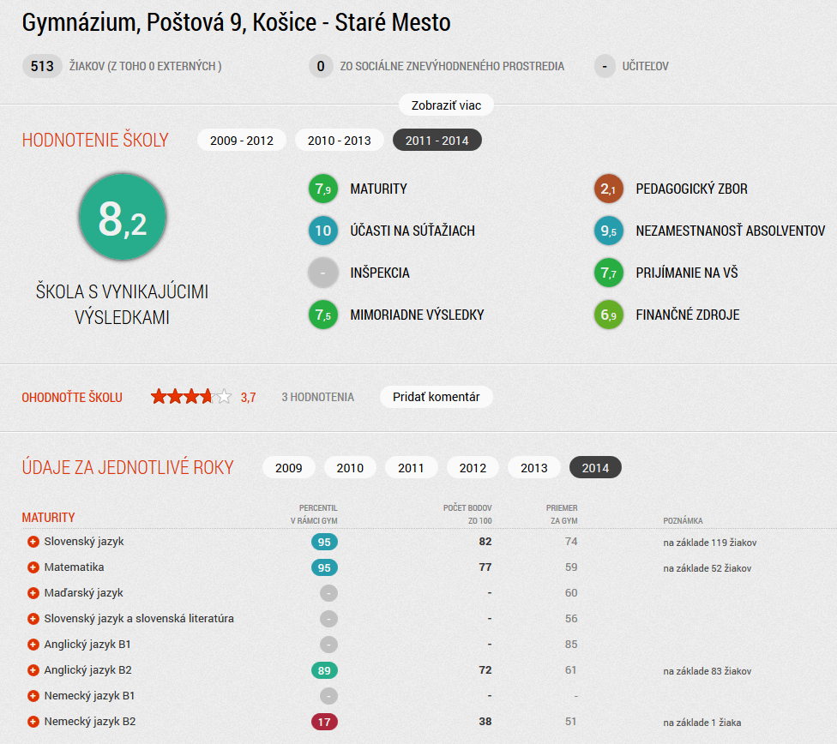
Measuring quality
Source: INEKO portal on primary and secondary schools, http://skoly.ineko.sk/

Slide 26
Key success factors
Influential pro-reform group
Transparent privatization, international tenders
Tax reform bringing simplicity and lowering direct taxes
Labor market reform bringing flexibility
Pension reform linking benefits to contributions and introducing fully funded second pillar
Education reform (2003) introducing per-pupil financing of schools
Increasing transparency and fight against corruption

Slide 27
Key measures
1998-2002: Privatization of banks, telecom, and energy industry
2000: Free Access to Information Act (no “trade secret” objection)
Open legislation:
  The portal http://jaspi.justice.gov.sk offers complete information from collection of laws and official gazettes
  The portal http://www.rokovania.sk includes complete information on the consultation of legislative proposals with full texting of comments and reactions

Slide 28
Key measures
2003: Online business registry (user-friendly, searchable)
2004: Specialized Court and Prosecutor’s Office (focus on big corruption cases)
2007: Online Land Registry
2011: Publishing all property contracts and invoices of public institutions on internet.
  The contracts are not valid unless they are published
  Shift from on-demand (i.e. based on information demanded by citizens) to automatic transparency
  Searchable portals (such as http://tender.sme.sk)

Slide 29
Key measures
2011: Wider use of mandatory electronic auctions and other competition methods in public procurement. According to the Transparency International Slovakia this measure led to rise of bids in public tenders and to 6-15% savings.
2012: Publishing court rulings on internet, random selection of judges
Current challenges: Open data initiative, measuring quality and efficiency of public services

Slide 30
Thank you for your attention!
For more details, see the analysis: http://www.ineko.sk/file_download/817

