Slide 1
"How to reduce unemployment in Slovakia – the EU Perspective"
Mr. Zoltan KAZATSAY
Deputy Director General
DG Employment

Slide 2
Progress with employment rate is stalling
Notes:
The Europe 2020 target aims at 75% of the population aged 20-64 to be employed.
The national targets, specified in National Reform Programs 2011 would result in the employment rate of around 74% .
On the basis of recent developments, the Europe 2020 target of a 75% employment rate will not be met.
Under assumption of no policy change, the EU will reach the rate of 71%.
Average employment growth of 0.9-1% would be needed between 2013 and 2020 in order to reach target.
(Annual average employment growth in the 'Pre-crisis period' (from 2002-08) was 1.4%)

Slide 3
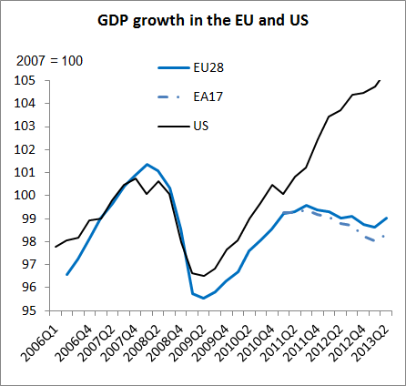
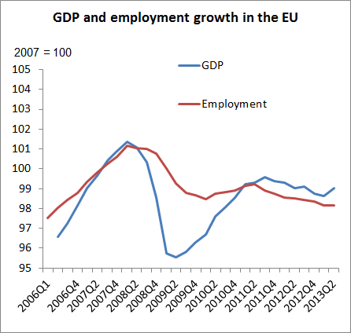
Signs of bottoming out after nearly two years of second dip recession in the EU
Source: National Accounts
Notes:
- EU went through double dip recession spread over five years
- EA GDP growth diverged slightly down since 2011
- US recovered much better since its recession
- GDP and employment stabilised in the second quarter
- Employment held up well in the first stage of the crisis
- but over 5 years employment loss exceeds fall in GDP

Slide 4
Employment performances vary markedly
Employment rates in the EU
(share of people employed in the 20-64 age group)

Slide 5
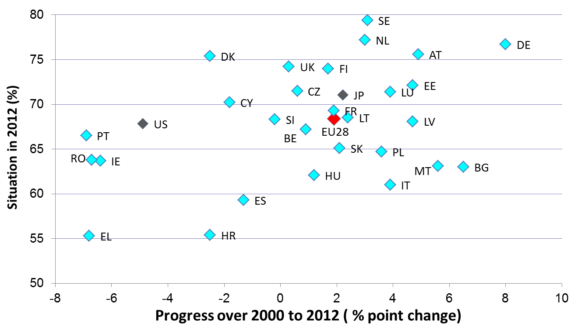
Progress since 2000
Progress over time per country
(share of people employed in the 20-64 age group)

Slide 6
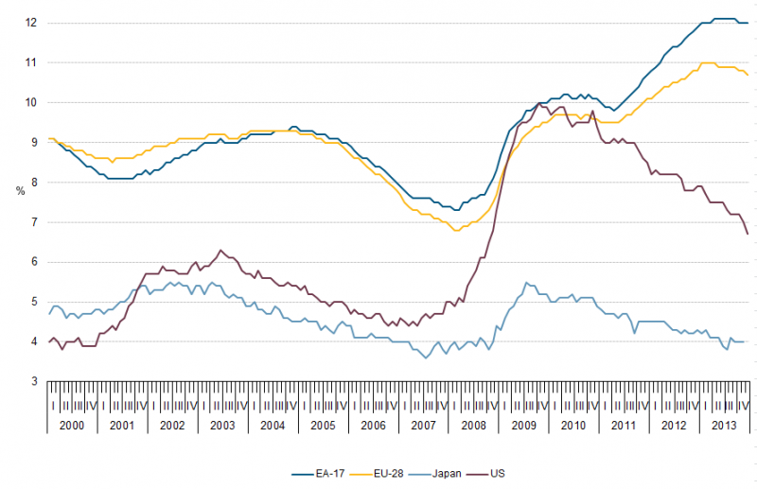
Unemployment stabilised in 2013,
Notes:
- Unemployment in the EU stabilised in 2013
- While it has been on the downward trend in the US
- Last 5 years left high unemployment in many Member States

Slide 7
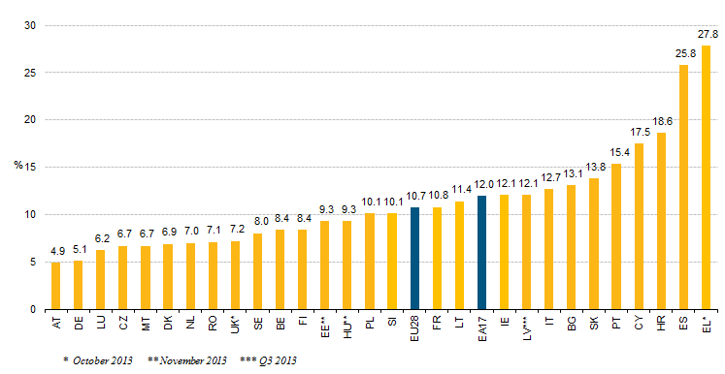
but remains at very high level in many MSs
Notes:
High variability of unemployment among MSs

Slide 8
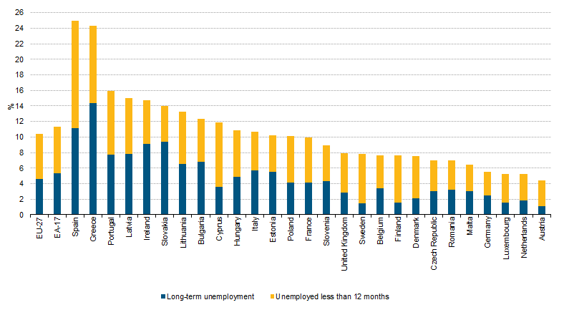
With a long duration in many MSs
Notes:
Unemployment duration has increased over past years

Slide 9
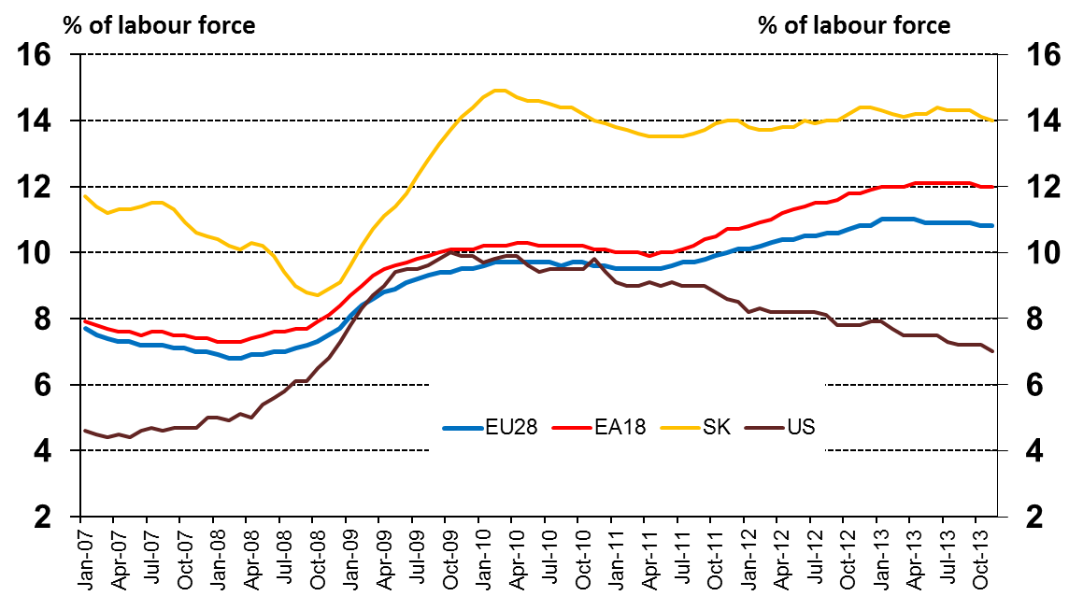
Slovakia unemployment rate compared with EU28 euro area, US and JP
Notes:
Unemployment duration has increased over past years

Slide 10
Slovakia youth unemployment rate over 30%
Notes:
Unemployment duration has increased over past years

