Slide 2
Content
Empirical Facts and Figures
(Slovakia – Austria)
Policy Conclusions - Lessons to be learnd

Slide 3
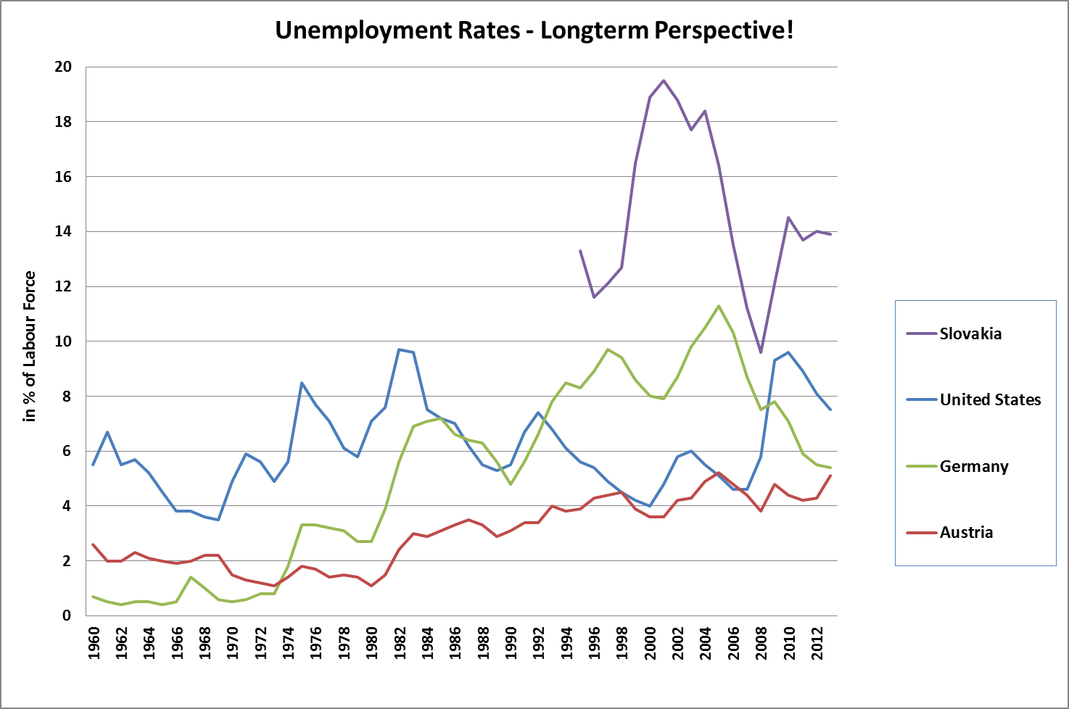
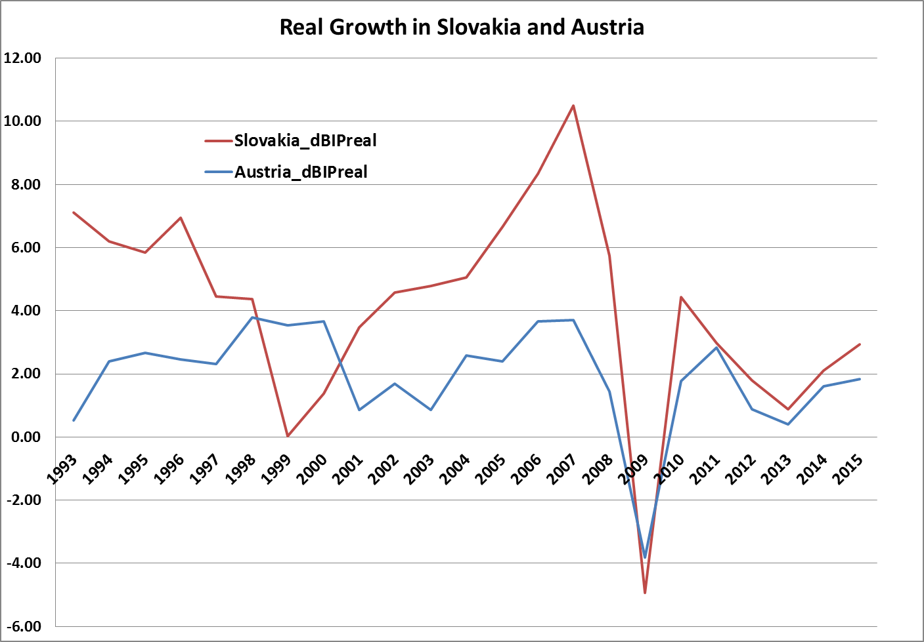
Unemployment and Growth

Slide 4
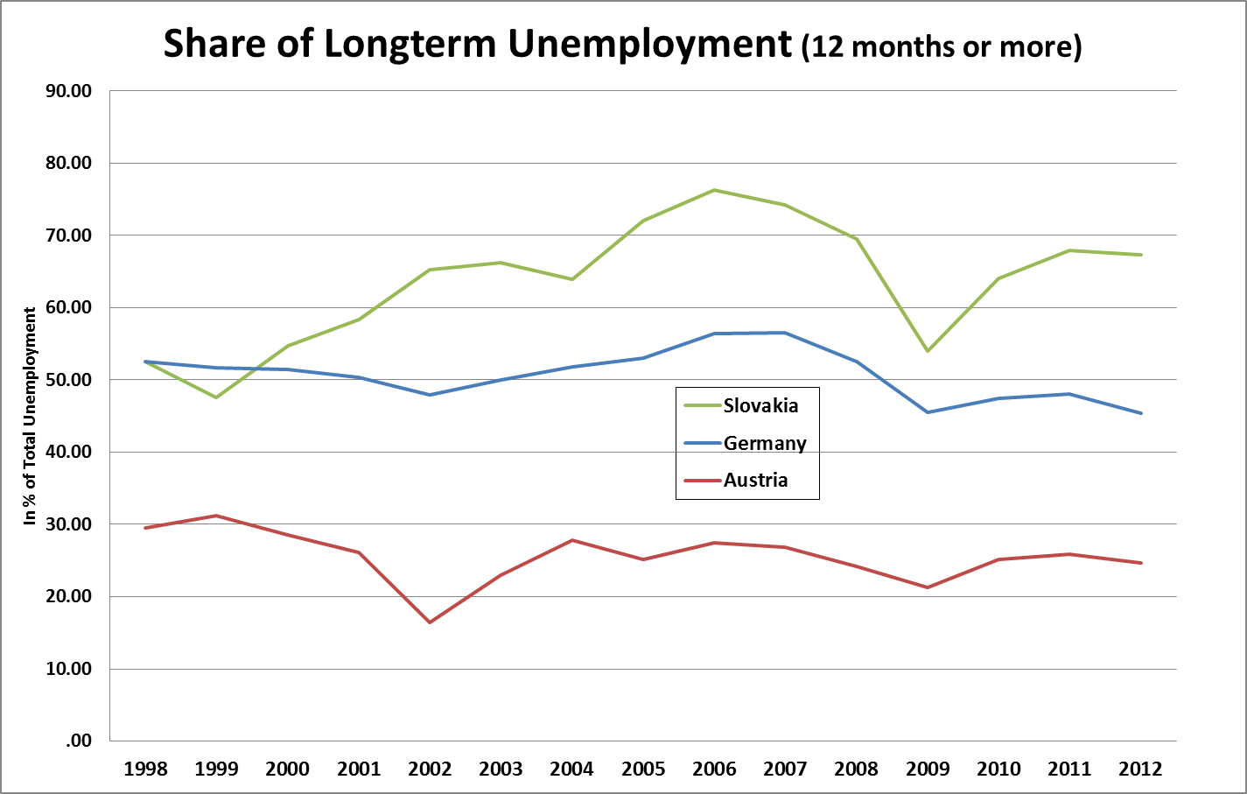
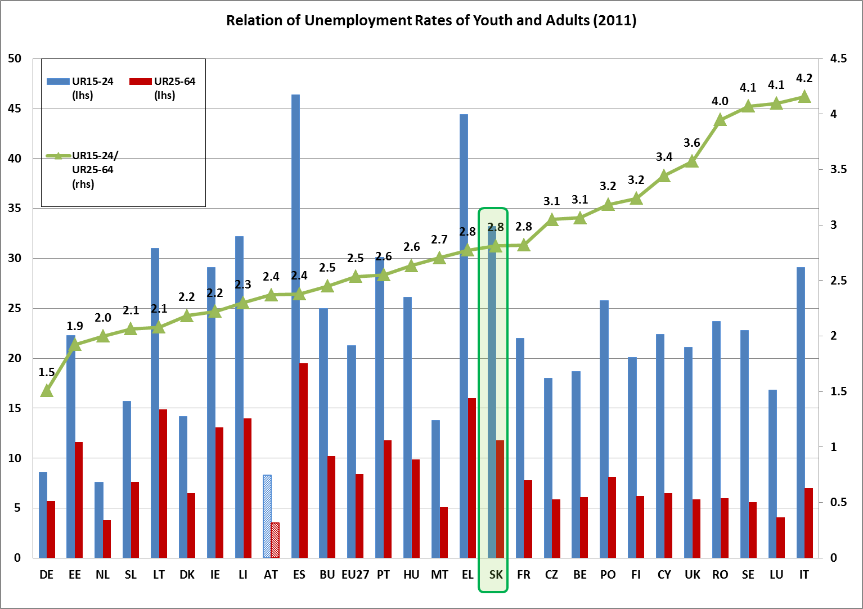
LTU and Youth

Slide 5
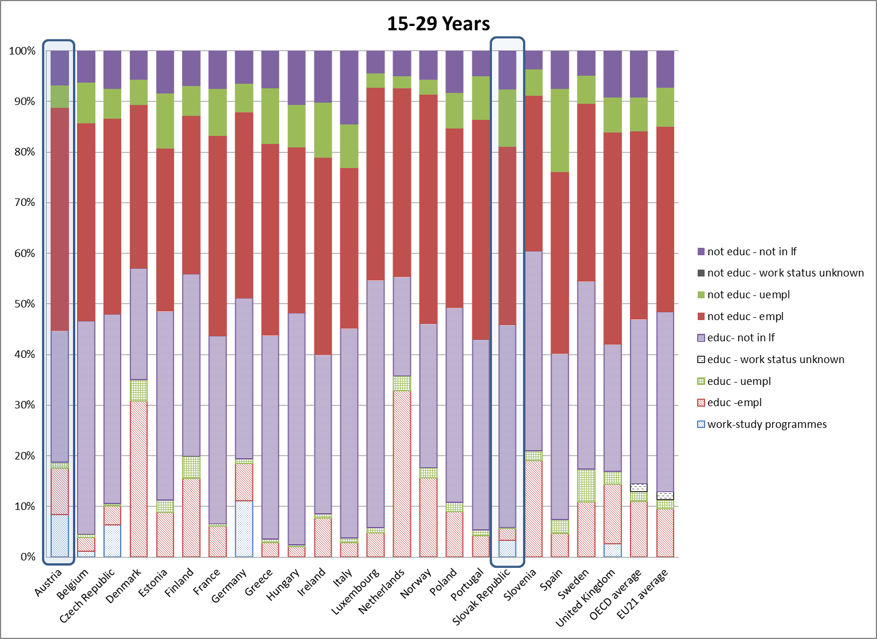
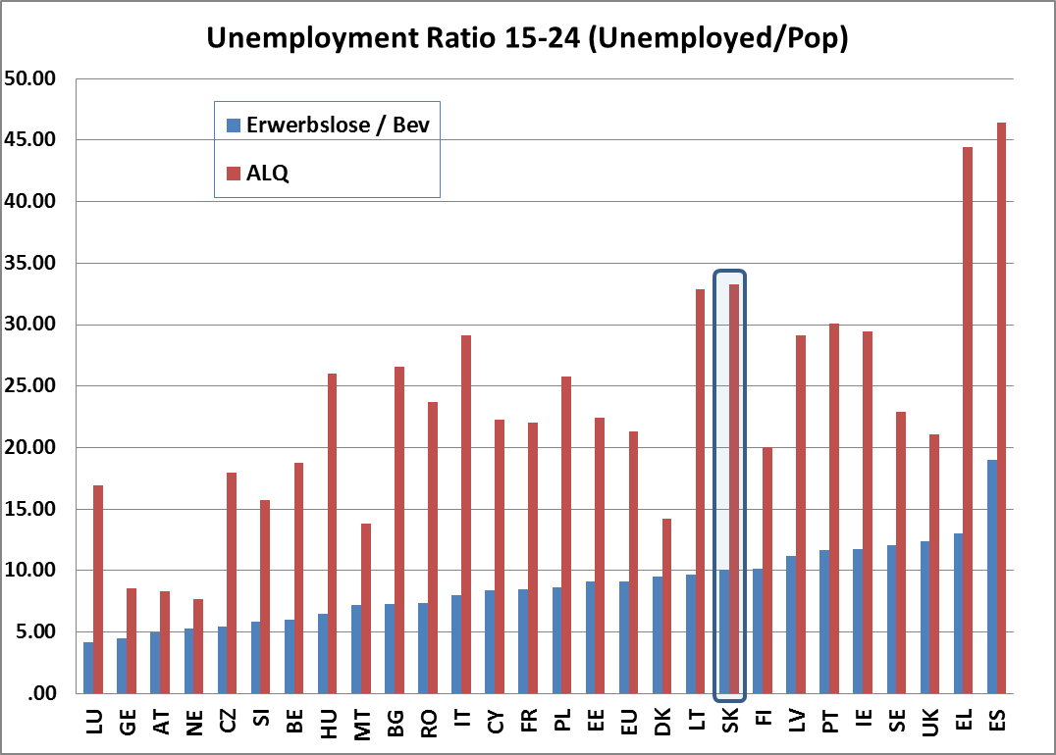
Youth alternative measures

Slide 6
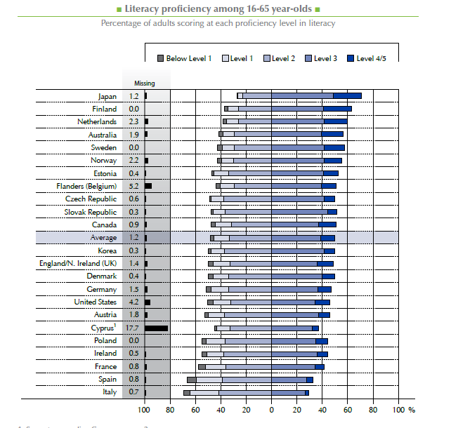
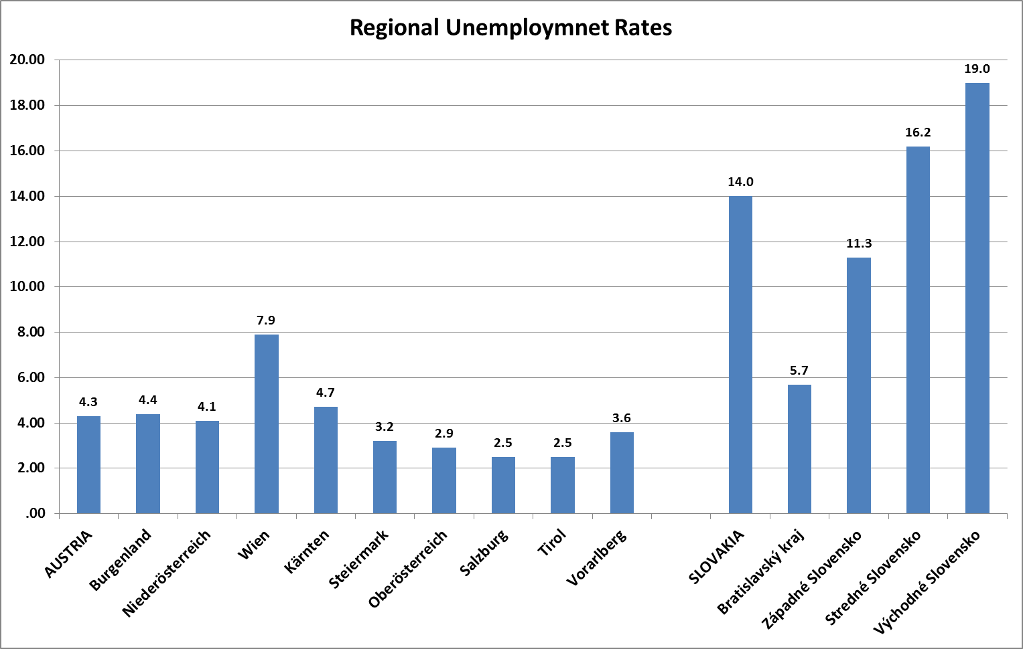
PIAAC-Results and Unemployment

Slide 7
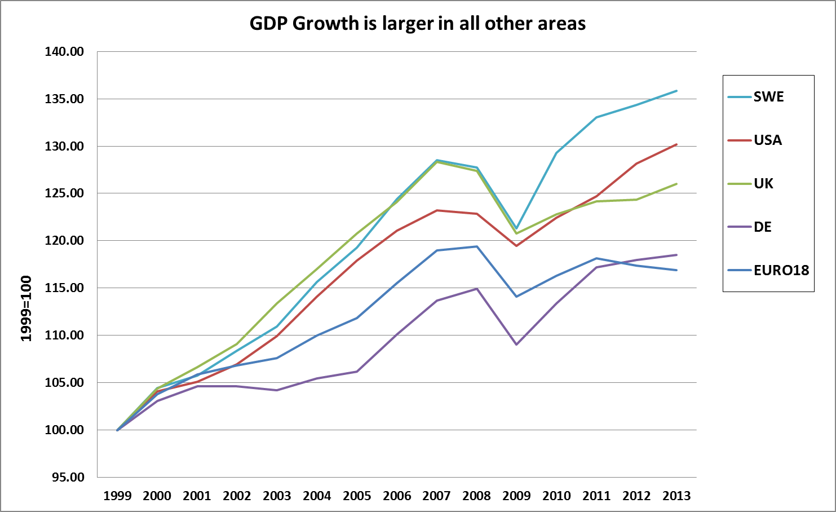
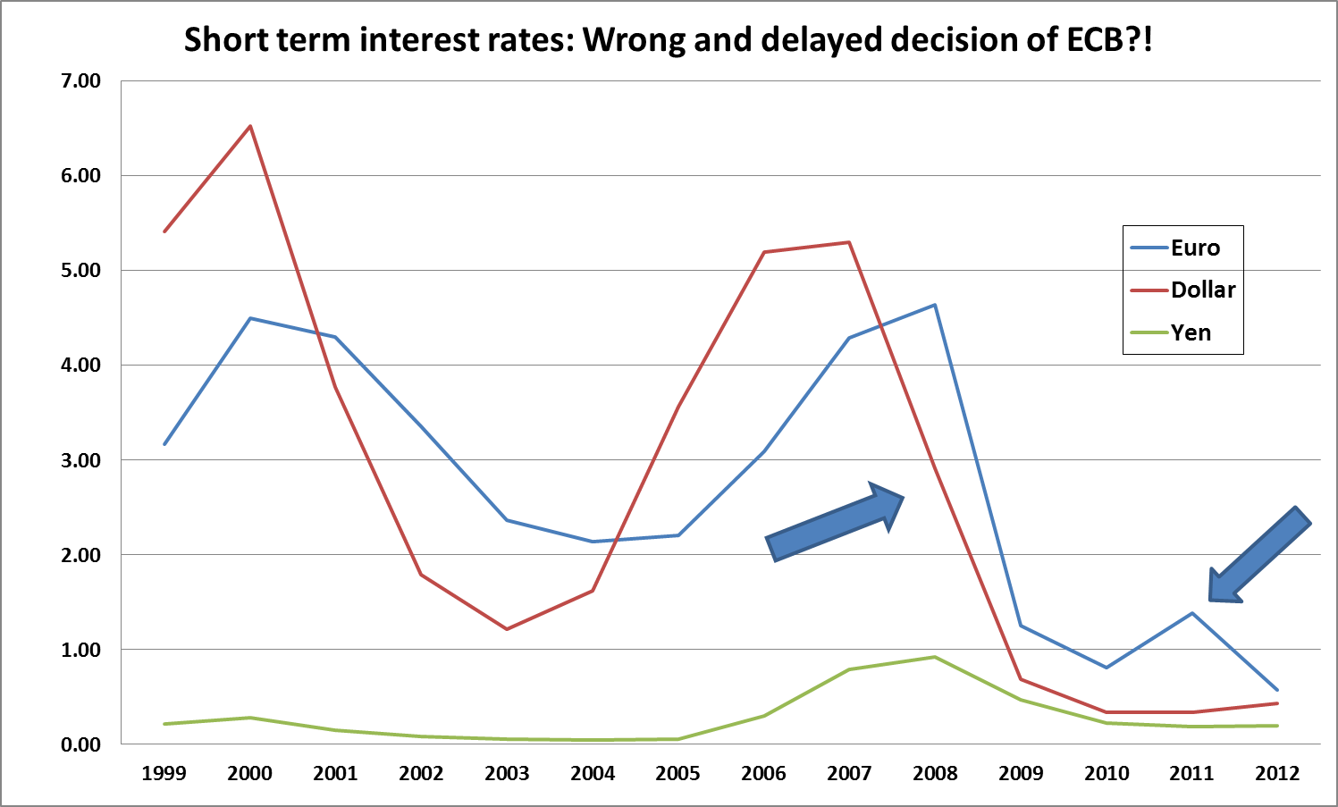
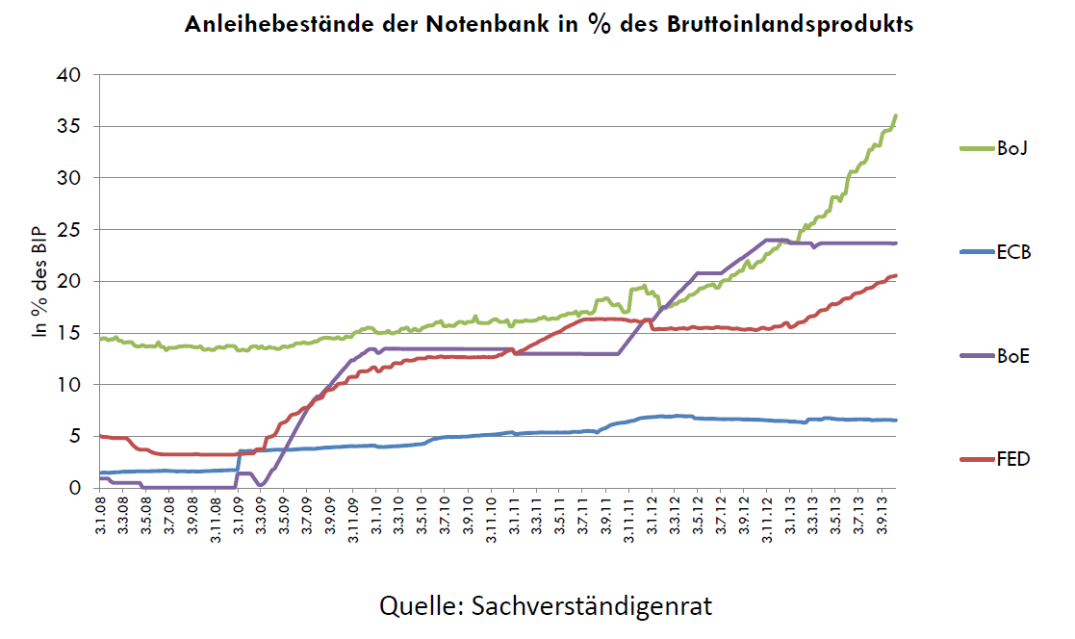
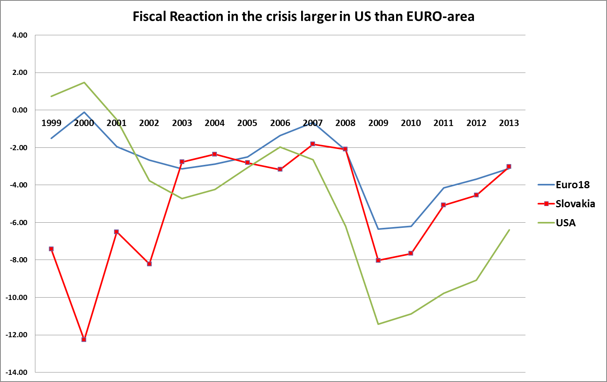
Macroeconomic Policies (1)

Slide 8
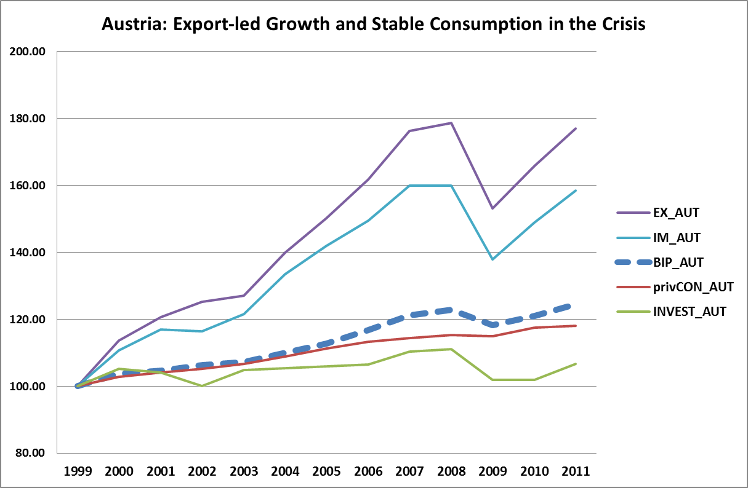
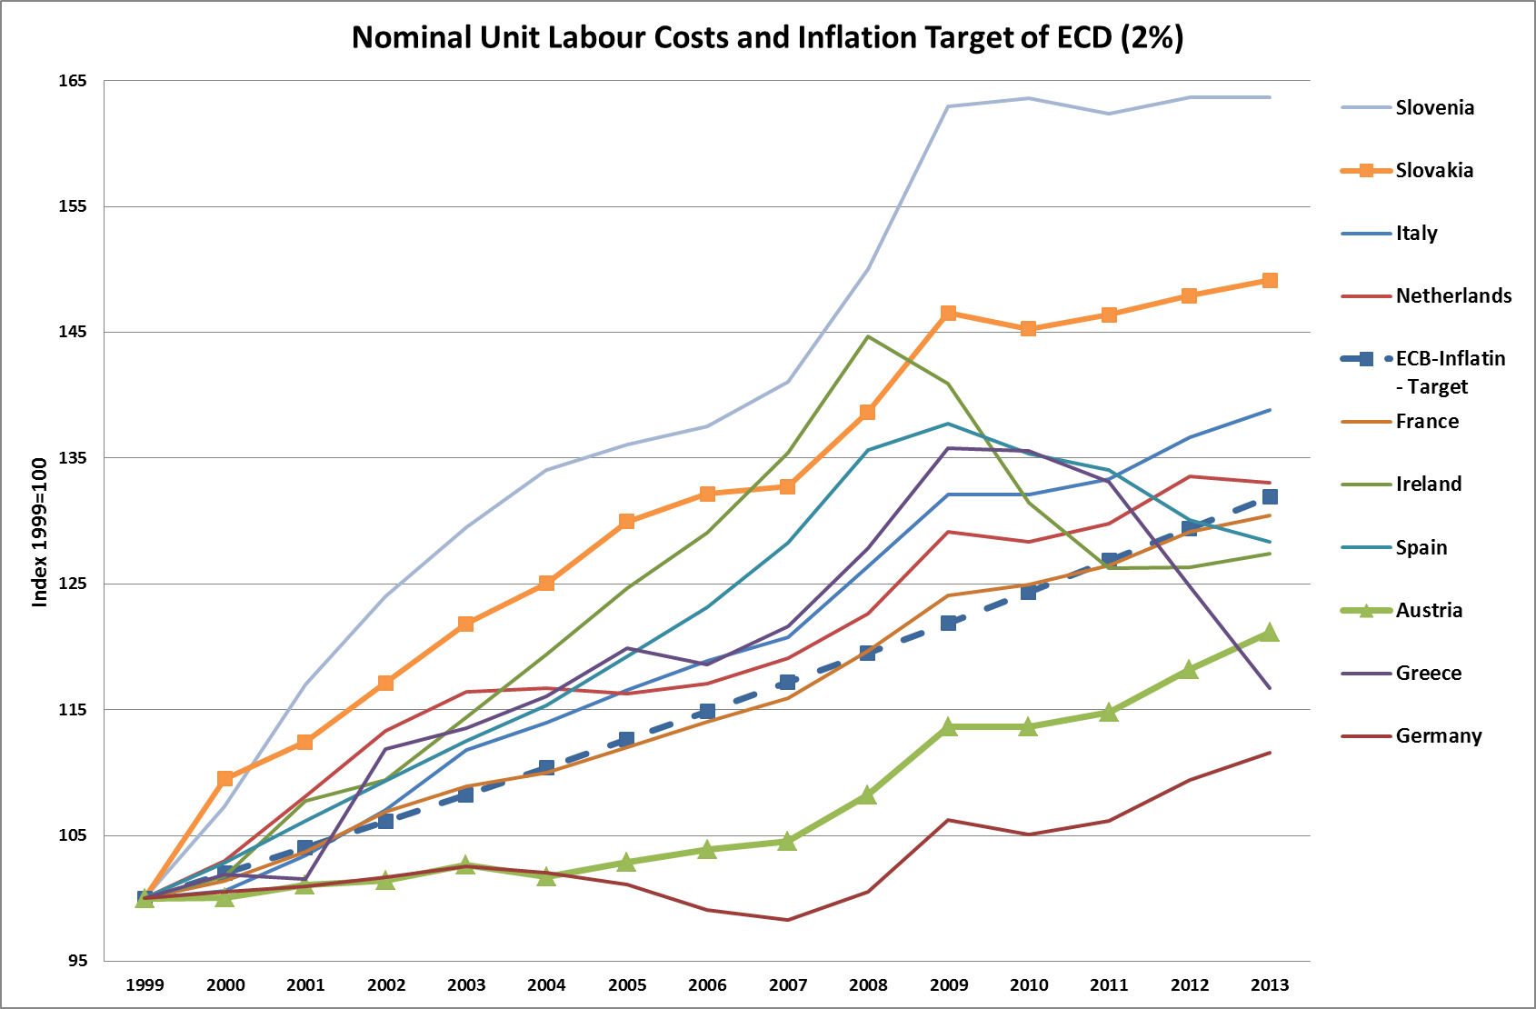
Macroeconomic Policies (2)

Slide 9
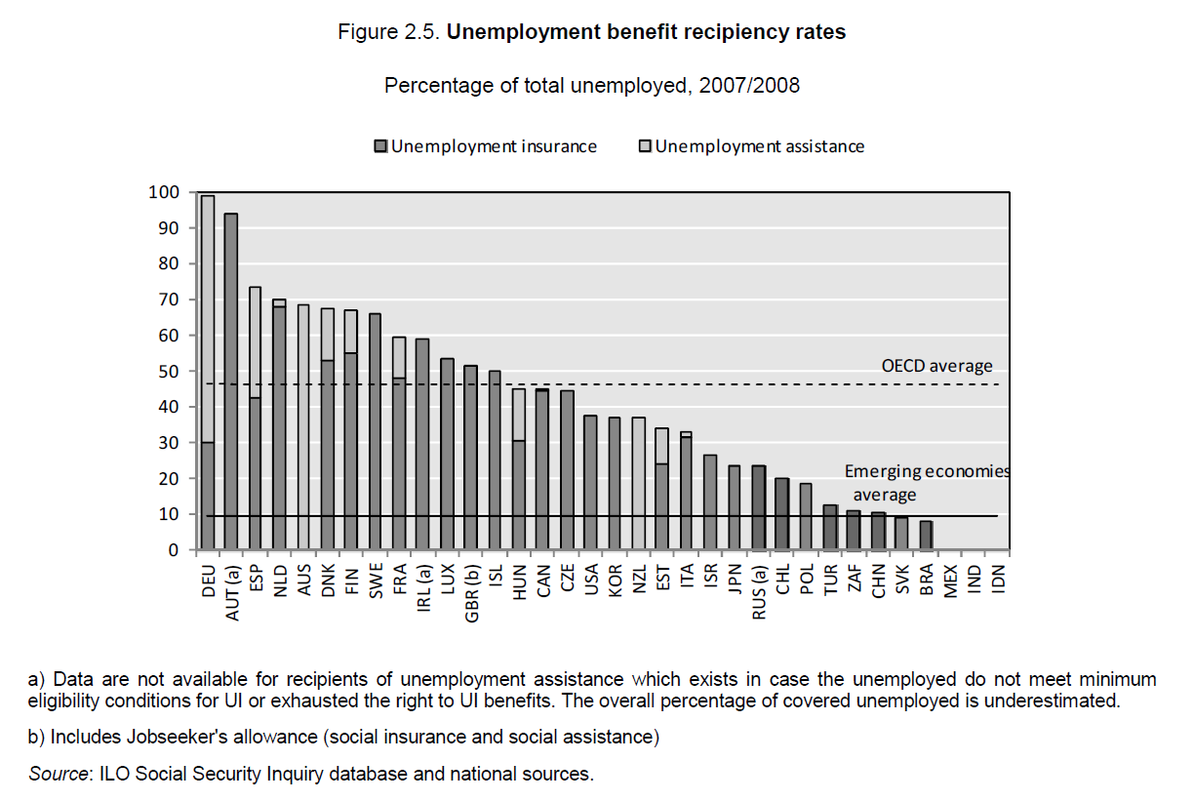
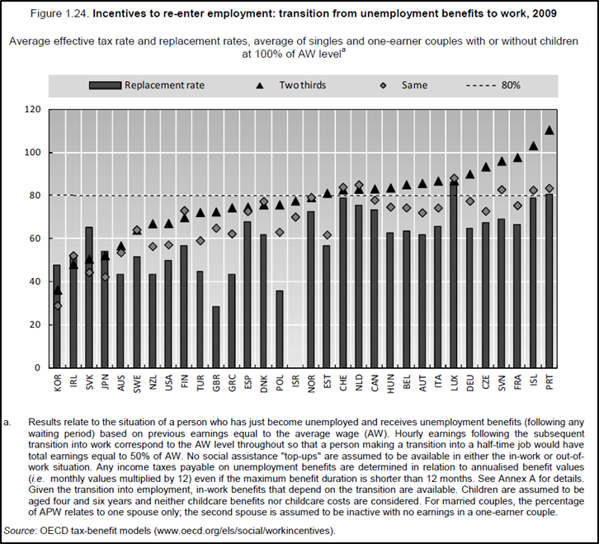
Incentive Problems (1) ?

Slide 10
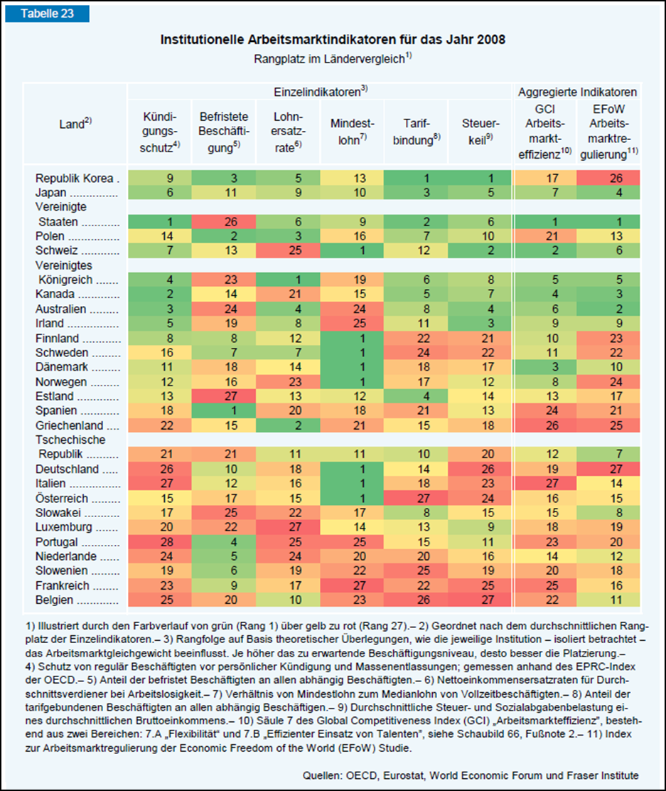
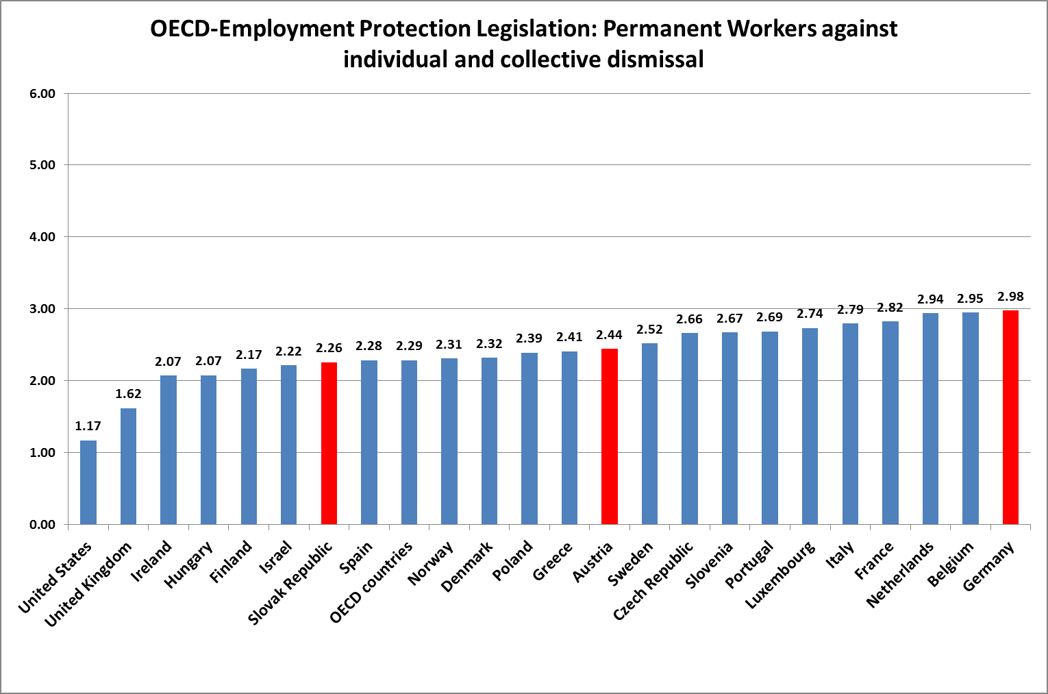
Incentive Problems (2)?

Slide 11
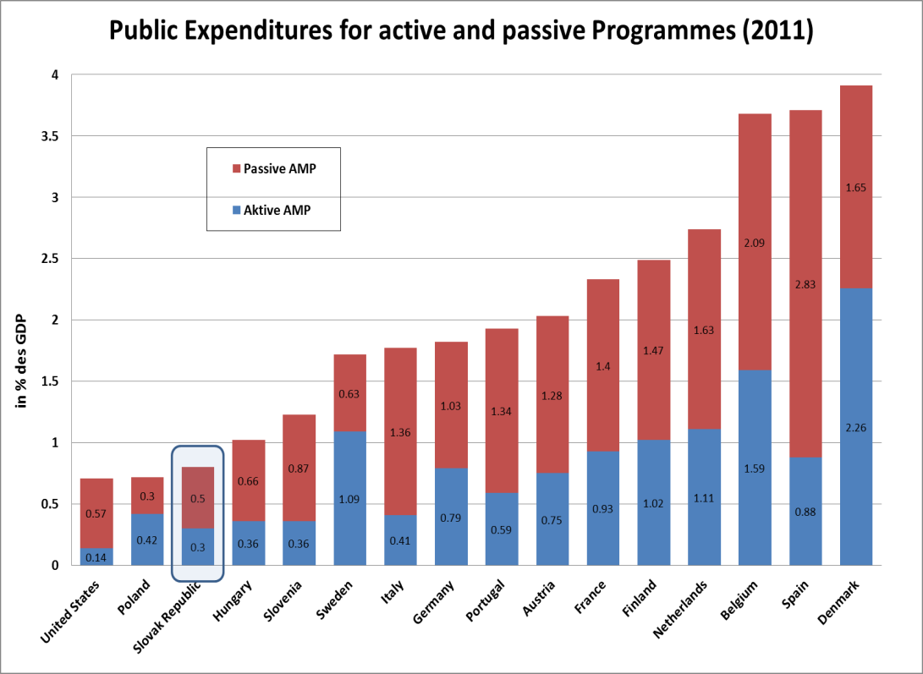
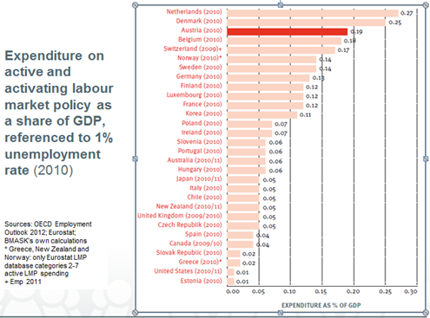
Active and Passive LMP-Measures

Slide 12
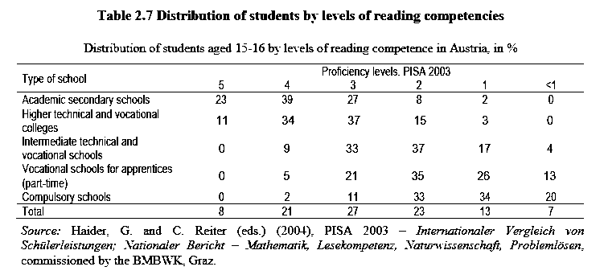
Apprenticeship System: Pros and Cons
Pro Con
3- 4 years training on the job * Employer are reluctant
(relevant skills!), 4:1 job:school * 0,2% of GDP public money
Strong legal basis – standarized * hight drop-out rates (lack of
Currucula (ISCED 3B) quality assurance)
Fair balance Employer - * migrants discrimination access
Employee (Social Partner-
Ship!)
Low entry wages
(12-46% of average)
Careers opportunities
for low achievers in
schools

Slide 13
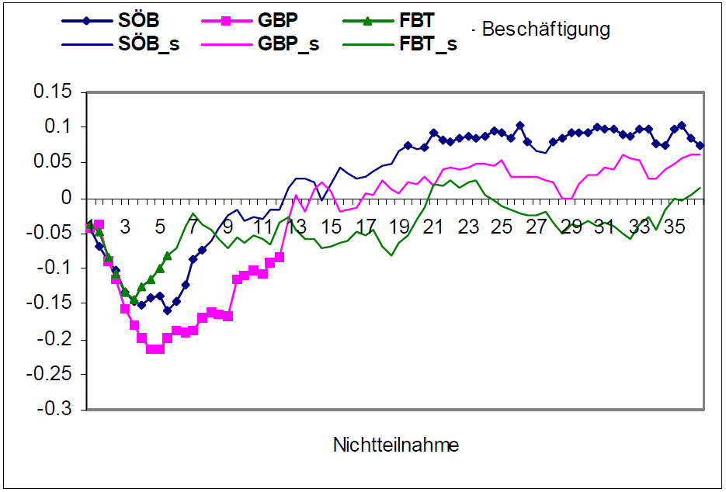
Successful Programme for LTU (SÖB)
Subsidised intermediate labour market for LTU, handi-capped, older and other disadvantaged groups
Work in enterprises (environmental protection, social care, repair, crafts, recycling, services, transport, art, catering, homeservices) produce goods and services close to markets (20% of cost)
66% of wage cost for participants, 100% for key personal (supervisors)
Max duration: 1 year (average 78 days)
Programme selection: PES-
counselor
Wage rate: € 1300 (minimum
Wage = € 1000)
Job+intensive counselling,
Training, socio-pedagogical
support
26.000 part., € 115 mio (0,05%)
Source: Lechner et. al. 2007

Slide 14
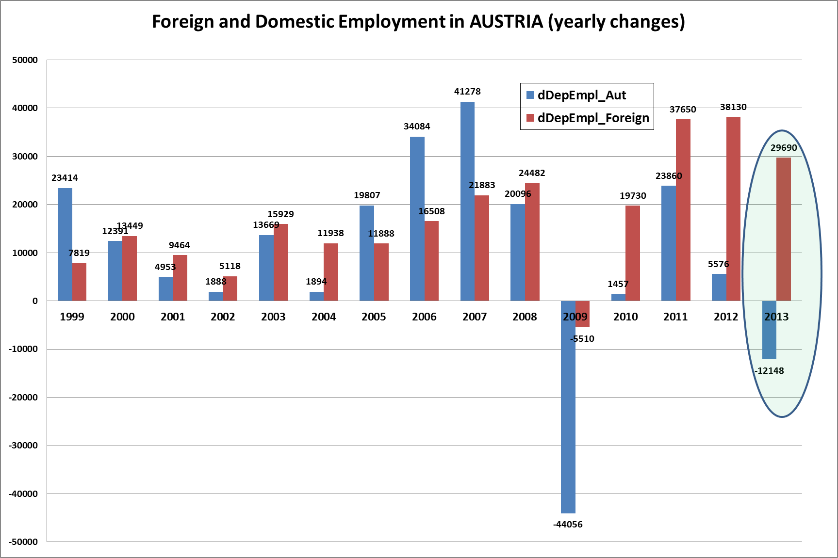
The Role of Migration in the receiving country:
+ Qualified Workers with low reservation wages
+ Substitution effects

Slide 15
Policy Conclusions (1)
Right Balance of Flexibility and Security (AUT: Export-lead growth, hard currency strategy; Social Partnership)
Social Partnership: Difficult compromises
Dual System – Youth (see: „Why is youth unemploy-ment so low in Austria? A critical assessment“, Social-europe 04/3013)
Policy committment

Slide 16
Policy Conclusions (2) „Modern Approach for Fair, Inclusive, Pro-active LMP – Lessons learned from Austrian Experiences“
(Social Europe 11/2012)
Policies matter (not only markets)
Macroeconomic Policies are key for employment
Muddling through – trial an error
Innovation, Protection, Coordination
Rights and Duties of PES clients
Active and passive LMP (Replacemet Rates, Evaluations)
Only natural ressources – skills and comptences (invest!)
Do not aim for a large deregulated low-wage sector (India)
Labour market policies in times of crisis (inject confidence, domestic demand – short time working)

Slide 17
Thanks for Attention!!!
For further work see:
In English
http://www.social-europe.eu/author/johannes-schweighofer/
In German
http://johannes-schweighofer.at/publikationen.htm
http://johannes-schweighofer.at/vortraege.htm

Slide 18
Further Material

Slide 19
Integration in the Labour Market

Slide 23
Active Labour Market Policies

Slide 24
Incentives to take up a Job

Slide 25
Social Partnership –
Short Term Work
2009: Ca. 66.000 effektiv Kurzarbeitende (durchschnittl.
ca. 26.000; ca. 20% Frauen) in 300 Betrieben; 113 Mio. € (=0,05% BIP) , durchschnittl. 24% AZ-Reduktion (13 Mio. Stunden von 5,6 Mrd., 0,25% AZ-Reduktion)
Notes:
Arbeitszeitreduktion um 10-90%
Einkommensentfall – Ausgleich mit ALQ (Einkommensschutz 90% in der Metallindustrie)
Gesicherte Arbeitsplätze: 3700 (Hijzen, Venn 2011) bis 6000 (Mahringer et. al. 2011)

Slide 26
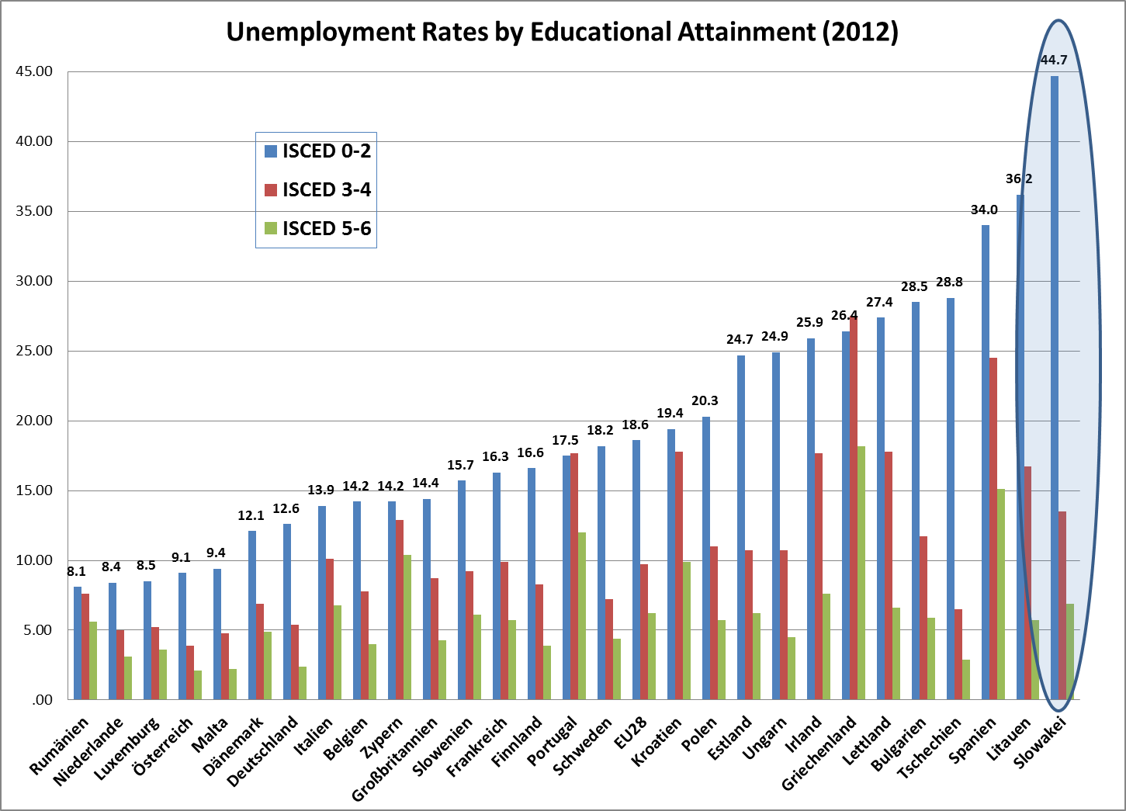
Notes:
Arbeitszeitreduktion um 10-90%
Einkommensentfall – Ausgleich mit ALQ (Einkommensschutz 90% in der Metallindustrie)
Gesicherte Arbeitsplätze: 3700 (Hijzen, Venn 2011) bis 6000 (Mahringer et. al. 2011)

