Slide 1
Hungary and the Euro – Challenges and Perspectives
22 November 2013, Bratislava
Crisis in the Eurozone: Slovak Experiences with the Common Currency
Olivér Kovács
Research Fellow, ICEG European Center, Hungary

Slide 2
Outline
Macroeconomic (in)stability from regional perspective
A more holistic approach is needed
  2.1 The appreciating role of national governance / state
  2.2 Public sector innovation is essential
Conclusion

Slide 3
Macroeconomic (in)stability from regional perspective
- Catching up or getting stuck?

Slide 4
Macroeconomic instability
– Catching up or getting stuck?
Chart 1. GDP per capita, based on PPP, EU15=100
Chart 2. GDP per capita, based on PPP, reference year 2005, EU15=100
Source: Eurostat, National Accounts
Source: Eurostat, National Accounts

Slide 5
Macroeconomic instability
– Unsustainable fiscal governance
The dynamic growth trajectory of 2000-2006 was mainly driven by increasing indebtedness
Chart 3. Gross public debt
(% of GDP)
Source: Eurostat, National Accounts

Slide 6
Macroeconomic instability
– Unsustainable fiscal governance
The dynamic growth trajectory of 2000-2006 was mainly driven by increasing indebtedness, especially in terms of net foreign debt-to-GDP ratio
Chart 4. Net foreign debt
(% of GDP)
Source: Eurostat, National Accounts

Slide 7
Macroeconomic instability
– Unsustainable fiscal governance
Pro-cyclical fiscal policy with the aim at stabilising inexorably on mechanistically derived deficit targets cannot be considered as panacea
Chart 5. Structural Balance
(% of GDP)
Chart 6. Structural Primary Balance
(% of GDP)
Source: EC (2013)
„Eschewing debt could be as harmful as letting debt-to-GDP to rise.”
(Paul de Grauwe, 2013)

Slide 8
Macroeconomic instability
– Unsustainable fiscal governance
Positive correlation between deficit and growth
Chart 7. Relationship between deficit and real GDP growth
Real GDP growth (%)
Deficit/GDP (%)
Source: Eurostat,

Slide 9
Macroeconomic instability
– Destabilising, rather than stabilising
Mainly revenue based fiscal adjustment together with unconventional economic policy resulted in high uncertainties leading to anaemic net investment, depressed internal demand Zero-close potential economic growth
Chart 8. Net investment (% of GDP without amortisation)
National economy
Private sector

Slide 10
Macroeconomic instability
– Destabilising, rather than stabilising
Surplus in current account balance is not a benevolent characteristic, it is mainly due to the depressed internal demand
Chart 9. Current account balance (millions of EUR)
Source: The Central Bank of Hungary

Slide 11
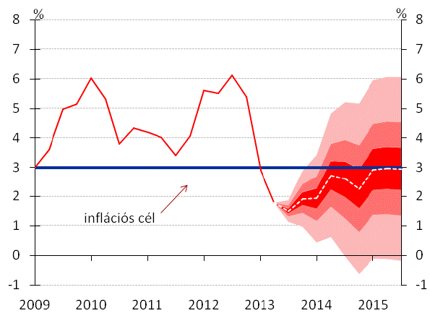
Macroeconomic instability
– Destabilising, rather than stabilising
Inflation target of the Maastricht Treaty seems to be achievable
Chart 10. Inflation trajectory
Inflation target
Source: The Central Bank of Hungary, September 2013

Slide 12
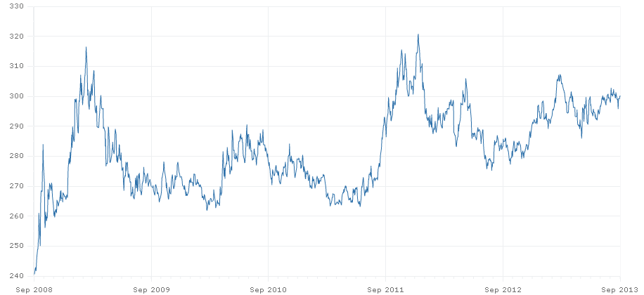
Macroeconomic instability
– Destabilising, rather than stabilising
Exchange rate stability does not seem to be a priority of the government
Chart 11. Hungarian Forint vs. Euro
Source: The Central Bank of Hungary, European Central Bank

Slide 13
Status of criteria for Euro-adoption
 | HICP inflation rate (12-months average of annual rates) | Public finance |  | Long-term interest rate (12-months average of 10yr bond yields) | ERM II member
 |  | Budget deficit (% of GDP) | Gross public debt-to-GDP ratio
Reference rate | max. 2.5% | max. 3% | max. 60%, or approaching the reference rate sufficiently | max. 4.81% | min. 2 years
Hungary | September 2013: 1.3% | 2012: 1.9% | 2013. Q1: 82.4%] | April 2013: 7.23% | No
There is no stipulated target date pursued by the government.

Slide 14
Macroeconomic instability
The Hungarian catching up has been being based mainly on unsustainable fiscal governance coupled with external imbalances
Fiscal consolidations invoked to fend off excessive deficits proved to be futile undertakings if we look at the catching up (lagging behind) process, which was transformed into a „getting stuck” phenomena (zerlo-close potential economic growth);
External imbalance was reversed which is predominantly determined by lowering and lowering real investments;
Pro-cyclical fiscal adjustment (mainly revenue based) is not conducive to economic growth;
There is no stipulated target date for euro adoption pursued by the government;
a more holistic approach would be essential in targeting euro adoption meaningfully
Notes:
GDP 2013. III. negyedévében 1,7%-kal nőtt az előző év azonos időszakához viszonyítva.

Slide 15
II. A more holistic
approach is needed
2.1 The appreciating role of national governance / state

Slide 16
Old and new challenges
Demographic challenges (i.e. ageing population and its side effects);
Climate change;
Changing characteristics of emerging markets (e.g. China);
Relatively weak productivity performance of Europe;
Sui generis sovereign debt crisis

Slide 17
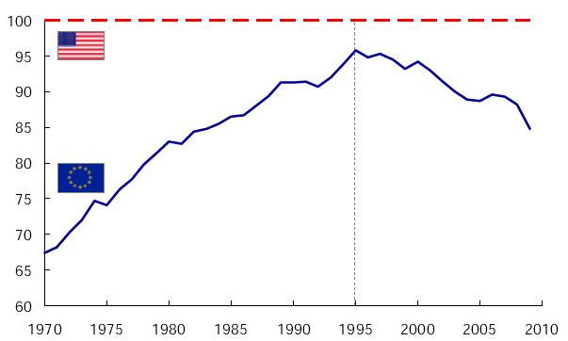
Relatively weak productivity performance of Europe
Source: McKinsey Global Institute (2010).

Slide 18
Old and new challenges
Demographic challenges (i.e. ageing population and its side effects);
Climate change;
Changing characteristics of emerging markets (e.g. China);
Relatively weak productivity performance of Europe;
Sui generis sovereign debt crisis
  „The Great Recession”
  Decade long task of public debt
Fiscal consolidations
that require trust

Slide 19
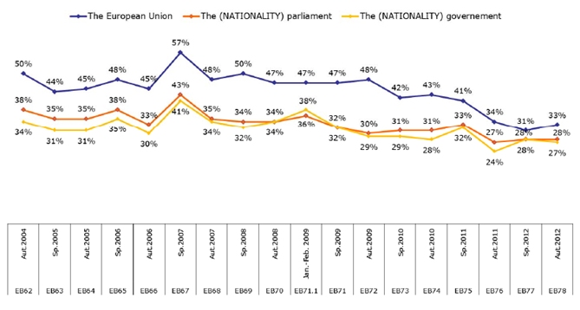
Declining trust base of citizens
Source: Standard Eurobarometer 78, p. 14

Slide 20
Old and new challenges
Demographic challenges (i.e. ageing population and its side effects);
Climate change;
Changing characteristics of emerging markets (e.g. China);
Relatively weak productivity performance of Europe;
Sui generis sovereign debt crisis
  „The Great Recession”
  Decade long task of public debt
Fiscal consolidations
that require trust
more efficient public sector with improved service
quality/accessibility
Good national governance and the innovativeness of
public sector are heavily appreciating

Slide 21
II. A more holistic
approach is needed
2.2 Public sector innovation is a de rigueur aspect towards better conditions for euro-adoption

Slide 22
Public sector innovation (PSI)
A definition of public sector innovation:
Innobarometer 2010 (2010:13) considers public sector innovation as “[...] any novel, or significantly improved (without indicating precisely what a ‘significant improvement’ might be) service, communication or organisational method”.
Types of public sector innovation: (EPSIS Report, 2012)
  Innovations in services;
  Process innovation;
  Organisational innovation;
  Communication innovation;
Benefits from public sector innovation
  More efficient public services with improved quality and accessibility → trust building in time when painful measures are inevitable

Slide 23
Main features of public sector innovation
evolution of innovation: no „invisible hand” – „Ever tried. Ever failed. No matter. Try again. Fail again. Fail better.” (Samuel Beckett)
measuring the outcome: is rather difficult (non-quantifiably outcomes linked to the objective of increasing well-being of the people, lack of standard methodology)
accountability, visibility: risk aversion, failure avoidance – „We are in politics, not in business” (Walter Hallstein)
heterogeneous character: increasing complexity – „Nichts ist aussen, nichts ist innen, denn was aussen ist, ist innen” (Hermann Hesse)
PSI → cumbersome feature
less innovation experience vis-á-vis the private sector

Slide 24
Examples of PSIs
workplace innovation
project-, team-based organisation
boundary-crossing management and careers, awards
putting customers' perspectives and needs into the focus
innovative public finance, PPI, innovative procurement
involvement of all the beneficiary community (e.g. participatory budgeting → increases trust base

Slide 25
3. Conclusion

Slide 26
Conclusion
Hungary is currently far from fulfilling the requirements of euro-adoption;
Monetary and fiscal policy should behave in a symbiotic way;
Fiscal consolidation is needed in a more holistic and strategic way (i.e. not being focused exclusively on mechanistically consolidated deficits to targets judged as optimal ones);
Unfold the potential of public sector innovation;
EZ accession requires all time government to be engaged in cultivating a fertile ground for it via credible plans and actions (e.g. stipulating and announcing a target date);

Slide 27
22 November 2013, Bratislava
Crisis in the Eurozone: Slovak Experiences with the Common Currency
Thank you very much for your attention!
Olivér Kovács
Research Fellow
ICEG European Center
okovacs@icegec.hu

