Slide 1
Financing education and solving information asymmetries in Slovakia
Peter Goliaš
INEKO, 22. May 2013
Bratislava

Slide 2
Contents
Overview of the financing system
  Primary and secondary education
  Tertiary education
Information asymmetry as a key problem
Examples of solving information asymmetries
  Primary and secondary education: INEKO rankings
  Tertiary education: Ministerial portal vs.iedu.sk, ARRA rankings

Slide 3
Primary & Secondary
Centrally financed schools:
  Primary schools, grammar schools, secondary vocational schools, conservatories, schools for kids with special education needs
Regionally financed schools:
  Primary arts schools, language schools, pre-primary schools, school facilities (dormitories, clubs, etc.)
Owners:
  Public (municipalities, state): 90% of kids
  Private: 4% of kids
  Religious: 6% of kids

Slide 4
Financial flows
Taxpayers
State budget
Municipalities
Ministry of Education
District authorities
Private & Religious owners
Central financing
Regional financing
Private & Religious schools
Public schools
Source: Author

Slide 5
Reform from 2003-04
Introduction of „normative“ financing based on number of pupils
Replaced the old system based on historical mostly cost-based and bargaining financing
Goals:
  Increase transparency
  Increase pressure on rationalization of the „schools‘ net“
  Increase efficiency

Slide 6
Normative sources
The biggest piece of cake (at least 94% of all current expenditure)
2012: On average 1680 € per pupil
Non-discrimination of owners = Almost the same rules for public, religious and private schools
Discretionary spending. Exceptions:
  Private & Religious schools cannot spend them on rent and advertisement
  Private schools cannot spend them on capital expenses

Slide 7
Computing normatives 1/2
  Political decision about state budget including the amount and the ratio of personal and operation expenditure
  Normative (computed for every school) = Wage normative (annual personal costs per pupil) + Operation normative (annual operation costs per pupil)
Normative income (computed for every school) = Normative * Number of pupils

Slide 8
Computing normatives 2/2
Wage normative depends on:
  School type, categarization of teachers into wage classes, need of teachers for a specific study plan, study form (internal/external), language of education, school size (only for primary schools)
  The school must get full wage normative
Operation normative depends on:
  School type, costs coeficient, study form (internal/external), language of education, average expenditure on heating over past three years, school size (only for primary schools)
  The school must get at least 80% of its normative

Slide 9
Additional sources
Special agreements: The owner may demand more money from the ministry. In 2012 agreements amounted to 2,14% of normative sources (98% was personal expenditure).
Non-normative sources (up to 6% of overall current expenditure):
  Education coupons for pupils (in 2012 value of 29€, 82% of pupils used them)
  Solving accidents
  Contribution for 5-year old kids in pre-primary schools
  Transport contribution (in 2012 13,5% pupils from primary schools used it)
  Contribution for socialy disadvantaged (14% of kids take it)
  Contribution for teachers‘ assistents for disabled or gifted pupils
  Contribution for teachers leaving for pension
  Contribution for exceptional results, etc.

Slide 10
Tertiary education 1/2
 | 2011 | Main criteria
Education and operation | 59,75% | Number of students and graduates, qualification of teachers, need of teachers for each study plan, publication activity and quotations
Research | 24,37% | Research quality according to acreditation committee (45%), domestic and foreign grants (28%), publication activity and quotation (24,5%)
Social support for students | 12,39% | Historical expenditure, number of students
Development projects | 1,14%
Capital expenditure | 2,35%
Total | 100,00%
Source: Author based on the Ministry of Education

Slide 11
Tertiary education 2/2
The subsidies do not have a specified purpose („block grants“). The only exception is that personal costs cannot exceed 80% of the subsidy used for financing current expenditure.
The state does not finance private universities with the exception of the social scholarships for students.

Slide 12
Key problems
Most schools in Slovakia are financed mainly according to the number of their students combined with some historical cost-based coefficients
This creates pressure to compete by attracting as many students as possible
Normally, quality should be guaranteed by free choice of school (students and their parents should choose the best)
Problems:
  Information asymmetry: Students and parents have little information about the quality of schools. There is a risk of „race-to-the-bottom“: Schools compete by investing in „visible“ things (building, food, furniture, equipment) and under-investing in quality of education (teachers‘ salaries)
  Cost-based coefficients persist: Lower pressure on efficiency

Slide 13
Possible solutions
Including quality indicators into the financing formula. Here are some examples from the tertiary education in Slovakia:
    Qualification of teachers (problematic)
    Publication activity, frequency of quotations (reasonable, but mainly for science, less for education)
    Domestic and foreign grants won in past two years (reasonable)
    Unemployment rate of graduates (reasonable)
Computing efficiency for every school (OECD methodology), developing efficiency-based „normative“ (alternative to cost-based)
Collecting and publishing information indicating quality (school rankings)
Any combination of solutions mentioned above

Slide 14
How to measure quality?
INEKO uses following indicators for primary and secondary schools:
    Results of national standardized exit tests
    Financial rewards for exceptional results
    Unemployment rate of graduates (only for secondary)
    Financial sources per student
    Less relevant: Student-teacher ratio, qualification of teachers, IT equipment, results of state inspections, etc.
Most needed improvements:
    Measuring „value-added“
    Measuring success of graduates when entering higher education (tracking students‘ path among schools)
    Collecting data about graduates‘ salaries (only for secondary)

Slide 15
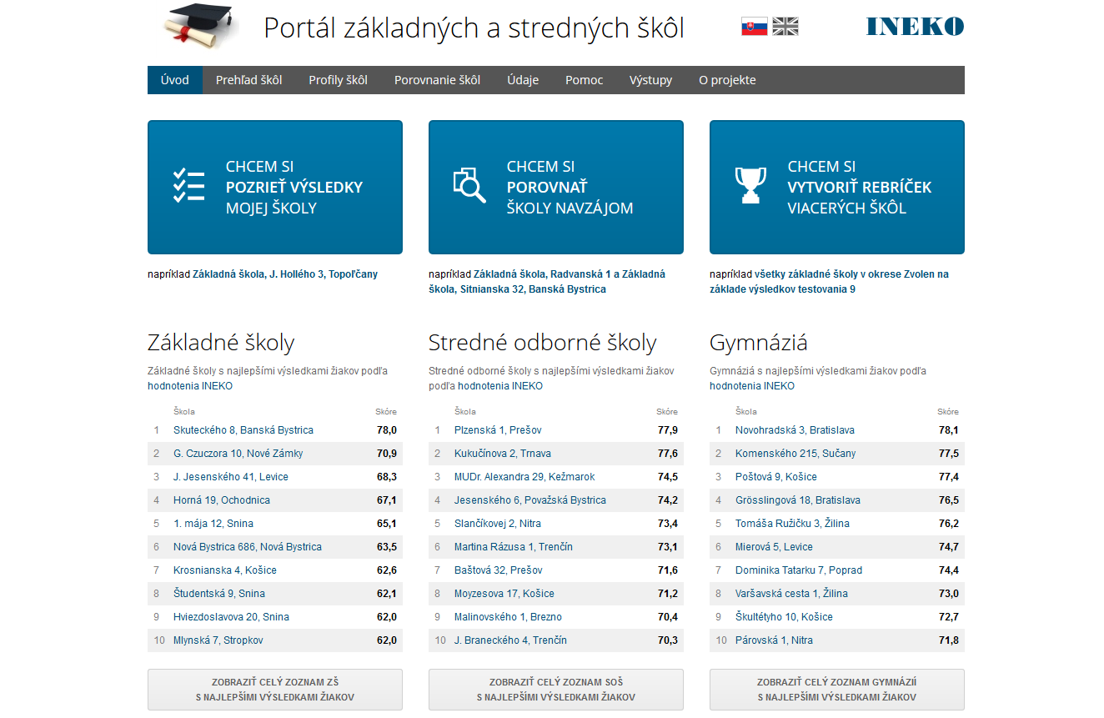
INEKO rankings 1/4
Source: www.skoly.ineko.sk

Slide 16
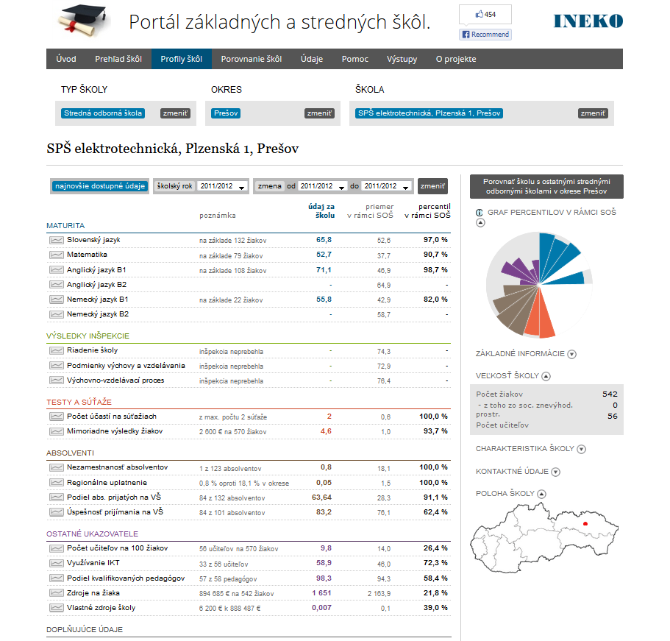
INEKO rankings 2/4
Source: www.skoly.ineko.sk

Slide 17
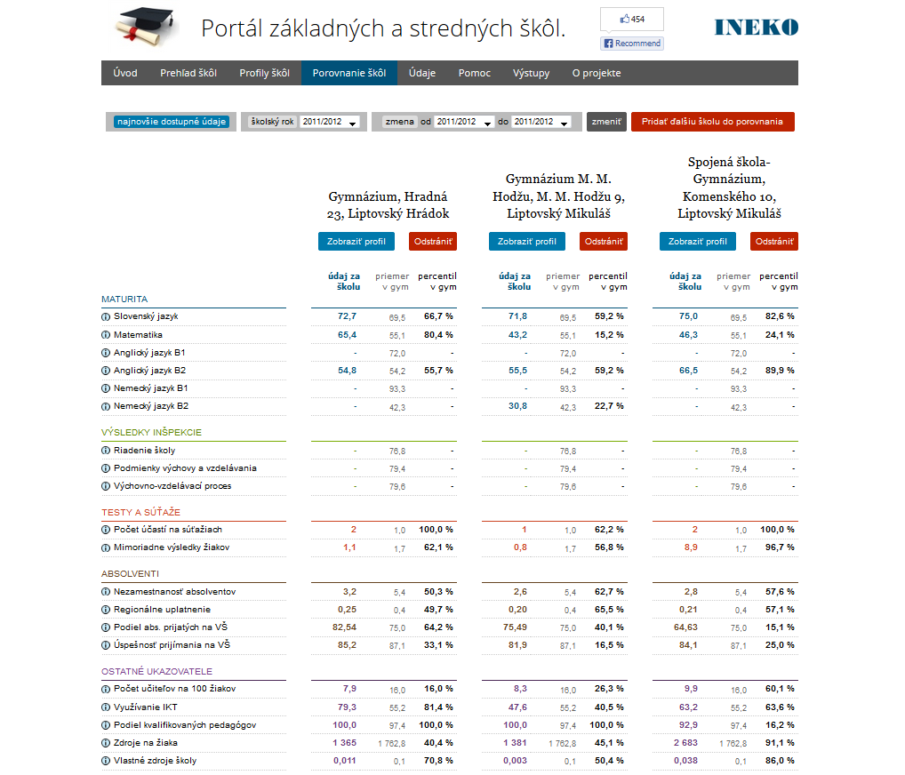
INEKO rankings 3/4
Source: www.skoly.ineko.sk

Slide 18
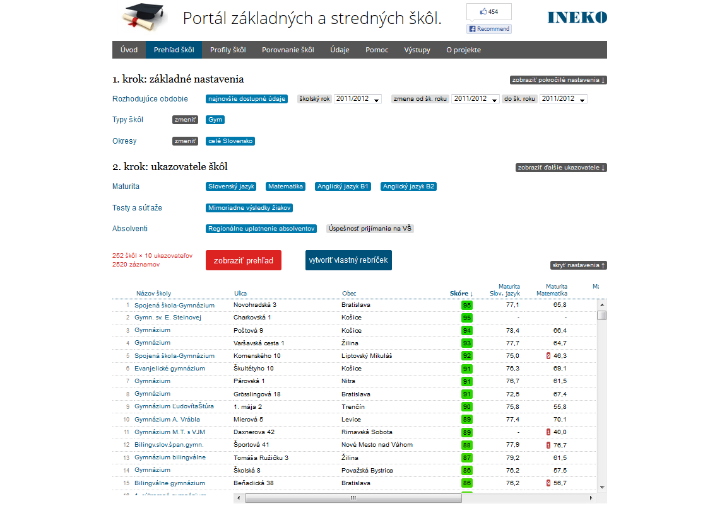
INEKO rankings 4/4
Source: www.skoly.ineko.sk

Slide 19
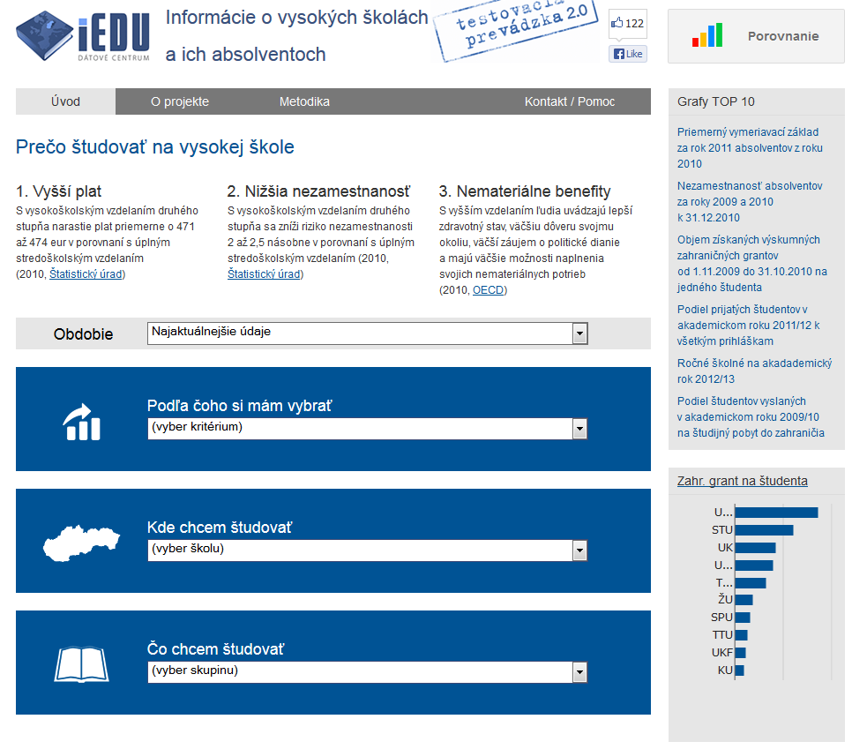
Ministerial „tertiary“ portal 1/3
Source: www.vs.iedu.sk

Slide 20
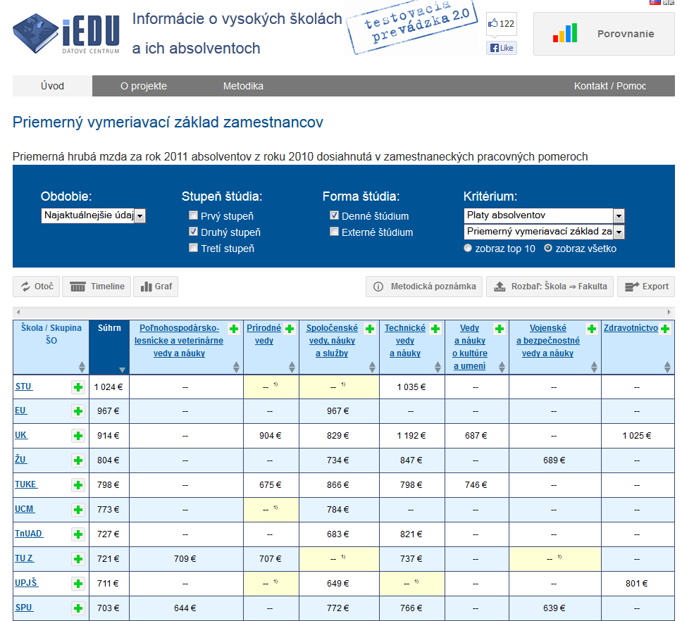
Ministerial „tertiary“ portal 2/3
Source: www.vs.iedu.sk

Slide 21
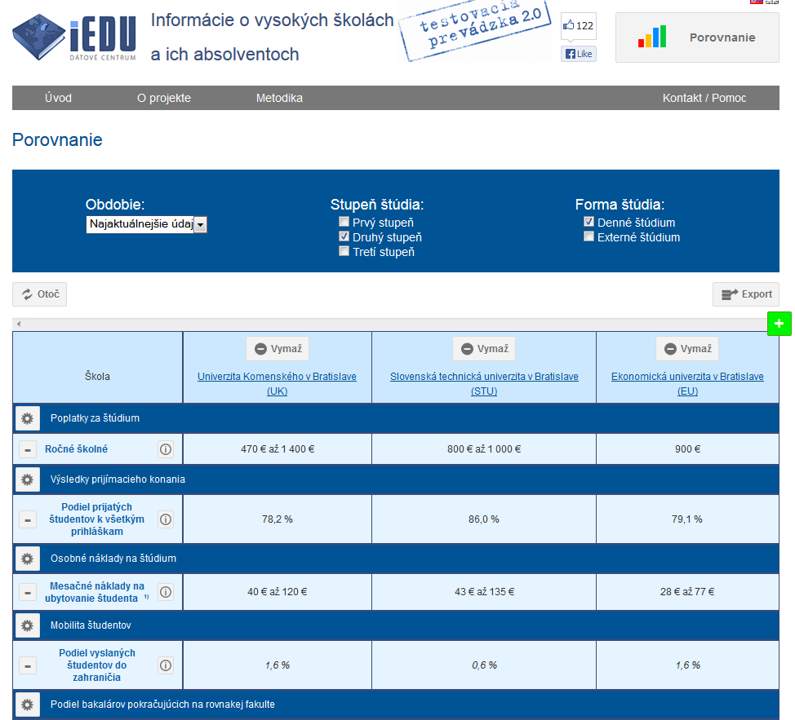
Ministerial „tertiary“ portal 3/3
Source: www.vs.iedu.sk

Slide 22
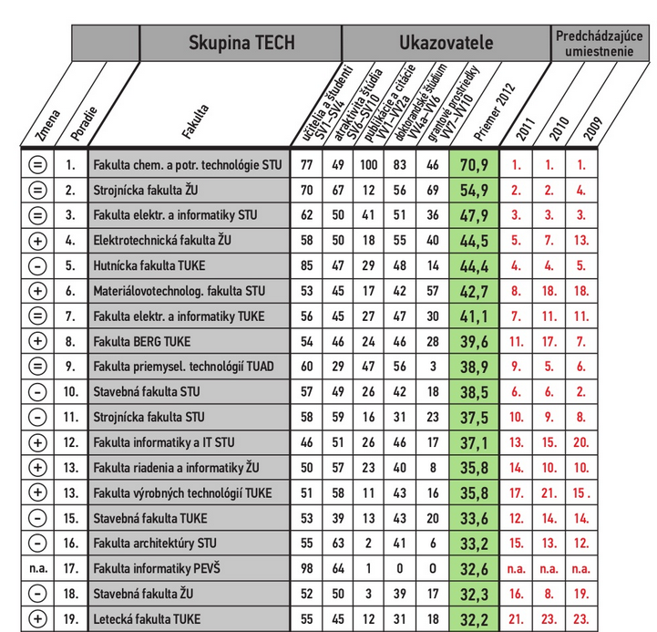
ARRA „tertiary“ rankings
Source: www.arra.sk

Slide 23
Thanks for your attention!

