Slide 1
Structural incentives and their impact on the informal economy
Peter Goliaš
Institute for economic and social reforms (INEKO), Slovakia
November 13, 2012
Chisinau, Moldova

Slide 2
Shadow economy and cycles
Informal economy is often a substitution of the safety net and/or a buffer between unemployment and regular employment
In growing economy:
  People move from unemployment to both regular and informal employment
  There is no clear pattern about moving from informal to formal employment (it probably depends on other factors, e.g. rules, repression, social capital)
In recession:
  Informal employment falls if unemployment rises (informal workers get unemployed)

Slide 3
Rules verzus repression
Informal economy involves mainly low-earners
Bad rules => strong motivation of people with low income to stay informal, for example due to high tax/administrative burden
If you fight shadow economy with repression and you have bad rules, you risk harming the economy (they might get unemployed)
Usually with bad rules there is limited repression:
  Politically it is inconvenient to punish low-earners
  There is room for free-riders (e.g. rich speculants)
Conclusion: Rules (motivation) first, repression second

Slide 4
Key rules (structural incentives)
Tax system:
  Tax burden: Tax wedge, Marginal effective tax rate (METR)
  Tax mix: Labor, capital, consumption, real estate
  Tax administration (capacity, complexity, corruption)
Income-dependent social benefits
Labor market:
  Employment protection (e.g. restrictions on dismissal)
  Active and Passive interventions (Unemployment trap)
  Labor Union power, Minimum wage
Link between contributions (social insurance) and benefits
Bureaucracy, market competition, etc.
Caution: Even good rules may not work if there is low level of social capital and weak institutions

Slide 5
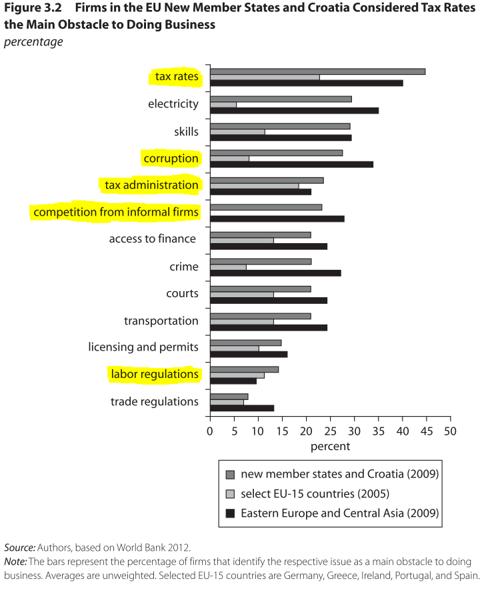
Obstacles to doing business

Slide 6
Tax system – problems
Key problem in Central and Eastern Europe – High taxes on labor (especially at low earnings):
  Mainly due to social insurance contributions
  Firms and workers often face trade-off between compliance and survival
  Leibfritz (2011): Relatively low formal salaries, together with relatively high taxes on labor, may explain why in the new members of the EU undeclared work often takes the form of under-declaration of income through payment of part of registered workers’ wages in cash or through false registration of workers as self-employed.
  Formal employment does not decline, but government revenues are lower

Slide 7
Tax system – problems
Other problems:
  A combination of high taxes on labor and low taxes on capital can induce individuals to transform labor income into capital income to reduce their tax burden.
  Where the effective tax burden is lower for the self-employed than for dependent workers, workers may shift—voluntarily or coerced by employers—from dependent employment to self-employment.
  The tax treatment of families may encourage secondary earners to work informally if additional formal income is taxed at a high marginal rate.
  Ineffective tax administration (complexity, corruption)

Slide 8
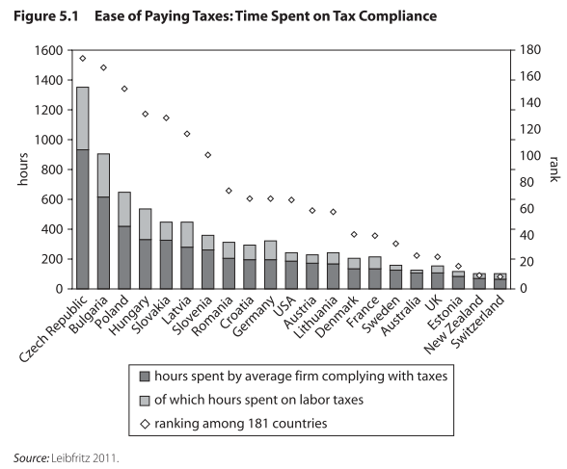
Tax system complexity

Slide 9
WB Doing Business 2013
Paying taxes
 | Moldova | Romania | Slovakia | Germany | USA
Ranking | 109. | 136. | 100. | 72. | 69.
Payments (number per year) | 48 | 41 | 20 | 9 | 11
Time (hours per year) | 220 | 216 | 207 | 207 | 175
Total tax rate (% of proﬁt) | 31.2 | 44.2 | 47.9 | 46.8 | 46.7

Slide 10
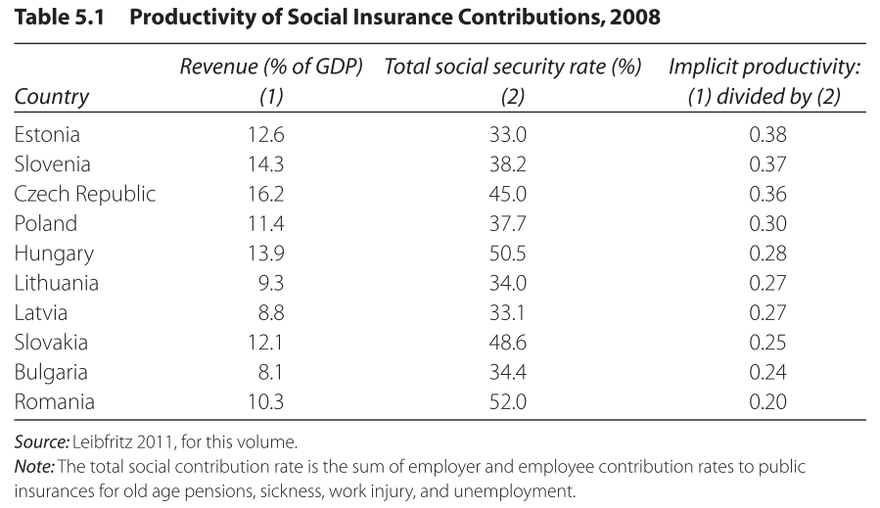
Social insurance ”productivity”

Slide 11
Tax wedge
Definition:
  Difference between labor costs and the take-home pay of workers
  (Social insurance contributions paid by employers and employees + Personal income tax paid by employees) / (Total labor costs)
Depends on family type and wage level
For a single person with no children who receives a gross wage 33 percent of the average wage, only a few EU-15 countries—including Sweden, Germany, Belgium, and Finland—charge higher taxes than most of the EU’s new member states

Slide 12
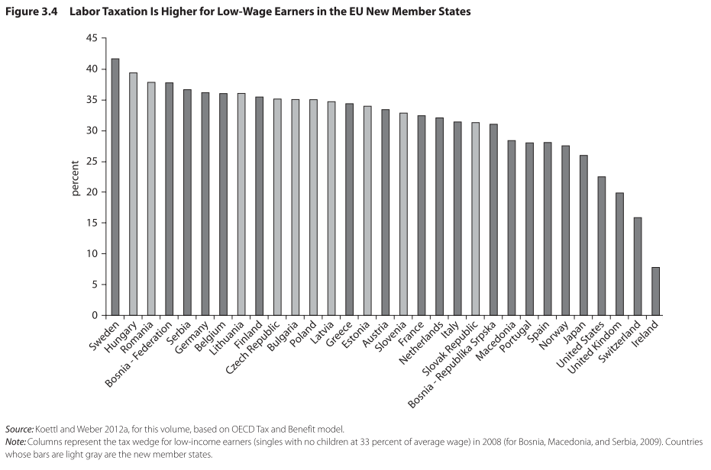
Tax wedge for low-earners

Slide 13
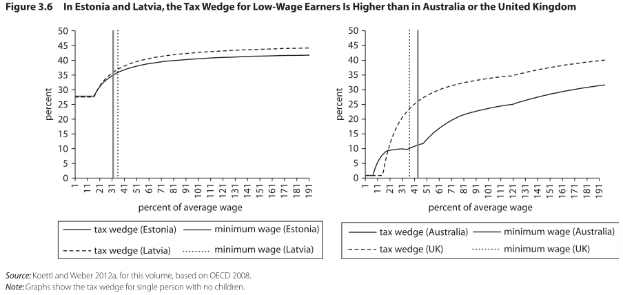
Tax wedge – progressivity

Slide 14
Formalization tax rate (FTR)
For individual, turning from informal to formal employment means:
  Loss of tax wedge
  (At least partial) Loss of income-tested benefits: Social assistance, housing benefits, in-work and family benefits
  Gain of social insurance benefits: Old-age and disability pension, health insurance, unemployment and sickness benefits, employment protection, etc.
Definition of FTR:
  The share of informal income that an informal worker has to give up to formalize
  [Informal income (informal wage + social benefits) - Formal net income (formal net wage + social benefits)] / Informal income

Slide 15
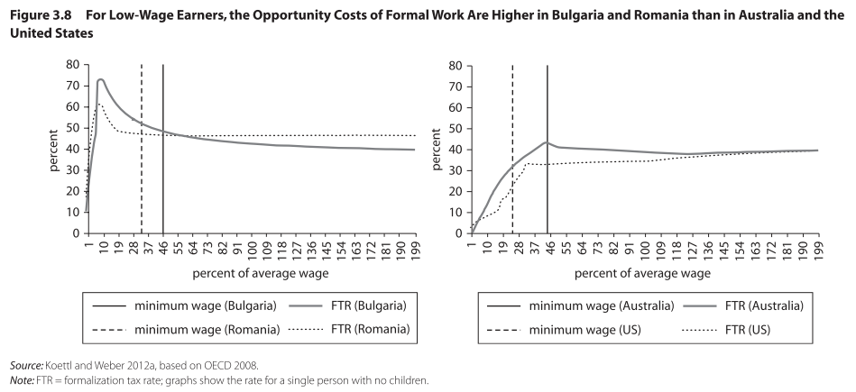
FTR in selected countries
Interpretation: For example, in Bulgaria, single persons with no children who earn less than the minimum wage in the informal sector have to give up from 50% to 70% of their income to formalize.

Slide 16
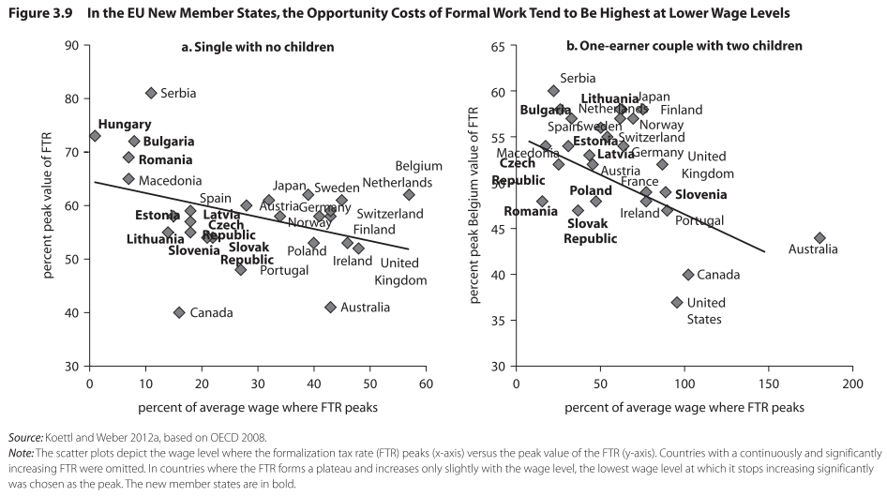
FTR peaks

Slide 17
Marginal effective tax rate (METR)
Definition:
  The METR measures, at a given wage level, how much of an additional euro earned in formal gross wages is taxed away, either as labor tax or in the form of withdrawn benefits.
  It is an indication of how much it pays for workers to earn more gross income, either by increasing work hours or receiving higher wages.
The new EU members tend to have high METRs—usually 100 percent—at low wage levels

Slide 18
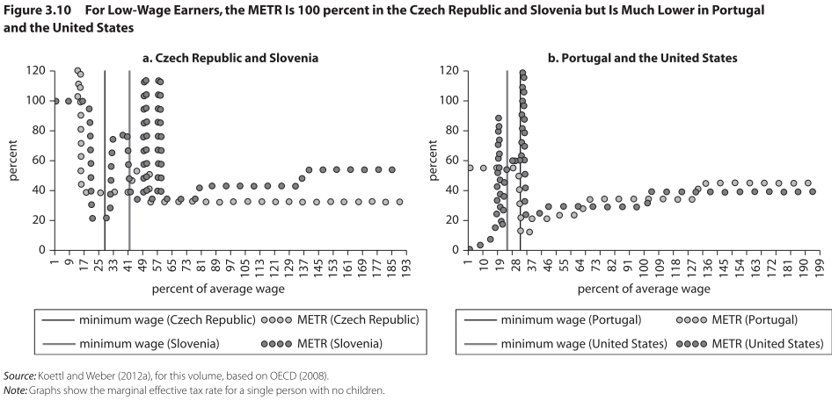
METR in selected countries
Interpretation: In the Czech Republic and Slovenia, every additional euro earned in formal income is 100% taxed away through withdrawal of social assistance at wage levels below 20% of the average wage. In Portugal, it is only 50% and in the US even less.

Slide 19
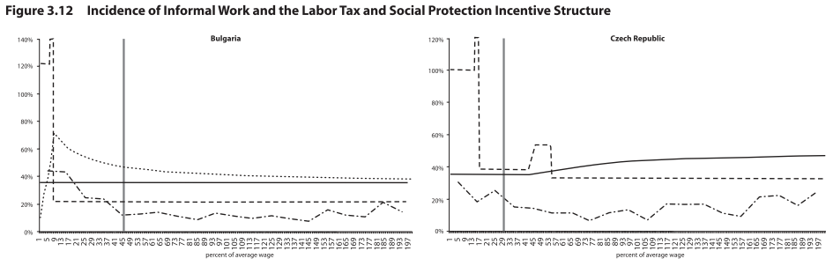

Overall picture 1/3

Slide 20
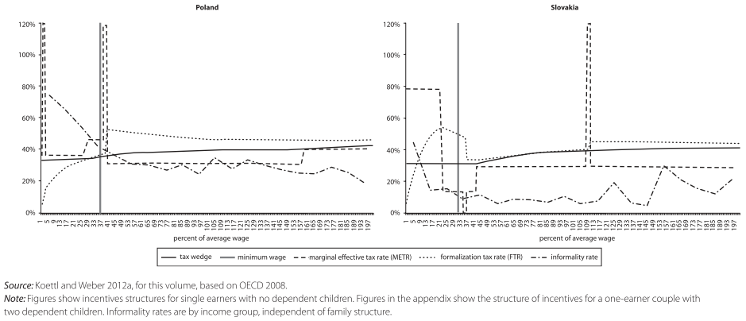
Overall picture 2/3

Slide 21
Overall picture 3/3
Regression analysis on microdata shows that the levels of both the FTR and METR have a strongly significant, positive correlation with the probability that a worker is engaged informally
In other words, greater individual disincentives to formal work (as measured by FTR and METR) correlate strongly with higher probabilities of being informal
The tax wedge yields a negative correlation with informality; the tax wedge is lowest with low-wage earners and increases with income level
Caution: Causality cannot be established using cross-sectional data

Slide 22
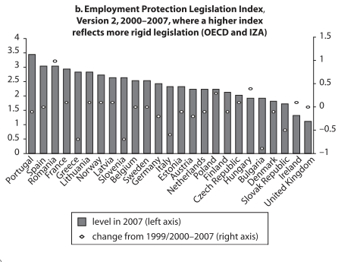
Employment protection

Slide 23
Contribution-benefit link
The effect of strengthening the link depends critically on whether workers perceive the link between contributions today and benefits far in the future to be strong and credible (e.g. it depends on credibility of institutions).

Slide 24
Health insurance
Most important from among social insurance entitlements in regard of their influence on informal economy
People feel immediate threat of falling sick
Easy access to free health insurance decreases motivation to work formally
Entitlements to free health insurance should be:
  Limited to the poor
  Based on a means test, not an income test nor a formal employment status (such as registered unemployment)
States should build a robust means-testing mechanisms (or their proxies, e.g. based on electricity consumption, or frequent contact with a social worker)

Slide 25
World Bank recommendations
Apply tax incentives for low-wage earners
„Smooth“ marginal effective tax rates (e.g. flat tax)
Remove minor taxes (e.g. heritage, gift taxes) and minimize exemptions and loopholes
Shift taxes away from taxing labor earnings to VAT or progressive real estate taxes
Integrate collection and auditing of taxes and social insurance contributions
Automate administrative processes and interactions between the tax authorities and taxpayers (e.g. electronic payments)

Slide 26
World Bank recommendations
Reward formal work; any additional formal wage should increase net income, including benefits; the withdrawal of benefits has to be gradual
Adopt the “flexicurity” approach of protecting people rather than protecting jobs
Tie social insurance benefits closely to contributions (plans with primarily redistributive objective should be shifted to general taxation)
Provide free health insurance only to the poor people, based on a means-testing (alternative is a narrower definition of health coverage package)
Keep low ratio of minimum/average wages

Slide 27
Reform examples 1/5
Slovak flat-tax reform from 2003/04:
  Decrease in direct income taxes (to 19% for individuals and businesses), increase in indirect consumption taxes (19% VAT)
  Radical simplification of tax code (no exemptions, no minor taxes)
  Tax deductible (people with low income do not pay income taxes)
  Tax bonuses for children (parents pay lower taxes or, with too low income, they get money back from the state – negative tax)

Slide 28
Reform examples 2/5
Germany Hartz IV reform (in effect from early 2000s):
  Monthly wages less than €400 are not subject to social insurance contributions
  For monthly incomes between €401 and €800, the contribution rate rises gradually to the full share

Slide 29
Reform examples 3/5
USA: Refundable tax credits (the “earned income credit” and the “making work pay” credit) are available to low-wage earners and their families:
  For a U.S. taxpayer with one child, 34 percent of earned income up to US$9,000 is refundable, which amounts to the equivalent of a cash benefit of about US$3,000
  This refundable credit is phased out at incomes above US$16,000
  Similar benefits are available for other family types and single persons earning low incomes

Slide 30
Reform examples 4/5
Denmark’s renowned “flexicurity” model:
  Shifts protection away from jobs to the people who lose employment
  Low costs of hiring and firing employees
  Intensive deployment of active programs such as retraining and job search assistance

Slide 31
Reform examples 5/5
Chile introduced a mixed system of unemployment insurance in 2001:
  Individual saving accounts are underpinned with a risk-pooling safety net
  Employers and workers are required to pay into accounts, and when workers leave or lose employment, they can draw on a specified portion their accumulated savings
  Should a person’s job search extend longer than five months, they receive a defined minimum unemployment benefit

Slide 32
Sources
In From the Shadow: Integrating Europe’s Informal Labor, Policy Research Working Paper 5923, World Bank, Washington, DC., September 2012
  Background paper: Leibfritz, W. 2011. “Undeclared Economic Activity in Central and Eastern Europe: How Taxes Contribute and How Countries Respond to the Problem.”
The World Bank Doing Business Reports 2010-13
Author’s thoughts and experience

Slide 33
Thank you for attention.

