Slide 1
Barriers to healthy business environment in Moldova
(including best Slovak experience)
Peter Goliaš
Institute for economic and social reforms (INEKO), Slovakia
November 14, 2012
Chisinau, Moldova

Slide 2
Key measures
Overall ranking
 | Economic Freedom Index, 2012 | Corruption Perception Index, 2011 | Doing Business, 2013 | World Competitiveness Report, 2012-13 | Shadow Economy Index, 2000-07
Moldova | 124. | 112. | 83. | 87. | 135.
Romania | 62. | 75. | 72. | 78. | 77.
Slovakia | 51. | 66. | 46. | 71. | 25.
Germany | 26. | 14. | 20. | 6. | 18.
USA | 10. | 24. | 4. | 7. | 2.
Source: | Heritage Foundation | Transparency International | World Bank | World Economic Forum | Schneider, Buehn, Montenegro

Slide 3
Economic Freedom Index, 2012
 | Moldova | Romania | Slovakia | Germany | USA
Overall ranking | 124. | 62. | 51. | 26. | 10.
Business | 67. | 70. | 67. | 15. | 14.
Trade | 81. | 37. | 12. | 12. | 37.
Fiscal freedom | 38. | 34. | 51. | 162. | 133.
Gvt spending | 142. | 112. | 122. | 150. | 127.
Investment | 123. | 14. | 24. | 10. | 36.
Financial freedom | 72. | 72. | 17. | 39. | 17.
Property freedom | 72. | 72. | 53. | 2. | 19.
Corruption | 108. | 70. | 60. | 15. | 22.
Labor | 159. | 85. | 105. | 159. | 1.
Source: Heritage Foundation

Slide 4
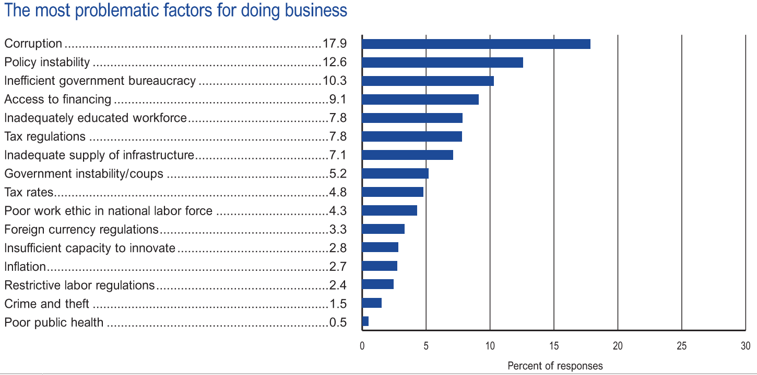
World Economic Forum
World Competitiveness Report 2012-13, results for Moldova:

Slide 5
What is the evidence?
Corruption undermines competitiveness:
Source: GCR, 2008-2011
On the corruption scale 10 stands for highest transparency

Slide 6
Trust to government
 | Moldova | Romania | Slovakia | Germany | USA
Confidence in police | 36% | 55% | 62% | 82% | 79%
Confidence in judicial system | 27% | 24% | 34% | 61% | 48%
Confidence in government | 24% | 12% | 28% | 42% | 35%
City: Quality of healthcare | 43% | 38% | 63% | 91% | 73%
City: Educational system | 54% | 54% | 62% | 66% | 64%
Honesty of elections | 31% | 17% | 50% | 62% | 42%
Corruption in government | 81% | 87% | 78% | 63% | 73%
City: Roads and highways | 17% | 36% | 35% | 77% | 66%
City: Public transportation | 55% | 61% | 59% | 67% | 61%
Source: Gallup WorldView

Slide 7
World Economic Forum
World Competitiveness Report 2012-13, results for Moldova, the least competitive indicators (selected by author):
Indicator | Rank
Quality of roads | 144
Judicial independence | 138
Brain drain | 137
Agricultural policy costs | 134
Extent of market dominance; Effectiveness of anti-monopoly policy | 130
Property rights | 122
Favoritism in decisions of government officials | 121
Prevalence of foreign ownership | 120

Slide 8
WB Doing Business 2013
Starting business
 | Moldova | Romania | Slovakia | Germany | USA
Ranking | 92. | 68. | 83. | 106. | 13.
Procedures (number) | 7 | 6 | 6 | 9 | 6
Time (days) | 9 | 10 | 16 | 15 | 6
Cost (% of income per capita) | 5.7 | 2.8 | 1.8 | 4.9 | 1.4
Minimum capital (% of income per capita) | 8.7 | 0.8 | 21.3 | 0.0 | 0.0

Slide 9
WB Doing Business 2013
Dealing with construction permits
 | Moldova | Romania | Slovakia | Germany | USA
Ranking | 168. | 129. | 46. | 14. | 17.
Procedures (number) | 26 | 15 | 11 | 9 | 15
Time (days) | 291 | 287 | 286 | 97 | 27
Cost (% of income per capita) | 69.3 | 79.1 | 7.3 | 48.1 | 14.4

Slide 10
WB Doing Business 2013
Getting electricity
 | Moldova | Romania | Slovakia | Germany | USA
Ranking | 161. | 168. | 100. | 2. | 19.
Procedures (number) | 7 | 7 | 5 | 3 | 4
Time (days) | 140 | 223 | 158 | 17 | 68
Cost (% of income per capita) | 578 | 584.2 | 249.1 | 48.3 | 16.1

Slide 11
WB Doing Business 2013
Paying taxes
 | Moldova | Romania | Slovakia | Germany | USA
Ranking | 109. | 136. | 100. | 72. | 69.
Payments (number per year) | 48 | 41 | 20 | 9 | 11
Time (hours per year) | 220 | 216 | 207 | 207 | 175
Total tax rate (% of proﬁt) | 31.2 | 44.2 | 47.9 | 46.8 | 46.7

Slide 12
WB Doing Business 2013
Trading across borders
 | Moldova | Romania | Slovakia | Germany | USA
Ranking | 142. | 72. | 98. | 13. | 22.
Documents to export (number) | 7 | 5 | 6 | 4 | 4
Time to export (days) | 32 | 12 | 17 | 7 | 6
Cost to export (US$ per container) | 1,545 | 1,485 | 1,560 | 872 | 1,090
Documents to import (number) | 7 | 6 | 7 | 5 | 5
Time to import (days) | 35 | 13 | 17 | 7 | 5
Cost to import (US$ per container) | 1,870 | 1,495 | 1,540 | 937 | 1,315

Slide 13
WB Doing Business 2013
Resolving insolvency
 | Moldova | Romania | Slovakia | Germany | USA
Ranking | 91. | 102. | 38. | 19. | 16.
Time (years) | 2.8 | 3.3 | 4.0 | 1.2 | 1.5
Cost (% of estate) | 9 | 11 | 18 | 8 | 7
Recovery rate (cents on the dollar) | 32.0 | 29.2 | 53.6 | 78.1 | 81.5

Slide 14
Best Slovak practices 1/3
1998-2002: Privatization of banks, telecom, energy (transparent international tenders)
2000: Freedom on Information Act (focus on public sector contracts, no “trade secret” objection)
2003: Labor market reform
  More flexible Labor Code (entry/exit, fixed-term, part-time)
  Weaker Unions
2003-2004:Flat-tax reform:
  Decrease in direct income taxes (to 19% for individuals and businesses), increase in indirect consumption taxes (19% VAT)
  Radical simplification of tax code (no exemptions, no minor taxes)
  Tax deductible (people with low income do not pay income taxes)
  Tax bonuses for children (parents pay lower taxes or, with too low income, they get money back from the state – negative tax)

Slide 15
Best Slovak practices 2/3
2003: Online business registry (user-friendly, searchable)
2004: Specialized Court and Prosecutor’s Office (focus on big corruption cases)
2004: Social benefits reform:
  Activation benefits for unemployed (part of social benefit is payable only upon providing limited work for public purposes)
2005: Pension reform:
  Linking contributions to pension benefits
2007: Online Land Registry

Slide 16
Best Slovak practices 3/3
2011: Publishing all property contracts and invoices of public institutions on internet
  They will not become valid unless they are published
  Shift from on-demand to automatic transparency
  Creation of searchable portals
2011: Wider use of mandatory electronic auctions when public sector institutions purchase goods
  TIS research: more bids, 6-15% savings
2011: Wider use of competition methods in public procurement
2012: Publishing court rulings on internet, public selection of judges

Slide 17
Thank you for attention.

