Slide 1
Shadow economy in Europe and how to fight against it
(with focus on undeclared work and the best Slovak experience)
Peter Goliaš
Institute for economic and social reforms (INEKO), Slovakia
September 27, Chisinau, Moldova

Slide 2
What is shadow economy?
Also „grey market“, „informal economy“
Naturally legal activities hidden deliberately from public authorities (ATKearney, Schneider)
The part of an economy involving goods and services which are paid for in cash, and not declared for tax (BusinessDictionary.com)
Around 2/3 of „shadow“ income is spent in official economy (ATKearney, Schneider)

Slide 3
What is shadow economy?
Structure (ATKearney, Schneider):
  Around 1/3: Underreporting of profits – undeclared transactions in Business-to-Business (B2B) and Business-to-Consumer (B2C) relations
  Around 2/3: Undeclared work – workers paid „under the table“
Problems with measuring:
  Direct methods (statistical surveys)
  Indirect methods (national accounts vs electricity consumption, cash transactions, etc.)

Slide 4
Four key causes
High tax burden
Lack of „guilty conscience“
  Shadow economy is considered to be normal usually if there is low quality of state institutions and benefits
High spread of cash payments
Low risk of detection
  Depends on effectiveness of control and penalties
Source: The Shadow Economy in Europe, 2010, ATKearney, Friedrich Schneider from the Johannes Kepler University, Linz, Austria

Slide 5
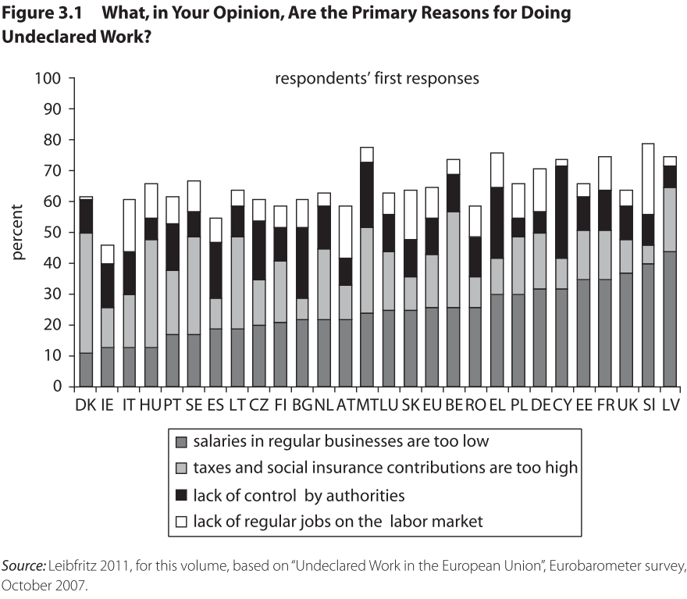
Survey on causes
Source: In From the Shadow: Integrating Europe’s Informal Labor, The World Bank report on shadow economy in the Central and Eastern Europe, September 2012

Slide 6
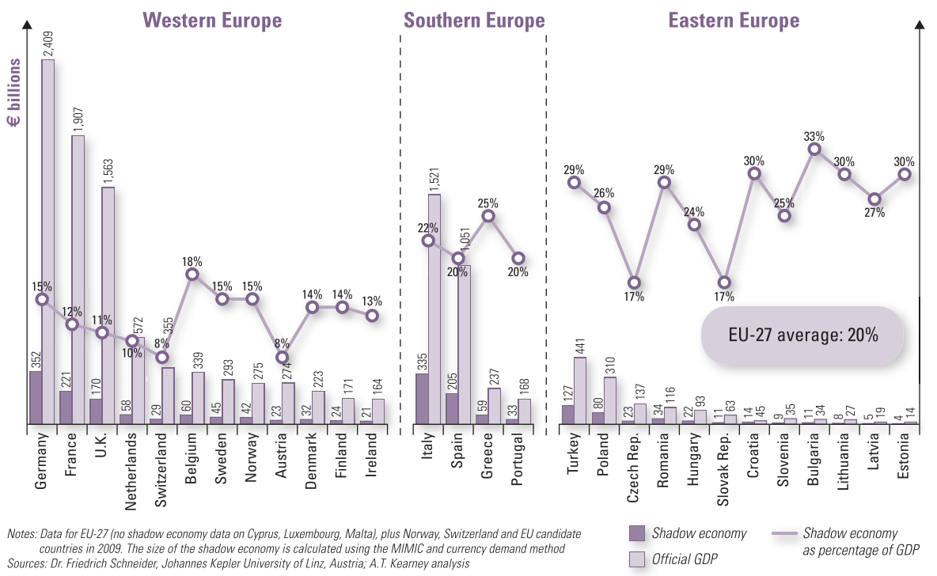
Shadow economy in Europe
Source: The Shadow Economy in Europe, 2010, ATKearney, Friedrich Schneider from the Johannes Kepler University, Linz, Austria

Slide 7
Shadow economy in Moldova
44.3% of GDP in 2006
135th position from among 165 countries
Only Ukraine (46.8%) and Georgia (62.1%) have higher rates from among transition countries
Source: Schneider, F., A. Buehn, and C. Montenegro. 2010. “Shadow Economies All over the World: New Estimates for 162 Countries from 1999 to 2007.”

Slide 8
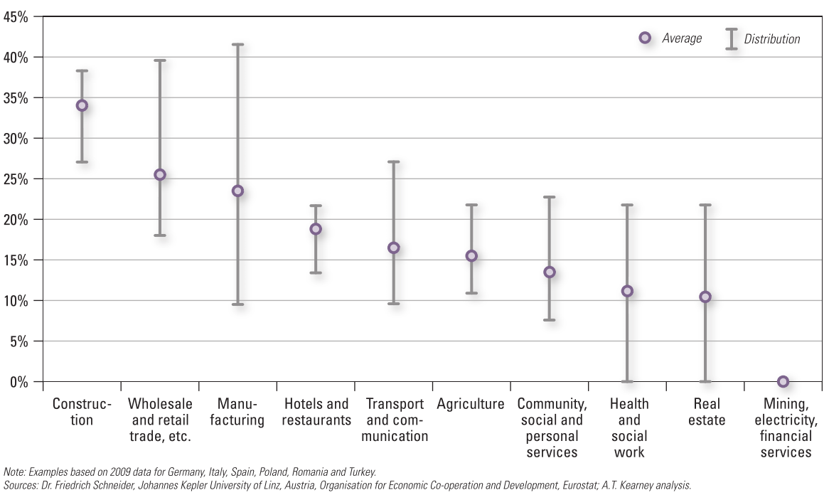
Shadow economy in sectors
Source: The Shadow Economy in Europe, 2010, ATKearney, Friedrich Schneider from the Johannes Kepler University, Linz, Austria

Slide 9
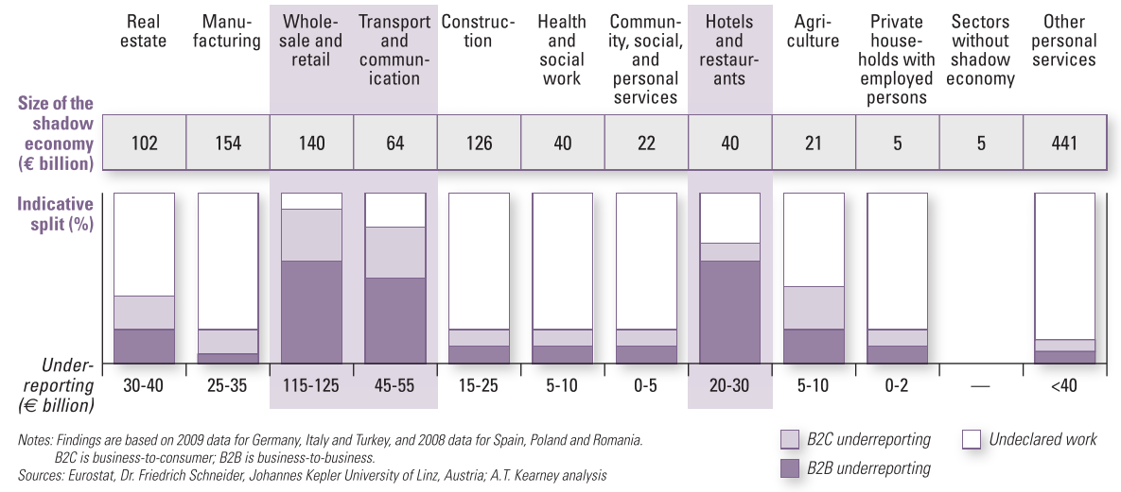
Structure of shadow economy
Source: The Shadow Economy in Europe, 2010, ATKearney, Friedrich Schneider from the Johannes Kepler University, Linz, Austria

Slide 10
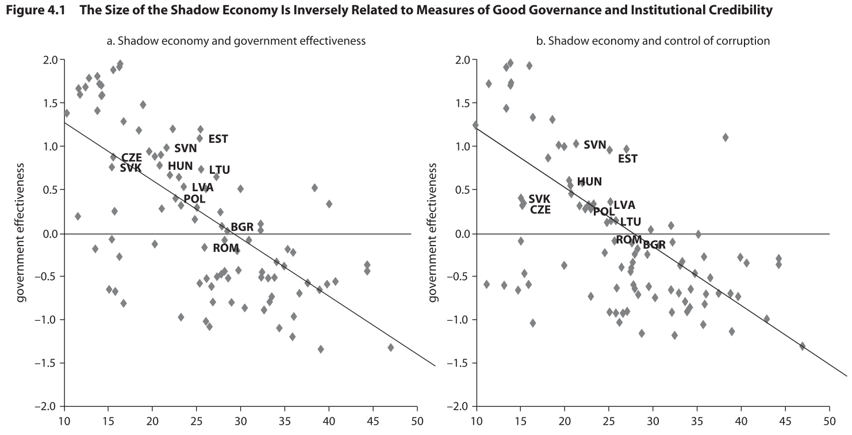
Correlation with good government
Source: In From the Shadow: Integrating Europe’s Informal Labor, The World Bank report on shadow economy in the Central and Eastern Europe, September 2012

Slide 11
Trust to government
 | Moldova | Romania | Slovakia | Germany | USA
Confidence in police | 36% | 55% | 62% | 82% | 79%
Confidence in judicial system | 27% | 24% | 34% | 61% | 48%
Confidence in government | 24% | 12% | 28% | 42% | 35%
City: Quality of healthcare | 43% | 38% | 63% | 91% | 73%
City: Educational system | 54% | 54% | 62% | 66% | 64%
Honesty of elections | 31% | 17% | 50% | 62% | 42%
Corruption in government | 81% | 87% | 78% | 63% | 73%
City: Roads and highways | 17% | 36% | 35% | 77% | 66%
City: Public transportation | 55% | 61% | 59% | 67% | 61%
Source: Gallup WorldView

Slide 12
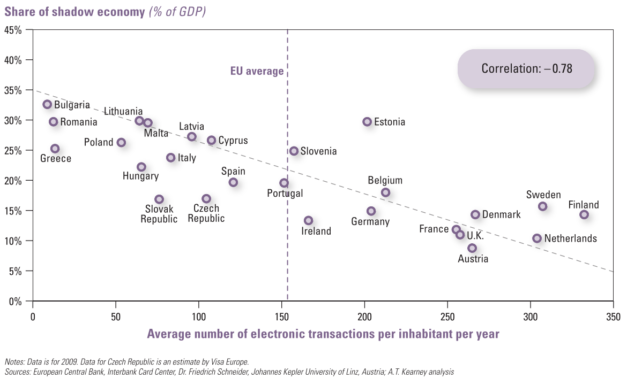
Correlation with electronic payments
Source: The Shadow Economy in Europe, 2010, ATKearney, Friedrich Schneider from the Johannes Kepler University, Linz, Austria

Slide 13
World Bank warnings
The shadow economy most often involves low-paying and casual part-time jobs.
Negative consequences:
  At the household level workers and families are unable to properly manage their income risks because they have no formal access to social security.
  Businesses that operate outside regulation lack access to credit and to protection of property rights while formal companies are overburdened due to tax revenue losses and unfair competition from informal firms.
  At the societal level, a large informal sector erodes the financing of public goods and services, thereby inhibiting the government’s capacity to provide proper education and health care services and a well-functioning infrastructure.
Source: In From the Shadow: Integrating Europe’s Informal Labor, The World Bank report on shadow economy in the Central and Eastern Europe, September 2012

Slide 14
World Bank warnings
The governments in Eastern Europe cannot afford a large shadow economy, neither in the short run due to fiscal concerns, nor in the long run due to the shrinking labour force (aging).
Shadow economy in Eastern Europe is so widespread that it risks undermining the region's long-term growth potential.
The ongoing financial crisis has created a "renewed sense of urgency" to end the practice of untaxed and unregulated work.
Source: In From the Shadow: Integrating Europe’s Informal Labor, The World Bank report on shadow economy in the Central and Eastern Europe, September 2012

Slide 15
World Bank recommendations
It is not all about enforcing laws and punishing offenders, but also about making the formal sector more attractive and changing social norms for paying taxes.
Building trust in government is a key factor in convincing citizens paying taxes is useful:
  A good starting point is building good and trustworthy relationships between tax officials and taxpayers
  Improved and sustainable high levels of tax morale can only be achieved through a successful liaison of three factors: corruption control, the quality of institutions, and the degree of citizens’ participation
Source: In From the Shadow: Integrating Europe’s Informal Labor, The World Bank report on shadow economy in the Central and Eastern Europe, September 2012

Slide 16
World Bank recommendations
States should apply friendlier tax system coupled with a viable social and employment protection schemes:
  Tax incentives for low-wage earners
  „Smooth“ marginal effective tax rates (e.g. flat tax)
  Remove minor taxes (e.g. heritage, gift taxes) and minimize exemptions and loopholes
  Shift taxes away from taxing labor earnings to VAT or progressive real estate taxes
  Design smart safety nets that reward formal work; any additional formal wage should increase net income, including benefits; the withdrawal of benefits has to be gradual
  Balance the protection afforded to workers and consumers and the flexibility afforded to employers
  Keep low ratio of minimum/average wages
Source: In From the Shadow: Integrating Europe’s Informal Labor, The World Bank report on shadow economy in the Central and Eastern Europe, September 2012

Slide 17
Most common measures
Negative enforcement:
  Controls (e.g. onsite visits, tax audits)
  Penalties (monetary, loss of state subsidies, up to forced closing of business)
  New regulations (e.g. identification cards for construction workers, forced use of electronic payments, limits on cash transactions)
  Setbacks: Negative measures are unpopular and might reduce economic activity
Source: The Shadow Economy in Europe, 2010, ATKearney, Friedrich Schneider from the Johannes Kepler University, Linz, Austria

Slide 18
Most common measures
Positive indirect enforcement proved to be most powerful:
  Simplifying the tax and social benefit systems (includes reduction in tax burden and red tape for low-earners)
Positive direct enforcement:
  Vouchers or reduced VAT for household services
  Marketing campaigns (might be less effective)
  Incentives for electronic payment systems
Source: The Shadow Economy in Europe, 2010, ATKearney, Friedrich Schneider from the Johannes Kepler University, Linz, Austria

Slide 19
Some examples
Germany: Monthly wages less than €400 are not subject to social insurance contributions. For monthly incomes between €401 and €800, the contribution rate rises gradually to the full share.
USA: Refundable tax credits (the “earned income credit” and the “making work pay” credit) are available to low-wage earners and their families.
Denmark’s renowned “flexicurity” model shifts protection away from jobs to the people who lose employment through intensive deployment of active programs such as retraining and job search assistance.

Slide 20
Best Slovak experience
Compulsory cash machines with fiscal memory
Privatization of banks in 1998 – 2002
Flat-tax reform from 2003/04:
  Decrease in direct income taxes (to 19% for individuals and businesses), increase in indirect consumption taxes (19% VAT)
  Radical simplification of tax code (no exemptions, no minor taxes)
  Tax deductible (people with low income do not pay income taxes)
  Tax bonuses for children (parents pay lower taxes or, with too low income, they get money back from the state – negative tax)

Slide 21
Best Slovak experience
Pension reform 2005:
  Linking contributions to pension benefits
Activation benefits for unemployed (part of social benefit is payable only upon providing limited work for public purposes)
Flexible employment: Labour Code, working „agreements“ (limited time, flexible entry/exit, no social security), agency work
Current proposal: Ban for cash transactions over 5000 EUR

Slide 22
My questions regarding Moldova
What is the tax wedge for low-earners?
How complicated is the tax system?
What is the minimum/average wage ratio?
What are the costs of dismissing employees?
What forms of flexible contracts do you have?
How do social benefits influence motivation to work (what are METRs incl. social benefits?)
Can you „cheat“ the cash machines?
How spread is bribing in tax collection/audit?
Are regions involved in income tax collection?
What is the spread of electronic payments?

Slide 23
My „draft“ recommendations
Reduce tax burden for low-earners, simplify your tax code (no special rates, no exemptions, etc.)
Introduce/improve flexible forms of employment
Align social benefits with working income to preserve motivation to work
Build social capital, trust to politicians and government institutions (increase transparency in public spending, fight corruption, improve quality of institutions)
Use more electronic payments/official registration of transactions
Decentralize part of income tax collection to municipalities

Slide 24
Thanks for your attention!

