Slide 1

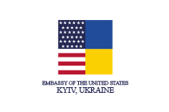
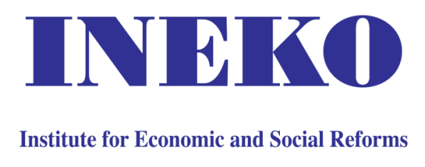
Corporate Governance of State-Owned Enterprises – Key Principles
Peter Golias
INEKO Director, Slovakia
September, 2021
Video Conference: Transparency and financial health of state-owned enterprises in Ukraine

Slide 2
About project
Title: Strengthening democratic resilience of key public institutions in Ukraine
Duration: July 1, 2020 – September 30, 2021
Implemented by: INEKO in partnership with ICPS
Funded by:
  The U.S. Embassy in Ukraine
  The Official Development Assistance of the Slovak Republic (SlovakAid)
Follow-up on previous projects running since October 2015

Slide 3
Why we do this
Project goal: To support democracy in Ukraine by transferring the Slovak know-how in following areas:
  Evaluation of independence of 17 regulatory and judiciary institutions;
  Evaluation of transparency and financial health of 50 biggest public enterprises;
  Evaluation of transparency and financial health of at least 50 biggest cities and 22 regions.

Slide 4
Key outputs and results
June 2021: Report and internet portal on independence of key public institutions in Ukraine: http://institutions.icps.com.ua/
Regular update of transparency and financial health ratings of:
  Public enterprises: http://companies.icps.com.ua/
  Local governments (cities and regions): http://local-governments.icps.com.ua/
Transparency rating | 2017 | 2018 | 2019 | 2021
Biggest cities (52) | 43 % | 51 % | 72 % | 70 %
Regions (24) | 45 % | - | 63 % | 63 %
Public enterprises (50) | - | - | 32 % | 49 %

Slide 5
Corporate Governance
Why to care about SOEs:
  Risk of inefficiency, low quality products, corruption and state capture
  Risk of low revenues from dividends and high subsidies
Current situation in Slovakia:
  SOEs include major firms in energy, transport, construction, healthcare, water supply, post service, lottery, waste disposal, land use, etc.
  Autonomous (non-coordinated) governance, lack of transparency and social/financial responsibility
  Ministry of Finance plans to implement
  Corporate Governance principles

Slide 6
Example of bad practice from Slovakia
In 2020-21 the Ministry of Transport selected 11 members of the Boards of Directors in 4 major SOEs (highway construction, personal and cargo railway transport, and Bratislava airport)
Only 14 candidates met basic criteria
Almost zero competition
Often no CVs, generally low transparency
Comment from local media: „Eligible candidates appear to be either unaware of the interviews or are convinced that the winners have been decided in advance.“

Slide 7
Example of good practice from Slovakia
In 2020-21 the Ministry of Finance selected 8 members of the Boards of Directors in 2 major SOEs (electricity transit, Slovak guarantee and development bank)
52 candidates met basic criteria (from total pool of 118)
Expert committees helped to assess top candidates
The Minister presented the winners in a press conference: "I wanted to make sure I really picked the best ones… No political nominations, we selected quality managers."

Slide 8
Example of the best practice from Slovakia
In 2019 the City of Bratislava selected 4 Chairpersons of the Boards of Directors in 4 major enterprises owned by municipality (transport, waste disposal, water supplies, municipal forests)
74 candidates met basic criteria (from total pool of 104)
16 candidates participated in public hearings
Expert committees helped to assess top candidates
All CVs and final evaluations were published
The City adopted methodology for selecting top managers
and has used it as a standard in all subsequent tenders

Slide 9
OECD Principles 1/3
Higher transparency:
  Transparent compensation for activities performed in the public interest, their separation from commercial activities
  Informing about any support (subsidies/transfers/guarantees) from the state
  Transparent remmuneration of managers
  Regular evaluation and awards
  Open selection procedures for top positions, involving independent experts in selecting top managers of big and important SOEs

Slide 10
OECD Principles 2/3
Protection from political interference:
  Autonomous operation of SOEs, clear separation from regulation and economic policy
  Avoiding nomination of people from the government as top managers
  Avoiding nomination of high-ranked people from the government in SOEs structures (supervisory boards, boards of directors, etc.)
  SOEs structures (supervisory boards) should have the right to elect/dismiss the CEO and other top managers without any political interference

Slide 11
OECD Principles 3/3
Central/coordinated monitoring on objectives, indicators (financial and non-financial KPIs) and their fullfilment for every SOE
  Publishing annual summary reports by ownership entities
Adopting Codes of Ethics, including rules for protecting the whistleblowers
Ban on funding the political campaigns and activities
High-quality independent external audits of financial statements

Slide 12
Next steps in Slovakia
The Government will approve the OECD Principles
The MoF will:
  Publish list of SOEs with basic information (legal form, ownership structure, economic activity, etc.)
  Publish datasets with key financial indicators, dividends, subsidies
  Collect data on objectives, indicators and their fulfilment
  Start due diligence in selected companies
  Monitor compliance with the Principles

Slide 13
Thank you for your attention! https://www.ineko.sk/projekty/strengthening-democratic-resilience-of-key-public-institutions-in-ukraine https://www.oecd.org/corporate/guidelines-corporate-governance-soes.htm http://companies.icps.com.ua/

