Slide 1

Independence of Key Public Institutions in Slovakia
Alzbeta Tibenska, INEKO
June 29, 2021
On-line conference,
Ukraine
Notes:
Hi everyone,
My name is Alzbeta Tibenska, I am an analyst at the Institute for economic and social reforms – INEKO
In today’s presentation I will talk about a project we have been working here on in INEKO for the past couple of years, which has also been adopted by ICPS (International Centre for Policy Studies), as well as by the Institute for Development and Social Initiatives (IDIS) in Moldova.
The project is called Independence of public institutions and its’ goal is to improve political independence of judiciary, control, regulatory and watchdog institutions in Slovakia.

Slide 2
Independence of Key Public Institutions
Helping increase independence of key judiciary, control, regulatory and watchdog institutions
Why independence?
  Higher quality of life
  Protected democratic principles
  Increased long-term stability of countries
Notes:
Why is independence important
Institutions impact quality of life, how citizens’ rights are protected and how well they are served by the government.
Institutions such as the Constitutional Court, Office for Public Procurement, (Police) Inspection Service and many other big and small institutions are the main vehicles for the exercise of executive or judiciary power in the country which should be independent from political interference
So these Independent institutions help protect democratic principles
And increase long - term stability of countries.

Slide 3
Negative effects of political interference
Corruption
Unofficial transfer of power to politicians
Nepotism
Loss of citizens’ trust in government
Market failure (if control and regulatory institutions fail)
Lower level of democracy overall
Notes:
If institutions are not guarded from political interference, many problems may arise, such as
Corruption
Unofficial transfer of power to politicians or other interested parties as well as
Nepotism
Which leads to
Loss of citizens’ trust in government, also often in country’s judiciary system,
Market failure especially if control and regulatory institutions fail, and an overall
Lower level of democracy

Slide 4
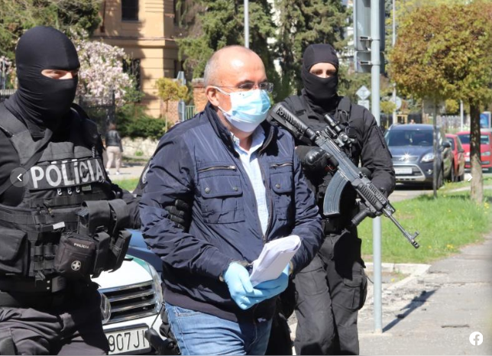
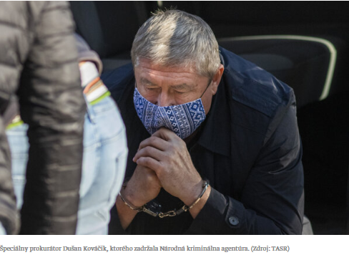
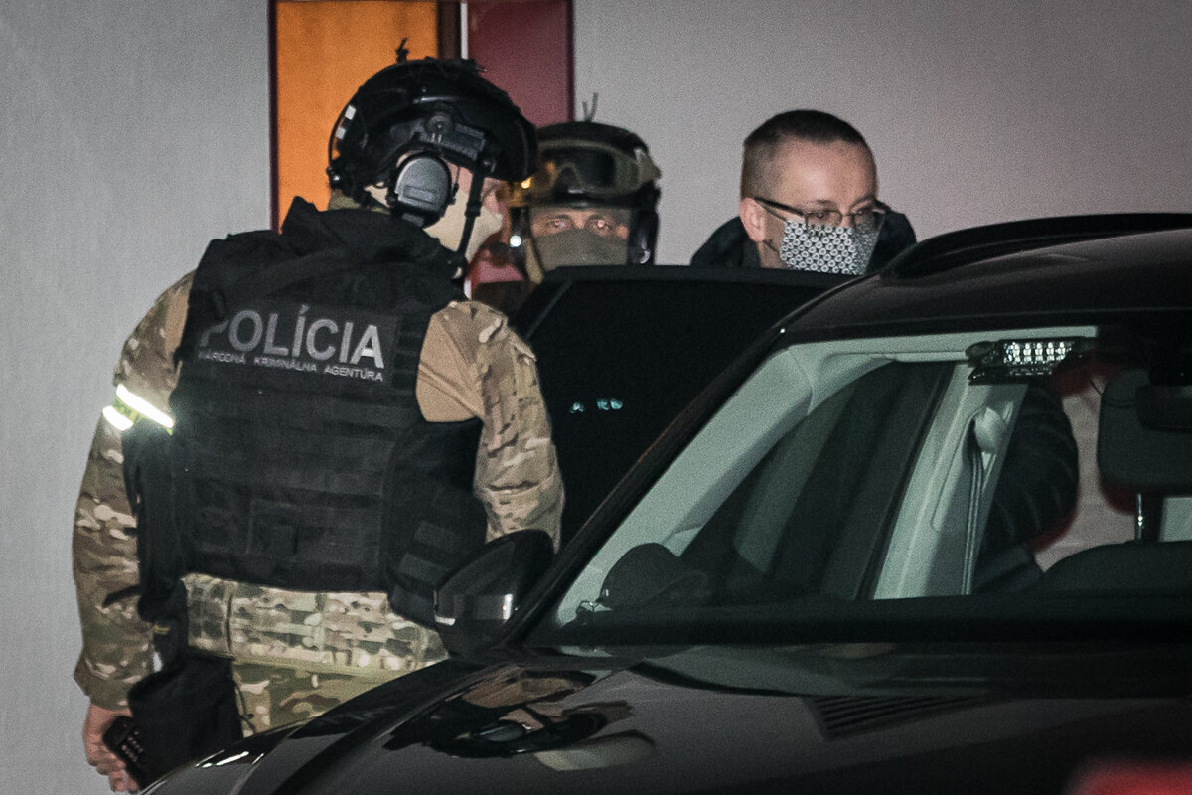
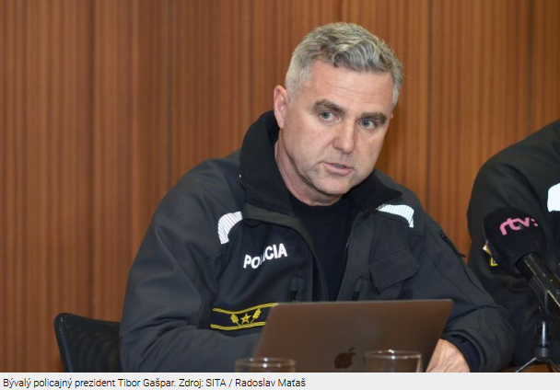
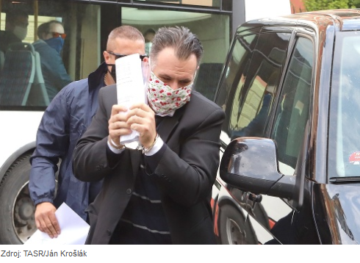
Ex-director of Slovak Information service Vladimír Pčolinský is currently under investigation on criminal charges including corruption
Ex - special prosecutor Dusan Kovacik being arrested by the police on several criminal charges including corruption
Source: Plus 7 Dni
Ex-director of Administration of State Material Reserves Kajetan Kicura is currently under arrest for crimes of corruption
Ex-Police president Tibor Gaspar is currently under arrest on several criminal charges including corruption
Ex-director of Agricultural Paying Agency Juraj Kozuch is currently under arrest for crimes of corruption
Notes:
During 2020 and 2021 multiple arrests of directors of some of the most important institutions were made in Slovakia. All were based on charges of corruption which they carried out during their time in office.
Investigation in these cases uncovered a serious and systematic misuse of power in institutions, manifesting lack of independence and safeguards to prevent it.
Here are some of the most notable cases – the involve institutions such as Police, Slovak Information Service, as well as Special Prosecutor’s Office, all of which we evaluate in our project.

Slide 5





Methodology
Appointment and position of the governing body
What authorities appoint representatives, how many times can one person hold the office, how
many people share the power within the institution
I.
Dismissal of appointees
Under what circumstances can representatives be dismissed
II.
Sovereignty of institutionS
How independent institutions are from the government, how are they being financed
III.
Remuneration of appointees and employees
How fair is financial compensation
IV.
Selection procedure of the main representative
How transparent, competitive and expertise-oriented is the selection process
V.
Notes:
Methodology
Similarly to the Ukrainian methodology, we evaluate five main areas.
Firstly, the Appointment and position of the governing body – where we look at what authorities appoint representatives, how many times can one person hold the office, how many people share the power within the institution, etc.
Secondly, we focus on Dismissal of appointees, where we examine under what circumstances representatives can be dismissed.
Thirdly, in Sovereignty of institutions section we evaluate how independent institutions are from the government, and also for example how are they being financed.
We also look at how fair financial compensation in these institutions is (that’s the fourth section).
And lastly, we focus on selection procedures of the main representative.
Here, we focus mainly on how transparent, competitive, and expertise-oriented the selection process is.

Slide 6
RESULTS
 | Final results | I | II | III | IV | V
1 | Council for Budget Responsibility | 91% | 100% | 78% | 74% | 96% | 87%
2 | General Prosecutors Office | 73% | 100% | 78% | 82% | 65% | 77%
2 | Constitutional Court | 91% | 50% | 80% | 80% | 60% | 77%
24 | Financial Administration | 27% | 0% | 22% | 61% | 54% | 32%
25 | Administration of State Material Reserves | 36% | 0% | 33% | 54% | 17% | 31%
26 | Agricultural Paying Agency | 27% | 0% | 22% | 38% | 17% | 23%
Sources:
www.institucie.ineko.sk/
http://www.ineko.sk/file_download/1654
Notes:
The results show, no institution scored a full 100 per cent. The highest score is 87 per cent, and is to be mainly attributed to well written laws, that helps safeguard the institution. The same applies to the other top three – both General Prosecutor’s office and Constitutional Court have very independent position guaranteed by the legislation.
The three lowest scoring institutions are all below 35 per cent, and their ex directors are all currently being investigated or arrested. Main issue connecting the lowest scoring bodies is the lack of independence from ministries under which they belong. And an overarching problem was also the lack of any regulations when it comes to how the head of these institutions are selected. In all three examples the minister has the power to appoint anyone they wish. There is also a major issue with remuneration in Agricultural Paying Agency.

Slide 7
Comparison of results: Slovakia, Ukraine, Moldova
SLOVAKIA |  |  | MOLDOVA |  |  | UKRAINE
1 | Council for Budget Responsibility | 87% | 1 | General Prosecutor’s Office | 77% | 1 | Pension Fund of Ukraine | 78%
2 | General Prosecutors Office | 77% | 2 | National Bank of Moldova | 75% | 2 | National Anti-corruption Bureau of Ukraine | 70%
2 | Constitutional Court | 77% | 3 | Ombudsman’s Office | 71% | 3 | National Bank of Ukraine | 68%
24 | Financial Administration | 32% | 19 | Financial Inspection | 36% | 17 | State Tax Service of Ukraine | 40%
25 | Administration of State Material Reserves | 31% | 19 | Customs Service | 36% | 17 | Business Ombudsman Council | 40%
26 | Agricultural Paying Agency | 23% | 20 | Public Services Agency | 24% | 17 | National Securities and Stock Market Commission | 40%
Sources:
www.institucie.ineko.sk/
http://www.ineko.sk/file_download/1654
Notes:
In comparison to results from Moldova and from Ukraine, we notice the top three institutions all score around 70 per cent (apart from Council for Budget responsibility in Slovakia), and the bottom three range from 23 to 36 per cent for Slovakia and Moldova, while they are higher, 40 per cent for Ukraine.

Slide 8
Recommendations
Appointment
Power division within institution
Two or more bodies agree on appointment
Limited office term
I.
Representatives can only be dismissed in case of serious misconduct
Two or more bodies must agree on dismissal
Dismissal
II.
Decisions cannot be overruled by the government
Institutions decide on their own internal organisation
Institutions have financial freedom
Sovereignty
III.
Remuneration should reflect current job market rates to attract qualified directors and employees
Remuneration
IV.
Reasonable but strict qualification criteria
Public hearing, streamed live
Expert committee
Results presented to the public
Selection procedures
V.
Notes:
Recommendations
Some examples of recommendations based on best examples are as follows:
1.
There should be Power division within institution,
Two or more authorities should agree on appointment of the head
Office term should be limited
2.
Representatives can only be dismissed in case of serious misconduct and
Two or more bodies must agree on dismissal
3.
Decisions of institutions cannot be overruled by the government,
Institutions have the right to decide on their own internal organisation, and
Institutions have financial freedom
4.
Remuneration should reflect current job market rates to attract qualified directors and employees
5.
Reasonable but strict qualification criteria
Public hearing, streamed live
Expert committee
Results presented to the public

Slide 9
Impact of our project in Slovakia
INEKO and Legislative proposals
Legislative proposal for increasing Office for Public Procurement’s independence
Legislative proposal for introducing transparent and fair selection procedure in the upcoming selection of director of Office for Public Procurement
INEKO in committees
Peter Golias as member of selection committee in tender for new director of Council for Budget Responsibility
Peter Golias as member of selection committee in tender for new director of Agricultural Paying Agency
Jan Kovalcik as member of selection committee in tender for members of Office for Public Procurement board
INEKO devising framework for transparent selection procedures
Devising the selection process for the new president of the Financial Administration
Devising framework for selection procedures of directors of analytical sections of ministries
Notes:
The impact of our project in Slovakia was threefold.
Firstly Ineko is involved in writing legislative proposals. Last year we prepared a document in partnership with the Office for Public Procurement that was accepted into the framework plan of legislative tasks of the government office, meaning it should be discussed by the government in this election period. This document was based on our recommendations that resulted from this project.
We are also currently involved in proposing changes to legislation to ensure the next selection of the head of the Office for Public Procurement is selected in a transparent and fair manner.
Secondly, our collegues from INEKO are also recurrently invited on selection and expert commitees in selection procedures. For example Peter Golias acted as a member of selection committee in tender for new director of Council for Budget Responsibility. This institution scored a near perfect score for this tender, and was also the overall winner in the project. Peter Golias was also on the selection committee in the tender for new director of Agricultural Paying Agency. And our collegue Jan Kovalcik acted as a member of selection committee in tender for members of Office for Public Procurement’s board.
Thirdly, Ineko has been involved in devising selection procedure frameworks. Selection procedure for the new president of Financial Administration was codesigned by INEKO, as was the universal framework for selection procedures of directors of analytical sections of ministries.
All selection procedures INEKO participated in or helped devise include competition open to all qualified candidates, public hearing, streamed live, expert committee and all results presented to the public.

Slide 10
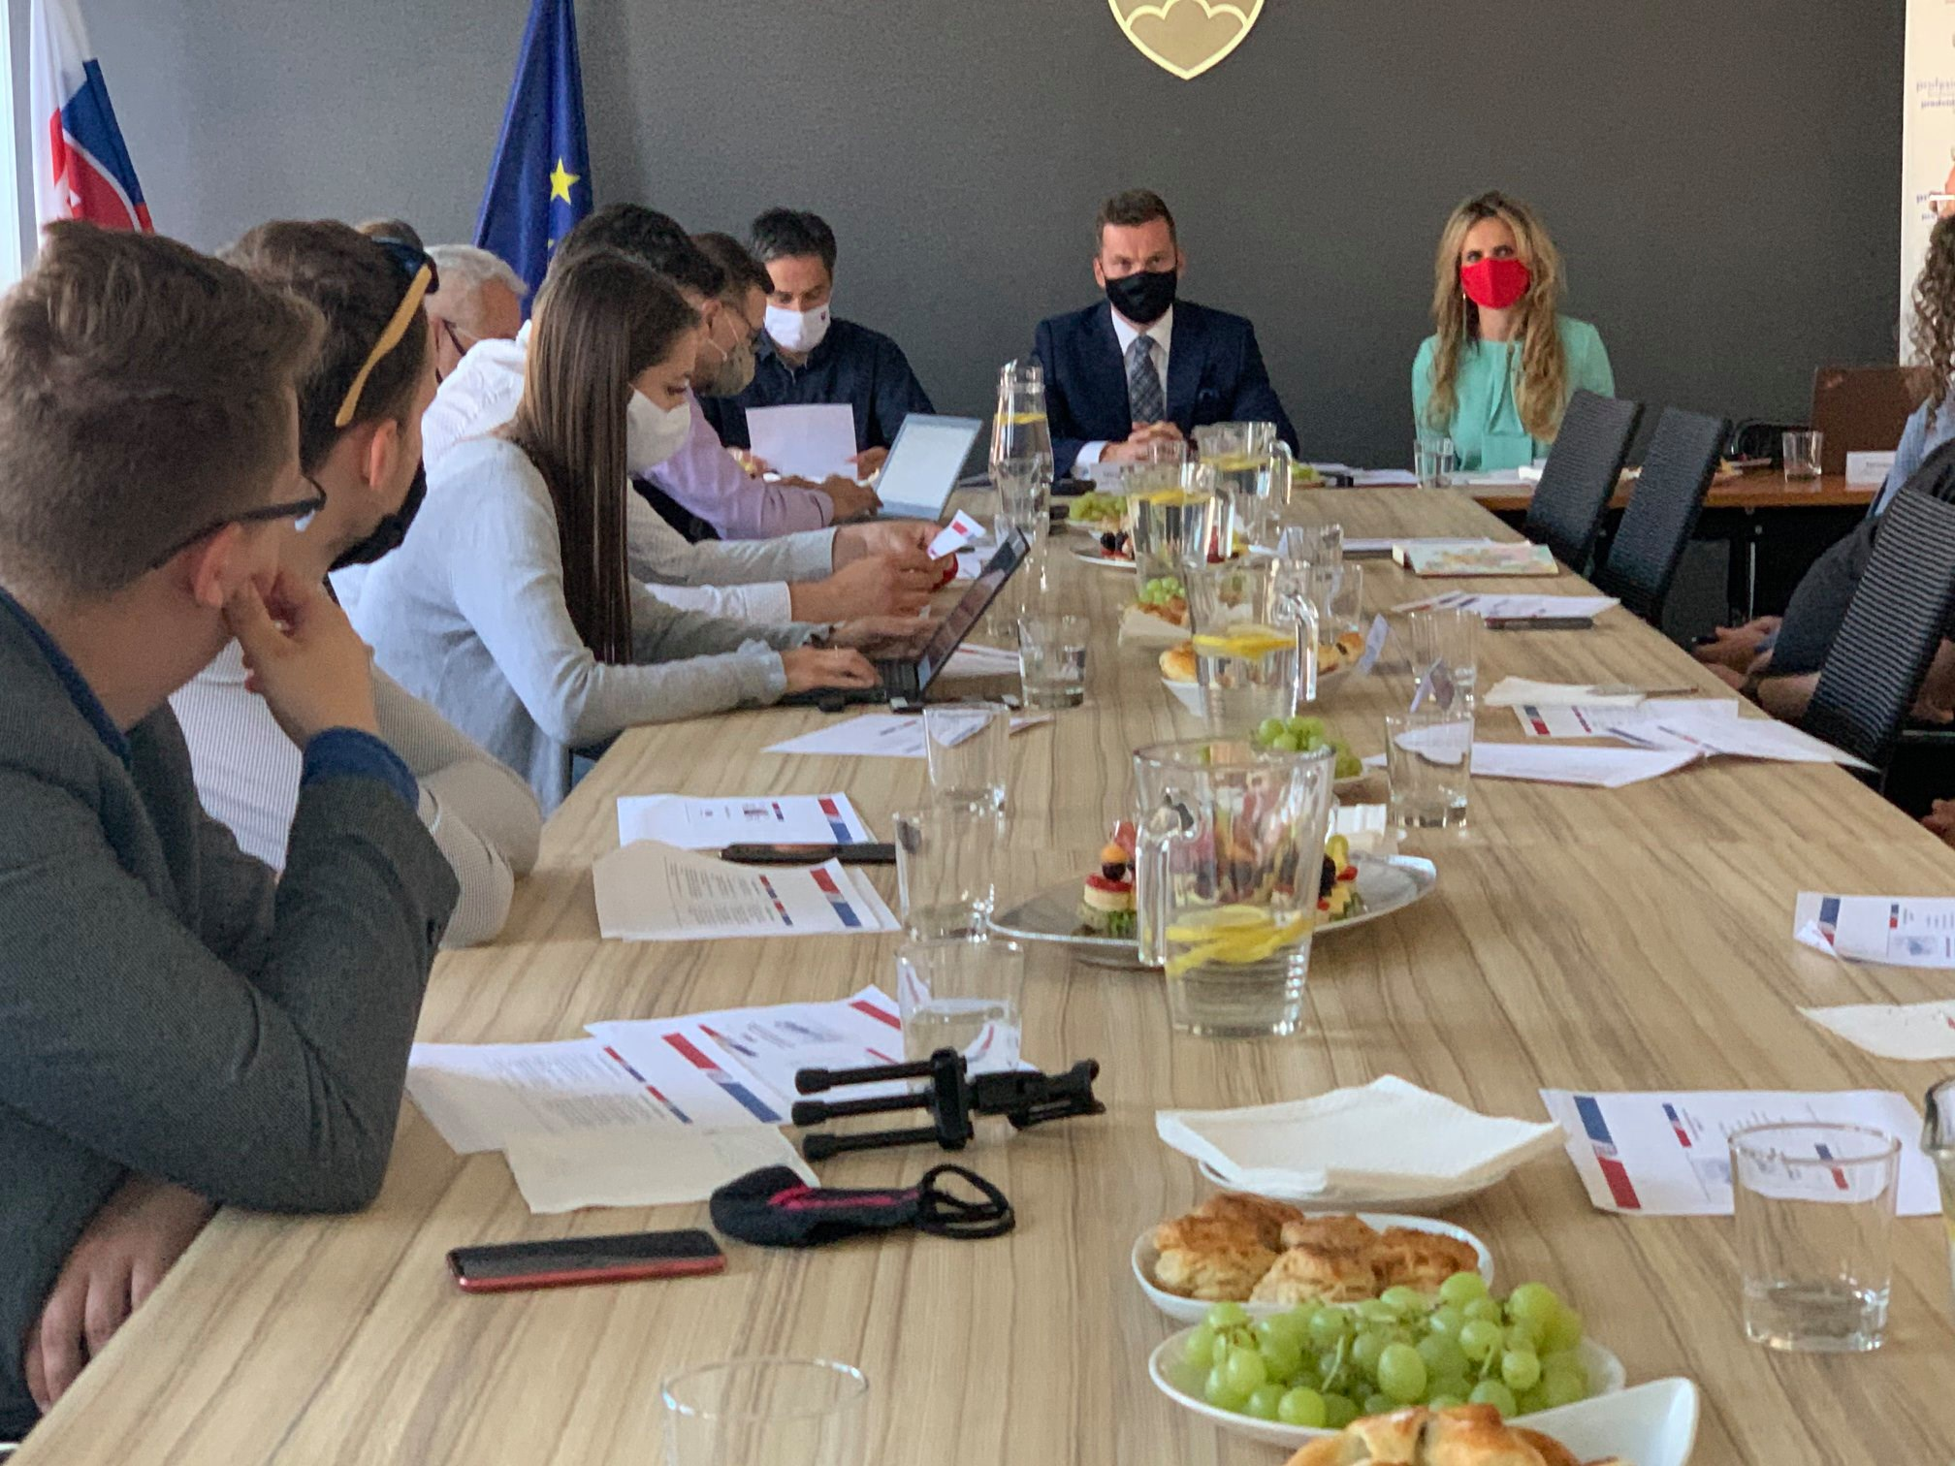
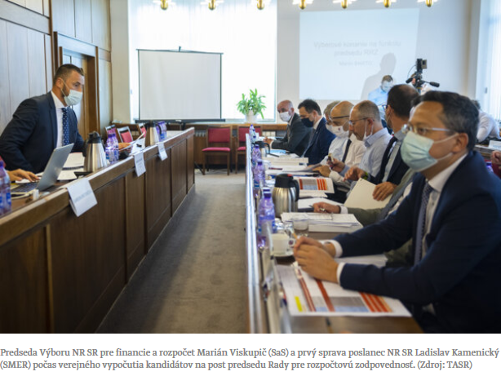
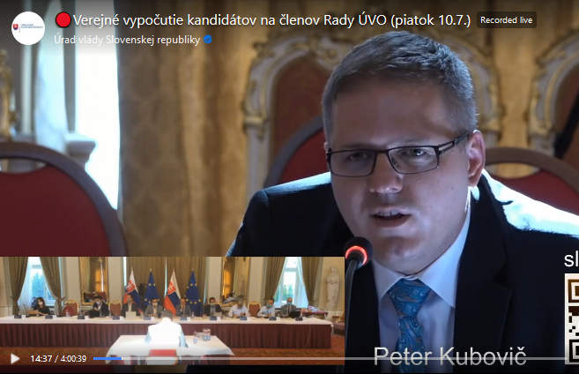
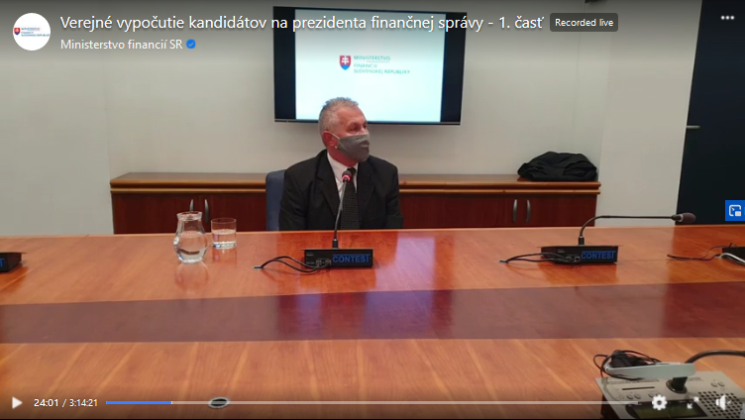
Presenting our legal proposal with representatives of office for public procurement to the media
Public hearing of candidates for the position of chairman of the council for budget responsibility
Public hearing of candidates for the position of members of the board of the office for public procurement
Public hearing of candidates for the position of president of financial administration

Slide 11
Other notable examples in Selection procedures
Bad practice
Weak legislation:
  Prison and Court Guard Service
Bending existing policies:
  Special Prosecutor’s Office
Ignoring results of well-organised and transparent selection procedure
  Agricultural Paying Agency
Good practice
Good legislation:
  Constitutional Court
  Supreme Court
Systematic implementation of transparent practices:
  City of Bratislava
  Ministry of Transport
  Ministry of Health
Notes:
What is happening beyond this project?
Here are some other notable examples:
There is always more work to be done however, as even good legislation can be compromised, and weak laws are unfortunately still prevalent.
Recently, new director of Prison and Court Guard service was selected, without Ministry of Justice that is responsiblr for this selection, even attempting to make the process transparent. Candidate’s name was announced for the first time after he was officially appointed. This all happened behind closed doors, with no preceding competition. And similar nominations are very common still.
Another highly criticised nomination occurred in February 2021 when the new special prosecutor was selected, after the previous one ended up arrested. With a fairly strong legislative framework for selection procedure already in place, the current government decided to change and relax the laws only to end up appointing a candidat, Mr Lipsic, who is highly politically involved and would not meet the criteria without these changes.
Apart from being an ex-minister of justice, and one who has been closely cooperating with the party currently in power, he did not meet some of the qualifications previously required by law – such as already being a prosecutor. Additionally, in 2017 he was convicted of killing a pedestrian while driving and is still serving a suspended sentence for this crime. For prosecutors, this is generally unacceptable.
The third example is the Agricultural Paying Agency
In April this year, Minister of Agriculture organised a tender for the director of Agricultural Paying Agency. The now ex-minister Micovsky (who had to leave office because of another scandalous nomination) invited a committee to assess and evaluate candidates, a member of which was also Peter Golias. However, the minister then proceeded to ignore the results the committee had submitted, and appointed a candidate – Mr Janoska, who didn’t even apply for the position. Mr Janoska was an interim director before, appointed after the previous director was arrested for corruption. Janoska’s qualifications are said to be inadequate for the given position, and he has also been criticised for having serious conflict of interest.
The worrying part in all three examples is that these selection procedures were highly monitored by the media and the public, mainly due to the preceding arrests and scandals. The appointing bodies, however, did not care enough and proceeded to ignore basic rules of transparency.
Things are not all bad however,
In the past few months, and years in case of City of Bratislava, some authorities have dramatically improved their selection procedures.
In case of the Constitutional Court and the Supreme court, strong legislation is already in place. Only highly qualified candidates are eligible, selection procedure is highly transparent from the very start, with the public having access to all information about candidates and evaluation criteria, with a mandatory public hearing in place and with a detailed public record of final evaluation of candidates.
While there are always ways to compromise the process despite existing binding regulation, this was certainly not the case for the two courts of Slovakia and the tenders were some of the most transparent we have seen.
Furthermore, these underlying laws are very well written and detailed and are a great reference when appealing to lawmakers to make changes to other laws.
A commendable action has been taken by other authorities as well, despite the lack of legal framework.
The City of Bratislava, Ministry of Health and Ministry of Transport have all passed their own regulations on how their selection procedures are conducted. Both Bratislava and Ministry of Transport have published frameworks for transparent selection processes in all their public institutions and public companies and have so far been successful in complying with their own rules. The City of Bratislava has also opened all of their hearings to the public and allowed citizens to watch and participate online in real time. The list of candidates along with their CVs and projects is always published prior to the public hearing. There is also a detailed written record of the committees decision and evaluation, including for example the points awarded to each candidate for each of the relevant categories. The members of selection committees are also always presented to the public in advance.

Slide 12
Thank you for your attention
institucie.ineko.sk
Alzbeta Tibenska
tibenska@ineko.sk
Notes:
That would be all from me, thank you very much for your attention.

