Slide 1
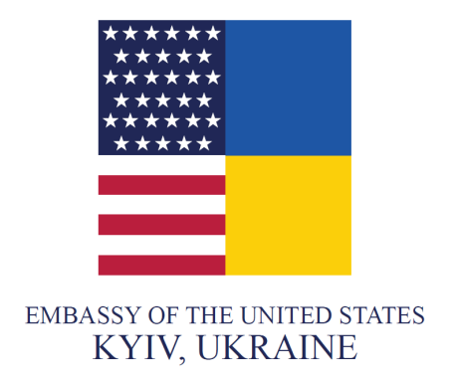


Quality of democracy in Ukraine compared to other countries
Peter Golias, INEKO
June 29, 2021
Video-conference: Presentation of the Independence Index of key public institutions in Ukraine

Slide 2
How democracy works?
Good environment: market economy, economic growth, educated and engaged citizens/political elites/businesses, supportive foreign actors
Regular free elections
Open public debate
Division of power
Minimizing „power abuse“
Solving problems
Social capital
Innovation
Higher standard of living
Better environment: economic growth, educated and engaged citizens/political elites/businesses
Source: Peter Golias, INEKO, Slovakia

Slide 3
Threats to democracy
Bad environment: economic decline, poor-educated public, corrupt political elites & businesses, weak media, destructive foreign actors, etc.
Authoritarianism
Iron Law of Oligarchy: power abuse
Populism
Popular but bad measures
  Deterioration of public goods
  Disruption of free competition, stronger monopolies
  Waste of public money, unsustainable public finances
  Corruption, state capture, injustice
  Violation of human rights, attacks on minorities, violence, wars
Lower standard of living
Worse environment: economic decline, poor-educated public, corrupt elites & businesses, weak media, etc.
Source: Peter Golias, INEKO, Slovakia

Slide 4
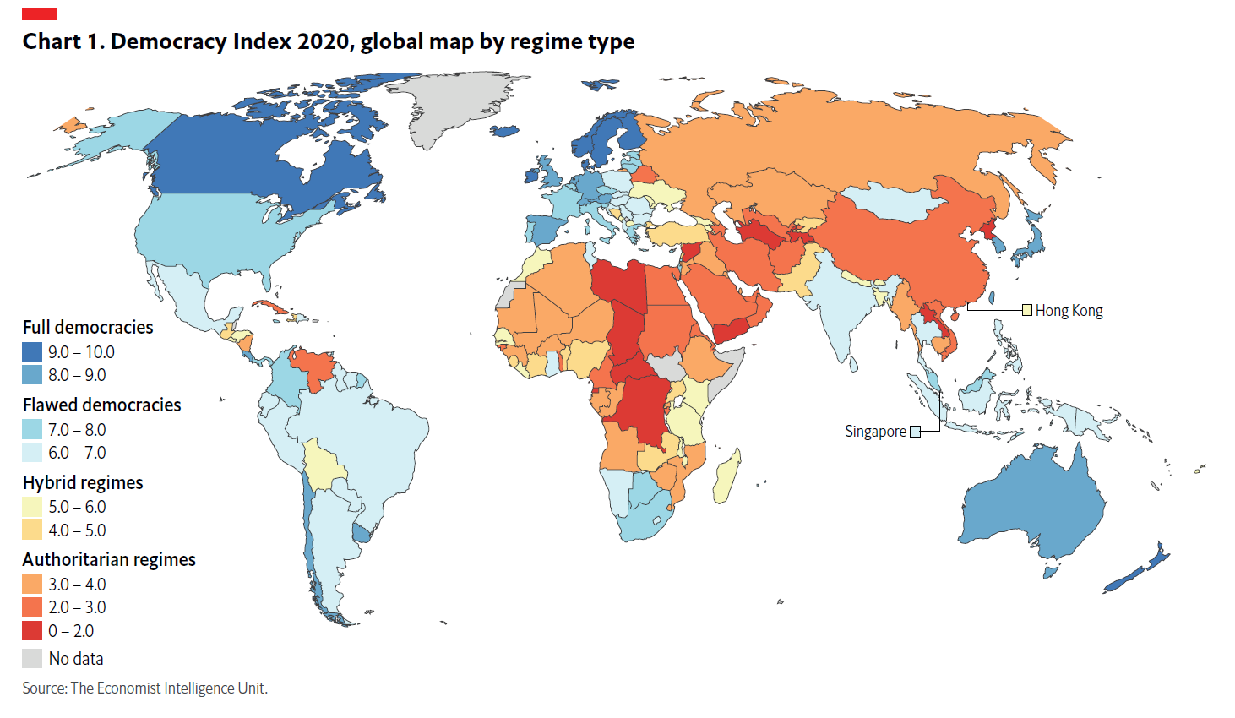
Source: EIU, Democracy Index 2020
Notes:
Výskumná agentúra The Economist Intelligence Unit so sídlom v Londýne rozlišuje:
Plne rozvinuté demokracie
Narušené demokracie
Hybridné režimy so znakmi demokracie aj autoritatívnych režimov
Autoritatívne režimy

Slide 5
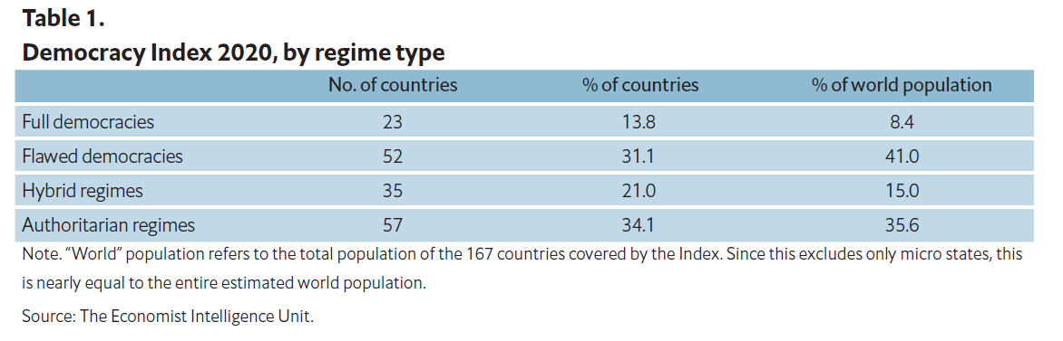
Source: EIU, Democracy Index 2020
Notes:
V plne rozvinutých demokraciách žije len 5,7 % svetovej populácie. Ide o 22 štátov, medzi nimi je napríklad Kanada, Austrália, Nový Zéland a viacero členov EÚ.
Najviac ľudí (42,7 %) žije v narušených demokraciách, kde patrí aj Slovensko.
Viac ako tretina svetovej populácie žije v autoritatívnych režimoch.

Slide 6
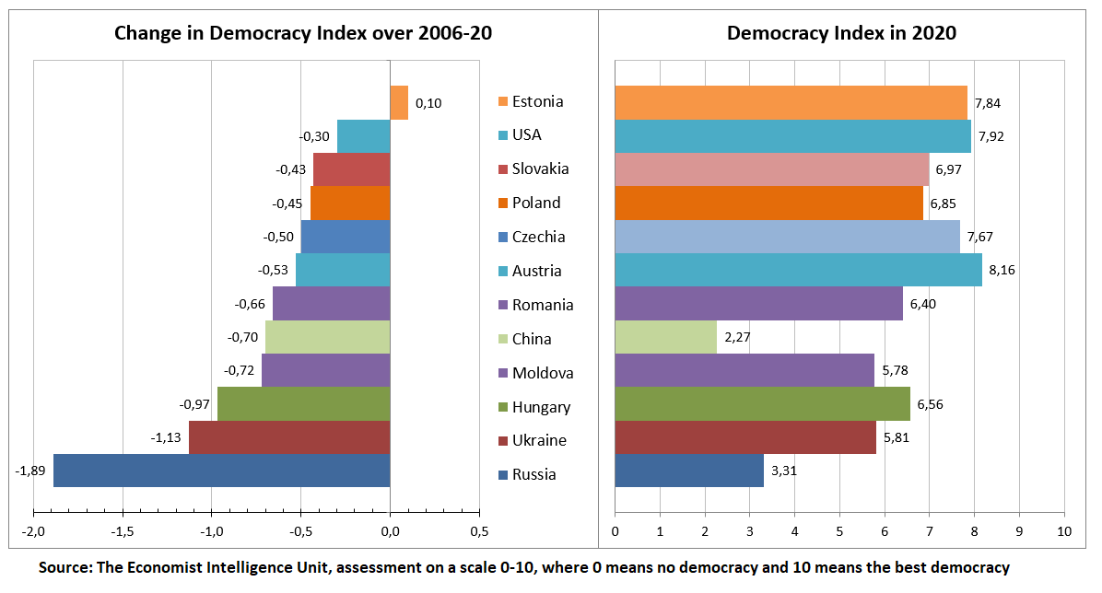

Slide 7
Source: EIU, Democracy Index 2020

Slide 8
What they assess
Electoral system (UA: 8.25) – free and fair elections, political system, etc.
Functioning of government (UA: 2.71) – checks and balances, corruption, trust to government and political parties, etc.
Political participation (UA: 7.22) – electoral participation, active membership in political organizations, engagement of citizens in public affairs
Political culture (UA: 5.00) – public meaning of democracy and its links to public order, economy, etc.
Civil liberties (UA: 5.88) – freedom of media, rule of law, independence of judiciary, protection of private property and human rights, etc.

Slide 9
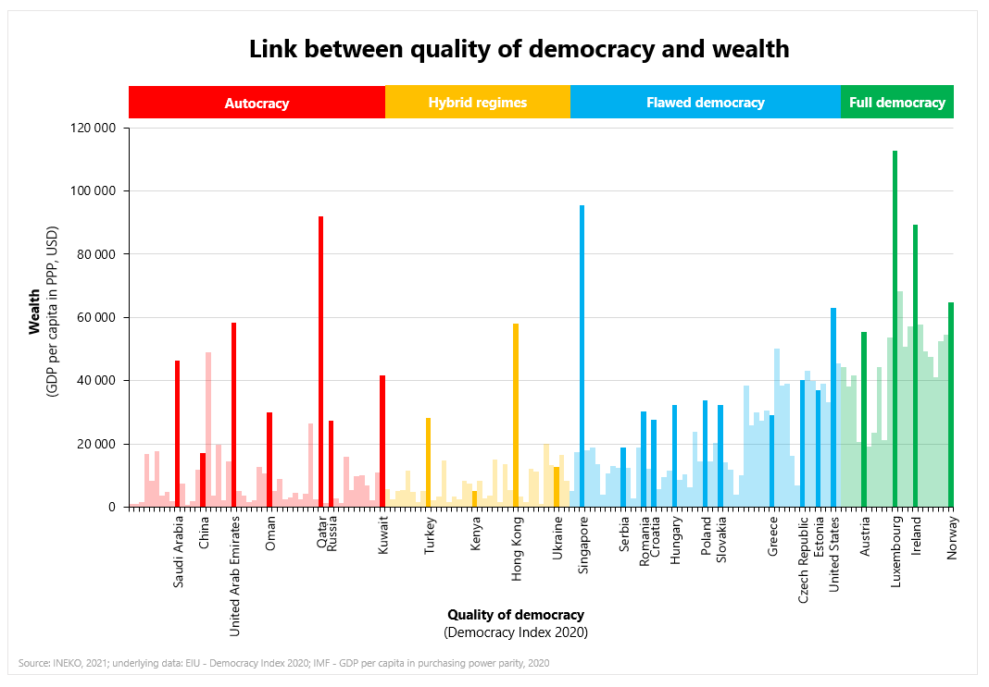

Slide 10
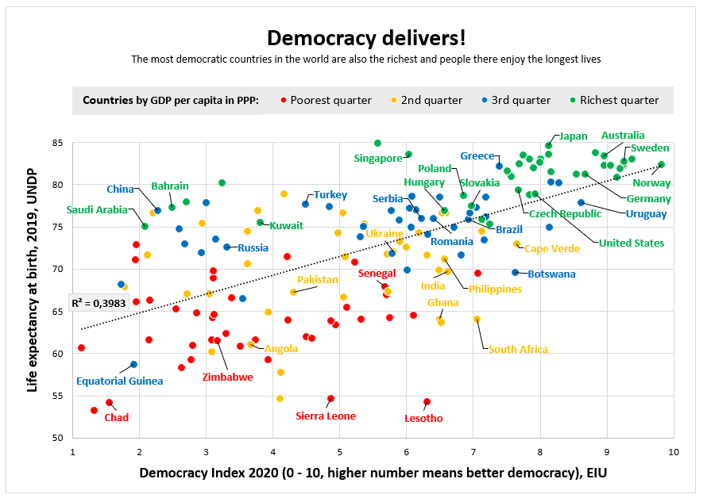

Slide 11
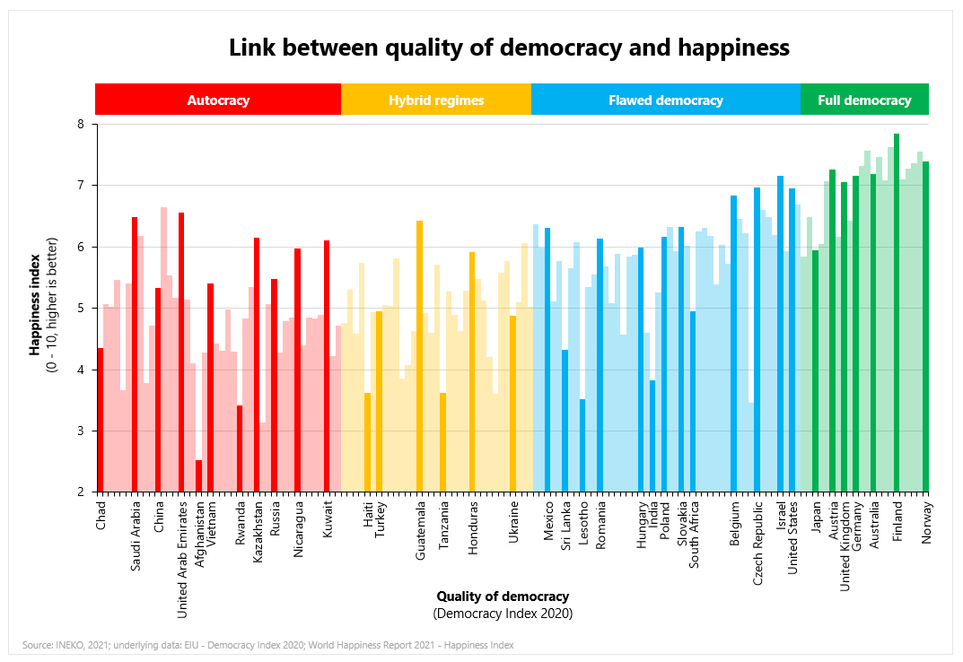

Slide 12
Thank you for your attention! https://www.ineko.sk/projekty/strengthening-democratic-resilience-of-key-public-institutions-in-ukraine

