Slide 1
Financial Stability of state-owned and private companies in Slovakia
Robert Kičina, 13 junE 2019, KIEV

Slide 2
Goal of the project activity
TO INFORM about financial stability of state-owned enterprizes (SOEs).
TO CREATE the Portal of financial stability of SOEs
TO COMPARE 30 selected Slovak SOEs with 30 selected Slovak private companies of appropriate size to set benchmarks
Own mathematical model to assess financial stability of companies:
Profitability – Liquidity – Leverage (indebtedness) – Activity

Slide 3



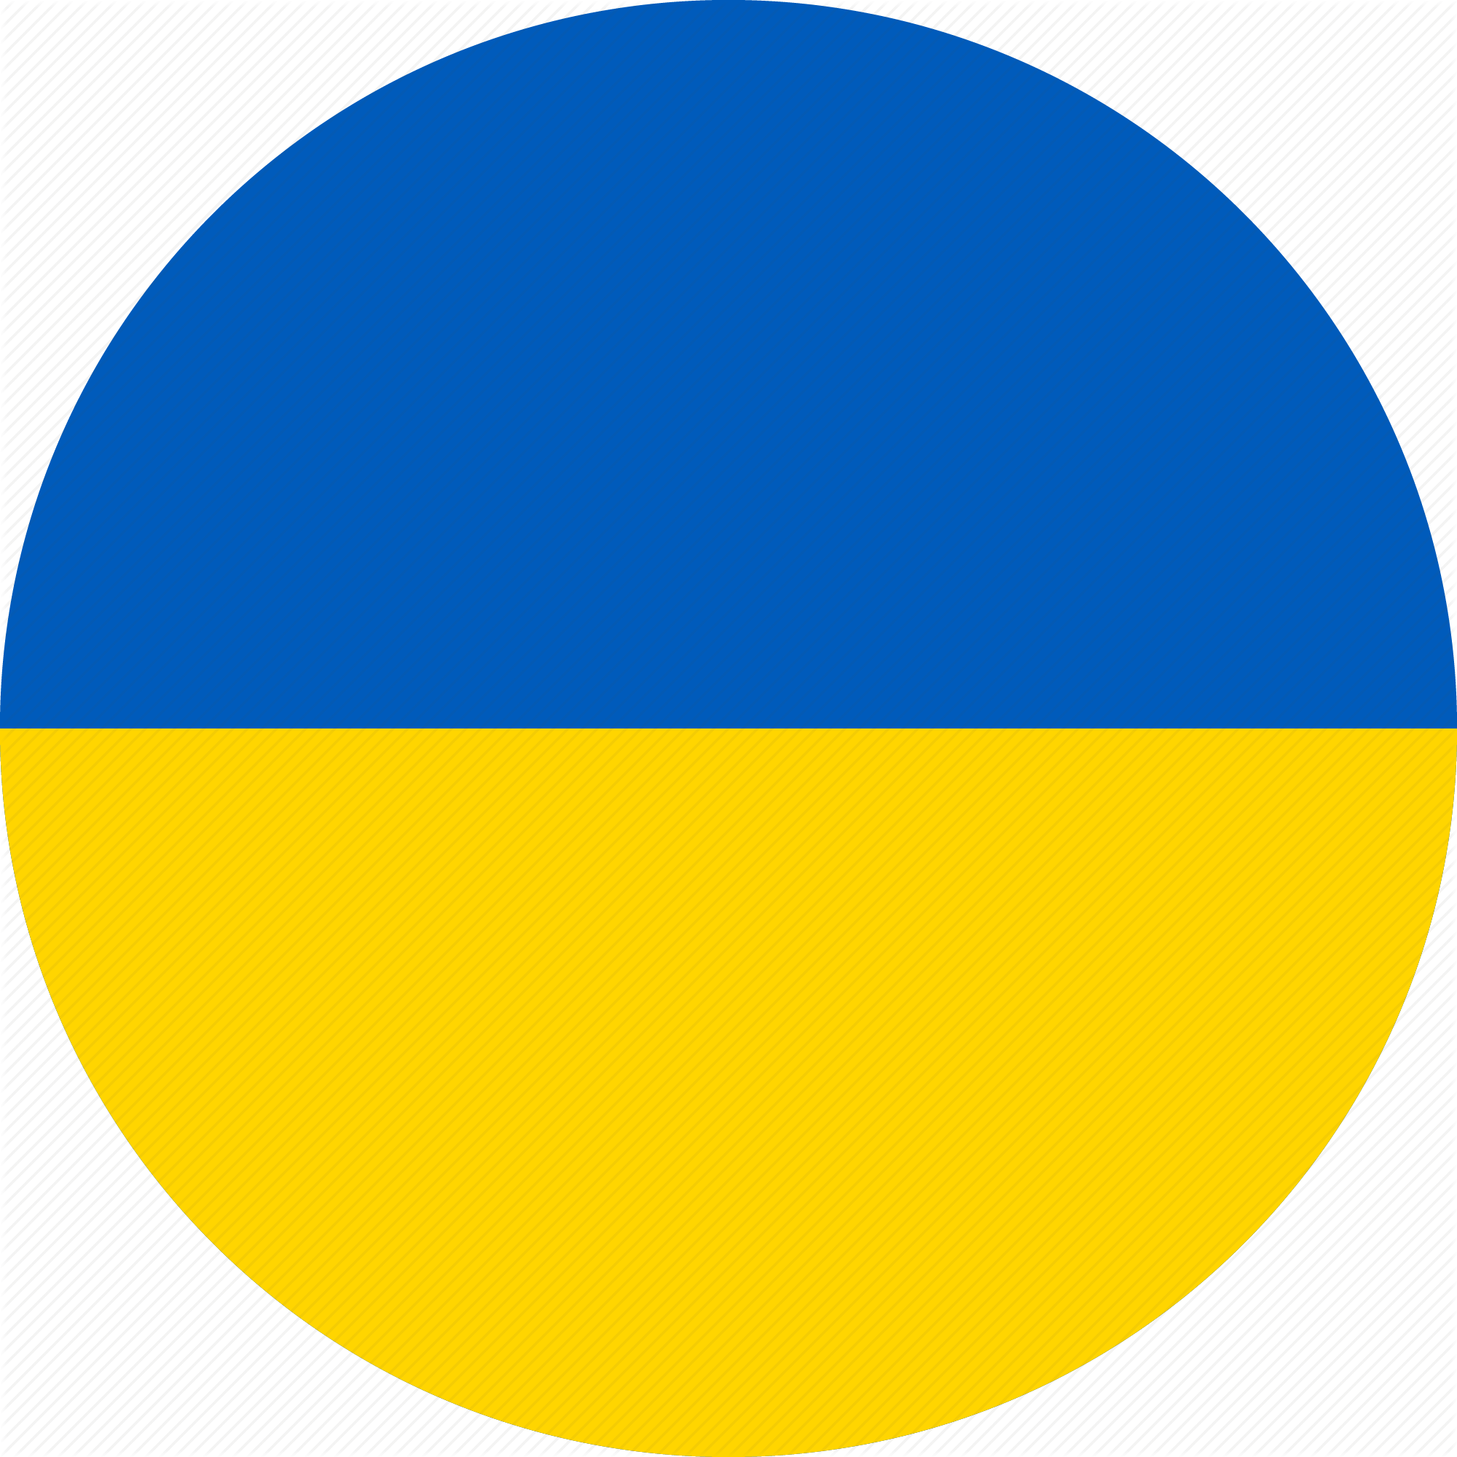
SK Energy Companies
Return on Equity
  Profit / Equity
Profit margin
  Profit / Sales
Debts to Assets
  Total Debts / Total Assets
Current Ratio
  Current Assets / Current Liabilities
9,2 % | 10,9 % | 12,7 %

Slide 4
SK Energy Companies
Return on Equity
  Profit / Equity
Profit margin
  Profit / Sales
Debts to Assets
  Total Debts / Total Assets
Current Ratio
  Current Assets / Current Liabilities
-0,4 % | 7,0 % | 51,4 %

Slide 5
SK Energy Companies
Return on Equity
  Profit / Equity
Profit margin
  Profit / Sales
Debts to Assets
  Total Debts / Total Assets
Current Ratio
  Current Assets / Current Liabilities
14,1 % | 35,1 % | 59,9 %

Slide 6
SK Energy Companies
Return on Equity
  Profit / Equity
Profit margin
  Profit / Sales
Debts to Assets
  Total Debts / Total Assets
Current Ratio
  Current Assets / Current Liabilities
0,89 | 2,18 | 8,23

Slide 7
SK Energy Companies
COMPANY | OWNERSHIP | INDEX
Transpetrol, a.s. | state | 6.18
Slovenská elektrizačná prenosová sústava, a.s. | state | 6.10
Slovenský plynárenský priemysel, a.s. | state | 6.03
Stredoslovenská energetika, a.s. | state | 5.96
eustream, a.s. | state | 5.76
SLOVINTEGRA ENERGY, a.s. | private | 5.66
Pow-en a. s. | private | 5.59
ELGAS, k.s. | private | 5.23
MAGNA ENERGIA a.s. | private | 5.04
innogy Slovensko s. r. o. | private | 4.94
Západoslovenská energetika, a.s. | state | 4.93
VEMEX ENERGO s.r.o. | private | 4.70
ČEZ Slovensko, s.r.o. | private | 4.46
Východoslovenská energetika Holding, a.s. | state | 3.73
Slovenské elektrárne, a.s. | private | 3.68
min | 2.47
1. quartile | 4.55
median | 5.13
3. quartile | 5.77
max | 7.17

Slide 8

SK Healthcare Companies
Return on Equity
  Profit / Equity
Profit margin
  Profit / Sales
Debts to Assets
  Total Debts / Total Assets
Current Ratio
  Current Assets / Current Liabilities

Slide 9
SK Healthcare Companies
Return on Equity
  Profit / Equity
Profit margin
  Profit / Sales
Debts to Assets
  Total Debts / Total Assets
Current Ratio
  Current Assets / Current Liabilities

Slide 10
SK Healthcare Companies
Return on Equity
  Profit / Equity
Profit margin
  Profit / Sales
Debts to Assets
  Total Debts / Total Assets
Current Ratio
  Current Assets / Current Liabilities

Slide 11
SK Healthcare Companies
Return on Equity
  Profit / Equity
Profit margin
  Profit / Sales
Debts to Assets
  Total Debts / Total Assets
Current Ratio
  Current Assets / Current Liabilities

Slide 12
SK Healthcare Companies
COMPANY | OWNERSHIP | INDEX
Východoslovenský onkologický ústav, a.s. | state | 6.39
Nemocnica Košice-Šaca a.s. 1. súkromná nemocnica | private | 5.51
Východoslovenský ústav srdcových a cievnych chorôb, a.s. | state | 5.25
Nemocnica Poprad, a.s. | state | 5.15
Národný ústav srdcových a cievnych chorôb, a.s. | state | 5.08
Stredoslovenský ústav srdcových a cievnych chorôb, a.s. | state | 4.85
Nemocnica s poliklinikou Štefana Kukuru Michalovce, a.s. | private | 4.74
Všeobecná nemocnica s poliklinikou Levoča, a.s. | private | 4.71
Nemocnica s poliklinikou Sv. Lukáša Galanta, a.s. | private | 4.33
Nemocnica Zvolen a. s. | private | 3.63
Nemocnica svätého Michala, a.s. | state | 3.13
Letecká vojenská nemocnica, a.s. | state | 2.90
min | 2.47
1. quartile | 4.55
median | 5.13
3. quartile | 5.77
max | 7.17

Slide 13
SK Transport & Logistics Companies
Return on Equity
  Profit / Equity
Profit margin
  Profit / Sales
Debts to Assets
  Total Debts / Total Assets
Current Ratio
  Current Assets / Current Liabilities
-59,7 % | -0,5 % | 13,9 %

Slide 14
SK Transport & Logistics Companies
Return on Equity
  Profit / Equity
Profit margin
  Profit / Sales
Debts to Assets
  Total Debts / Total Assets
Current Ratio
  Current Assets / Current Liabilities
-2,0 % | -1,7 % | 18,6 %

Slide 15
SK Transport & Logistics Companies
Return on Equity
  Profit / Equity
Profit margin
  Profit / Sales
Debts to Assets
  Total Debts / Total Assets
Current Ratio
  Current Assets / Current Liabilities
18,9 % | 40,8 % | 78,5 %

Slide 16
SK Transport & Logistics Companies
Return on Equity
  Profit / Equity
Profit margin
  Profit / Sales
Debts to Assets
  Total Debts / Total Assets
Current Ratio
  Current Assets / Current Liabilities
1,69 | 2,78 | 3,51 or 122,13*
* if PJSC State Joint Stock Company ‚Motor Roads of Ukraine‘ included

Slide 17
SK Transport & Logistics Companies
COMPANY | OWNERSHIP | INDEX
Letisko Košice - Airport Košice, a.s. | private | 7.17
GLS General Logistics Systems Slovakia s.r.o. | private | 5.92
Direct Parcel Distribution SK s.r.o. | private | 5.71
BUDAMAR LOGISTICS, a.s. | private | 5.40
Slovak Parcel Service s.r.o. | private | 5.19
Letisko Poprad - Tatry, a.s. | state | 5.15
ARRIVA Nové Zámky, a.s. | private | 5.14
Railtrans International, a.s. | private | 4.91
Letisko Sliač, a.s. | state | 4.89
Slovak Lines, a.s. | private | 4.87
Železnice Slovenskej republiky, a.s. | state | 4.81
Národná diaľničná spoločnosť, a.s. | state | 4.72
DHL Express (Slovakia), spol. s r. o. | private | 4.62
eurobus, a.s. | private | 4.55
ARRIVA NITRA a.s. | private | 4.55
Slovenská autobusová doprava Trenčín, a.s. | private | 4.12
Slovenská pošta, a.s. | state | 3.87
Letisko M.R. Štefánika - Airport Bratislava, a.s. | state | 3.67
Železničná spoločnosť Cargo Slovakia, a.s. | state | 3.34
Železničná spoločnosť Slovensko, a.s. | state | 2.47
min | 2.47
1. quartile | 4.55
median | 5.13
3. quartile | 5.77
max | 7.17

Slide 18
Conclusions from Slovakia
No clear line between financial stability of SOEs and privite companies
Conflict of interest (making regulation vs doing business in regulated sectors) have huge impact on SOEs and co-owned companies
In general: The smaller the SOE was the better it performed
Transparency, corporate governance principles and public control are inevitable to limit incompetent and unfair government influence
Privatization to standard foreign investors brings sophisticated know-how

