Slide 1
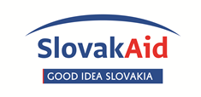

transparency of
Publicly owned enterprises in Slovakia
Transparency ranking of Slovak Publicly owned companies
Transparency International Slovakia, Jun 2019

Slide 2
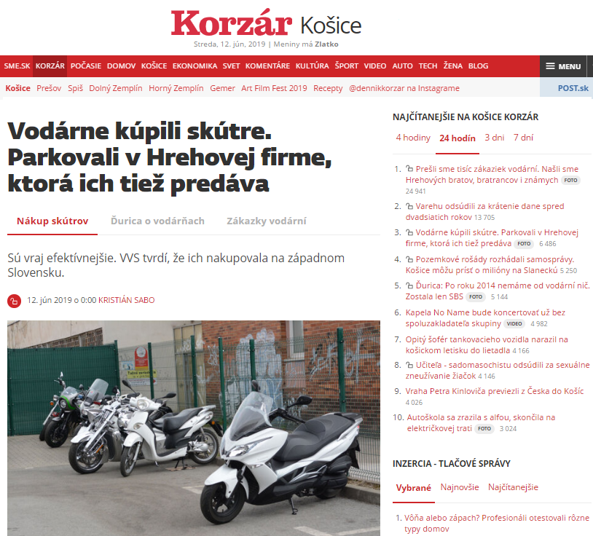
A Risky area
In Jun 2019 media publish a story about opaque contracts signed by the head of the Slovak MOE Východoslovenská Water Company
The motorbikes (delivered through a private company of the director)
Storage of waste (his brother´s company)
Water engineering products (his cousin)
Security services (cousin)
etc...

Slide 3
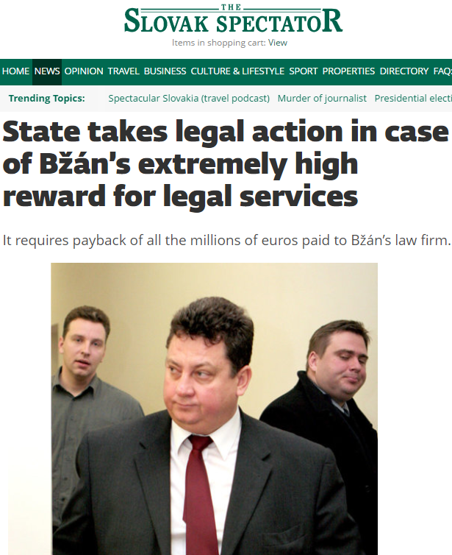
A Risky area
In 2015 Slovak SOE MH Invest contracted a lawyer for a legal dispute related to Gabčíkovo hydropower plant with the Italian company Enel
SOE won - in 2017 media publish the story about a dream pay-out for the lawyer
The lawyer should receive around €77 million for representing the SOE during an international arbitration (11% from value of dispute) – the published contract exposed
An ordinary Slovak would have to work around 7 thousand years for the sum
After strong criticism the lawyer agreed to reduce his pay-out to €17 million

Slide 4
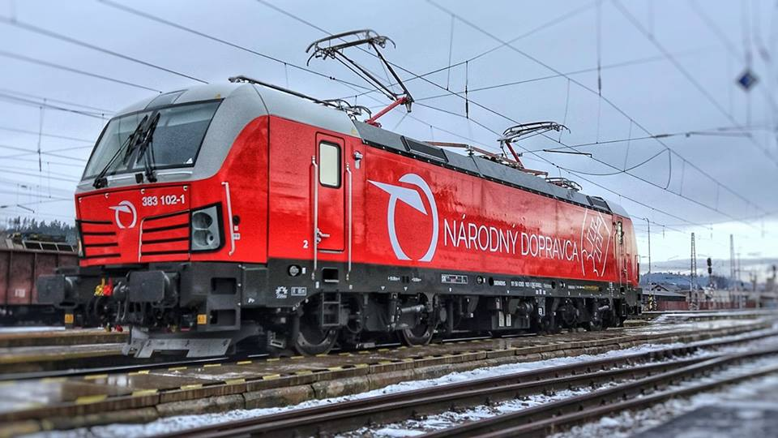
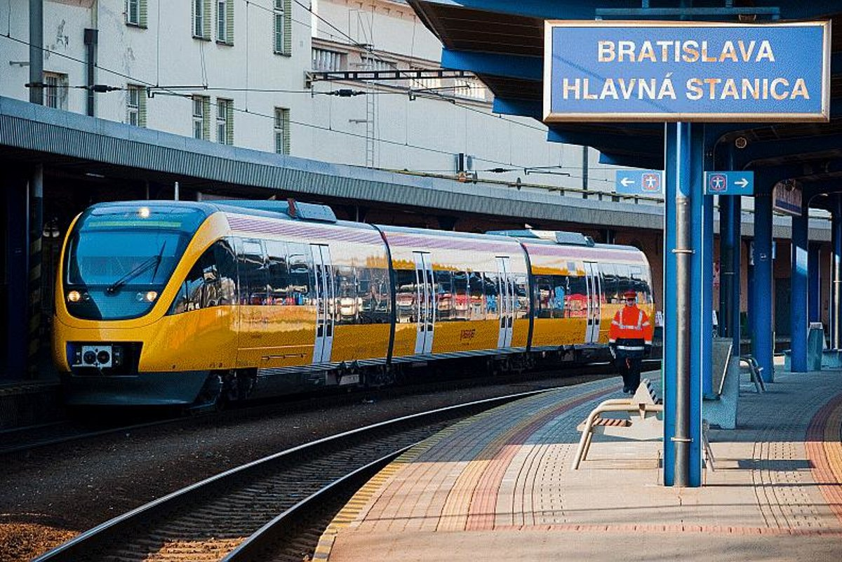
Lack of transparency
The number of state, region or municipality-owned enterprises unclear
81 of important SOEs and MOEs included in our 2015 Transparency ranking - 9.5 billion € (17 billion € – state budget)
Important competences – health insurance, hospitals, broadcasting, post services, energy, railways, motorways, public transport, heating, waste disposal, etc.
On the edge between public and private sector – lack of transparency

Slide 5
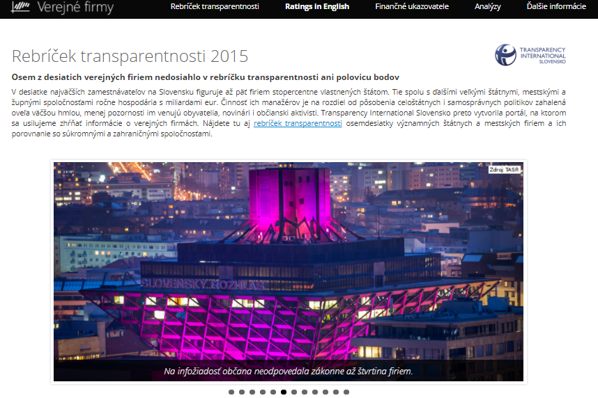
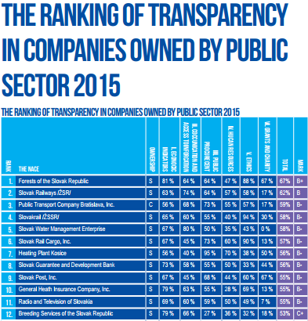
Transparency rankings

Slide 6
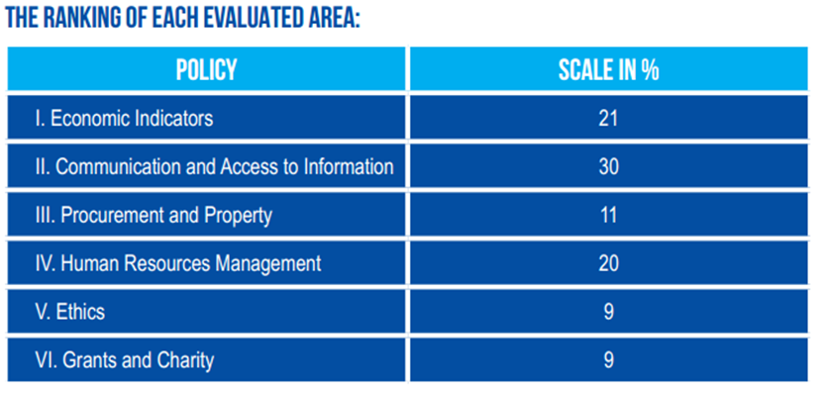
Transparency rankings
Transparency rankings of companies fully owned by public sector: 2012, 2015 (81 companies – 46 SOEs; 31 MOEs; 4 ROEs)

Slide 7
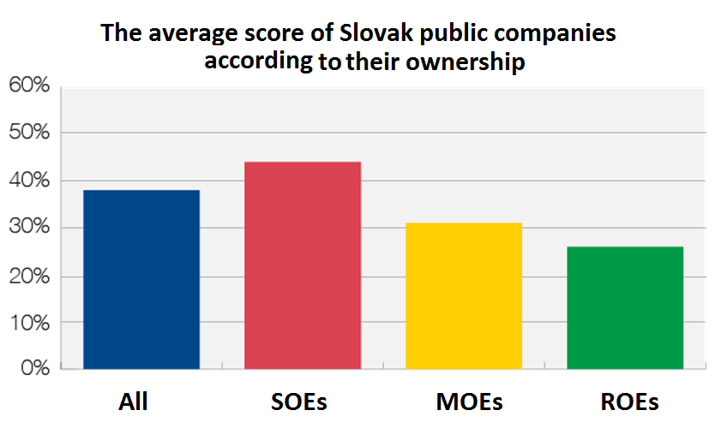
Transparency ranking

Slide 8
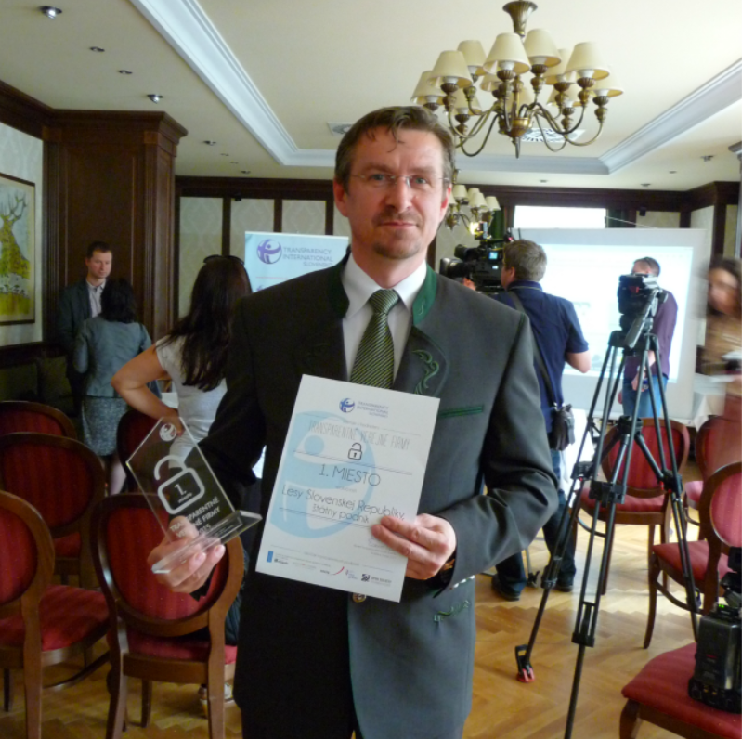
Transparency ranking

Slide 9
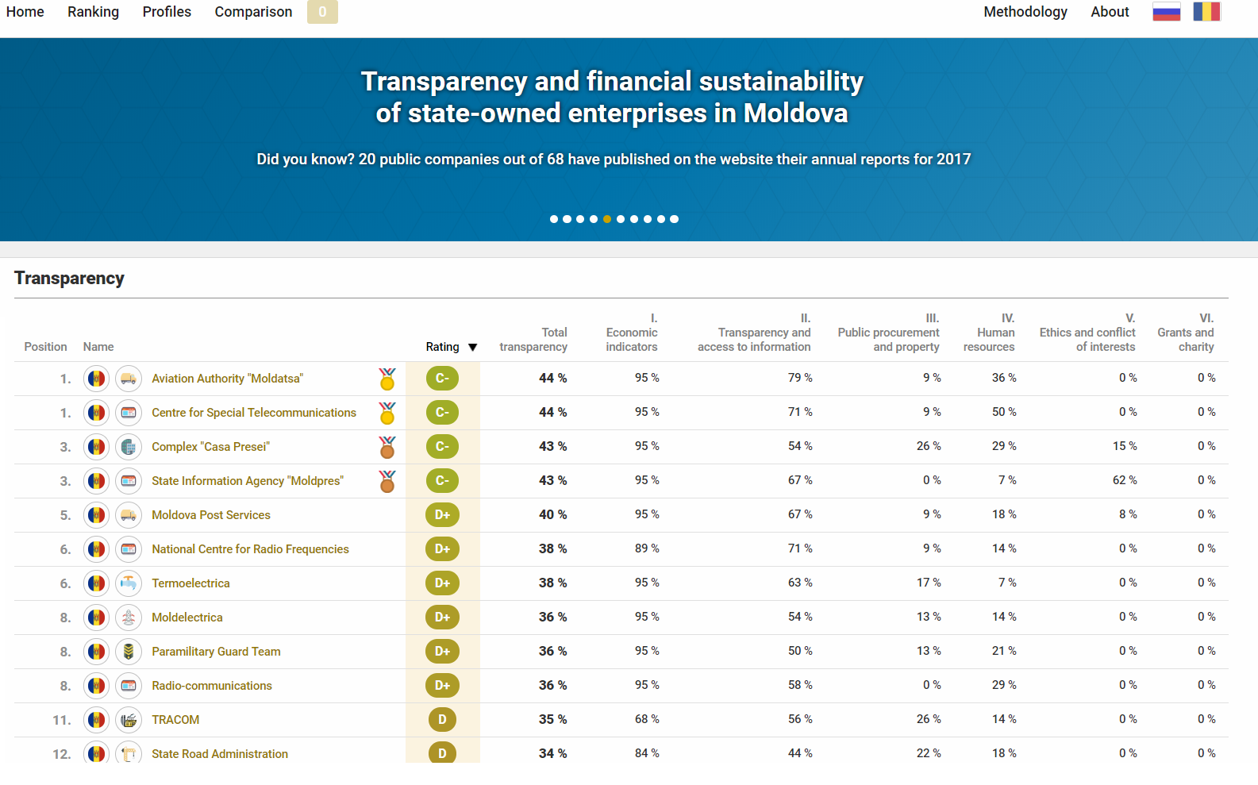
Moldovan ranking

Slide 10
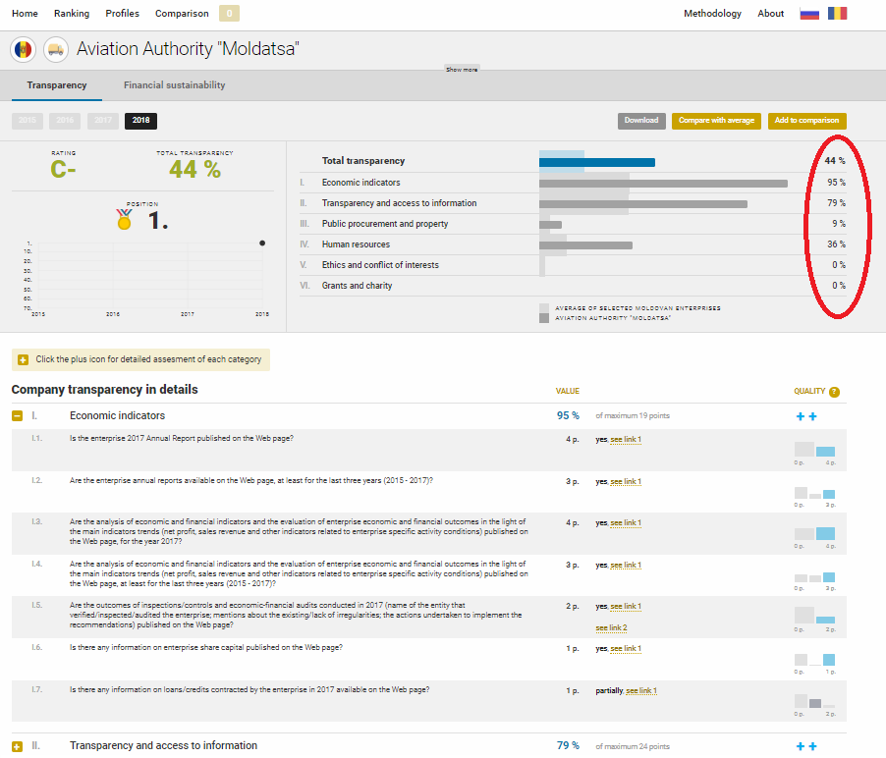
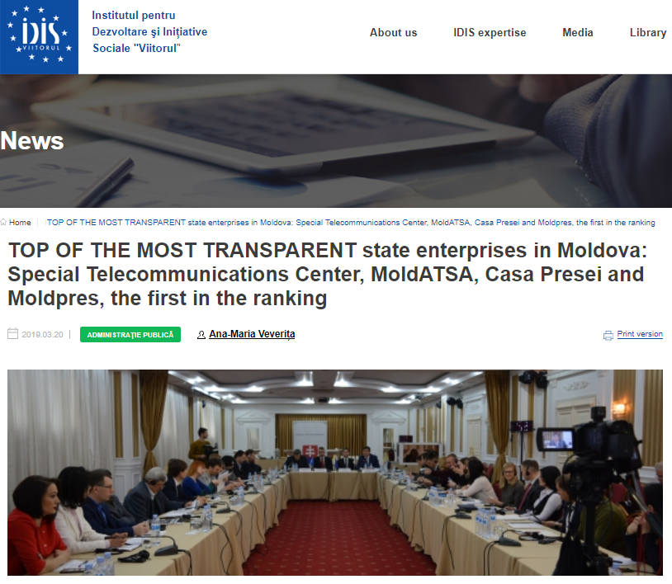
Moldovan ranking
www.companies.viitorul.org/

Slide 11
Findings
49 in 68 Moldovan companies owned by public sector did not respond to the request of information lodged in compliance with the legal terms and conditions
More than half of companies owned by public sector failed to publish not only the CVs of Management Board members, but also their names
Three quarters of the public companies did not publish public procurement notices in 2017 on the website
20 public companies out of 68 have published on the website their annual reports for 2017
Moldovan public companies scored only a third of points (17%) comparing with sixteen foreign companies owned by public sector, which scored almost 59% in the ranking

Slide 12
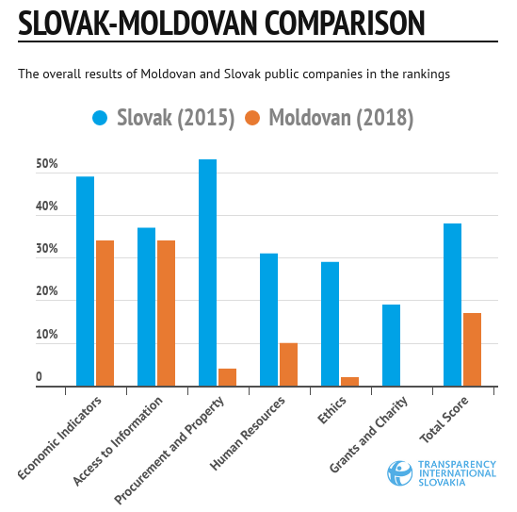
Transparency rankings

Slide 13
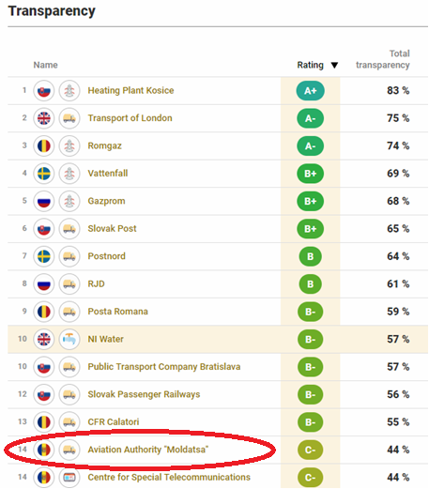
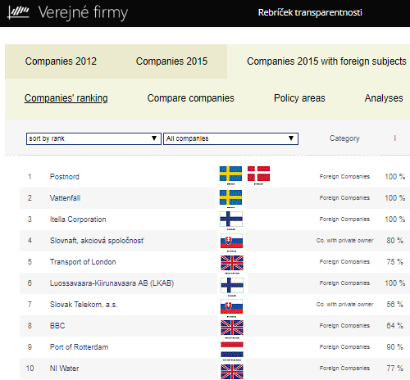
International Comparison

Slide 14
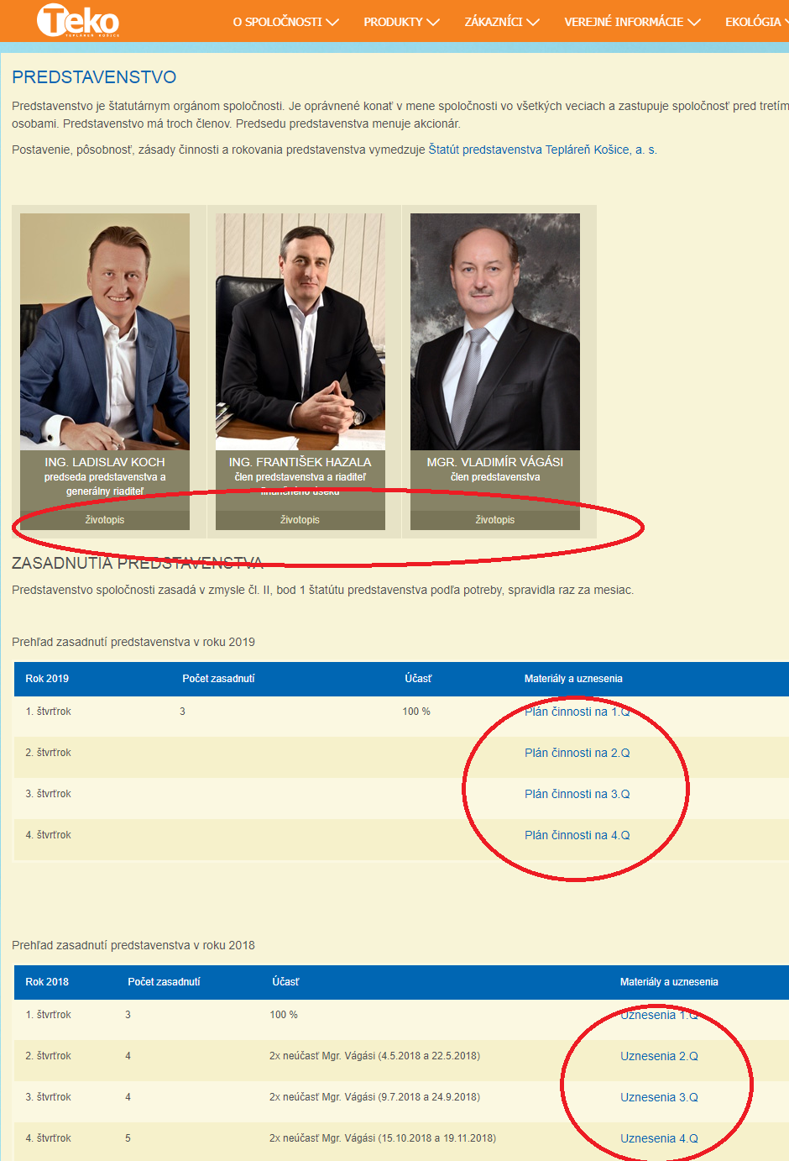
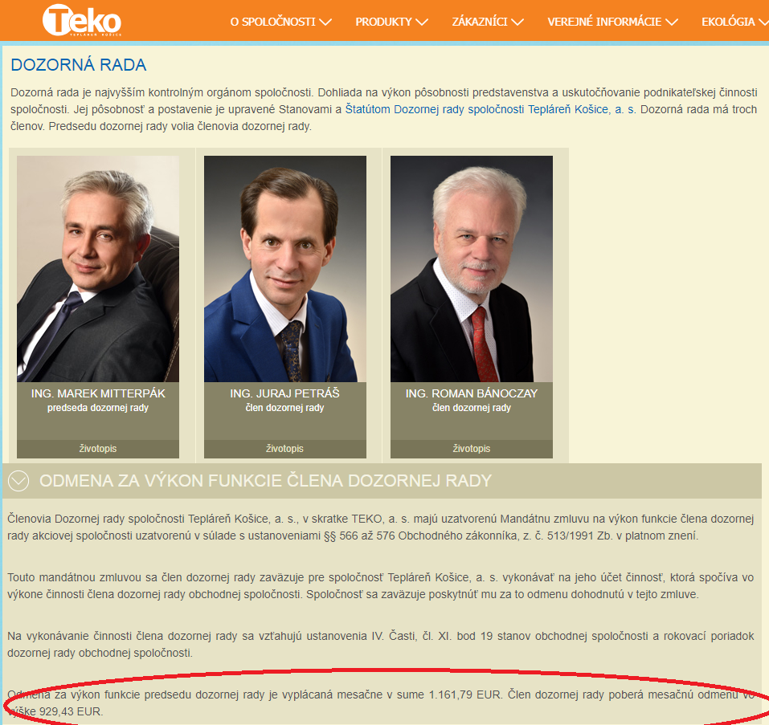
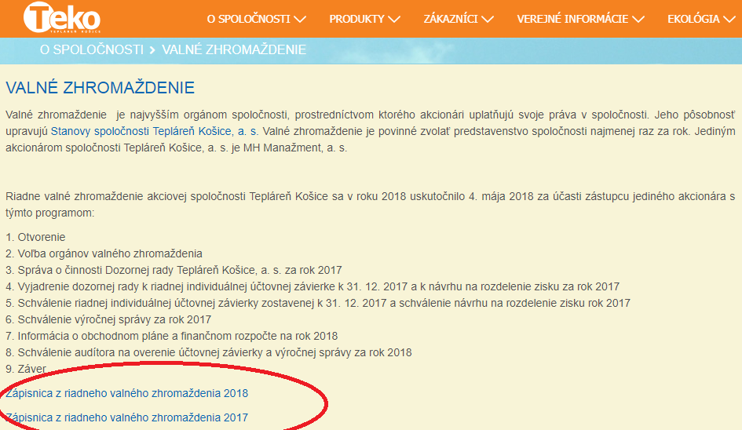
Access to Information

Slide 15
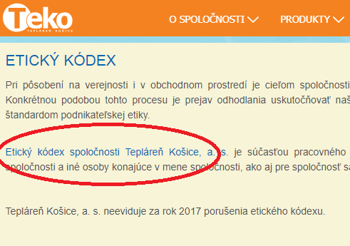
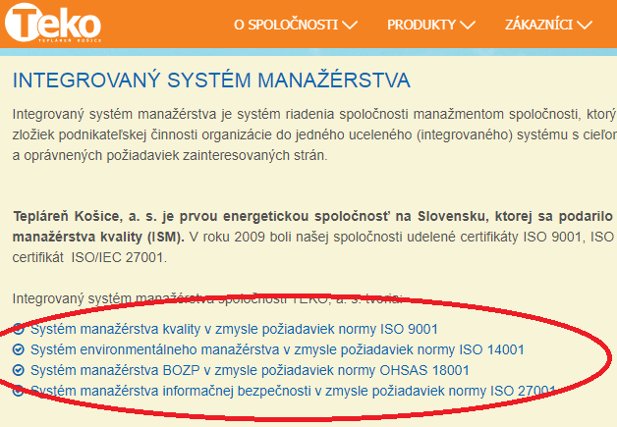
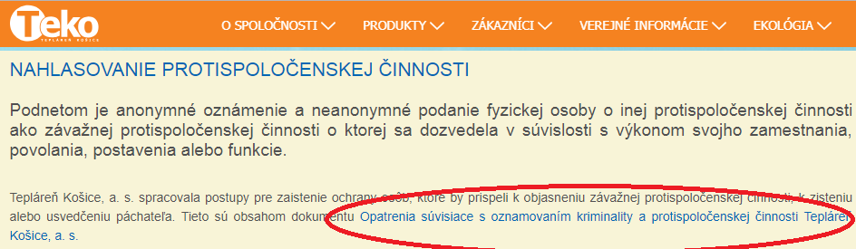
Ethics

Slide 16
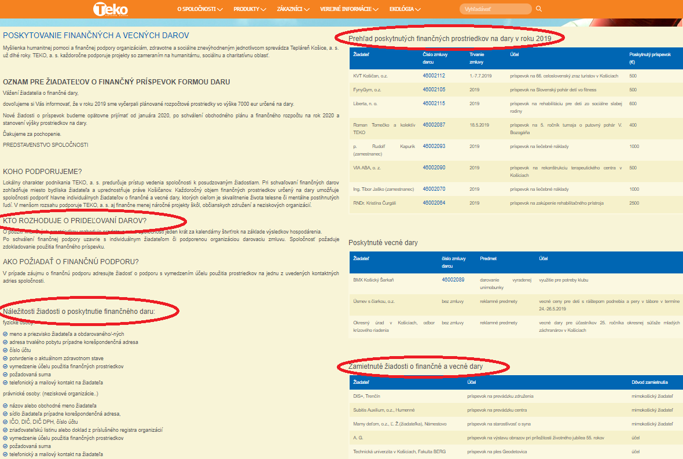
Grants and Sponsoring

Slide 17
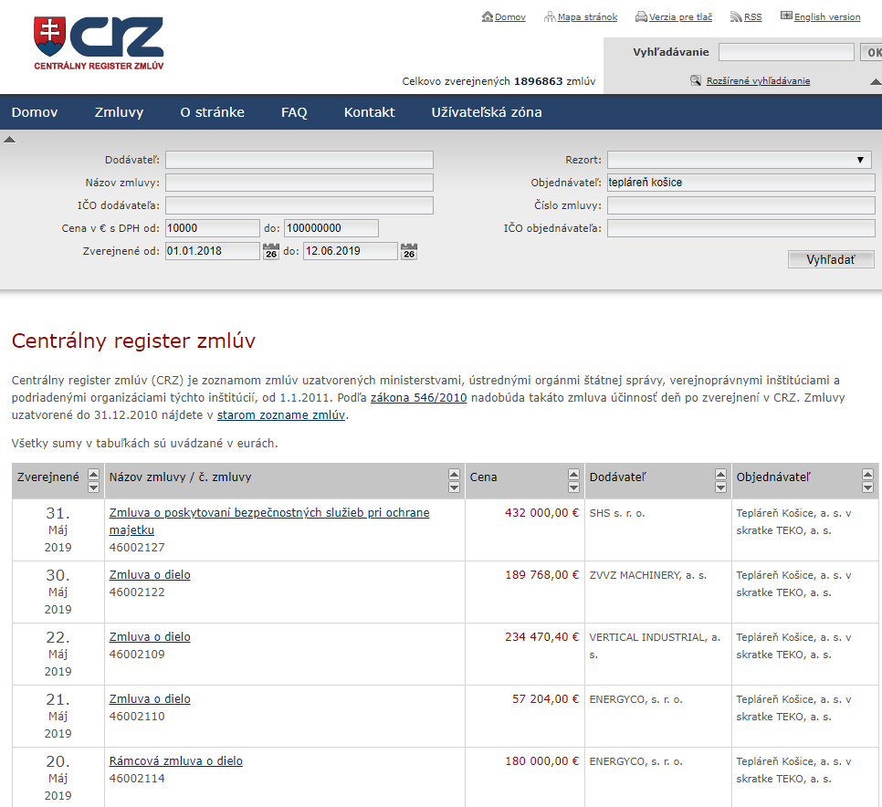
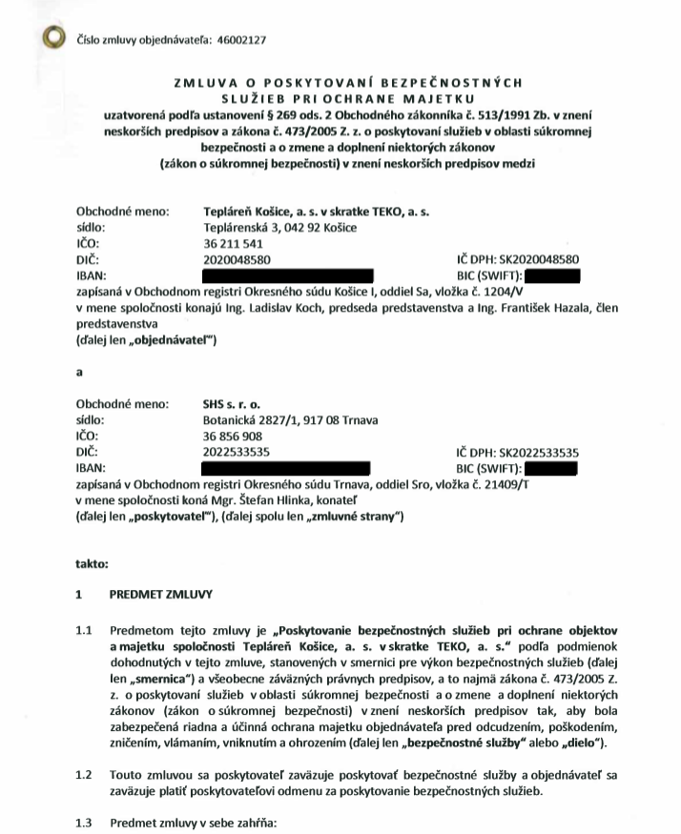
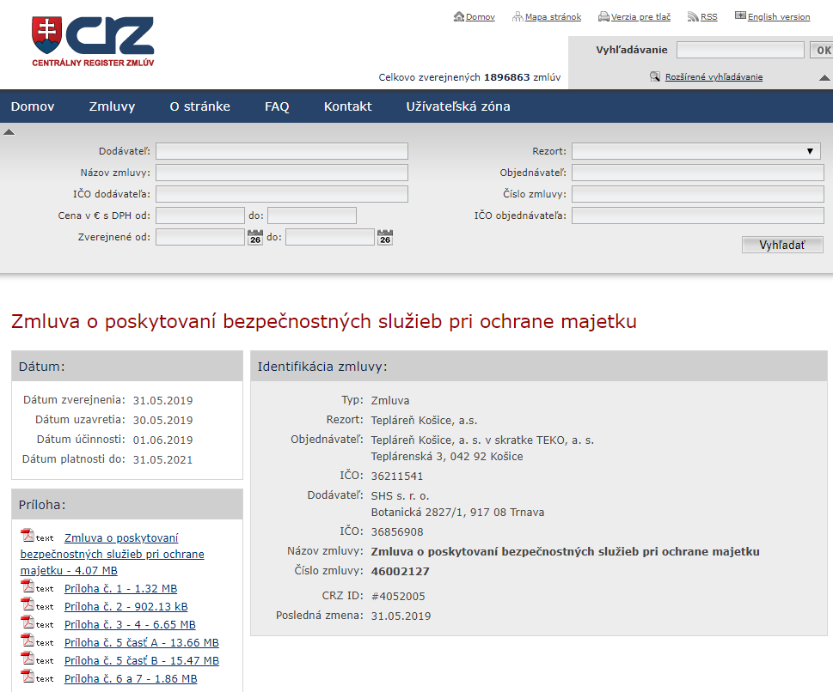
Contracts

Slide 18
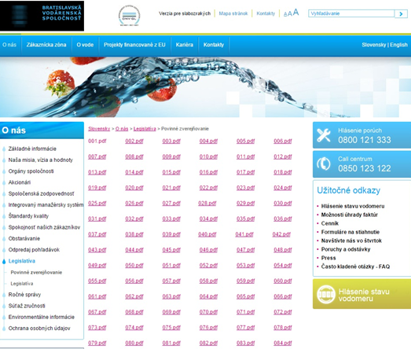
Different approach

Slide 19
Transparency matters
“
In recent years, we have seen how corruption involving SOEs can cause serious economic and political damage and lead to a breakdown of public trust extending well beyond the SOEs themselves.
This is why we need a concerted effort to stamp out corrupt and otherwise irregular practices in SOEs, as well as in government institutions exercising state-ownership rights.
Angel Gurría, OECD Secretary-General, 2018

Slide 20
Thank you for your attention
www.transparency.sk
facebook.com/transparencysk
twitter.com/transparencysk
transparency.blog.sme.sk
https://transparency.blog.sme.sk/
© 2019 Transparency International Slovakia

