Slide 1


Financial health of local governments in Slovakia and Moldova
Peter Golias
INEKO Director
March 20, 2018
Kyiv, Ukraine
Conference on transparency and financial health of local governments in Ukraine

Slide 2
About INEKO
Economic think-tank established in 1999
Mission: Supporting transition to democracy and market economy in Slovakia
Current projects:
  Financial health of local governments
  Results of primary and secondary schools
  Quality and efficiency of hospitals
  Feasibility of big transport infrastructure projects
  Fostering democracy
  Transfer of reform know-how abroad: Ukraine, Moldova, Serbia, Macedonia
Permanent staff: 6+
Budget: EUR200,000+ (Slovak Aid, US Embassy, Pontis Foundation, EC, private & international donors)

Slide 3
Financial transparency of LGAs
Four levels of transparency:
Financial health, financial indicators
Budgets – detailed data on revenues and expenditures
Orders, contracts and invoices
Participative budgeting and decision making

Slide 4
Financial health of LGAs
Since 2012: INEKO portal computing financial health of all municipalities and regions: http://www.hospodarenieobci.sk/
Data taken from the MoF Data Centre
Major developments/impact:
  Intensive public attention and pressure to govern finances of local Gvts responsibly
    125 thousand unique users, 1.5 million pageviews
    Hundreds of media releases every year
  New legal constraints (penalty, debt brakes, more strict rules on hidden debt)
  Fiscal stabilization of local Gvts

Slide 5
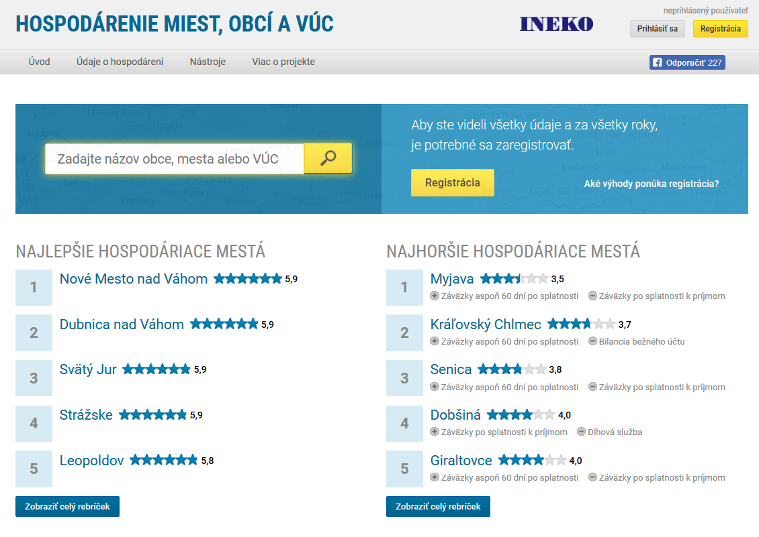

Slide 6
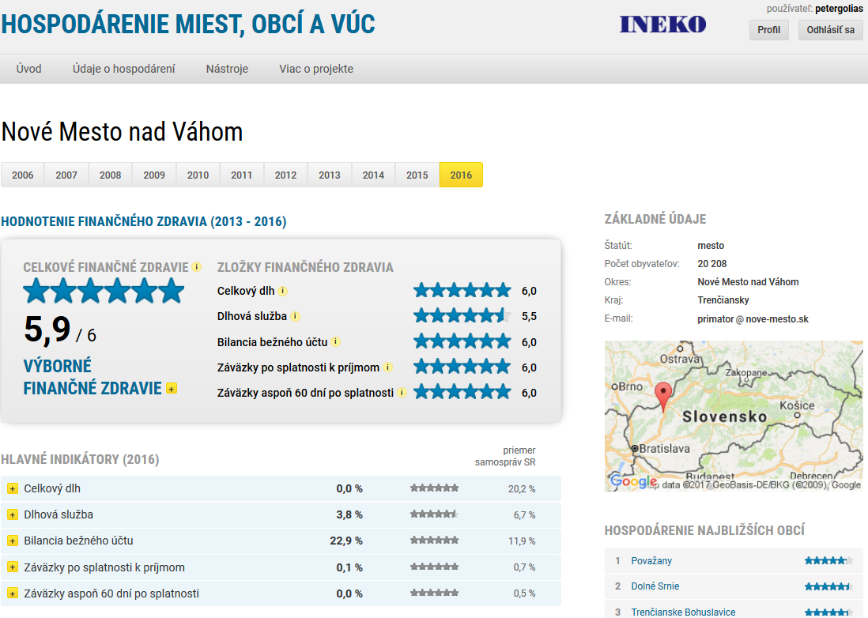

Slide 7
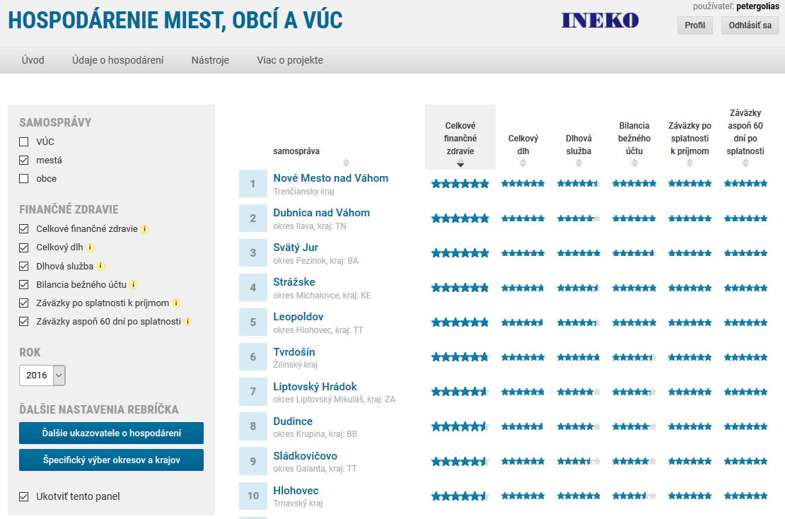

Slide 8
Financial health indicators
Indicators entering final rating | Weight
Overall debt over current revenues | 30%
Debt service (interest plus principle) over current revenues | 10%
Current account balance over current revenues | 30%
Overdue liabilities over current revenues | 15%
Liabilities overdue at least 60 days over current revenues | 15%
All indicators are transformed to the scale {0, 6}
Overall debt is computed based on data from the most recent year
Other four indicators are computed based on data from the 4 most recent years with following weights:
  Year t: 4
  Year t-1: 3
  Year t-2: 2
  Year t-1: 1

Slide 9
Underlying data
:
:
To calculate financial health | Other
Current account revenues | Capital account revenues
Current account expenditures | Capital account expenditures
Debt service – principal | Short-term receivables
Debt service – interest | Financial assets (e.g. cash, bank deposits)
Long-term liabilities | Short-term liabilities
Bank loans | Profit/Loss
Loans from the state/EU | Immovable assets
Overdue liabilities | Number of citizens
Liabilities overdue at least 60 days

Slide 10
Project in Moldova
  Portal launched in 2016: http://localbudgets.viitorul.org/
  Financial data of all municipalities and regions
  Data taken from the MoF, complete data available thanks to the World Bank BOOST project
  Project funded by: Slovak Aid, US Embassy, NED
  Implemented by INEKO and IDIS Viitorul
  Impact:
    Disclosure of political clientelism
    MD MoF displayed the portal banner on its webpage
    Investigative articles

Slide 11
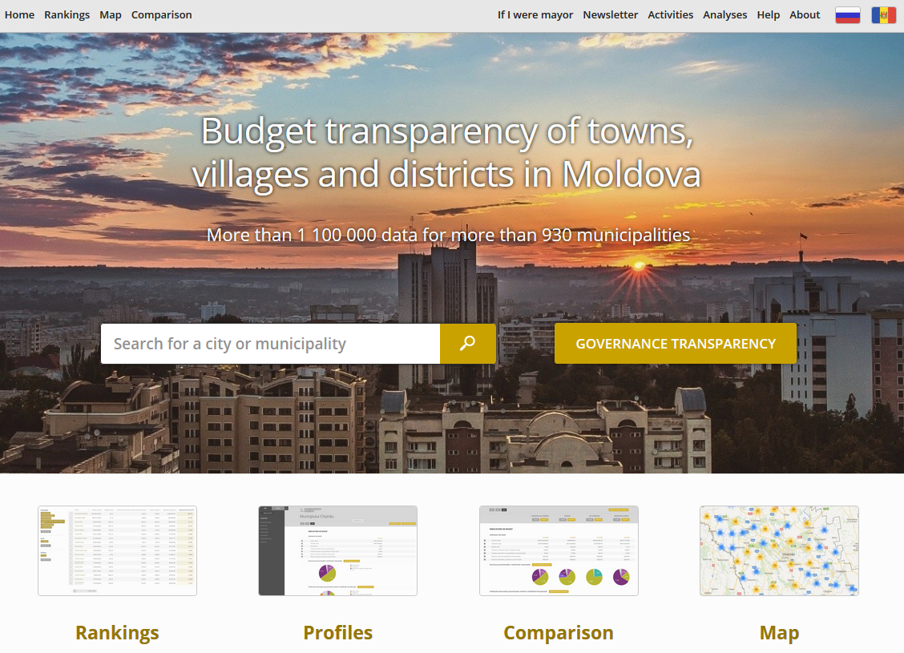

Slide 12
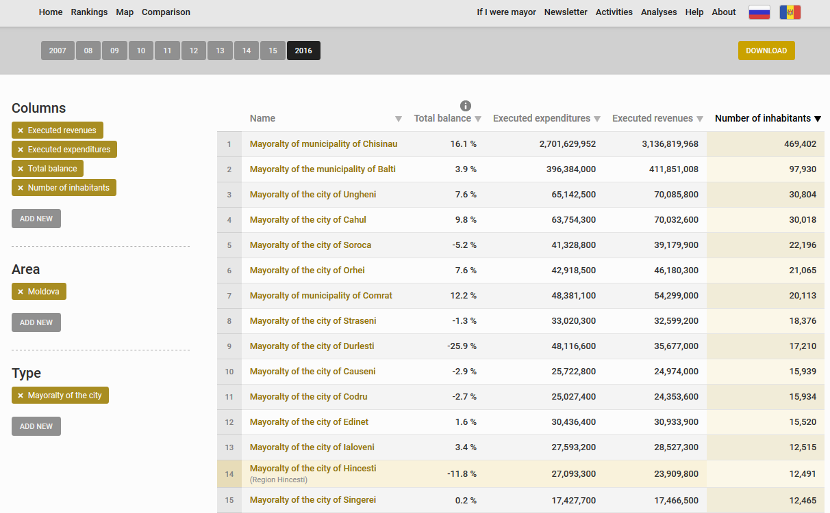

Slide 13
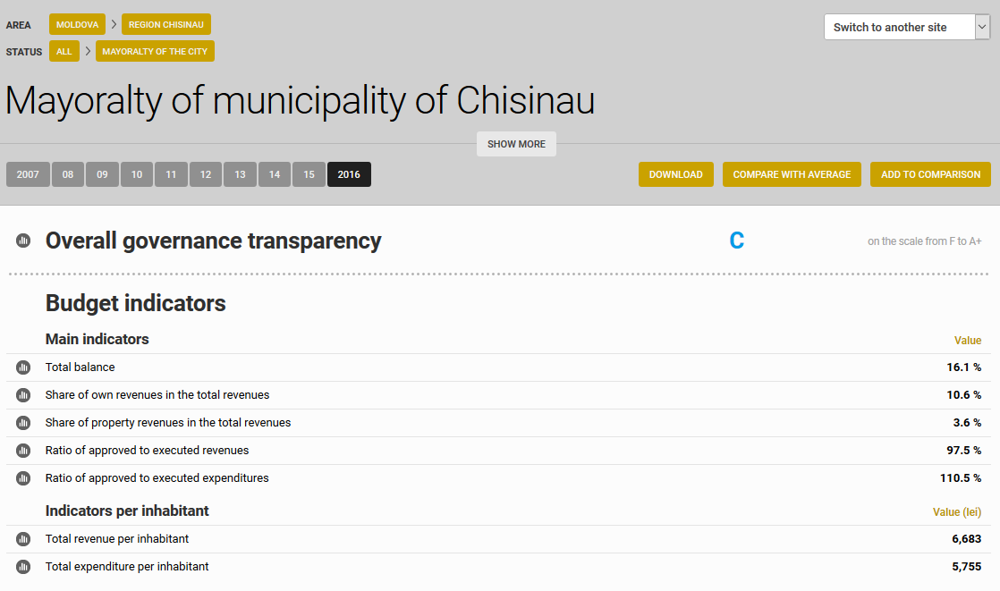

Slide 14
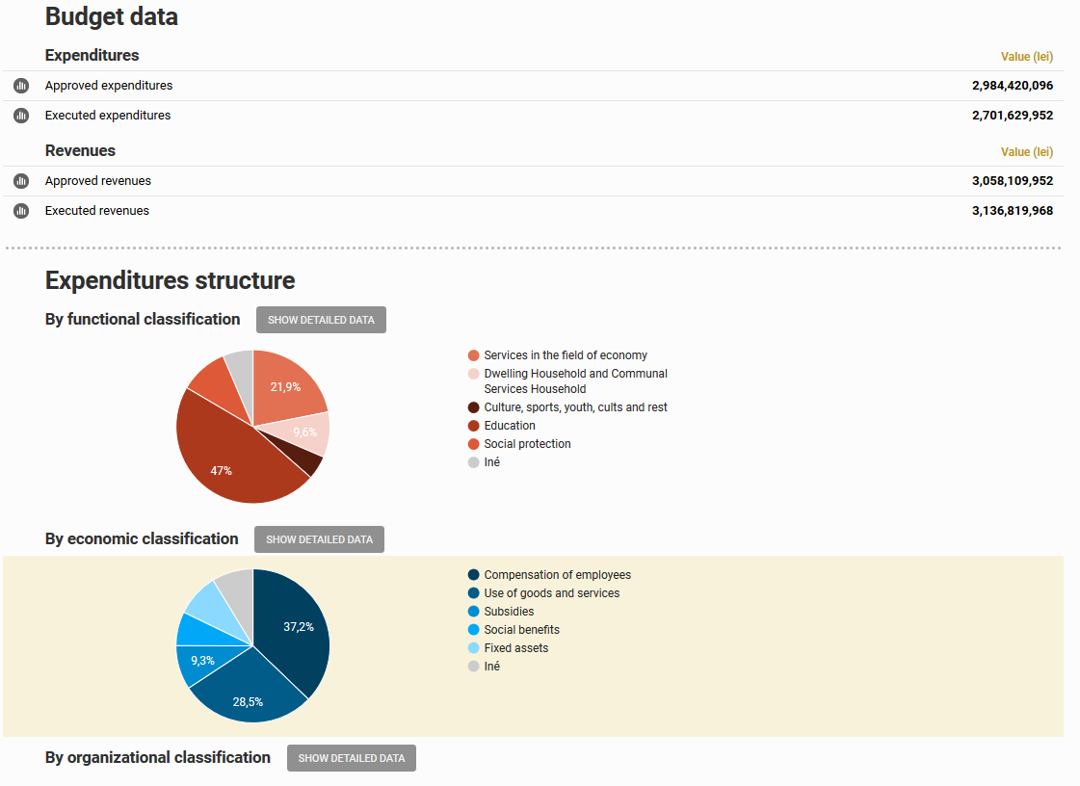

Slide 15
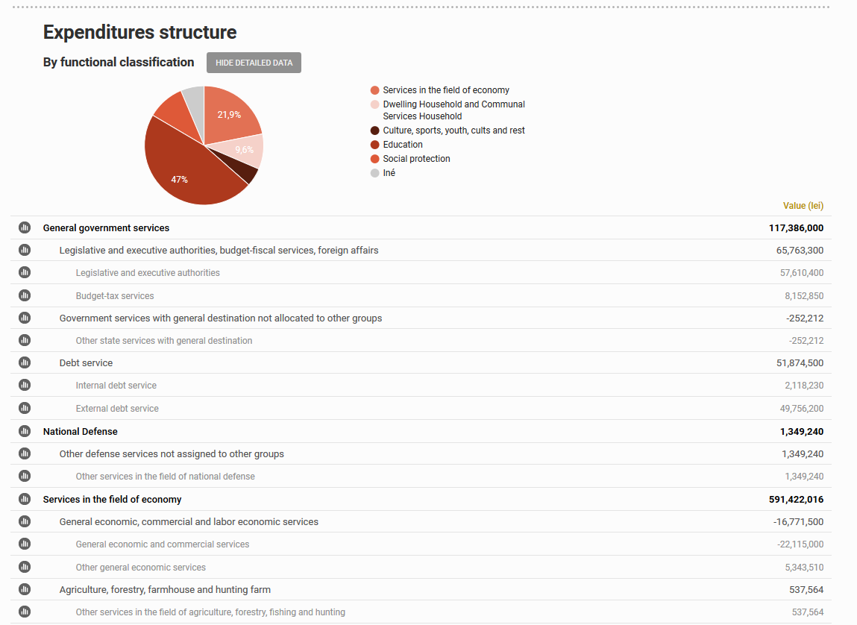

Slide 16
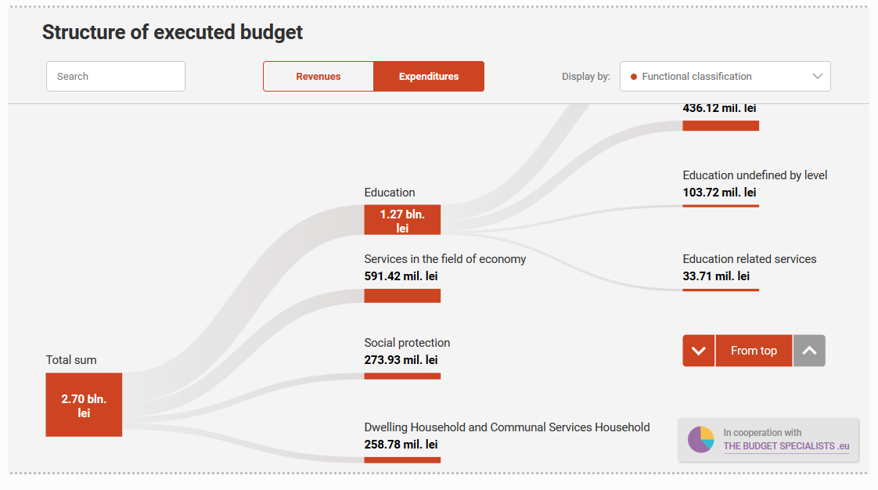

Slide 17
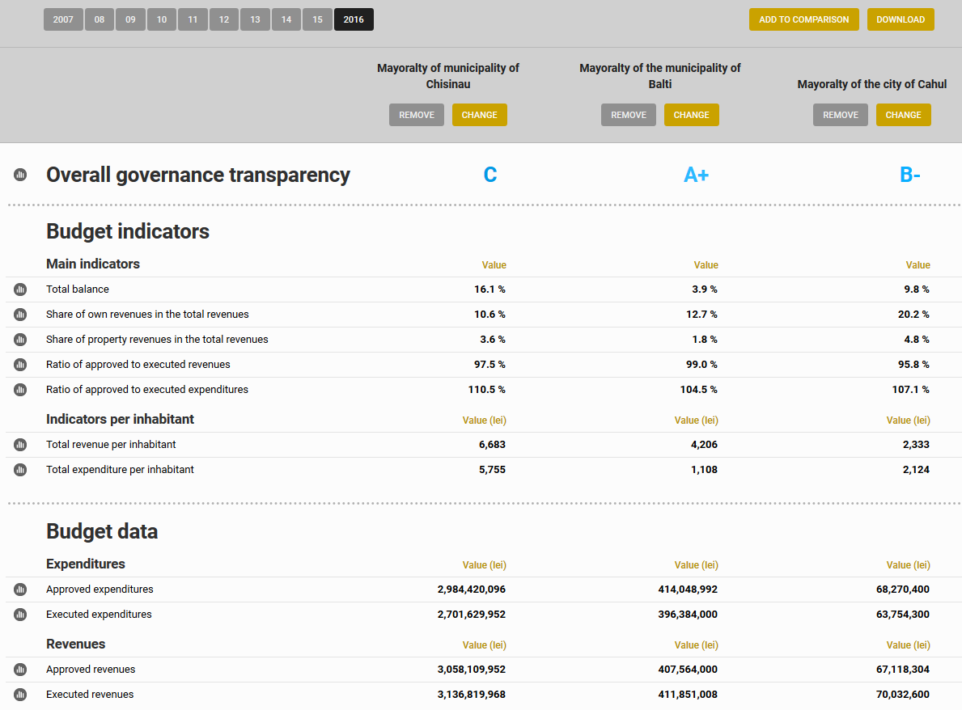

Slide 18
Thank you for your attention! http://www.hospodarenieobci.sk/ http://localbudgets.viitorul.org/

