Slide 1


Transparency in Slovak municipalities
Transparency International Slovakia, KIEV, March 2018

Slide 2
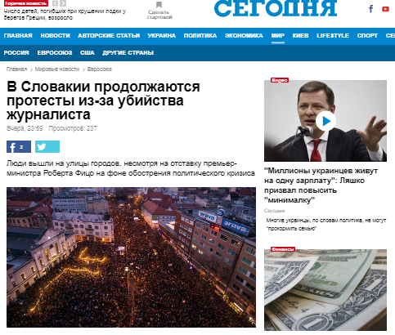

Slide 3
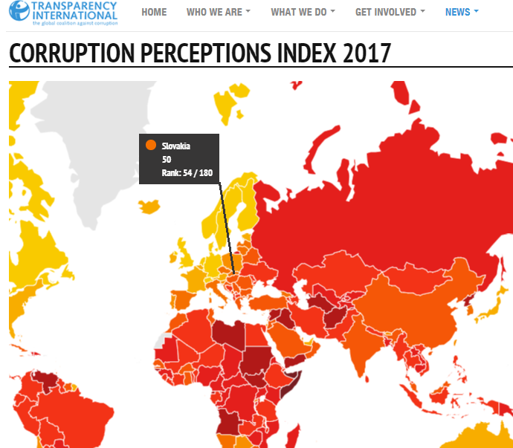

Slide 4
THE MUNICIPAL PROGRAM
TIS – Slovak NGO founded in 1998
Mission: to reduce corruption by increasing transparency and citizen involvement, strengthening of the processes and reducing red tape
Areas: health service, justice, public procurement, media, state-owned companies, municipalities, etc.
Municipal program: Open local government
TI Slovakia involvement in local governments since 1999
Four pillars:
  Transparency rankings – measuring
  Watchdog – investigation
  Anticorruption strategies – cooperation
  Local activists networking - support

Slide 5
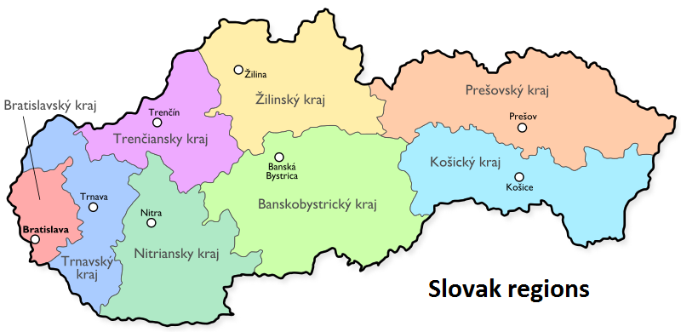
Self-government
More than 2900 municipalities; 8 regions
  2900 Mayors; 20 000 Local MPs; 8 Regional Presidents; 400 regional MPs
  Important competences – hospitals, schools, roads, public transport, social care facilities, building permits, land use planning, libraries, theatres, tourism
  Local taxes and fees
  The annual budget of Slovak municipalities and regions: 5,6 billion € (towns - over €3,7 billion)

Slide 6
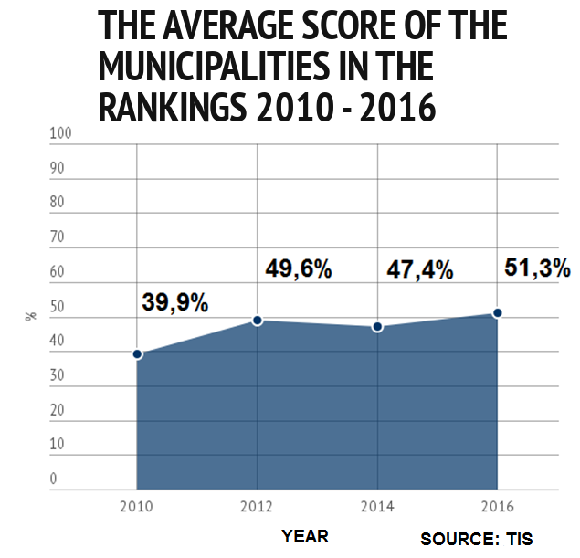
Transparency improvement
The transparency level has increased:
Towns: 2010/2016: +11 pp
Regions: 2011/2017: +8 pp

Slide 7
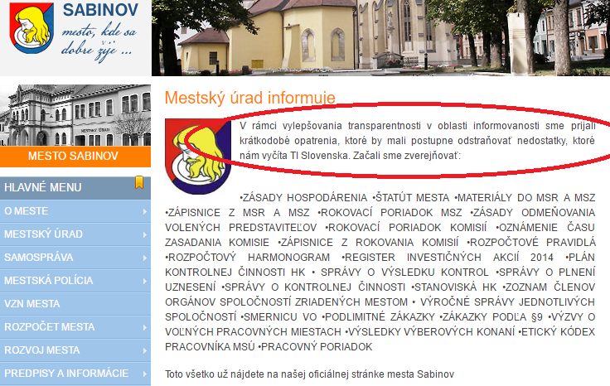
IMPROVEMENT PLAN
Broad media attention:
  In SK over 130 media citations in national and regional media immediately after unveiling the 2016 ranking
Sabinov occupied 100th place in 2014
Afterwards, they informed on the website about their improvement plan
In 2016 ranking they improved to 13th place
Notes:
Podobne Vranov – v roku 2012 posledné 99. miesto spolu s Bytčou.

Slide 8
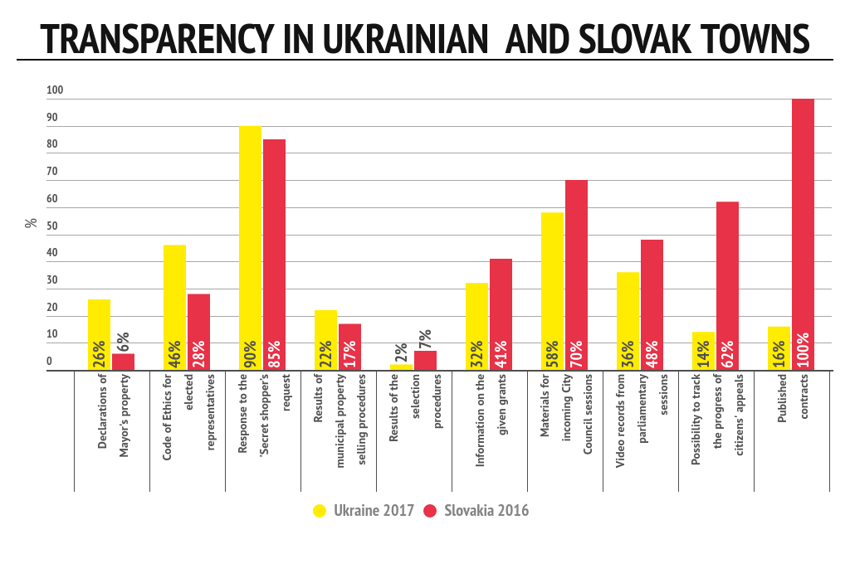
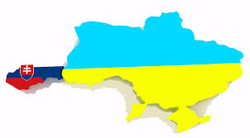
Notes:
Published contracts Slovakia 2010 – 11%

Slide 9
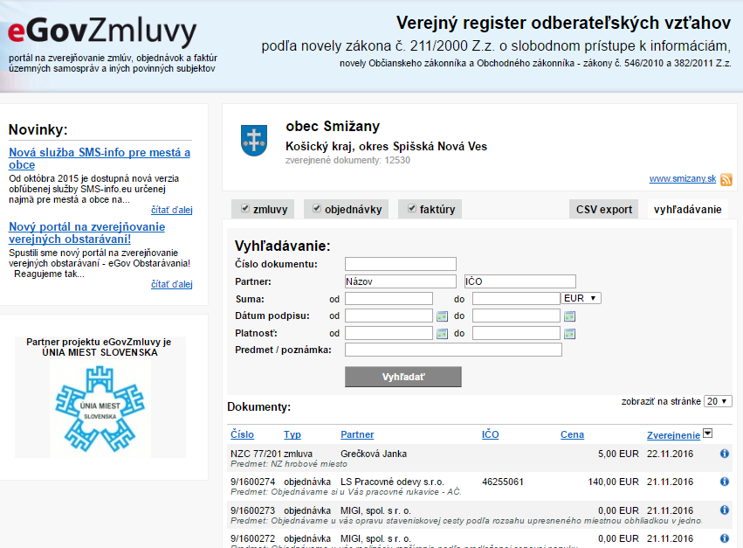
CONTRACTS: HOW TO DO IT
The quality of contract publishing is 61 % in average
Village Smižany - 99 %
They publish all the contracts with attachments, copying from the documents is possible
They also provide a system for searching of the contracts according to sum, date, company, etc.

Slide 10
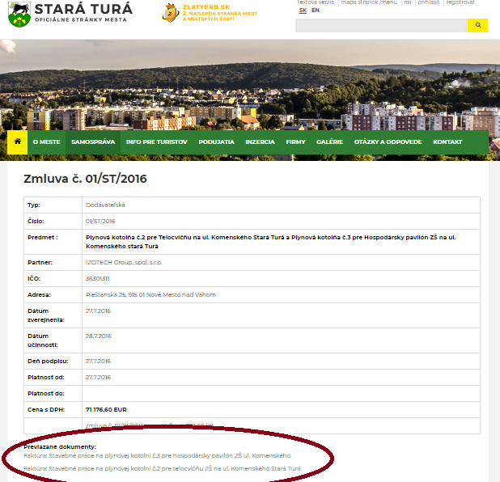
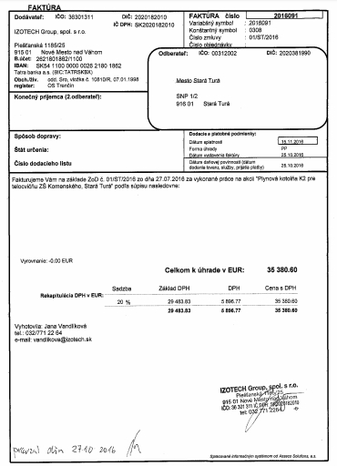

Slide 11

„THE SPEAKING TRUMPETS“
The local politicians usually inform citizens via municipal newspapers about important local topics and events that do not draw attention of the commercial or state media, but they often have impact on daily life
The municipal newspapers are a very effective tool to influence voters, mostly they are fully controlled by the Mayors
Therefore, they tend to be biased in many towns and they have been misused by local politicians for their political campaign
The lack of professionalism and oversight in the newspapers have deformed democratic process in the municipalities and reduced free competition of ideas connected to the community life

Slide 12
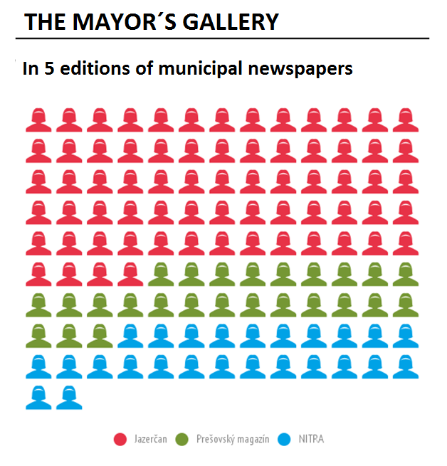
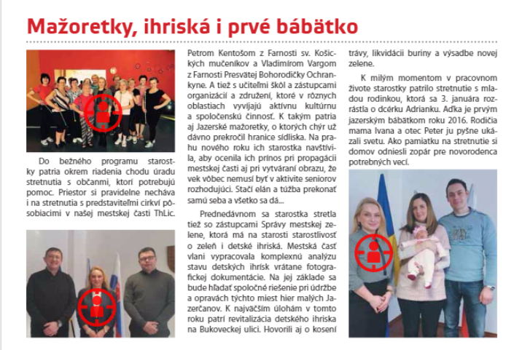
INDEX BENEFIT
We scrutinised 10 indicators
Positive: the share of self-government issues in the edition; the space offered to critical or polemic opinions; inclusion of the public in future decisions;
Negative: the anonymity of stories; excessive promotion of the local mayor or leadership of self-administration; the share of critical mentions harming their opponents
The newspapers are full of pictures of Mayors and the stories about their extraordinary performance

Slide 13
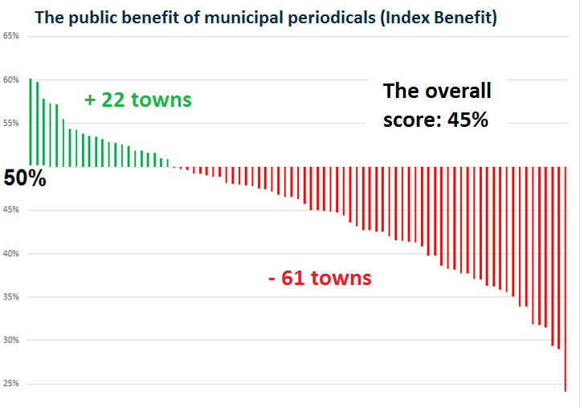
THE PUBLIC BENEFIT OF NEWSPAPERS
If positives and negatives are in the balance, the score of the paper reaches 50 percent
Negatives prevail in three quarters of municipal newspapers

Slide 14
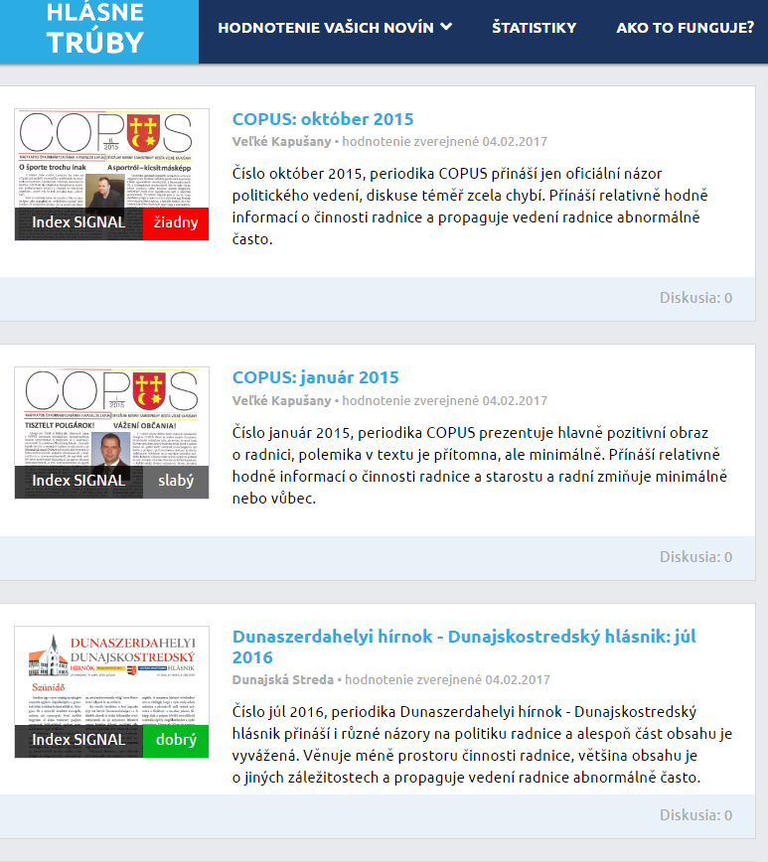
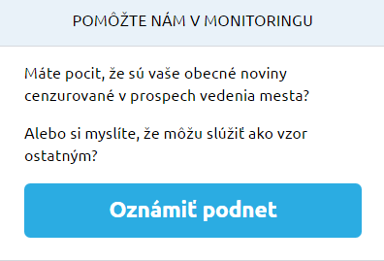
The portal
hlasnetruby.transparency.sk
The evaluation of 415 editions with the particular indicators
All the newspapers in one place
The statistical data
The recommendations
The trends (We are going to repeat the analysis)
The possibility to announce the new case

Slide 15
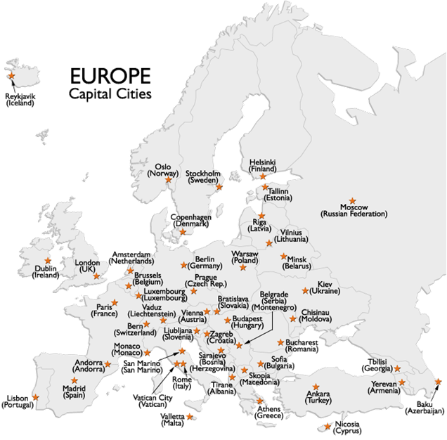
European Cities’ Openness Ranking
Building on a good practice
tool in motivating and persuading institutions to make their decision-making more visible to public and more open to public participation
Knowledge sharing and cooperation
better understand differences between countries, recognize best practices

Slide 16
Thank you for your attention
www.transparency.sk
facebook.com/transparencysk
twitter.com/transparencysk
transparency.blog.sme.sk
https://transparency.blog.sme.sk/
© 2018 Transparency International Slovakia

