Slide 1

Participatory budgeting (PB)
Slovak experiences
20th March 2018
Kiev Jakub Kmeť

Slide 2
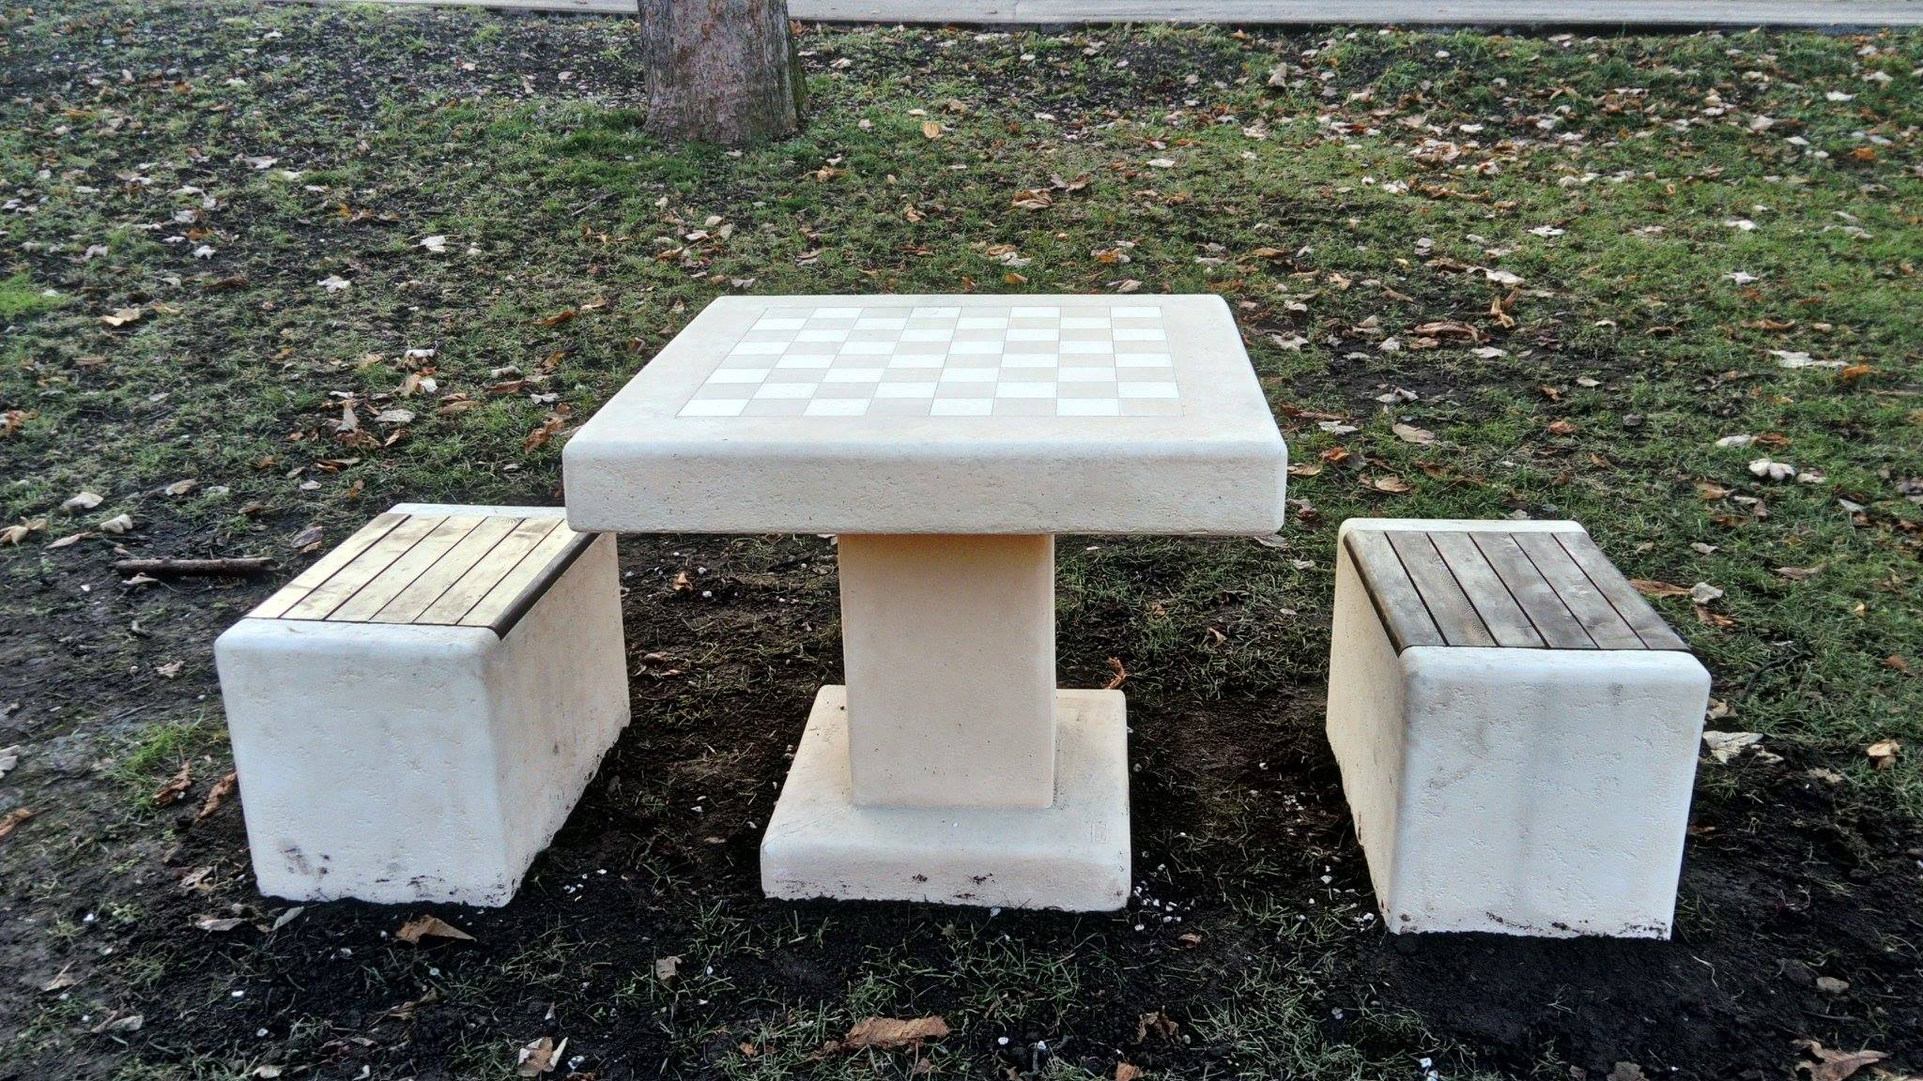
Chess table and chairs in Trnava
Notes:
Result of last volume of partipatory budget in slovak city Trnava
One of 16 projects which were supported by citizens
chess tables were placed on three public place

Slide 3
Participation
Notes:
je to o budovaní vzťahu a dôvery medzi občanmi a samosprávou
Je to dlhý proces
- prejudice

Slide 4
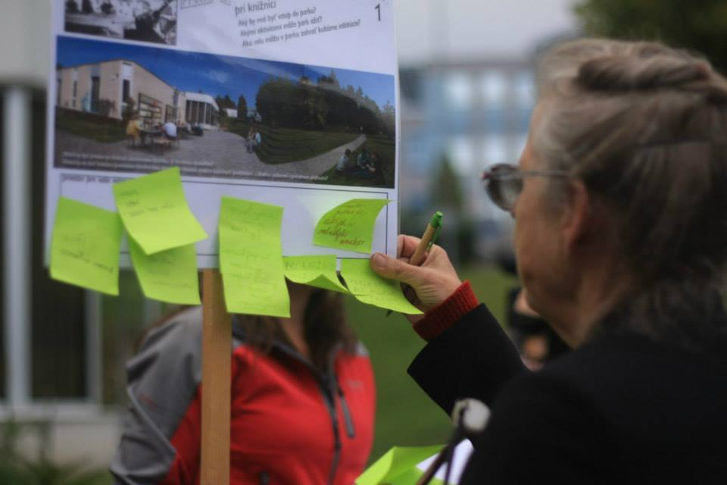
Citizens as a partners who know the city best
Notes:
Ľudia prinášajú expertízu ale aj nápady

Slide 5
Participation
Build the trust between citizens and authorities
Increase the legitimacy of decision making
Notes:
Results of participation

Slide 6
Participatory processes
planning public space
cooperate to create public policy
reporting systems
participatory budget

Slide 7
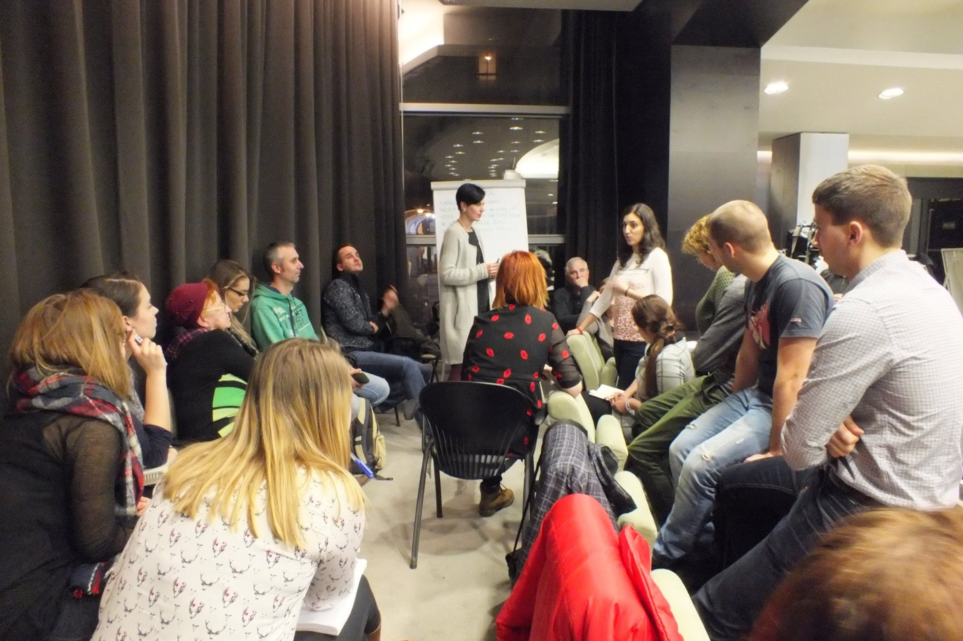
Participatory budget (PB)in Trnava

Slide 8
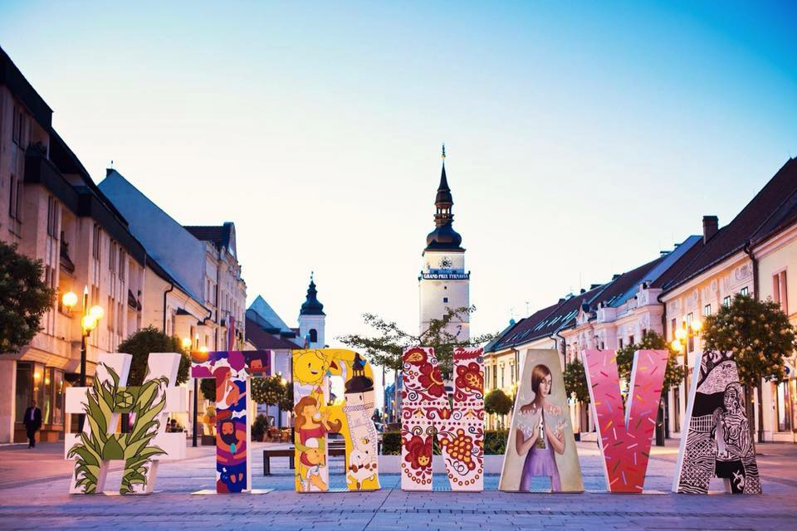
Trnava
Population – 64 000
60 km east from Bratislava
Centre of one of the 8 regions
Two universities
Annual budget – 62 million euros

Slide 9
89 500 €
31 projects
1800 citizens participated
For PB in two last years
Supported in two last years
In 2017

Slide 10
What PB is not
publishing the budget on website
online survey about priorities of municipality for budget
discussion about budget during the parliamentary session

Slide 11
What PB is
part of spending is determined by citizens (civis projects or public investments)
must to be repeated annually
must to be open to everyone in municipality
the final decision has to be made by citizens

Slide 12
Begining of PB
Porto Alegre (Brasil)
tool for prevent social inequality
Support services and infrastrucion in social deprivate areas of city

Slide 13
Goals of PB in Trnava
to increase the involvement of citizens in decision making about budget
to support community life of the municipality

Slide 14
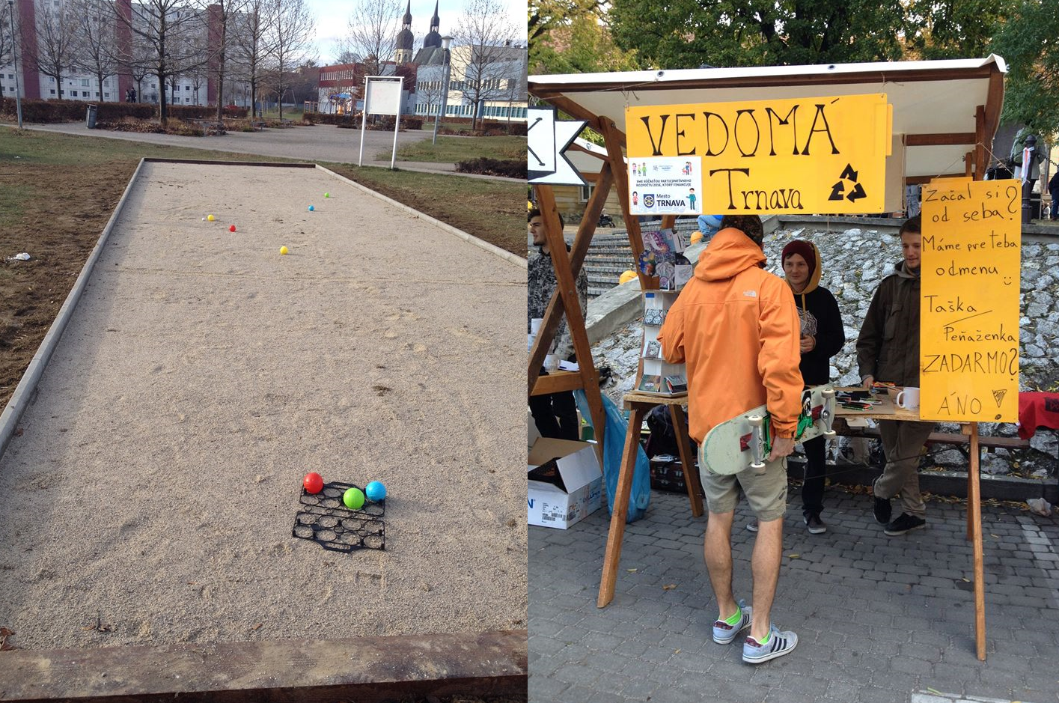
Two types of expenditure
Civic projects
Maximum budget 5 000 € per project
Implement by municipality or NGOs
Public investment
maximum budget 50 000 € per investment
Implement only by municipality

Slide 15
How it works in Trnava
Vote by the citizens
Evaluation
Generating and collecting Projects
Feasibility studies and cost evaluation by local authorities
Implementation

Slide 16
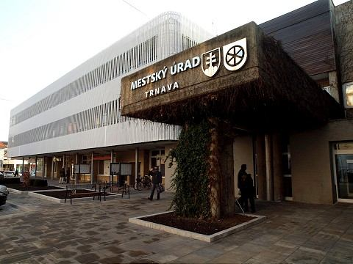
The role of local authority = Consultant
Advice with drafting the projects
Evaluate if the draft of project is reliable

Slide 17
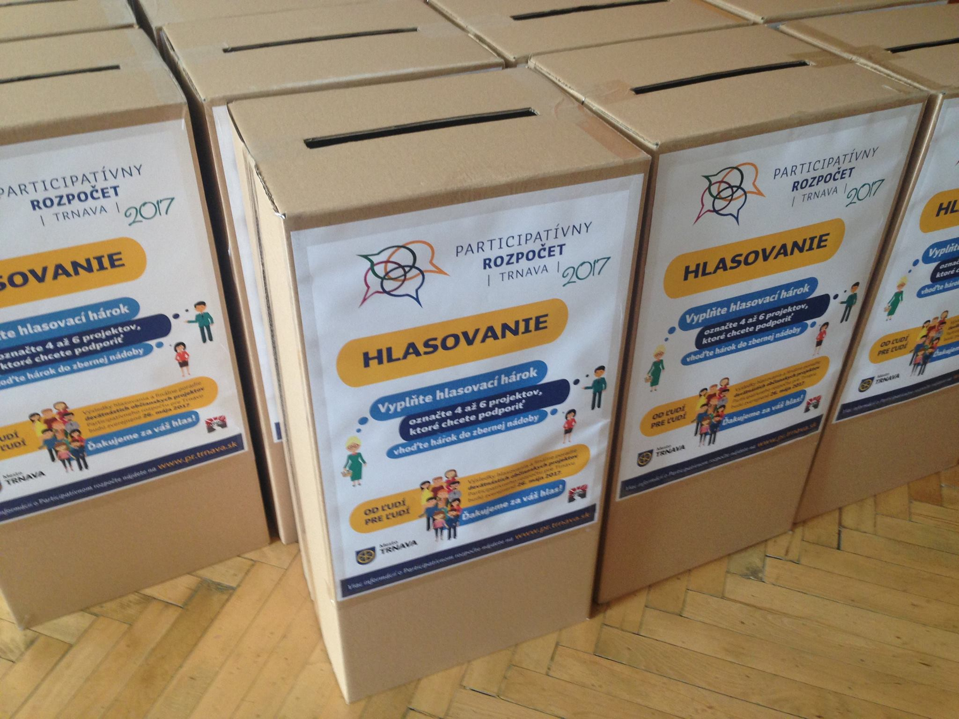
Threats of PB
Kidnapping of PB
Missing of rules
Politicians do not accept decision made by people

Slide 18
Advantages of PB
Space for ideas
Everyone has a opportunity to be involved and presents his idea to improve the municipality
Support for community life
The PB support networking between various communities in the municipality or people with the same interests
Learning
It is a opportunity to learn something new from others who are participating
Monitoring of needs
The municipality receives feedback from its citizens about the daily life in city and their needs
Involve citizens
Achieve active involvement by members of a community in a decision making process

Slide 19
Thank you!
Contact me: jakub.kmet2@gmail.com

