Slide 1

Strenghtening Capacities of Civil Society Actors in Moldova to Use Open Data
Peter Golias
INEKO Director
September 15th 2017
Open Data Media Camp, Chisinau, Moldova
Project funded by the Pontis Foundation in Slovakia

Slide 2
About INEKO
Economic think-tank established in 1999
Mission: Supporting transition to democracy and market economy in Slovakia:
  Democratic transition: Transparency, Feedback on populism, Report on the State and Develoment of Democracy (2017)
  Economic and social reforms: Public finance (pensions, taxes), Labor market, Health care, Education, Transport infrastructure
Transfer of reform know-how abroad: Ukraine, Moldova, Serbia, Macedonia
Permanent staff: 6+
Budget: EUR200,000+ (Slovak Aid, US Embassy, Pontis Foundation, EC, private donors, international donors)

Slide 3
Presentation blocks
Value for money in Slovakia – who and how oversees the efficiency of the public sector
Opening data – what is open and what is not in Slovakia
INEKO projects aimed to increase efficiency in local governments, education, health care and transport in Slovakia
INEKO projects aimed to increase efficiency in local governments in Moldova and Ukraine

Slide 4
Session 1:
“Value for money” in Slovakia
Who and how oversees the efficiency of the public sector
Peter Golias, INEKO Director
September 15th 2017, 9:00-10:30 am

Slide 5
Why “Value for money”?
Value / Money = Efficiency
Goals: Higher efficiency, reducing risk of wasting public money and corruption
Value: Financial benefits, healthy life years, time saved, less casualties in traffic accidents, jobs created, better educated population, etc.
Money: Costs of public expenditure
To assess “value” and “money” it is essential to have high quality DATA
Main risk: Pressures to “adjust” or hide data
To maximize the impact and limit bad decisions it is essential to PUBLISH analyses and OPEN DATA

Slide 6
Who guards the efficiency?
Until 2016:
  No official project/institutions
  Ad-hoc analyses by the Institute for Financial Policy at the MoF (influential Gvt think-tank)
  Informal oversight: NGOs, media, private sector
Since 2016:
  Launching “Value for money” project:
    Initiative of three persons (officials)
    New Value for Money Unit at the MoF
    Setting-up analytical units at other Ministries and State Institutions

Slide 7
How?
    NGOs, media, private sector
      Research, publishing data sets, interactive portals, and analyses based on publicly available information and data received throught the Free Access to Information Act
      Some examples:
        Financial data of local governments: http://www.hospodarenieobci.sk/
        Data about primary and secondary schools: http://skoly.ineko.sk/
        Data about hospitals: http://nemocnice.ineko.sk/
        Financial data of private firms: https://www.finstat.sk/
        Data about public tenders and contracts: https://tender.sme.sk/, http://otvorenezmluvy.sk/
        Court rulings: https://otvorenesudy.sk/

Slide 8
How?
    Value for Money Unit at the MoF
      Methodological support from the IMF
      Spending reviews: Systematic analyses of public expenditure in selected sectors:
        First phase: IT, healthcare, transport
        Second phase: Education, labor market and social policies, environment
        Third phase: Gradually all other public sectors
      Evaluating key policies, regulations, expenditure and investment projects
      Publishing analyses and underlying data
      Building a big Data Center at the Institute for Financial Policy at the MoF
      Key measures/recommendations should be implemented through the State Budget Act and subsequent norms
      Analysts just inform, politicians decide!
      http://www.finance.gov.sk/Default.aspx?CatID=5907

Slide 9
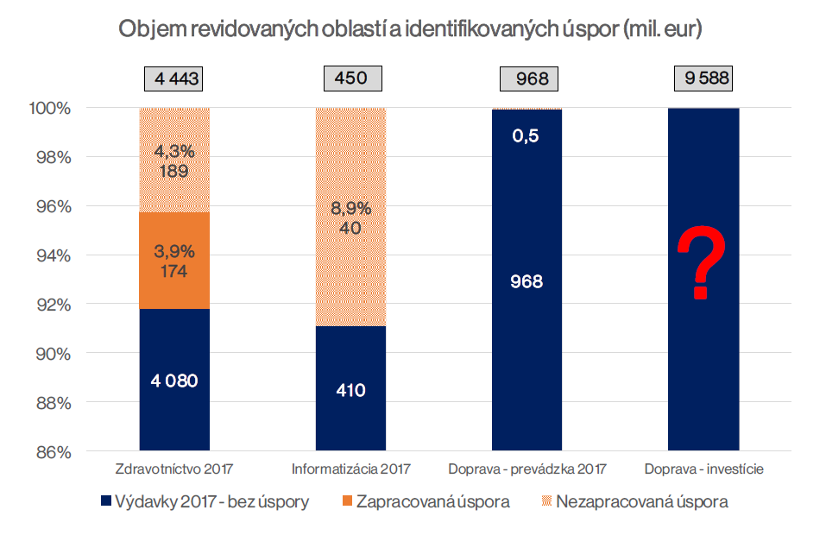
Volumes of reviewed sectors and identified savings (million EUR)
Healthcare 2017
IT 2017
Transport - operation 2017
Transport - investment
Expenditure 2017, without savings
Savings implemented in the state budget
Savings not implemented in the state budget

Slide 10
Transport - investment
Political pressure to exclude 6 biggest to-be-implemented projects
One of them is the highway bypass of the 3rd biggest city Prešov costing 900 million EUR
INEKO identified potential savings of up to 400 million EUR
VfM Unit at the MoF analyzed the project and identified savings of around 200 million EUR
The project is now under revision

Slide 11
Main barriers
Political pressures
  Politicians sometimes prefer less efficient alternatives
Corruption
  Hiding information preserves room for illicit behavior
Administrative barriers
  Missing legislation
  Officials may be busy, lazy, incapable or simply afraid of publishing data
Non-existing or “bad” data
It is often hard work
  Low capacity (personal and financial) of state institutions to identify, collect, analyze and publish relevant data

Slide 12
Key solutions
Active citizens, strong NGOs, media, firms
Legislative measures to open data, such as:
  2000: Free Access to Information Act
  2003: Online Business Registry
  2007: Online Land Registry
  2011: Publishing all property contracts and invoices of public institutions on internet
  2012: Publishing court rulings on internet
Systemic strengthening of state capacities
  2016: “Value for money” project

Slide 13
Time for discussion

Slide 14
Session 2: Opening data
What is open and what is not in Slovakia
Peter Golias, INEKO Director
September 15th 2017, 10:45-12:30 am

Slide 15
Key milestones
2000: Free Access to Information Act (no “trade secret” objection)
Gradual shift from on-demand (i.e. based on information demanded by citizens) to automatic transparency
2002 and later: Open legislation
  The portal https://www.slov-lex.sk/ offers complete information from collection of laws and official gazettes
  The portal http://www.rokovania.sk includes complete information on the consultation of legislative proposals with full texting of comments and reactions

Slide 16
Key milestones
2003: Online Business Registry (user-friendly, searchable), http://orsr.sk/
2007: Online Land Registry, www.katasterportal.sk/
2009: Online public tenders
  Searchable portals such as http://tender.sme.sk
2011: Publishing all property contracts and invoices of public institutions on internet, https://www.crz.gov.sk/
  The contracts are not valid unless they are published
  Searchable portals such as http://otvorenezmluvy.sk/
2012: MoJ: Publishing court rulings on internet
  Searchable portals such as https://otvorenesudy.sk/

Slide 17
Other portals/datasets
2012:
  INEKO: Financial data of local governments: http://www.hospodarenieobci.sk/
  INEKO: Data about primary and secondary schools: http://skoly.ineko.sk/
    2013:
      MoI: Crime statistics, maps of crime
      For-profit project: Financial and other data of private firms: https://www.finstat.sk/
    2014:
      MoF: Online Register of Financial Statements of public/private firms
      INEKO: Data about hospitals: http://nemocnice.ineko.sk/
    2017:
      MoF: Public budget data: https://www.rozpocet.sk/
      Register of final beneficiaries: https://www.uvo.gov.sk/register-konecnych-uzivatelov-vyhod-427.html

Slide 18
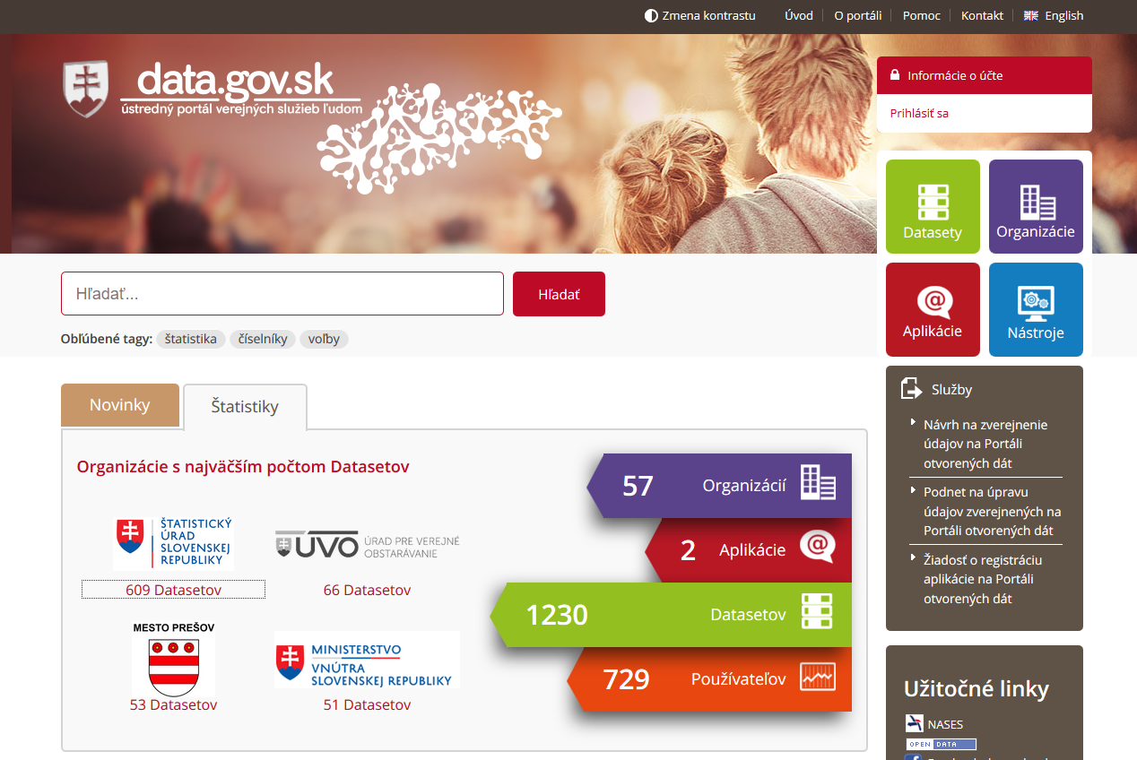
And many more...

Slide 19
What is missing?
Anonymized micro-data:
  Distributions of paid taxes, social and health contributions, turnovers, salaries, social benefits taken, costs of healthcare, tax declarations, etc.
Inter-connecting of various public databases:
  Ministry of education (registries of students), Social Insurance Agency (tax base – salaries), Unemployment Office
  Public tenders, public contracts
Data needed to assess quality of public services:
  Provision of healthcare, education, justice, etc.
And much more...
  Unanimous VAT returns: to be published soon
  Traffic intensity; Highway land-aquisition contracts
  Centralized publishing of Local Governments contracts

Slide 20
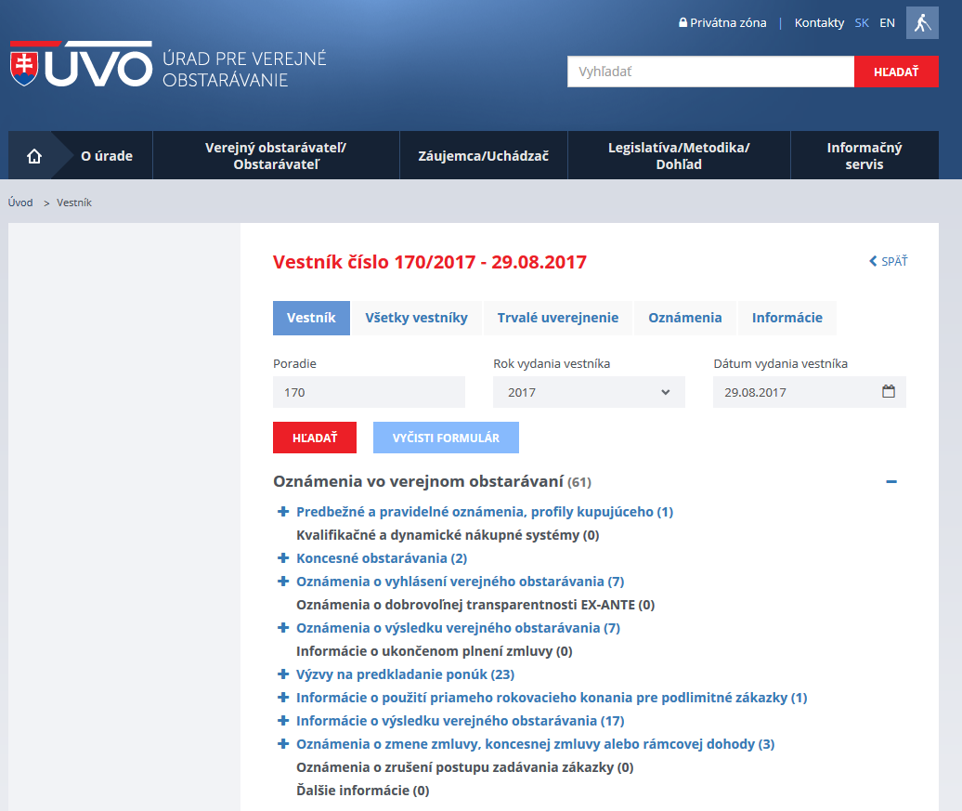
Some examples

Slide 21
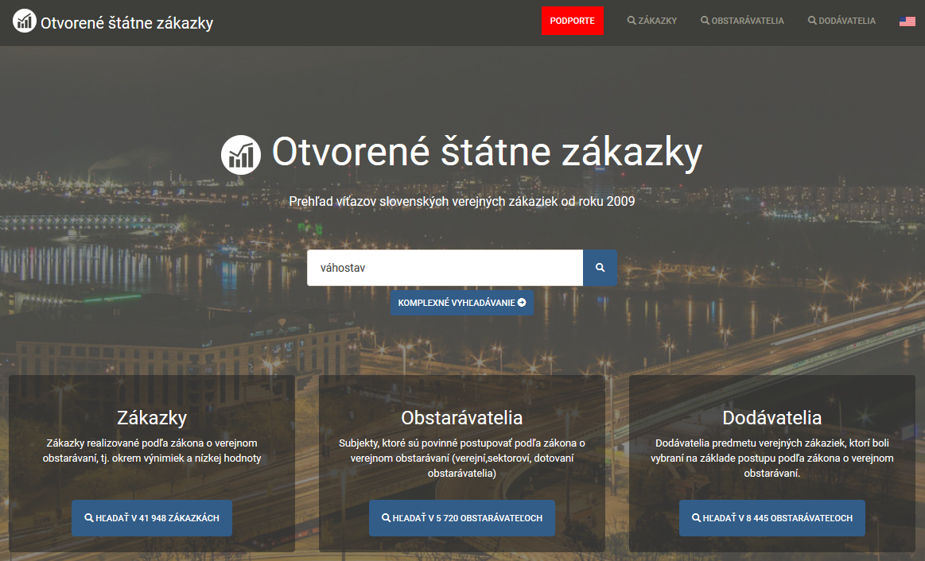

Slide 22
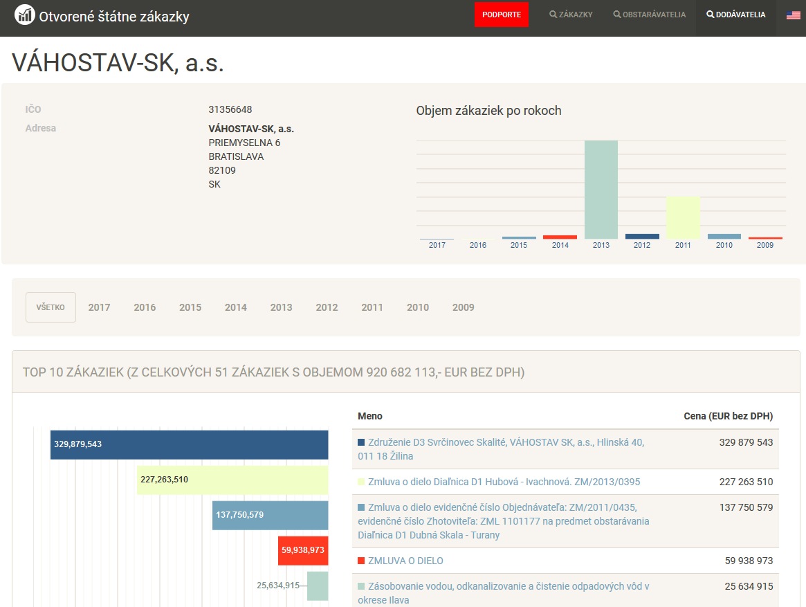

Slide 23
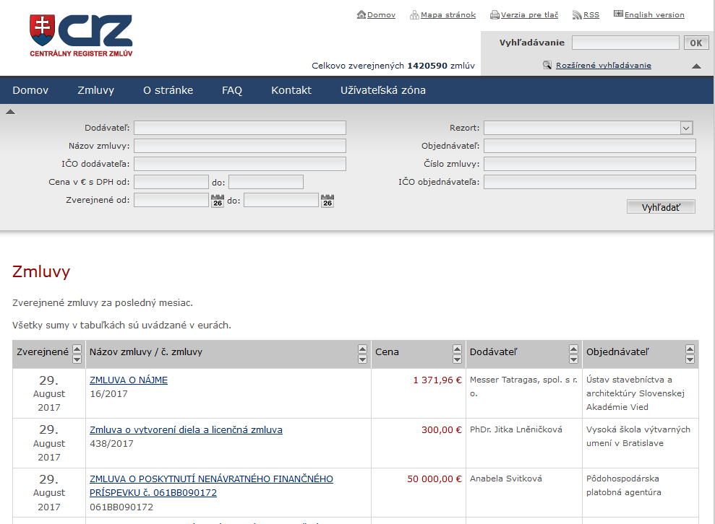

Slide 24
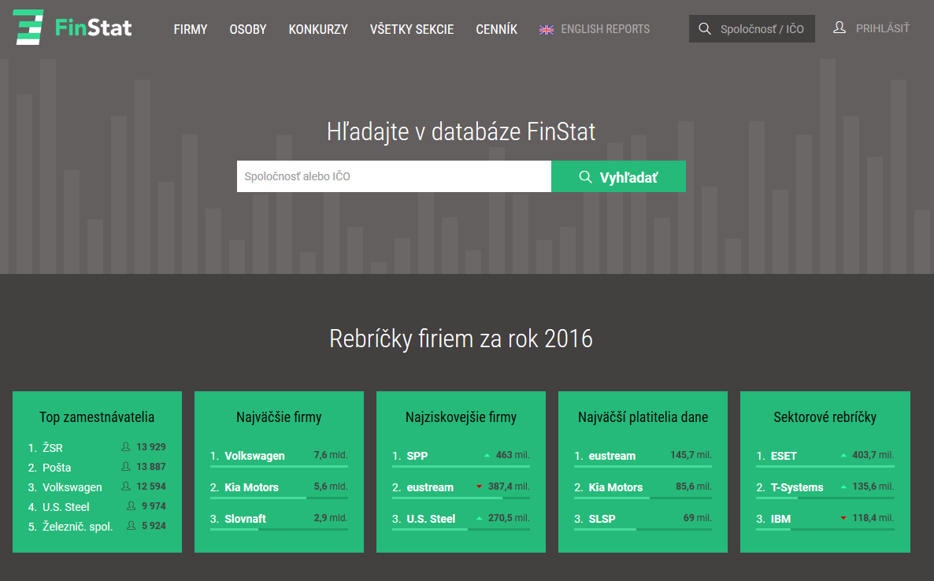

Slide 25
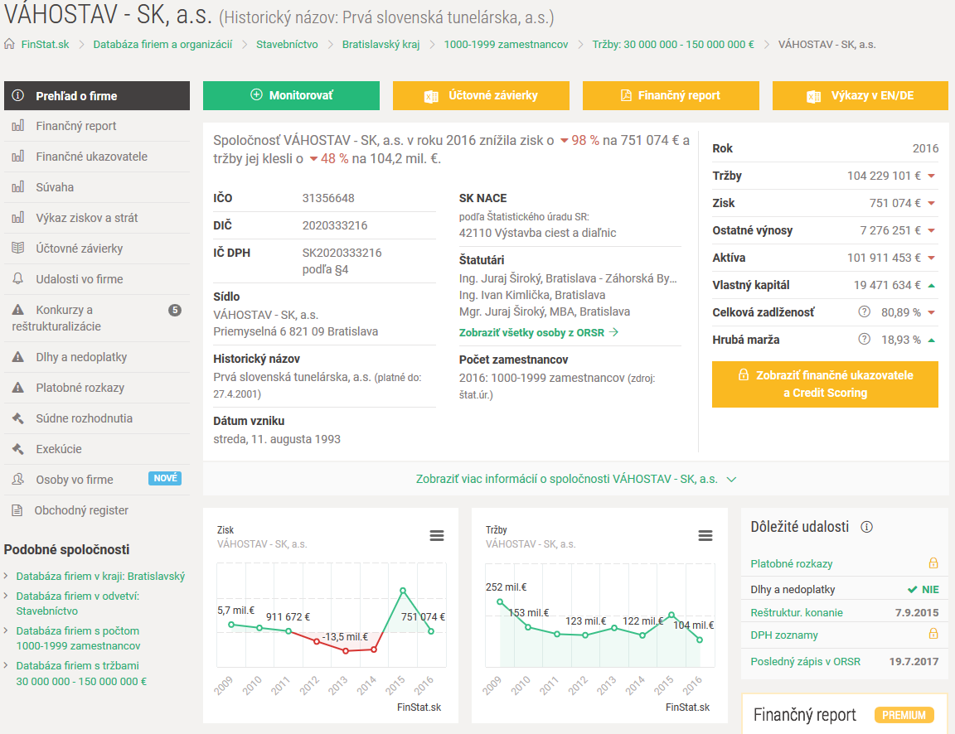

Slide 26
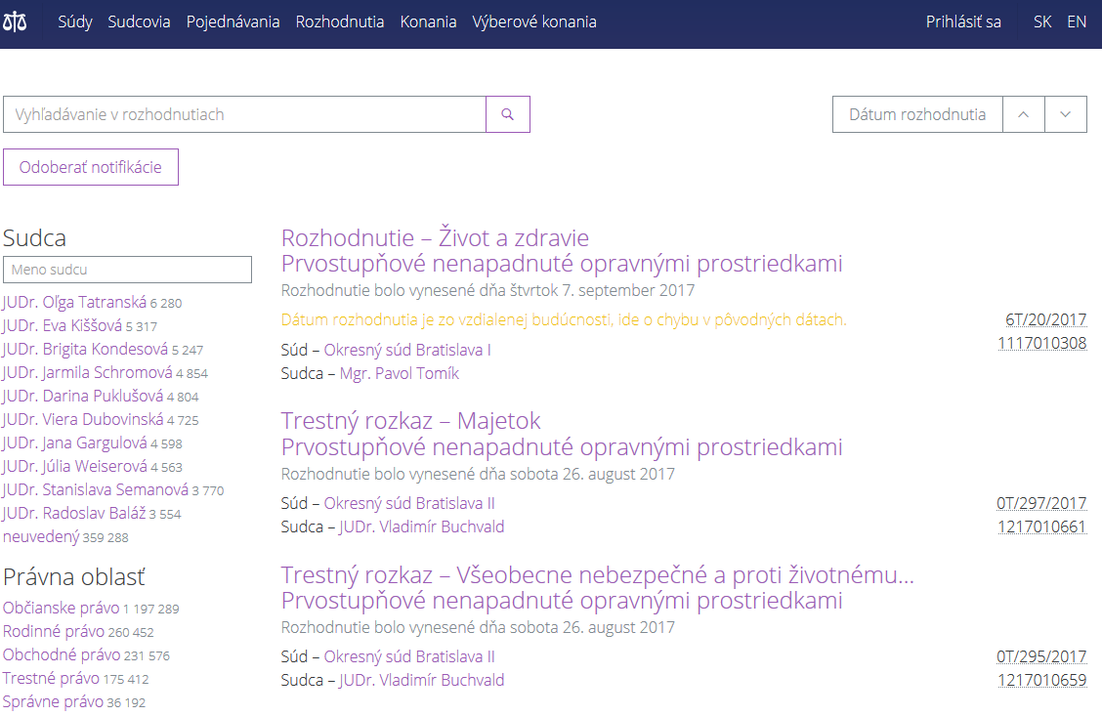

Slide 27
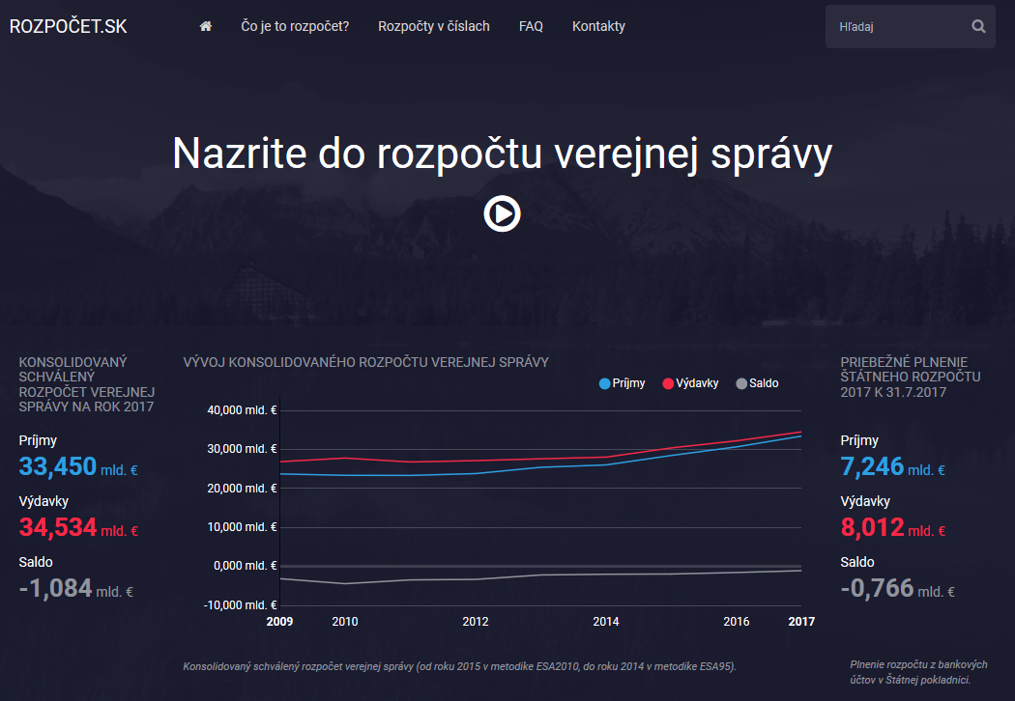

Slide 28
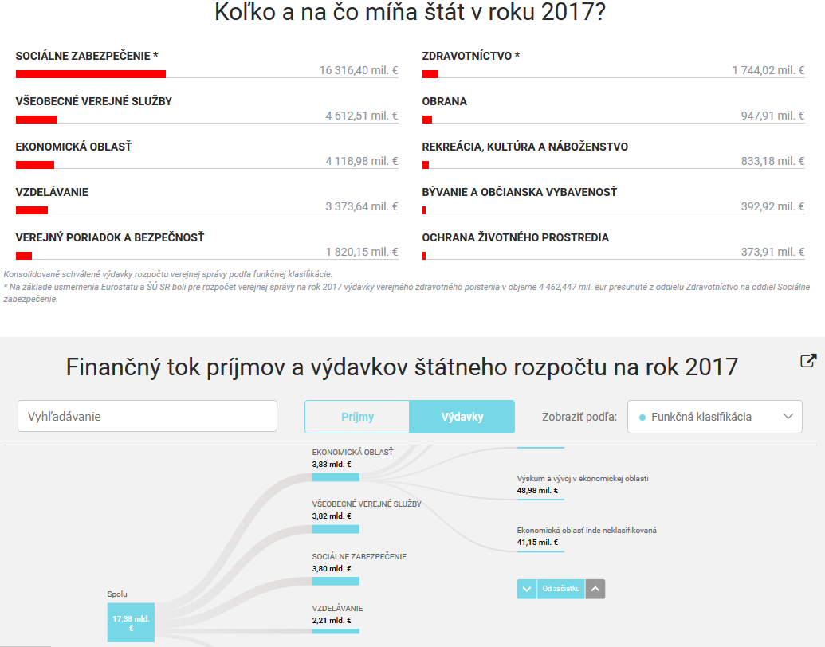

Slide 29
Time for discussion

Slide 30
Session 3:
INEKO projects in Slovakia
INEKO projects aimed to increase efficiency in local governments, education, health care and transport in Slovakia
Peter Golias, INEKO Director
September 15th 2017, 1:30-3:00 pm

Slide 31
Local governments
Since 2012: INEKO portal computing financial health of all municipalities and regions: http://www.hospodarenieobci.sk/
Data taken from the MoF Data Centre
Major developments/impact:
  Intensive public attention and pressure to govern finances of local Gvts responsibly; and to correct data
  New legal constraints (penalty, debt brakes, more strict rules on hidden debt)
  Fiscal stabilization of local Gvts
Plans: Adding detailed budget and balance sheet data

Slide 32
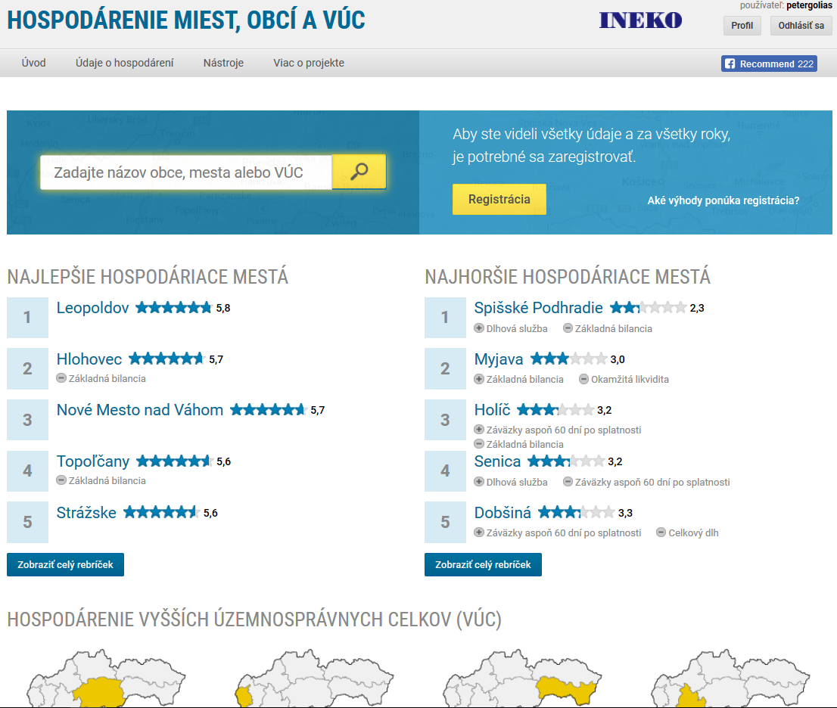

Slide 33
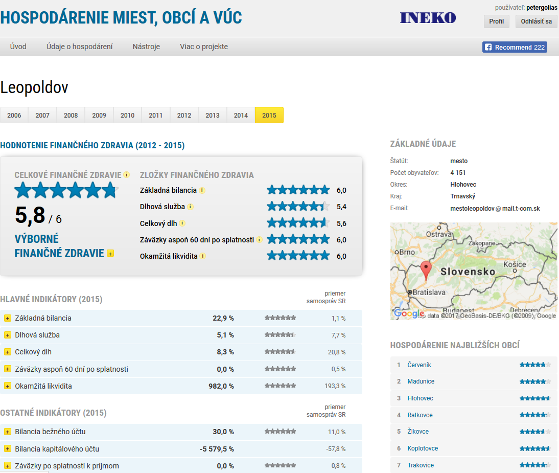

Slide 34
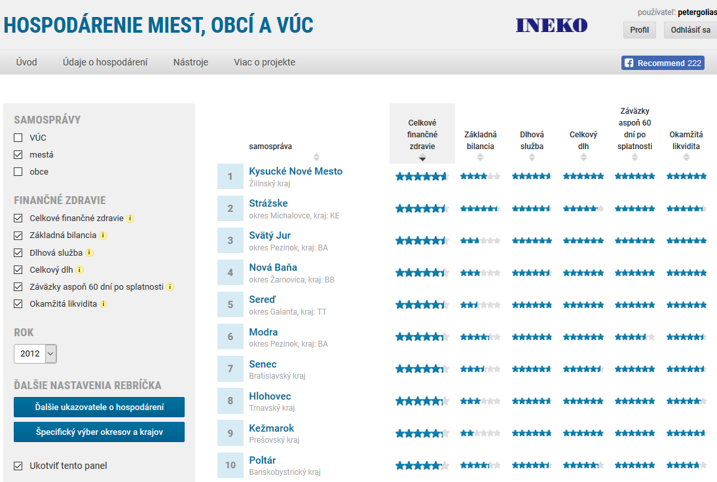

Slide 35
Financial health indicators
Indicators entering final rating | Weight
Overall debt over current revenues | 2
Debt service (interest plus principle) over current revenues | 1
Current and capital account balance over current and capital revenues | 1
Liabilities overdue at least 60 days over current revenues | 1
Immediate liquidity on financial accounts over short-term liabilities | 1
All indicators are transformed to the scale {0, 6}
Overall debt is computed based on data from the most recent year
Other four indicators are computed based on data from the 4 most recent years with following weights:
  Year t: 4
  Year t-1: 3
  Year t-2: 2
  Year t-1: 1

Slide 36
Underlying data
Current account revenues
Current account expenditures
Capital account revenues
Capital account expenditures
Debt service – principal
Debt service – interest
Short-term liabilities
Long-term liabilities
Bank loans
Loans from the state
Overdue liabilities
Liabilities overdue at least 60 days
Short-term receivables
Financial assets (e.g. cash, bank deposits)
Number of citizens

Slide 37
Portal on schools
Since 2012: INEKO portal displaying results of all primary and secondary schools: http://skoly.ineko.sk/
Data taken from the MoE and subordinated organizations and from the Labour Office
Major developments/impact:
  Intensive public attention and (even critical) debate about how to measure quality of schools
  New measure of “value added”, new standardized testing in the 5th grade
Plans: Further improvements in methodology

Slide 38
School ratings
Primary schools:
  20%: Results of the standardized national tests in the 5th grade
  60%: Results of the standardized national tests in the 9th grade
  20%: Exceptional results (competitions, projects)
Secondary schools - vocational:
  40%: Results of the standardized national school leaving tests
  10%: Exceptional results (competitions, projects)
  50%: Unemployment rate adjusted for regional differences
Secondary schools – grammar:
  60%: Results of the standardized national school leaving tests
  15%: Exceptional results (competitions, projects)
  25%: Unemployment rate adjusted for regional differences
All indicators are transformed to the scale {0, 10} and computed based on data from the 4 most recent years with following weights:
  Year t: 4; ...; Year t-1: 1

Slide 39
Underlying data
Results of the standardized national tests:
  5th and 9th grade at primary schools (Slovak language and mathematics);
  School leaving exams at secondary schools (Slovak and foreign languages, mathematics)
Exceptional results (competitions, projects)
Unemployment rate of graduates of secondary schools
Results of state school inspections
Teachers (number, qualification, usage of IT)
Financial sources (public and private)
Number of pupils, including socially disadvantaged
Number of pupils accepted for tertiary studies

Slide 40
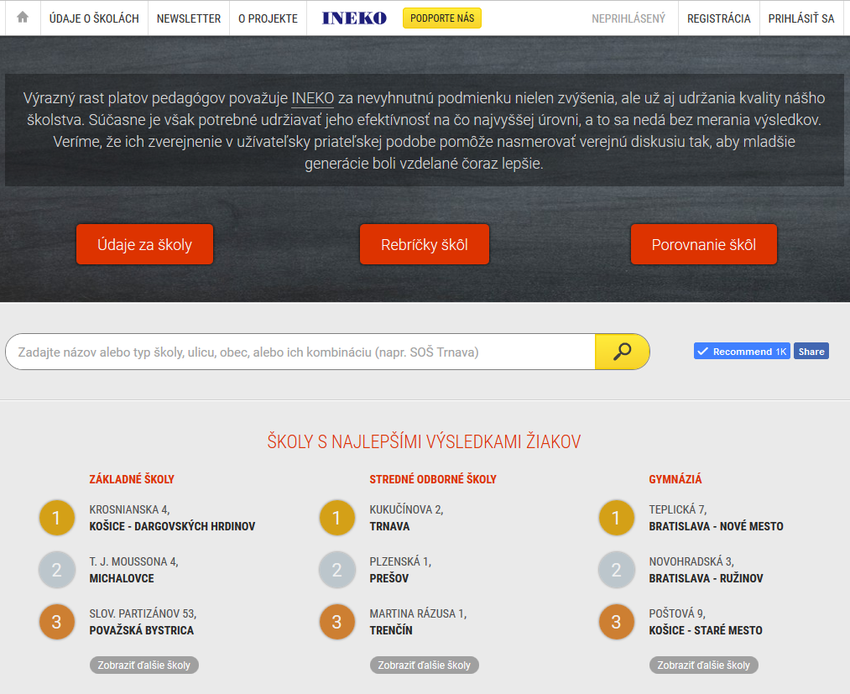

Slide 41
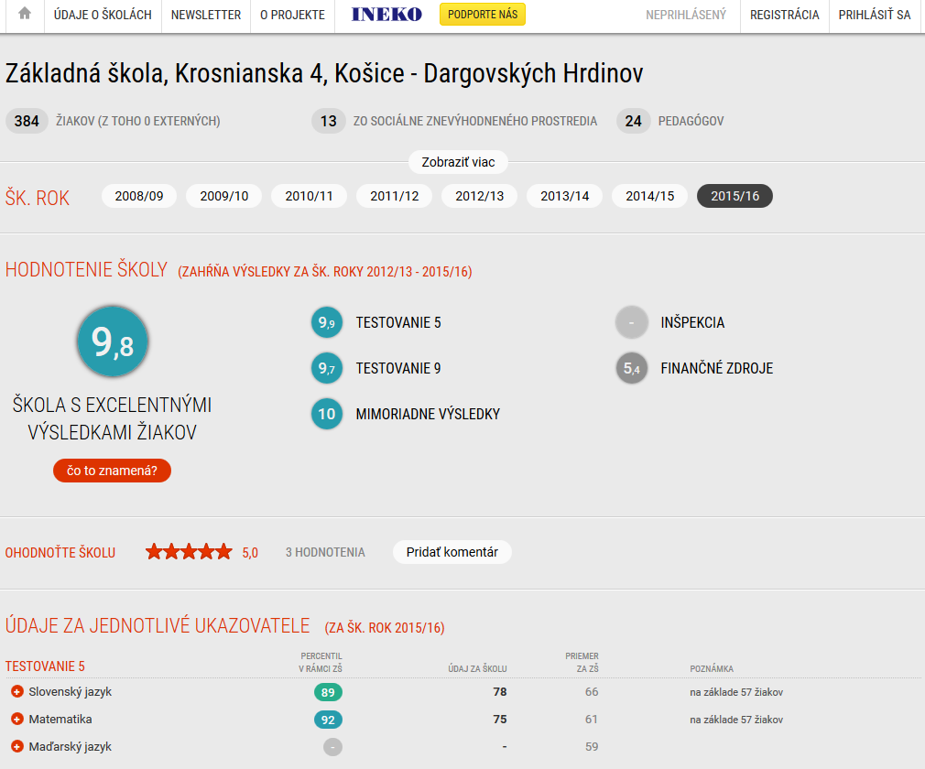

Slide 42
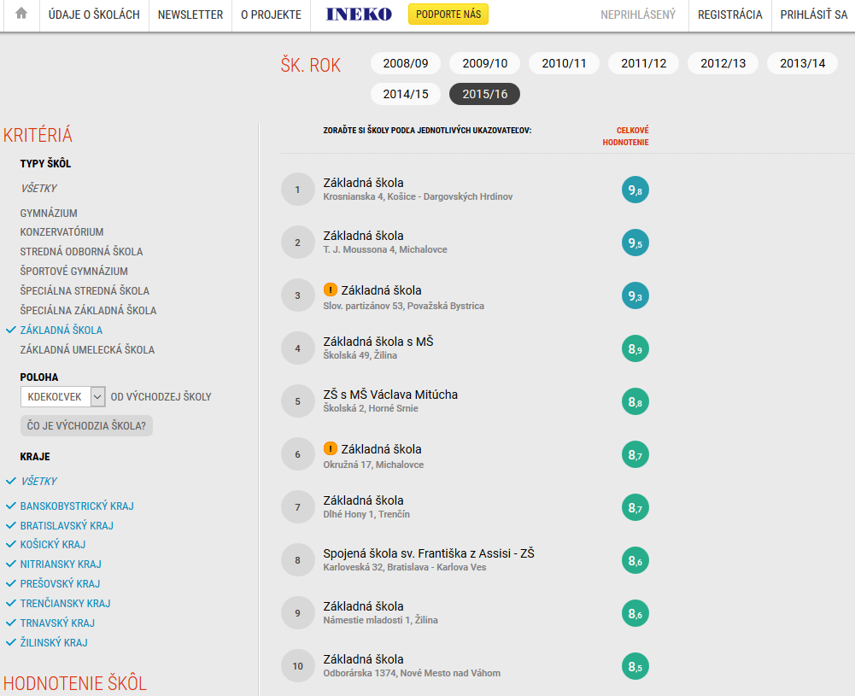

Slide 43
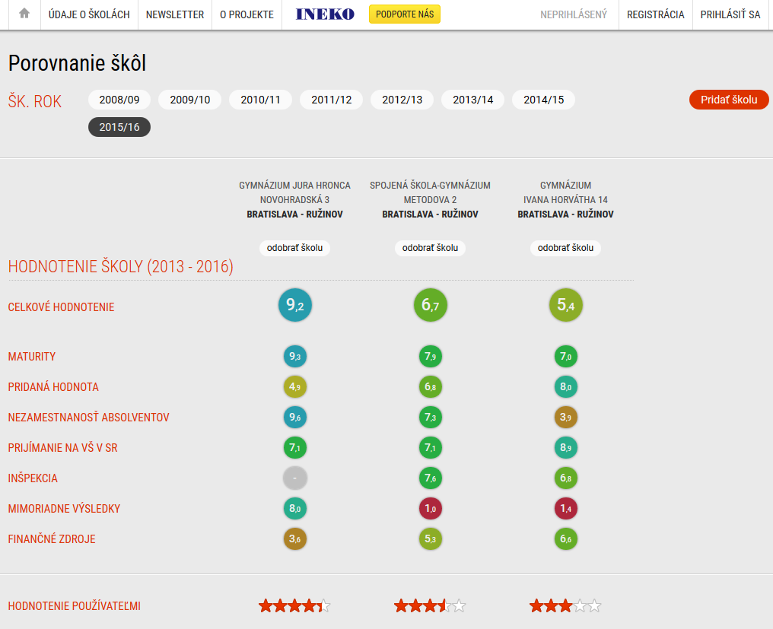

Slide 44
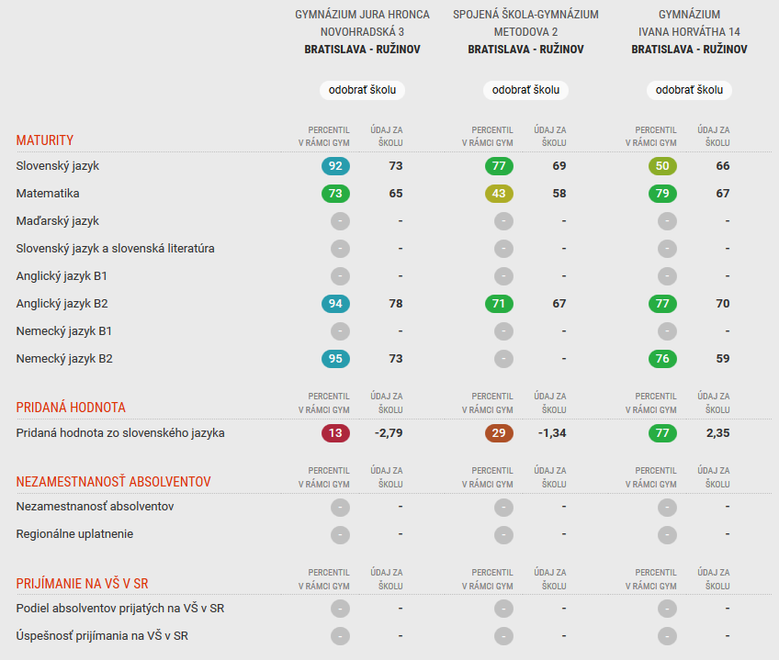

Slide 45
Portal on hospitals
Since 2014: INEKO portal displaying indicators of quality and efficiency of all hospitals: http://nemocnice.ineko.sk/
Data taken from the Health Insurance Companies, MoH and subordinated organizations, own research
Major developments/impact:
  Intensive public attention and debate about how to measure quality of hospitals
  Extension of data available
  MoH uses data in planning the minimum network of hospitals
Plans:
  Further improvements in methodology
  Including outpatient data
  Substantial upgrade to have more user friendly portal

Slide 46
Hospital ratings
25%: Patient satisfaction
  Questionnaires (20%) and complaints (5%)
40%: Quality indicators
  Rate of reoperation/rehospitalization, mortality indicators, penalties from Supervision Authority
20%: Financial stability
15%: Transparency
Almost all indicators are computed based on data from the 4 most recent years with gradually declining weights

Slide 47
Underlying data
Numerator and denominator for all quality indicators:
  Results of patient satisfaction surveys
  Number of patient complaints
  Waiting periods for specified diagnoses
  Official quality indicators (reoperation, rehospitalization, mortalities for specified diagnoses, nosocomial infections, decubitus ulcers, etc.
  Unofficial quality indicators (patient transfers, lenght of hospitalization, etc.)
Financial data
  Profit/loss, revenues, debt overdue, depreciation, liabilities, etc.
Transparency indicators
  Web page, mystery shopping, etc.
Other indicators:
  Number and amount of penalties from Supervision Authority for inappropriate treatment
  Number of official patient complaints
Names of awarded doctors and nurses

Slide 48
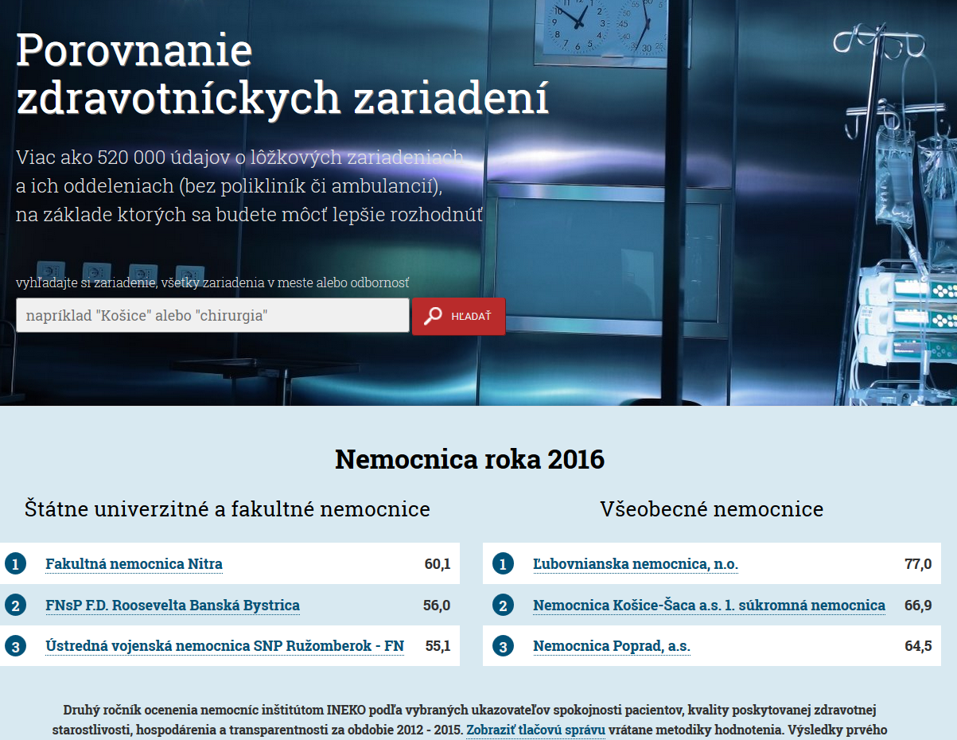

Slide 49
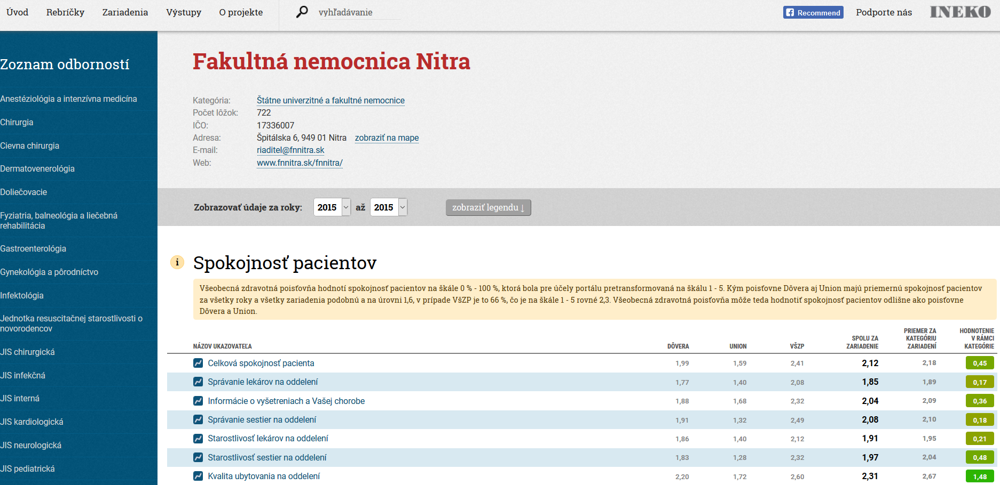

Slide 50
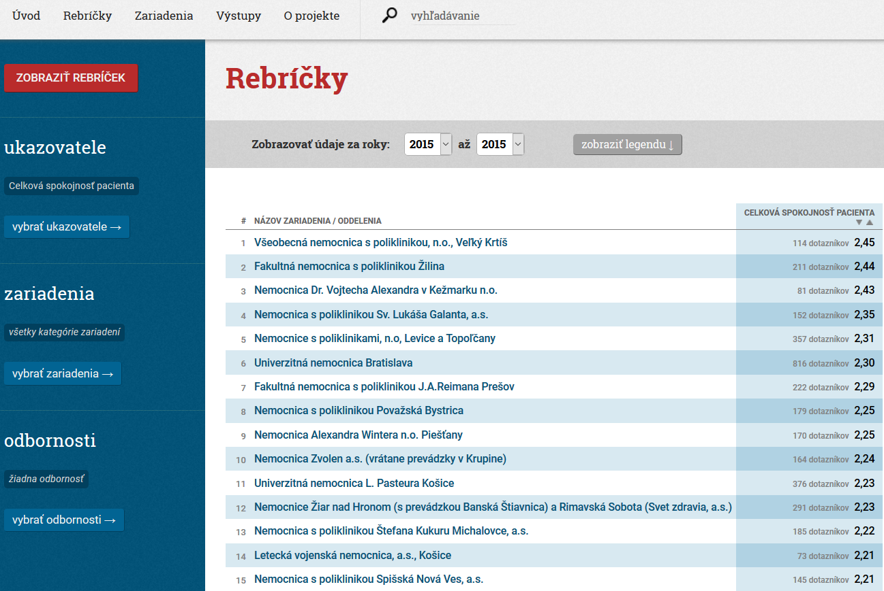

Slide 51
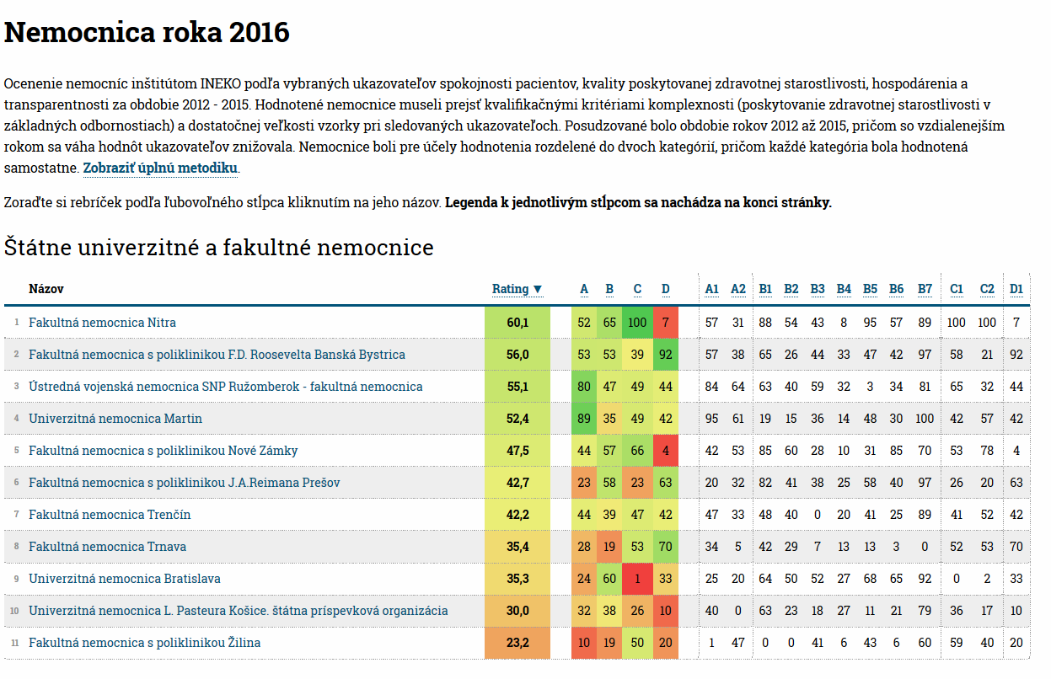

Slide 52
Transport infrastructure
2016-17: Collecting, processing and analyzing data about existing and planned highways including potential alternatives
  Technical parameters (length, width, type, material, objects), traffic intensity, assumed costs, timeframe
  Tenders: Number of bids, information about suppliers, prices of construction
Later in 2017: Programming and publishing interactive map of higways
Goal: To help public to assess priorities realistically and press for higher efficiency

Slide 53
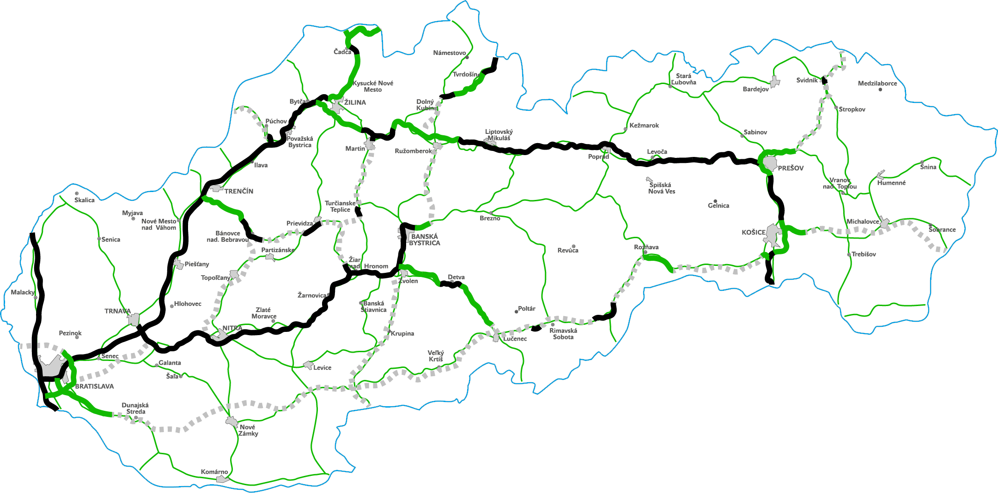
Road network in 2025
(highways and high-speed roads + modernized 1st class roads)

Slide 54
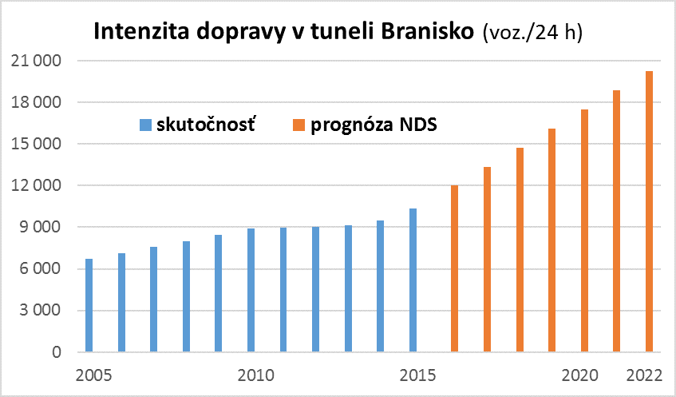
Traffic intensity in the tunnel Branisko (vehicles / 24 hours)
20 thousand is maximum limit for 1 pipe
Reality
State prognosis
Source: INEKO, National Higway Company
Note: The 2nd pipe of the tunnel (5 km long) would cost around 300 million EUR

Slide 55
Time for discussion

Slide 56
Session 4:
INEKO projects in Moldova and Ukraine
INEKO projects aimed to increase efficiency in local governments in Moldova and Ukraine
Peter Golias, INEKO Director
September 15th 2017, 3:00-3:40 pm

Slide 57
About projects
Title: Transparent, financially healthy and competitive municipalities in Moldova/Ukraine
Period: Since 2015
Funded by: Slovak Aid, US Embassy, NED
Implemented by:
  Moldova: INEKO and IDIS Viitorul
  Ukraine: INEKO and ICPS
Goal: To support regional development in Moldova/Ukraine through know-how transfer of successful projects implemented in Slovakia

Slide 58
Projects transferred
Portal on financial health of Slovak municipalities – INEKO, http://municipalities.ineko.sk/
Open local government – Transparency International Slovakia, http://mesta2014.transparency.sk/en
Competitive regions 21 – Business Alliance of Slovakia, http://www.regiony21.sk/

Slide 59
Created portals
Moldova
  Financial data of all municipalities and regions: http://localbudgets.viitorul.org/
  Transparency rating of 50 biggest cities and all regions: http://localtransparency.viitorul.org/
  Competitiveness rating of all regions: http://competitiveness.viitorul.org/
Ukraine
  Financial health of 22 biggest cities and 22 regions: http://budgets.icps.com.ua/
  Transparency rating of 50 biggest cities and 22 regions: http://transparency.icps.com.ua/
  Competitiveness rating of all regions: http://competitiveness.icps.com.ua/

Slide 60
Other activities
Creating two expert teams (2x5 people) analyzing data and communicating with local governments, monitoring their effort
Visits to municipalities
Advocacy
  Writing and publishing monthly newsletters
  Facebook
  Traditional media
Plans
  Evaluation of regional policies
  Assessing financial health and transparency of state-owned firms

Slide 61
Data sources
Financial data
  MD: the MoF, complete data available thanks to the BOOST World Bank project
  UA: Manual data collection
Transparency data
  Own research: web sites inspection, questionnaires among local governments
Competitiveness
  Own research: questionnaires among businesses, official sources

Slide 62
Impact
Good media coverage
High attendance at conferences
Rather weak portal readerships
Slightly improved transparency of MD municipalities over 2017/2016 ratings with several really engaged cities
MD MoF displayed banner of the financial portal on its webpage

Slide 63
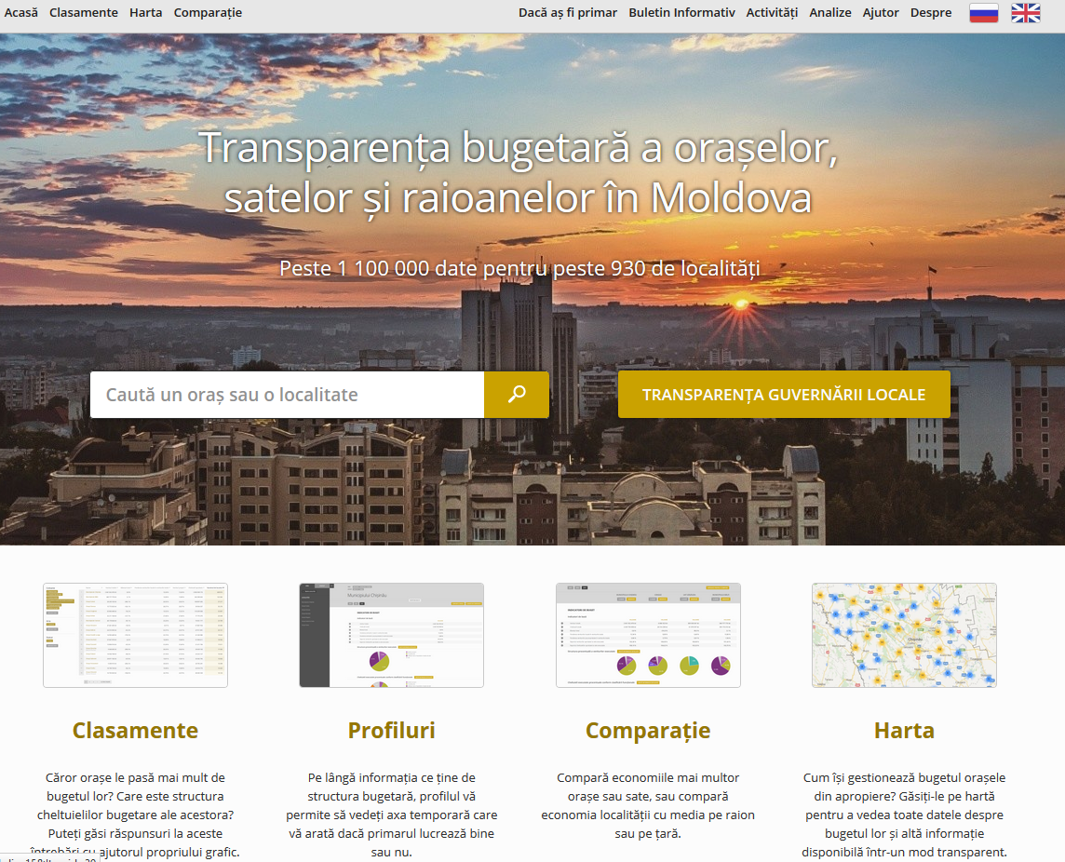

Slide 64
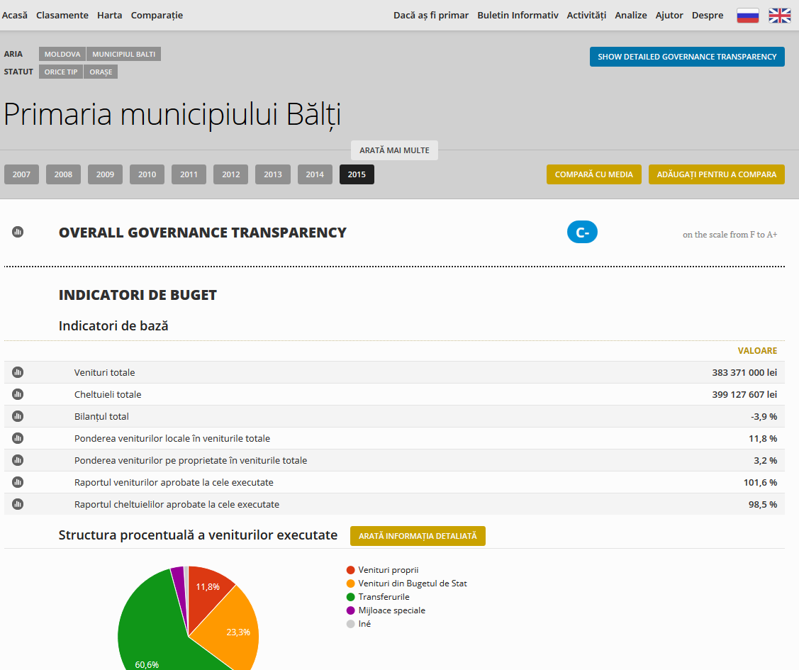

Slide 65
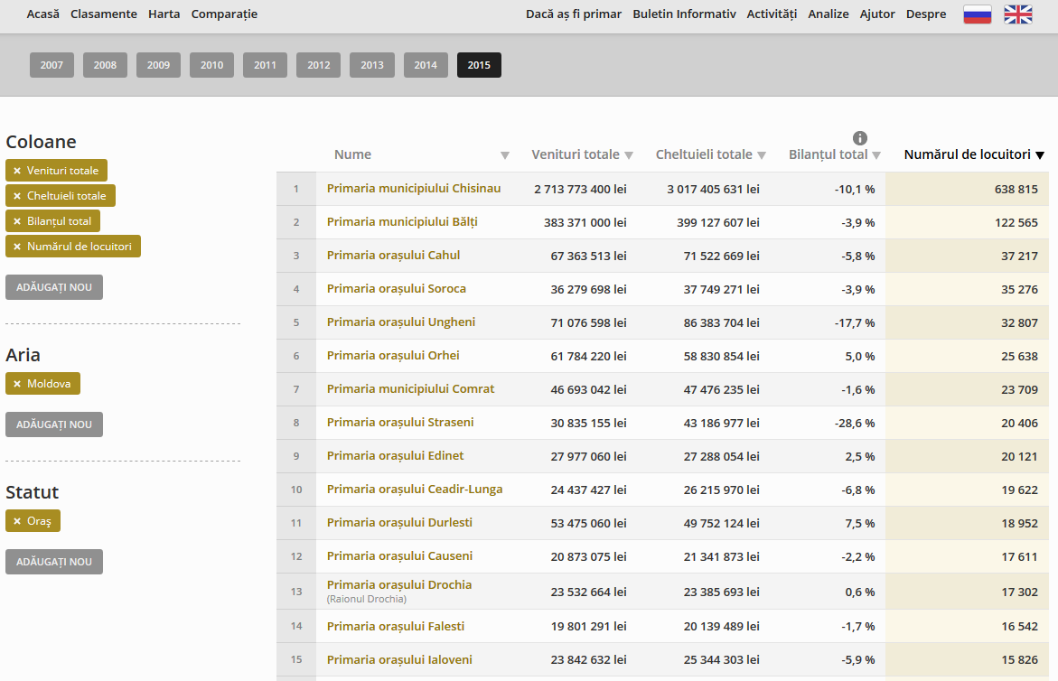

Slide 66
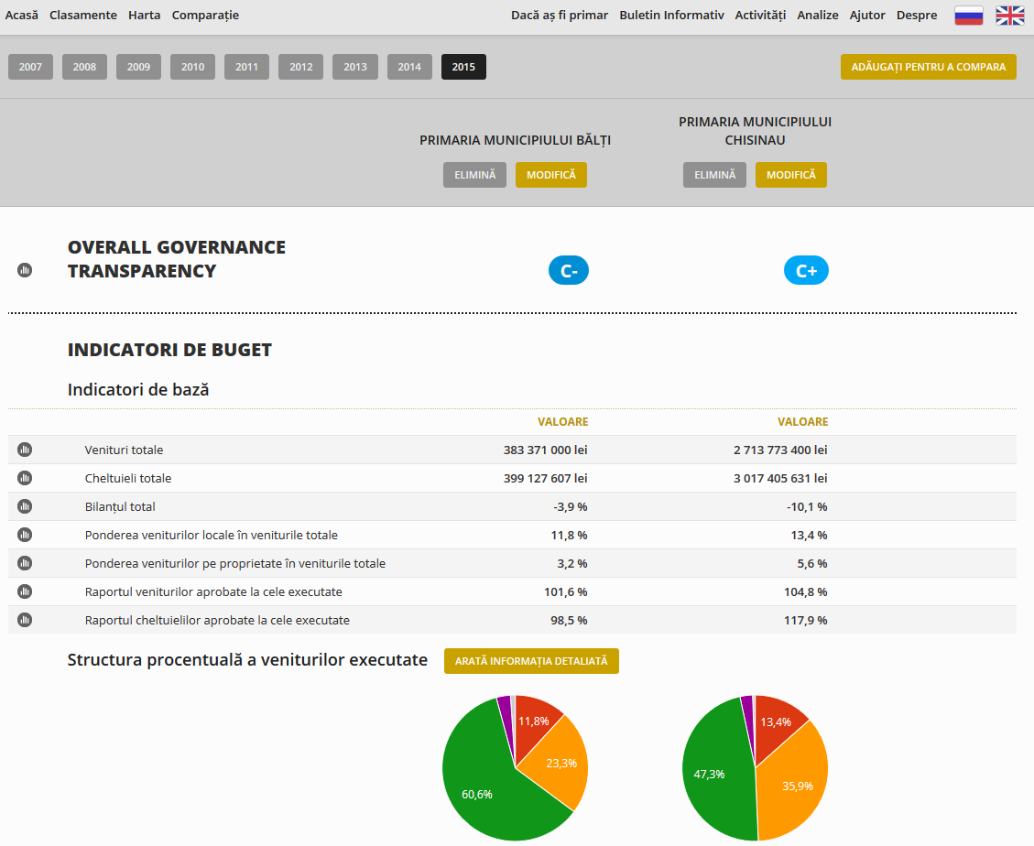

Slide 67
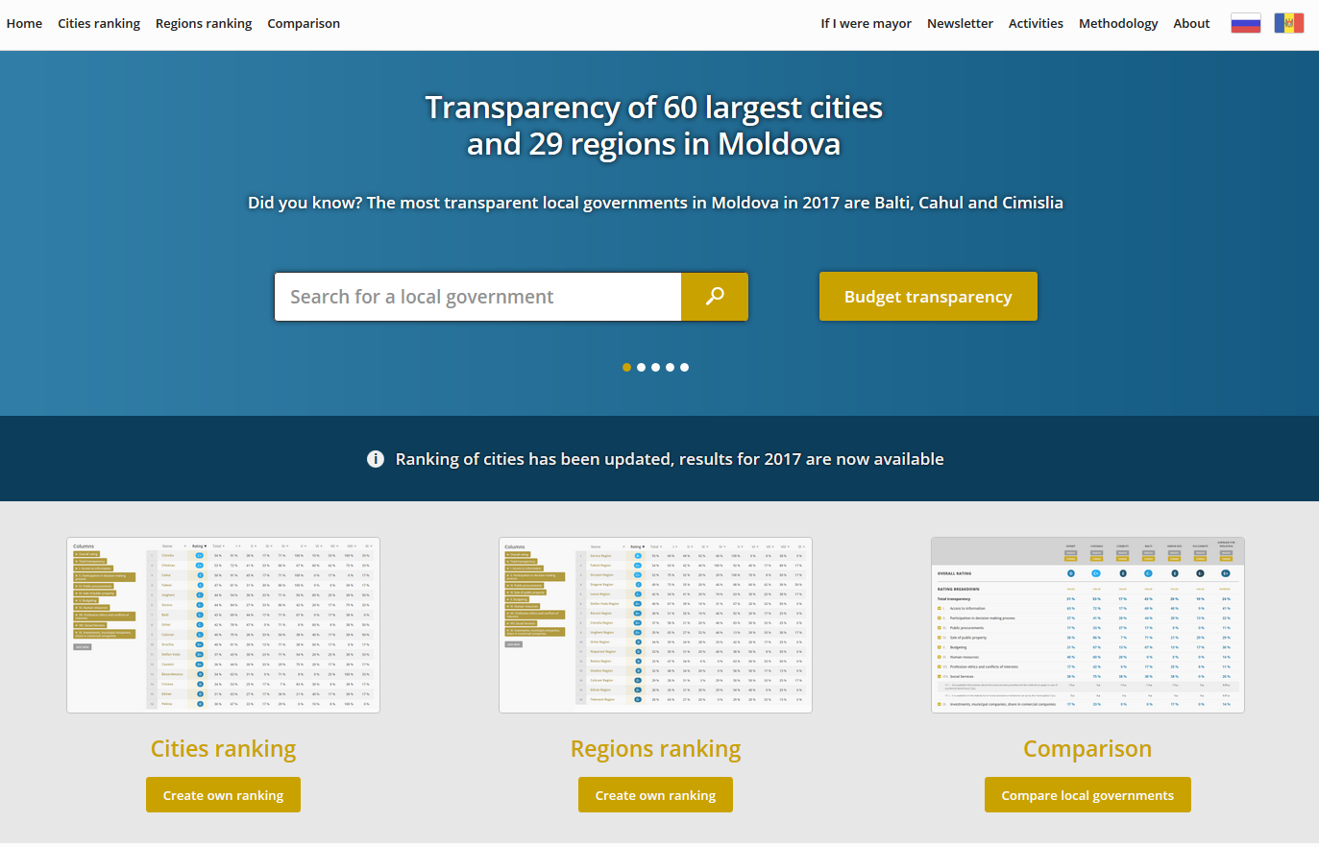

Slide 68
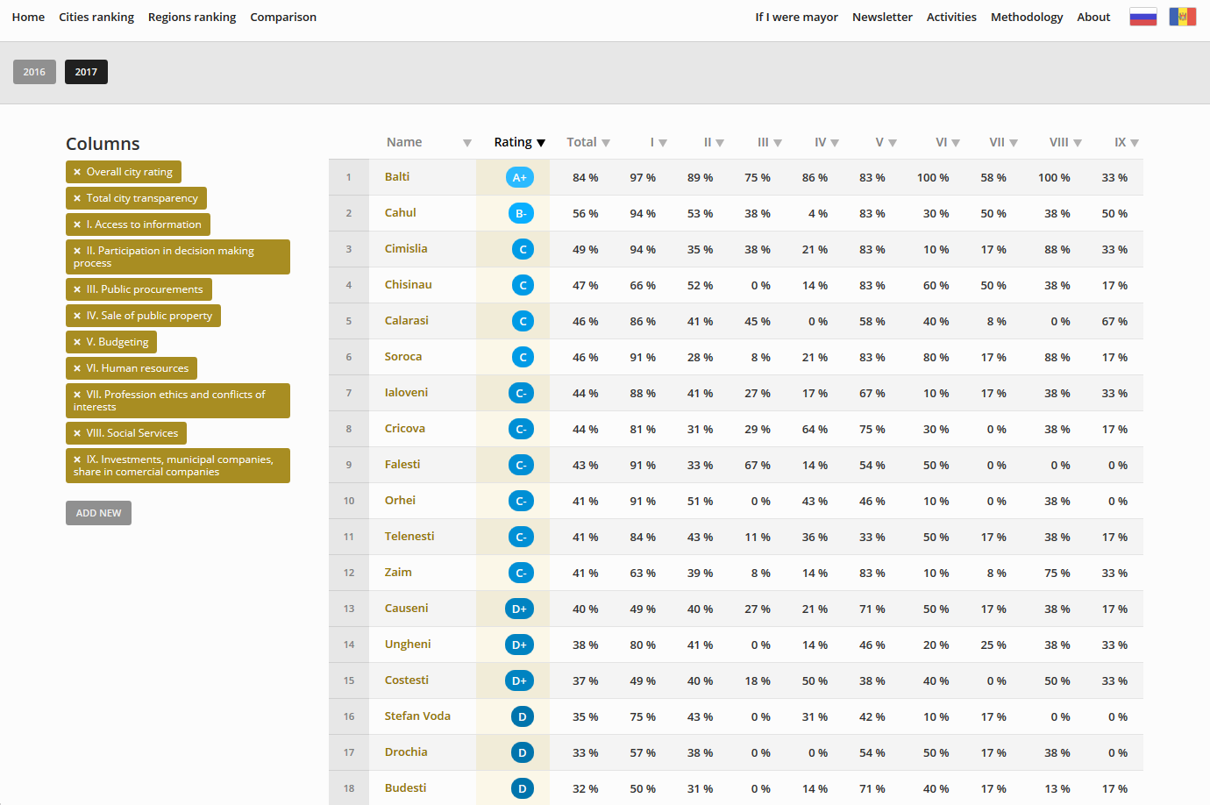

Slide 69
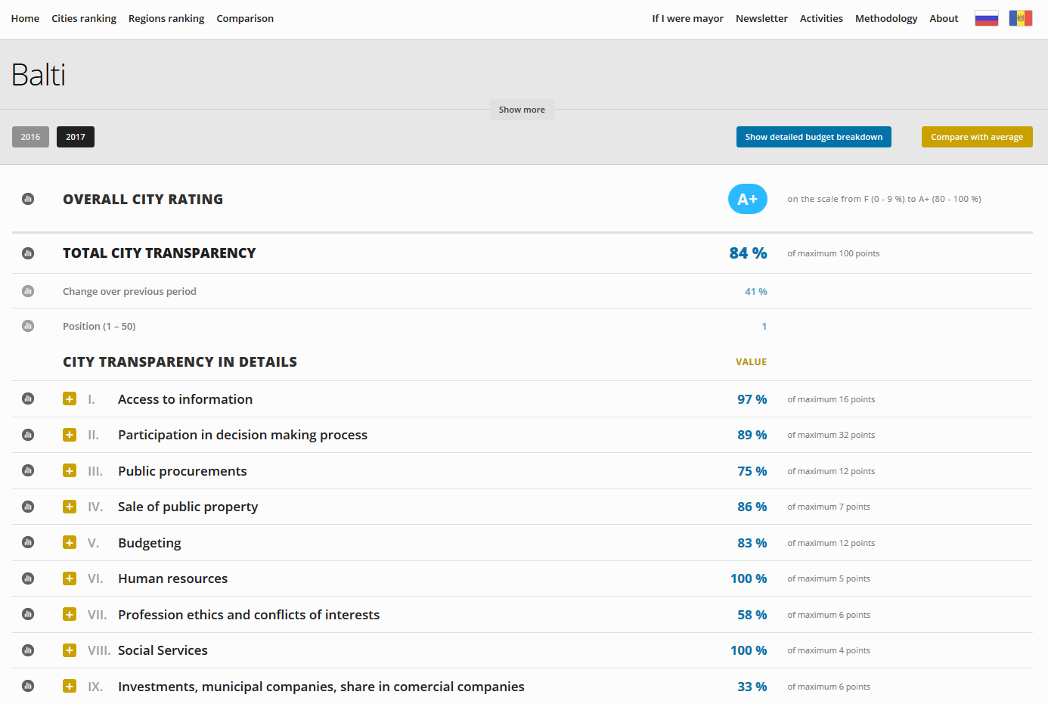

Slide 70
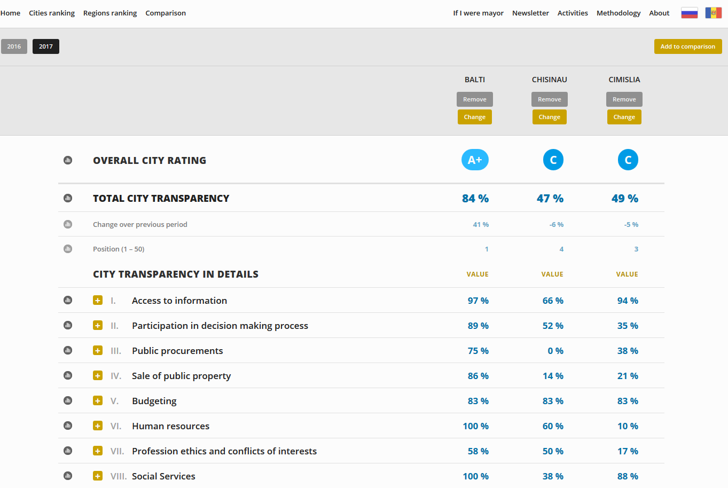

Slide 71
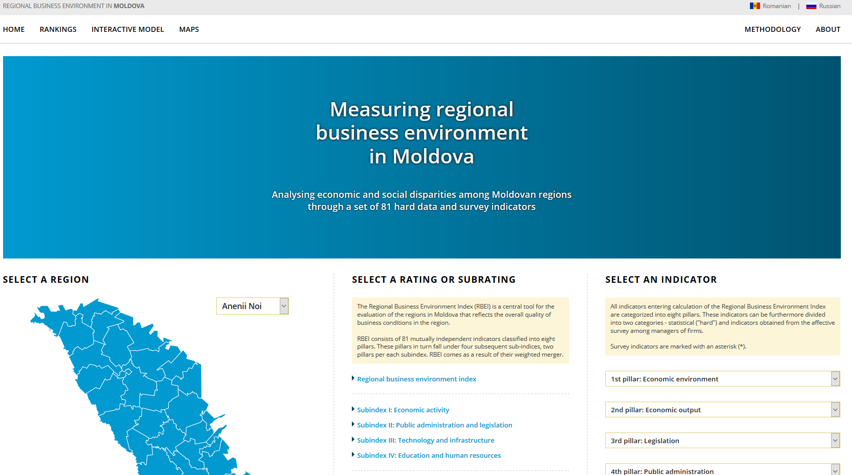

Slide 72
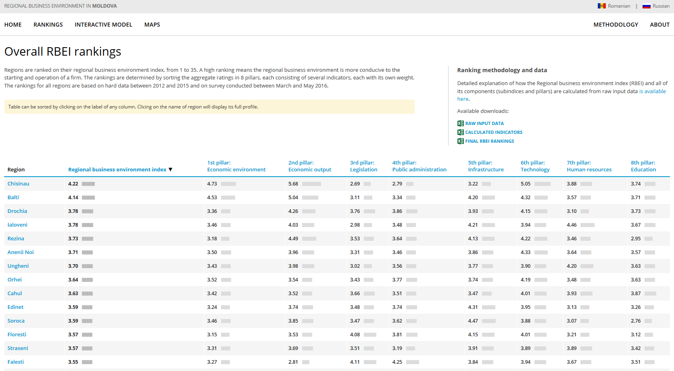

Slide 73
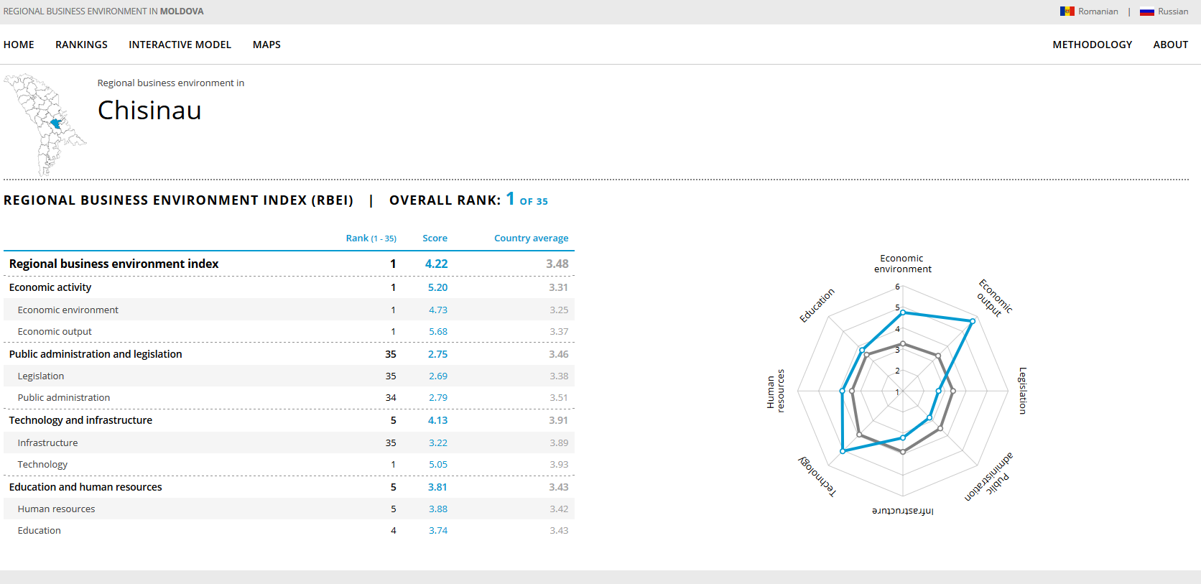

Slide 74
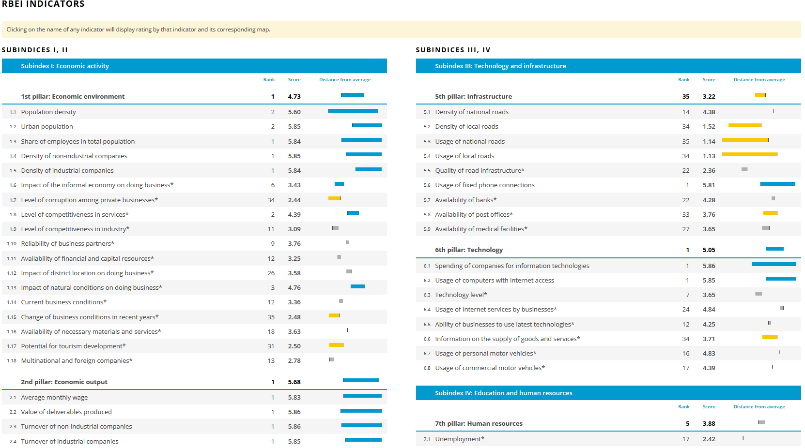

Slide 75
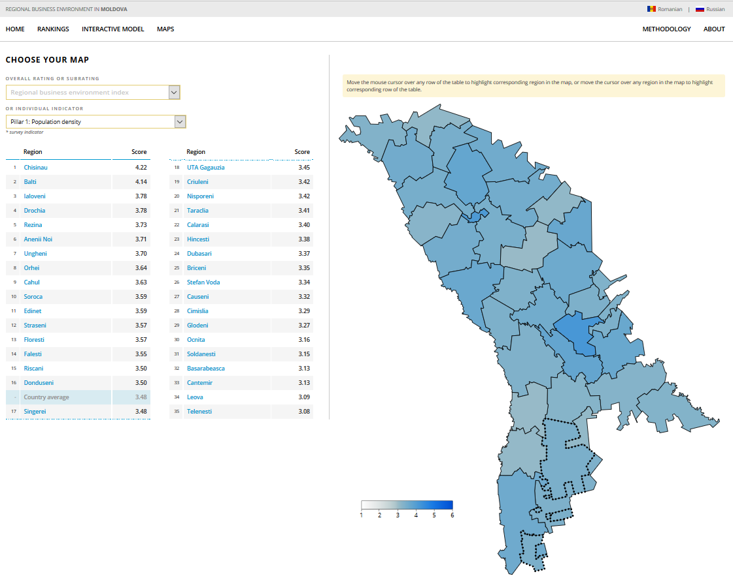

Slide 76
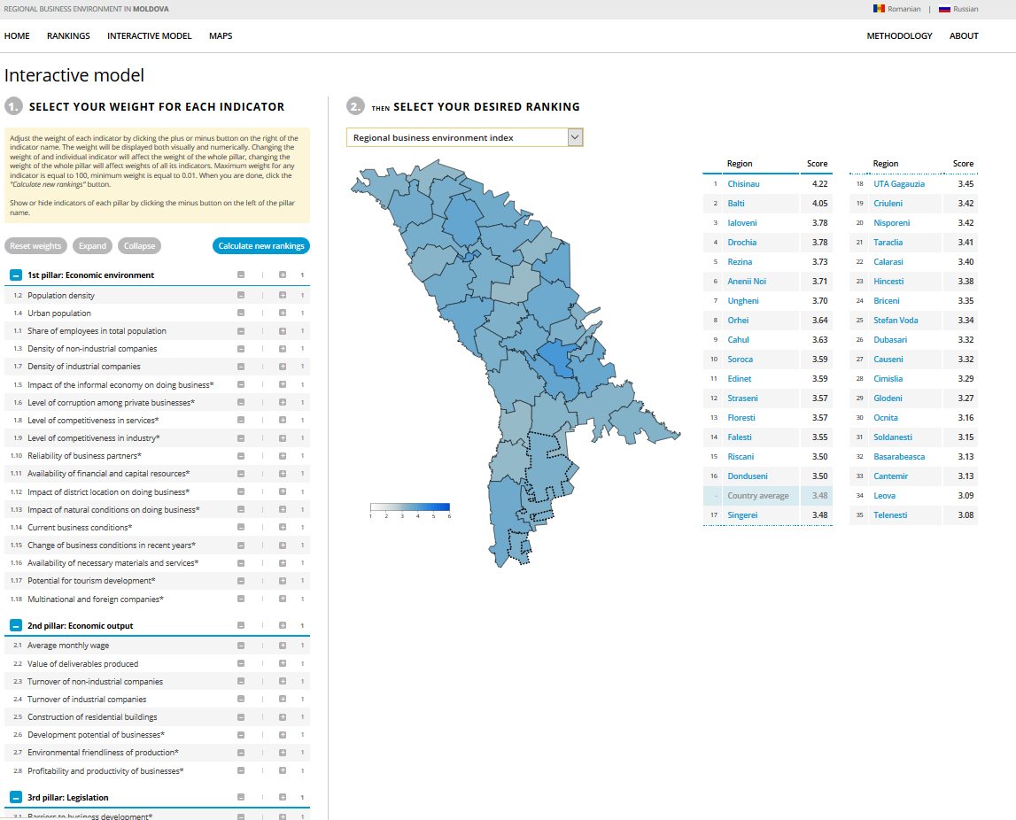

Slide 77
Time for discussion

