Slide 1

how to Improve transparency level in municipalities
Transparency rankings and Anticorruption strategies for Slovak municipalities
Michal Piško, Transparency International Slovakia, March 2017

Slide 2
THE MUNICIPAL PROGRAM
TIS founded in 1998
Mission: to reduce corruption by increasing transparency and citizen involvement, strengthening of the processes and reducing red tape
Areas: health service, justice, public procurement, media, state-owned companies, municipalities, etc.
Municipal program: Open local government
TI Slovakia involvement in local governments since 1999
Four pillars:
  Transparency rankings – measuring
  Watchdog – investigation
  Anticorruption strategies – cooperation
  Local activists networking - support

Slide 3
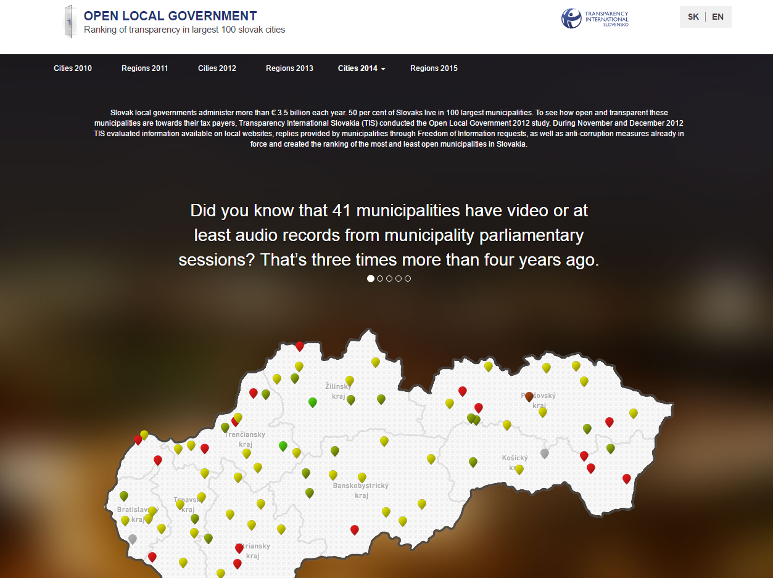
TRANSPARENCY RANKINGS
We elaborated 4 rankings of 100 largest Slovak municipalities (2010 – 2016)
three rankings of Slovak regions
two rankings of SOEs
two rankings of hospitals
Notes:
Although the ranking does not measure corruption, TIS holds that higher score in the ranking and more transparent towns and cities provide fewer opportunities for corrupt behaviour. However, it cannot be ruled out that municipalities high up in the ranking are not corrupt and vice versa.

Slide 4
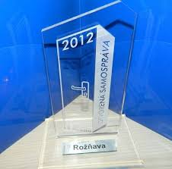
TRANSPARENCY RANKINGS
It shows differences in transparency among the various towns and increases the pressure for more open approach
Best practices, trends
Open access to information makes public oversight possible, the rules of the processes reduce space for arbitrary decisions
However, more transparency does not automatically mean no corruption

Slide 5
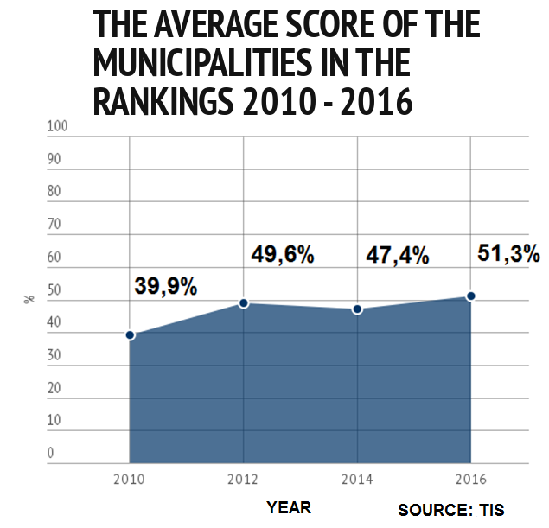
The transparency level has increased 2010/2016: +11 pp
The overall average score reached more than 50 per cent for the first time
2/3 of towns have became more open in comparison with 2014

Slide 6
TRANSPARENCY TRENDS

Slide 7
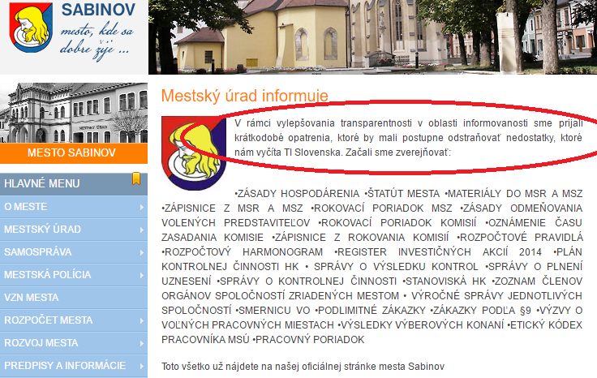
IMPROVEMENT PLAN
Sabinov occupied 100th place in 2014
Afterwards, they informed on the website about their improvement plan
In 2016 ranking they improved to 13th place
Notes:
Podobne Vranov – v roku 2012 posledné 99. miesto spolu s Bytčou.

Slide 8
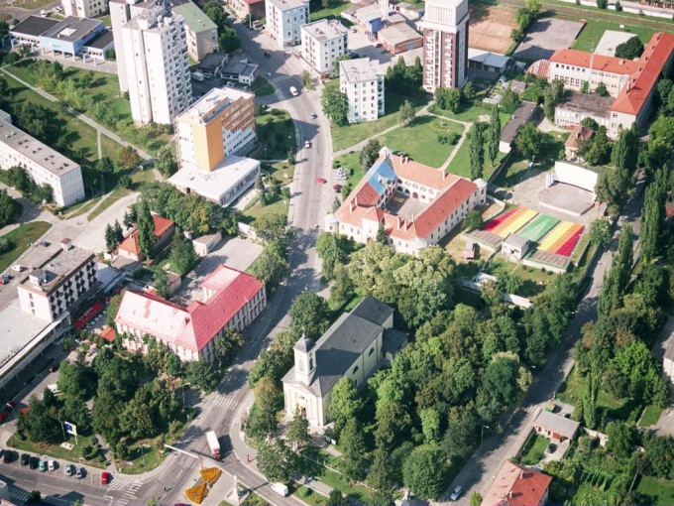
BEST PRACTICE
Best practices in some municipalities
In 2005 local activists started to publish all the municipal contracts on their own website
They won the next election

Slide 9
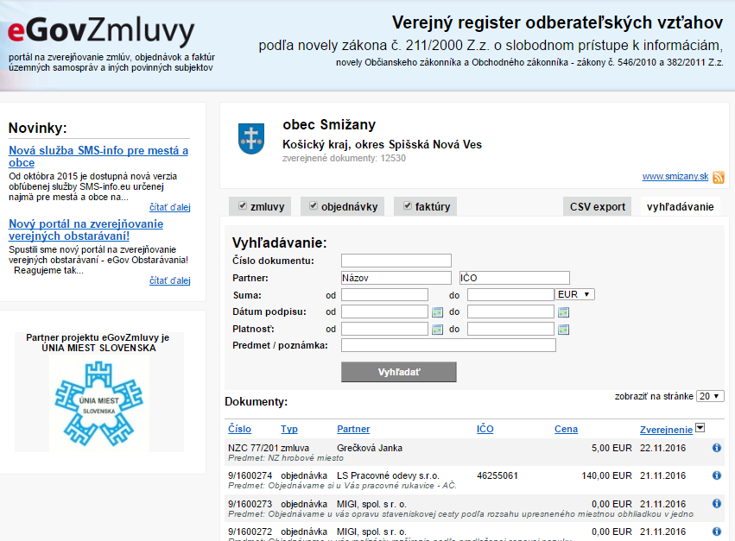
CONTRACTS: HOW TO DO IT
The quality of contract publishing is 61 % in average
Village Smižany - 99 %
They publish all the contracts with attachments, copying from the documents is possible
They also provide a system for searching of the contracts according to sum, date, company, etc.

Slide 10
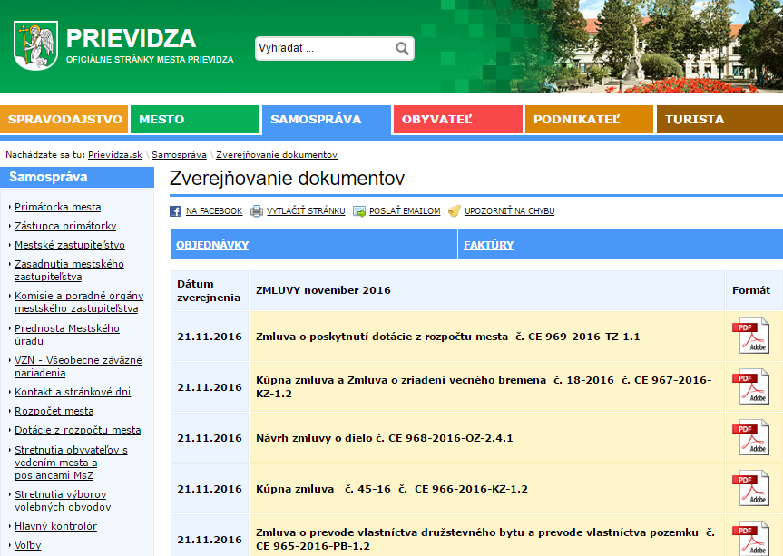
AND HOW NOT...
Prievidza (50 thousand inhabitants) – only 15 %
They don´t provide any search engine, the published documents are only scanned images without possibility to copy from them

Slide 11
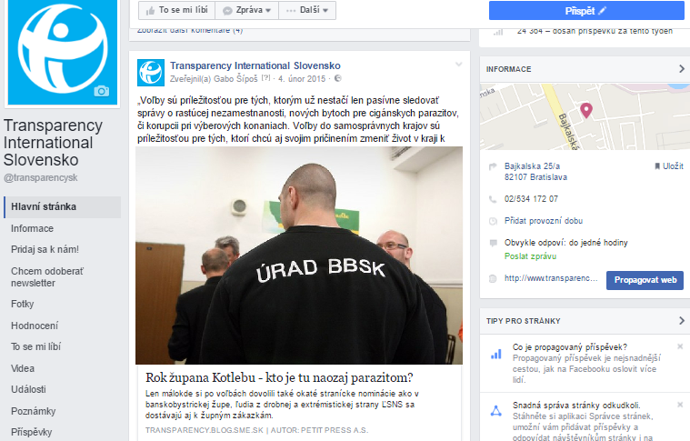
WATCHDOG
The year of the chairman - Who is the parasite in reality?

Slide 12
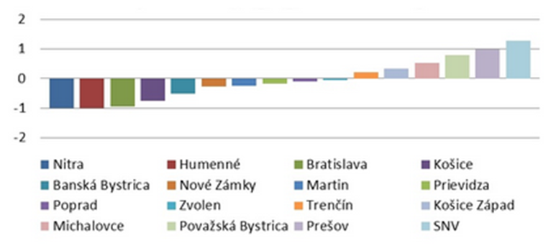
WATCHDOG
Buying printing toners – same goods, different prices
Prizes of toners varied significantly
SNV bought toners 2 times more expensive
13 BA districts bought toners from 20 suppliers

Slide 13
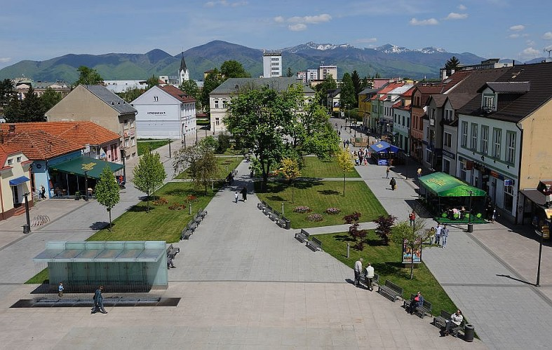
ANTICORRUPTION STRATEGIES
The Best practices transfer
First cooperation with the town of Martin in 2008 –project „Transparent town“
TI Slovakia – the development of anti-corruption strategy for the city in 17 municipal policies
Identification of the risks
Recommendations
Implementation
Notes:
This result was highly affected by a decision of Andrej Hrnciar, the Mayor of Martin, who was elected in 2006 and who defined transparency as his top priority. In 2008 he and his colleagues in the Local Parliament started cooperating with TIS at an anticorruption strategy for the town.

Slide 14
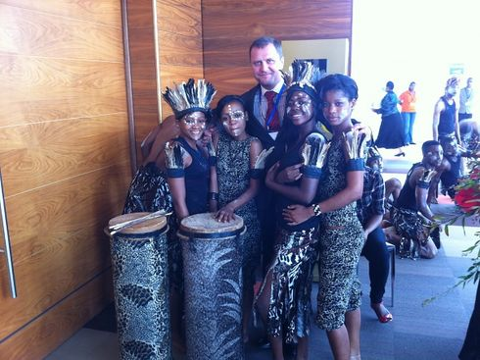
THE WIN-WIN PROJECT
The new Mayor of Martin defined transparency as his top priority. In 2008 he started cooperating with TIS
The anticorruption strategy was implemented in 2009. TIS experts also organized the training of the elected representatives and relevant employees
In 2010 Martin was given the UN Public Service Award in the category “Preventing and Combating Corruption in the Public Service”
Our experts learned about the intern procedures on the municipal level
Notes:
Since then TIS has implemented eight anticorruption strategies

Slide 15
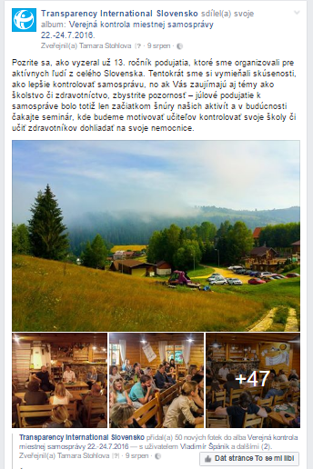
WORKSHOPS FOR ACTIVISTS
The workshops for local activists, clerks and journalists from 2004
The specific workshops for the local politicians
Around 500 (250 various) participants
Around 100 speakers (policymakers, prosecutors, judges, policemen, lawyers, experts in public procurement, whistleblowers, etc.)
Know-how, confrontation and cooperation
The case studies – how to understand other points of view

Slide 16
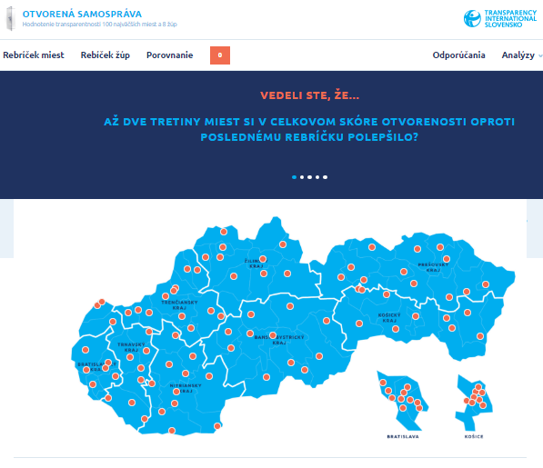
TRANSPARENCY PORTAL
samosprava.transparency.sk
It is possible to click on each town on the portal
You can find information about questions and answers for each town and each category
You can compare the actual answers with the previous ones
Comparison of the municipalities is available

Slide 17

THANK YOU FOR YOUR ATTENTION
samosprava.transparency.sk

