Slide 1


Guarding financial health of local governments in Slovakia
Peter Golias
INEKO Director
March 3rd, 2017
Kyiv, Ukraine
Conference on “Financial health, transparency and competitiveness of local governments in Ukraine”

Slide 2
Slovak experience
Since 2012: INEKO portal computing financial health of all municipalities and regions: http://www.hospodarenieobci.sk/
Major developments/impact:
  Intensive public attention and pressure to govern finances of local Gvts responsibly
  New legal constraints (penalty, debt brakes, more strict rules on hidden debt)
  Fiscal stabilization of local Gvts

Slide 3
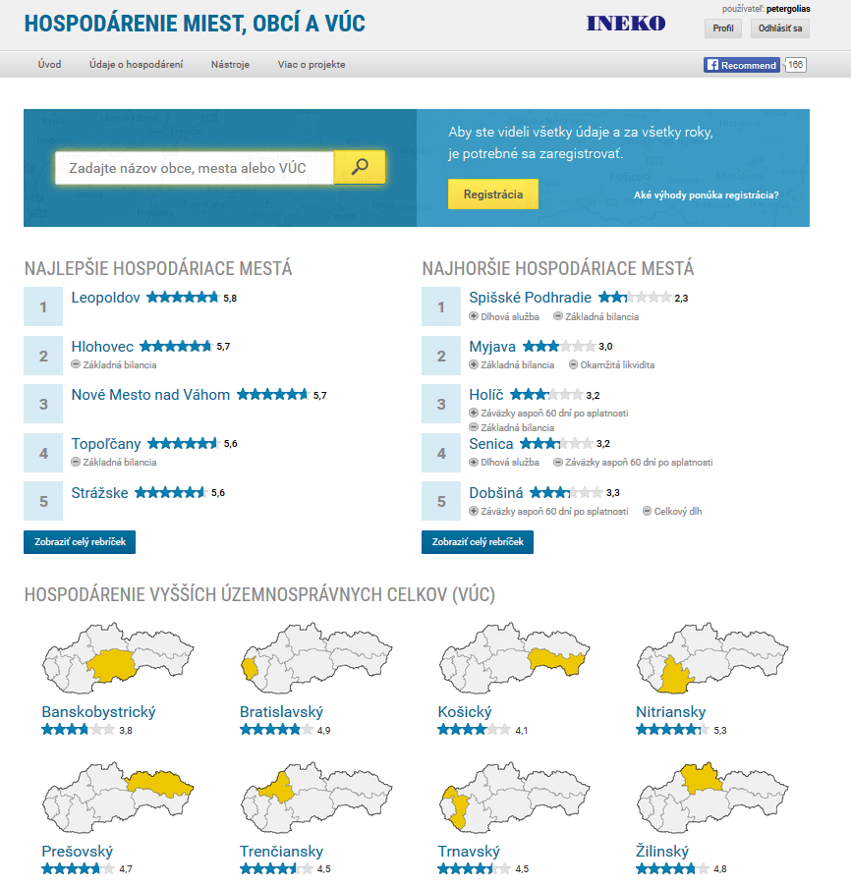
INEKO portal – main page

Slide 4
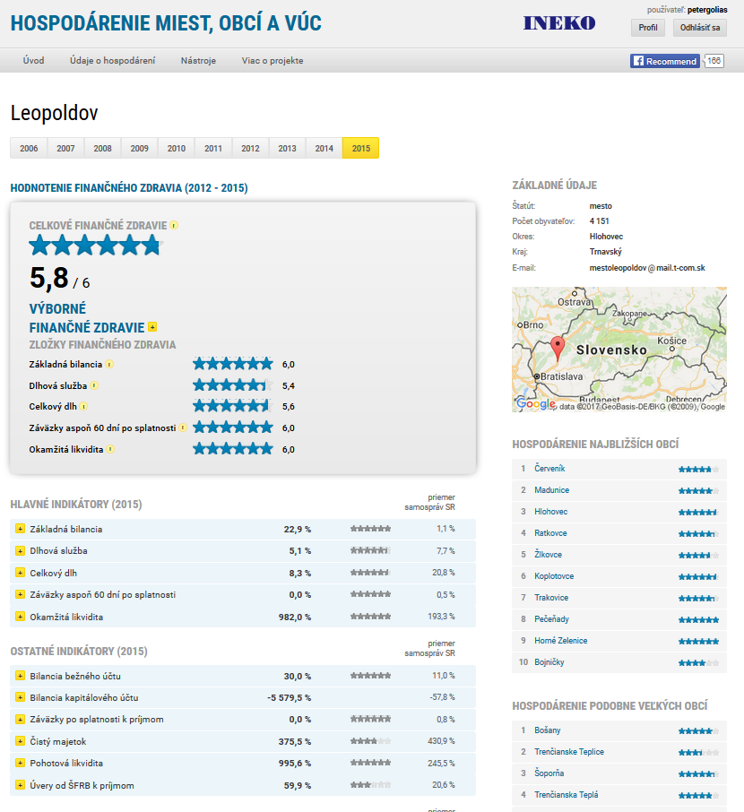
INEKO portal - profiles

Slide 5
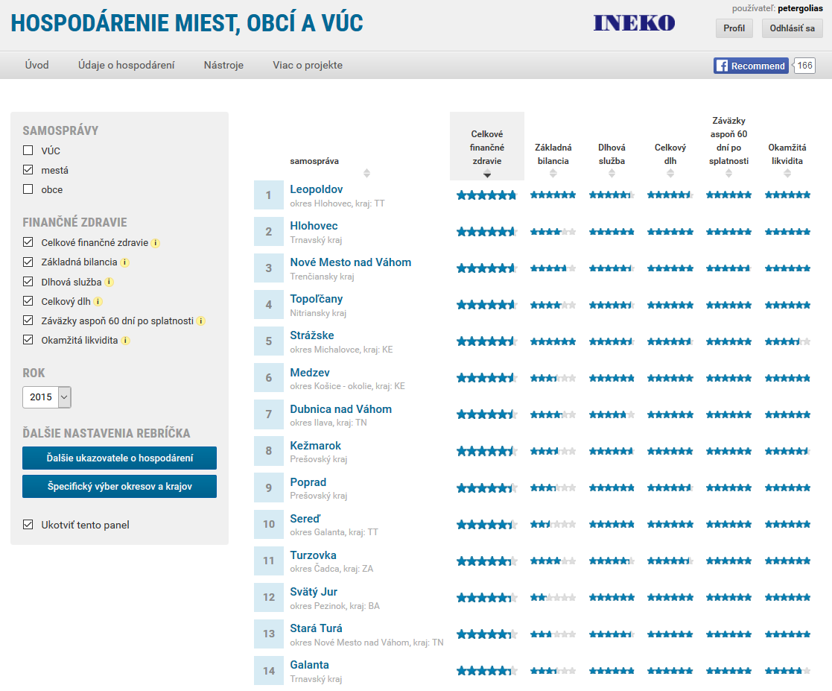
INEKO portal - rankings

Slide 6
Financial health indicators
Indicators entering final rating | Weight
Overall debt over current revenues | 2
Debt service (interest plus principle) over current revenues | 1
Current and capital account balance over current and capital revenues | 1
Liabilities overdue at least 60 days over current revenues | 1
Immediate liquidity on financial accounts over short-term liabilities | 1
All indicators are transformed to the scale {0, 6}
Overall debt is computed based on data from the most recent year
Other four indicators are computed based on data from the 4 most recent years with following weights:
  Year t: 4
  Year t-1: 3
  Year t-2: 2
  Year t-1: 1

Slide 7
Underlying data
Current account revenues
Current account expenditures
Capital account revenues
Capital account expenditures
Debt service – principal
Debt service – interest
Short-term liabilities
Long-term liabilities
Bank loans
Loans from the state
Overdue liabilities
Liabilities overdue at least 60 days
Short-term receivables
Financial assets (e.g. cash, bank deposits)
Number of citizens

Slide 8
Legal constraints
Conditions on taking more debt:
  Debt below 60% of current revenues in preceding year
    Exception 1: Debt to state organizations
    Exception 2: Bridging loans for EU funds
  Debt service (interest plus principal) below 25% of current revenues in preceding year
    Exception: One-off preliminary repayment

Slide 9
Legal constraints
Debt brakes: If debt above 50%, corrective measures are necessary:
  If debt under 58%, the mayor has to explain reasons, propose corrective measures to the Council and inform Ministry of Finance
  If debt above 58% but under 60%, revision of budget is necessary to achieve balanced budget by the end of year and balanced budget proposal for next year
  If debt above 60%, the municipality has to pay a penalty of 5% of debt exceeding 60% (this rule is set by Constitutional law)

Slide 10
Legal constraints
Conditions on adopting “corrective process“ (no rewards, new corrective budget, informing MoF):
  Overdue liabilities above 15% of current revenues in preceding year (without revenues from state or EU)
  Any accredited liability overdue of 60 or more days
If “corrective process“ does not lead to improvement after 90 days, the custodian nominated by the Ministry of Finance overtakes the “forced management“ of municipality

Slide 11
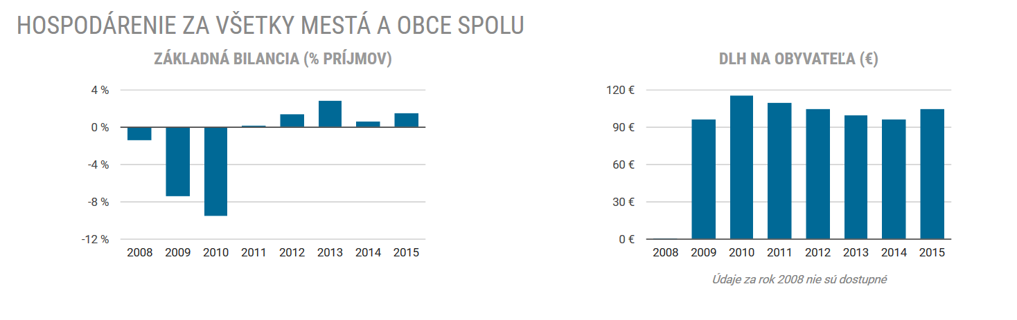
Fiscal stabilization
Budget balance (% of revenues)
Debt per capita (EUR)

Slide 12
Perspective/needed reforms
Legal:
  Debt restructuralization - managed bankrupcy of municipality
  Wider scope of the Law on Free Access to Information
  Disclosing the hidden debts: PPP, debt of public companies, etc.
Non-legal:
  Detailed budget transparency
  Better public control of how money is spent

Slide 13
Thank you for your attention! http://ineko.sk/; http://www.hospodarenieobci.sk/

