Slide 1
Indexing Democracy:
The Israeli Experience
Prof. Eytan Gilboa
Chair, Israel Public Diplomacy Forum
Director, Center for International Communication
Bar-Ilan University
eytan.gilboa@biu.ac.il

Slide 2
Approach
Evaluation of Public Diplomacy
Democracy and National Image/Nation Branding

Slide 3
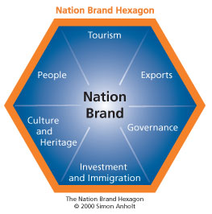

Slide 4
Characteristics
New State
Conflict and warfare
Socio-demographic structure
False Demonization: Racist & Apartheid State

Slide 5
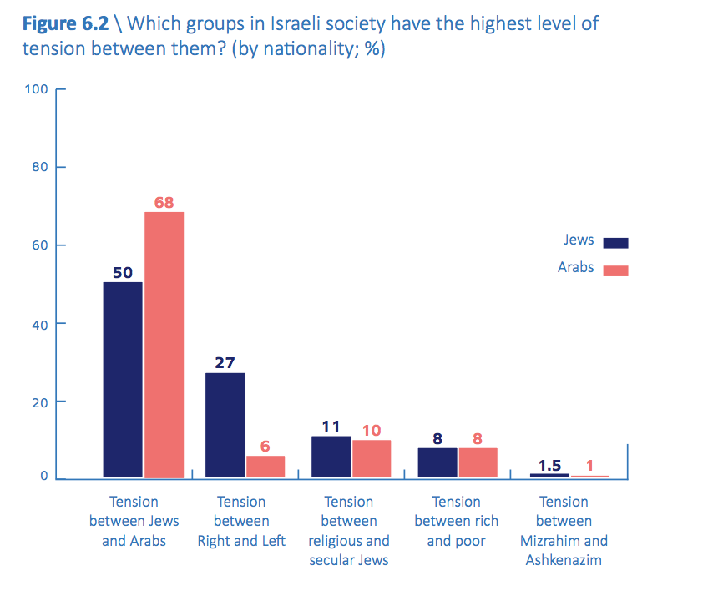

Slide 6
Demography
Group | Population |  | Proportion of total
Jews: | 6,119,000 | 75.0%
Secular | 5,499 000 | 65.1%
Religious | 750,000 | 9.9%
Arabs: | 1,688,600 | 20.7%
Other | 349,700 | 4.3%
Total | 8,157,300 | 100%

Slide 7
Political System
President
Prime Minister
Proportional Representation
Multi-Party System
Low Threshold
Coalition Governments

Slide 8
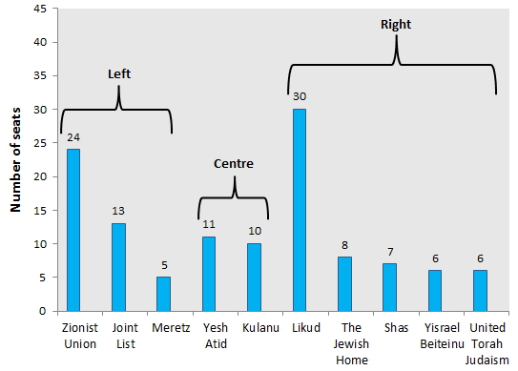

Slide 9
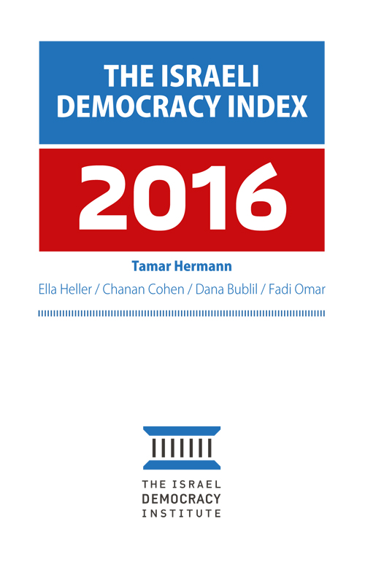
Indexing Sources
Public Opinion Polls
Democracy Indices
Global Comparative Ranking Indices

Slide 10
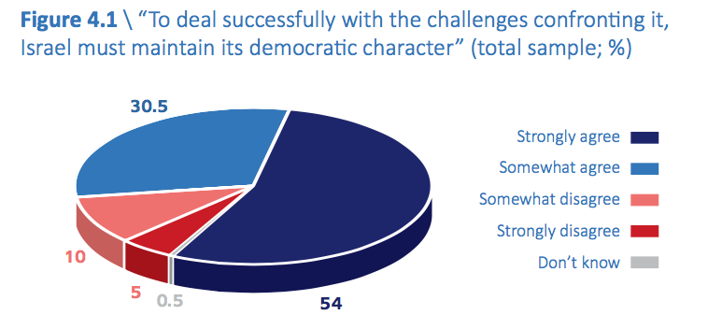

Slide 11
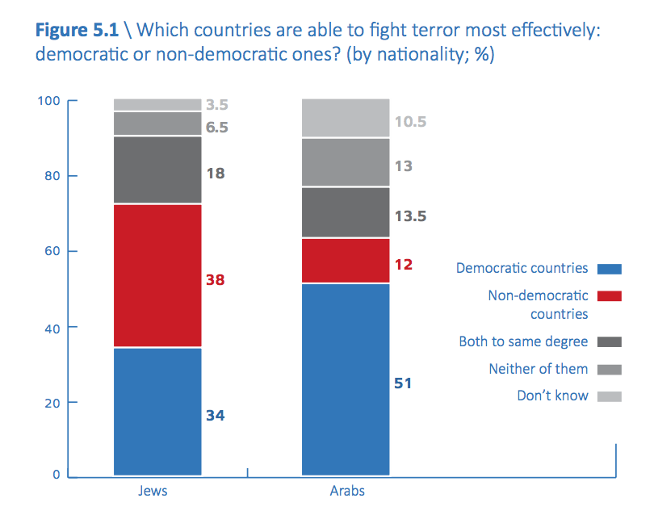

Slide 12
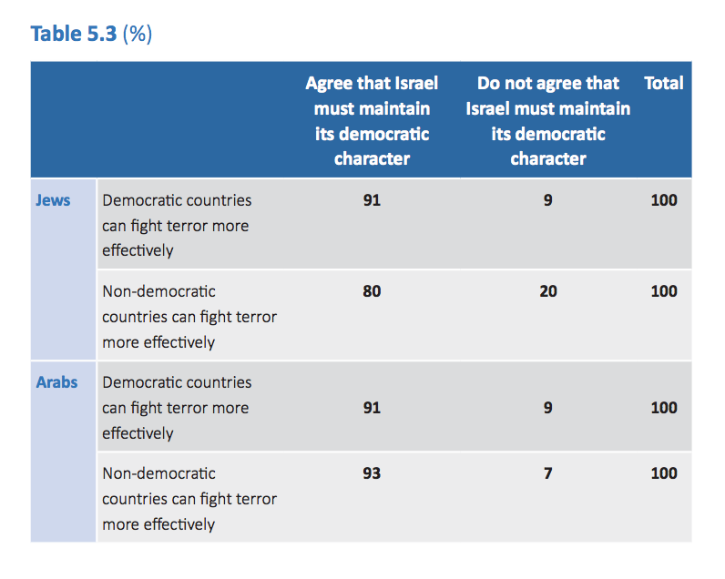

Slide 13
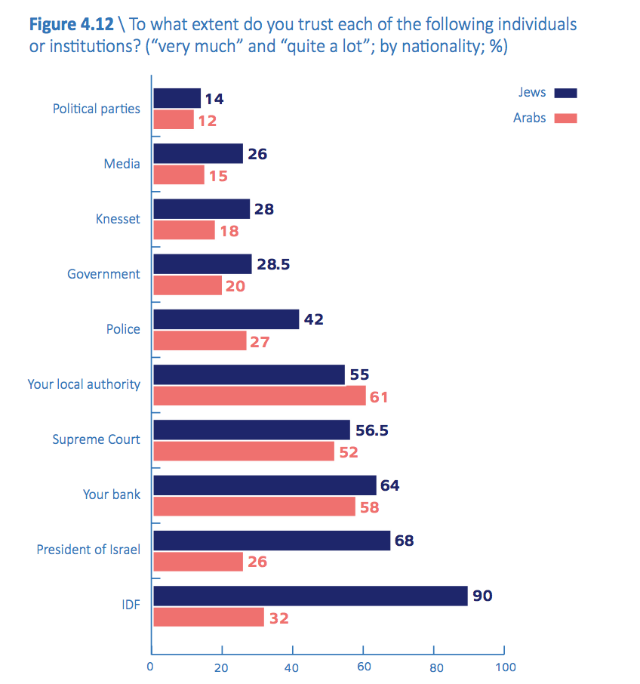

Slide 14
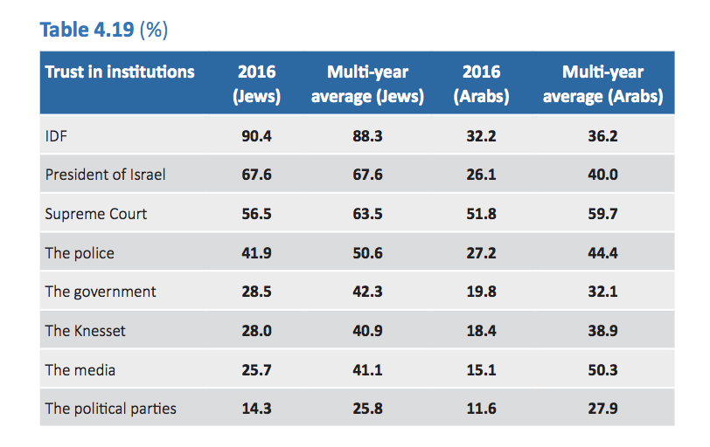

Slide 15
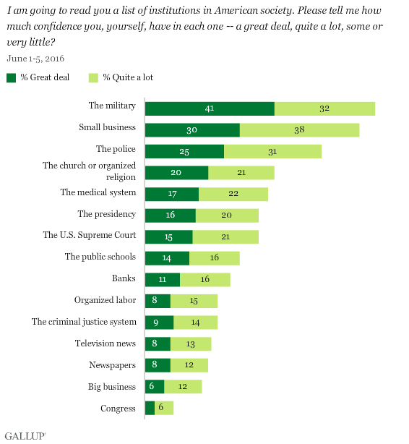

Slide 16
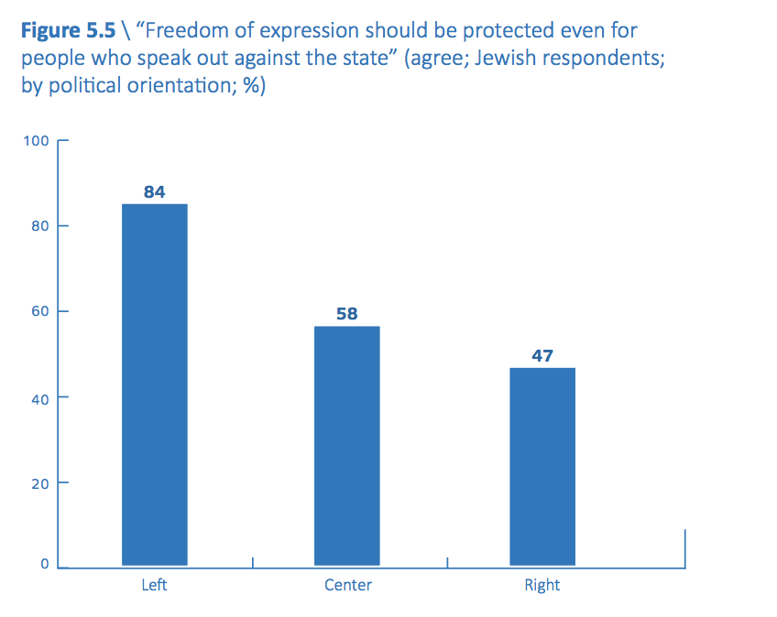

Slide 17
Democracy Data
Democracy Ranking:
http://www.democracyranking.org
Democratic Audit:
http://www.democraticaudit.com
Economist Intelligence Unit Democracy Index:
http://www.eiu.com
Freedom House: Freedom in the World Reports:
http://www.freedomhouse.org
Polity:
http://www.systemicpeace.org/polity/polity4.htm
Polyarchy Dataset:
http://www.nd.edu/~mcoppedg/crd/datacrd.htm
SGI - Bertelsmann Sustainable Governance Index:
http://www.sgi-network.org
UDS - Unified Democracy Scores:
http://www.unified-democracy-scores.org
Vanhanen's Index of Democracy:
http://www.prio.no/CSCW/Datasets/Governance/Vanhanens-index-of-democracy

Slide 18
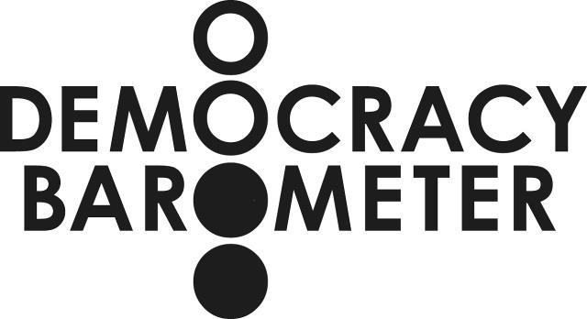
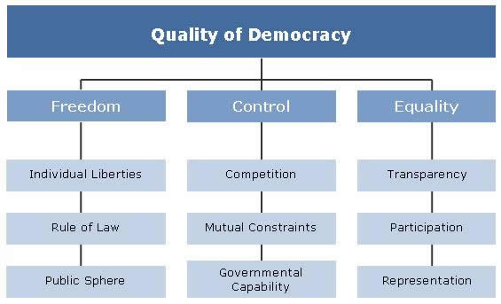

Slide 19
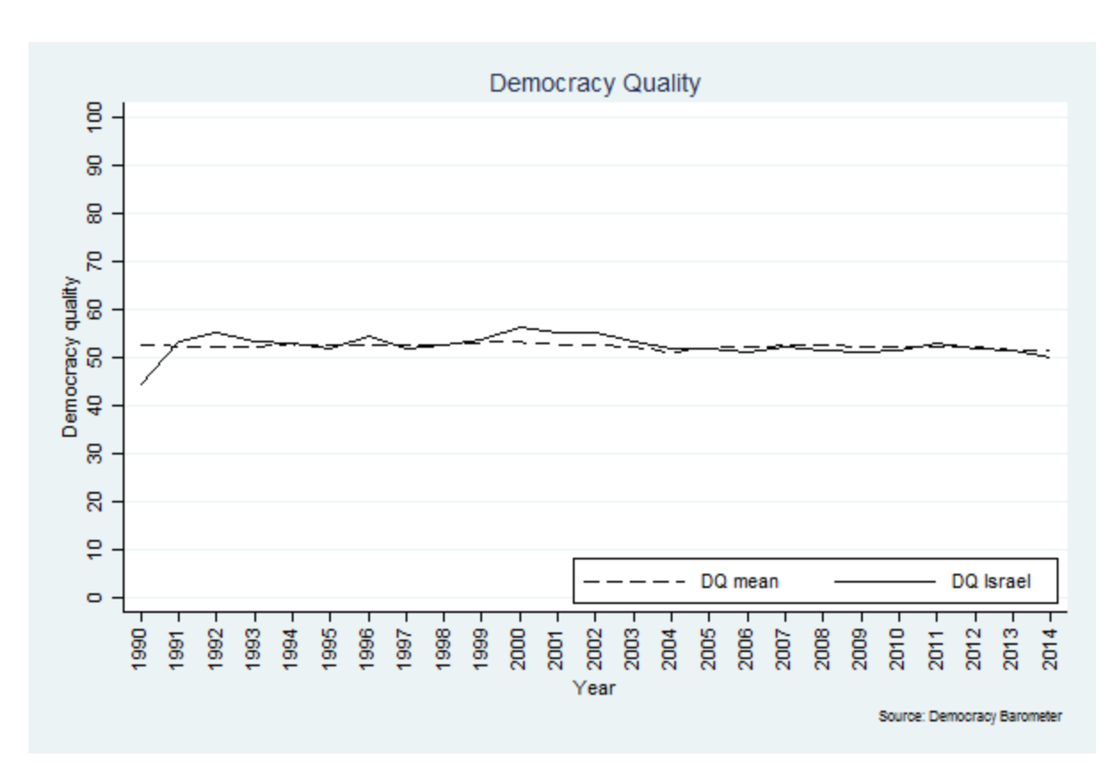

Slide 20
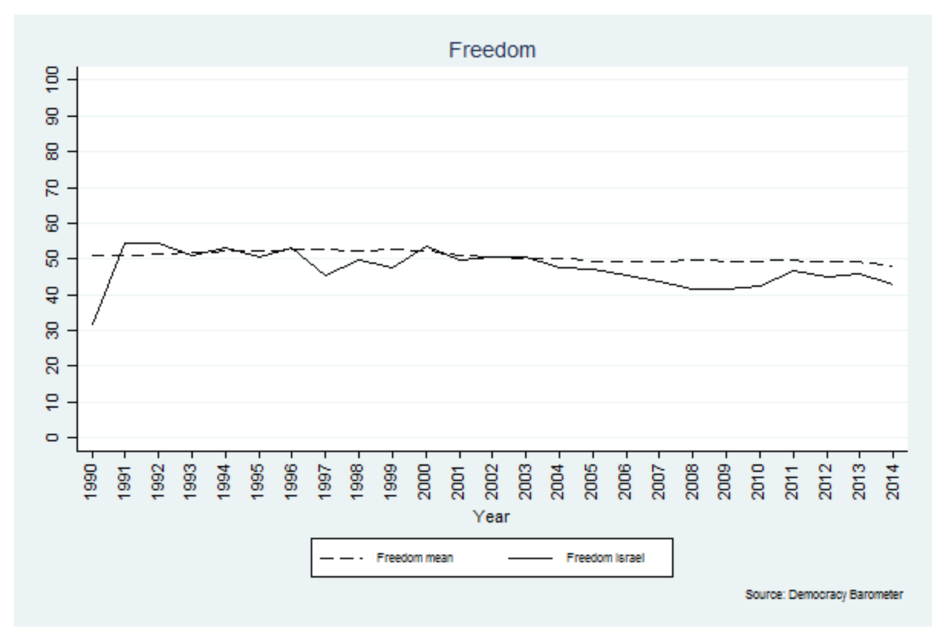

Slide 21
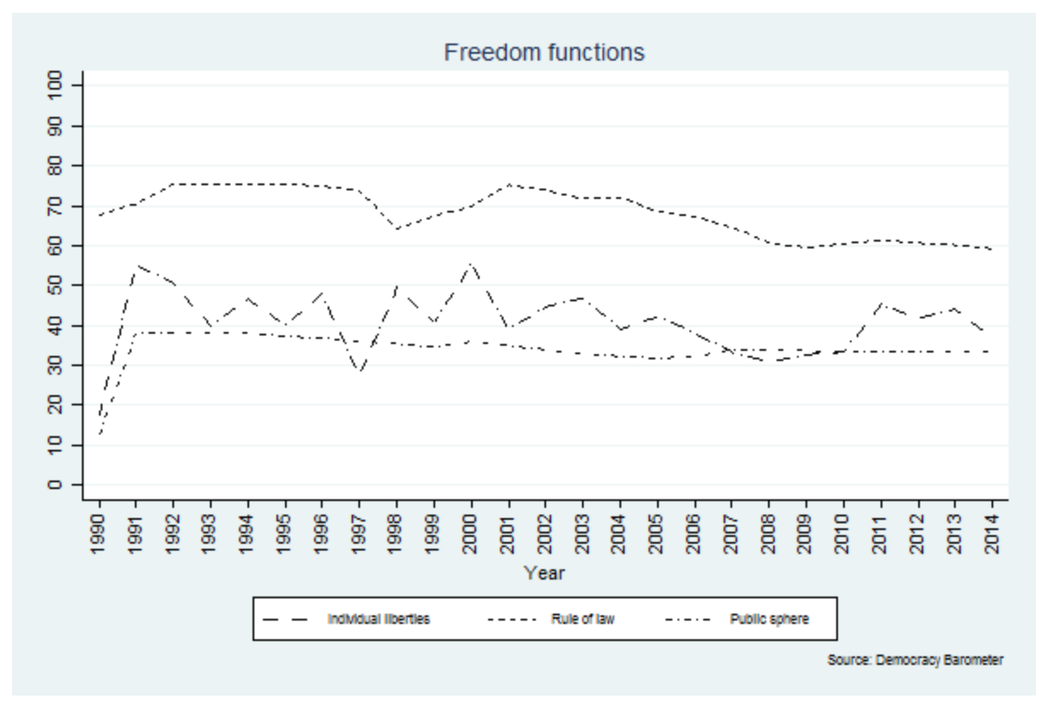
Individual Liberties, Rule of Law, Public Sphere

Slide 22
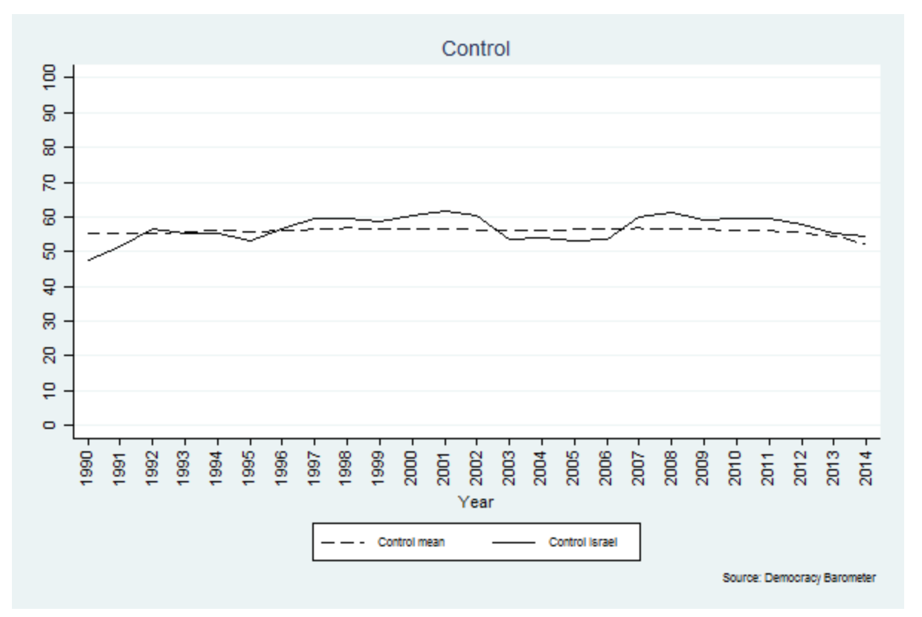

Slide 23
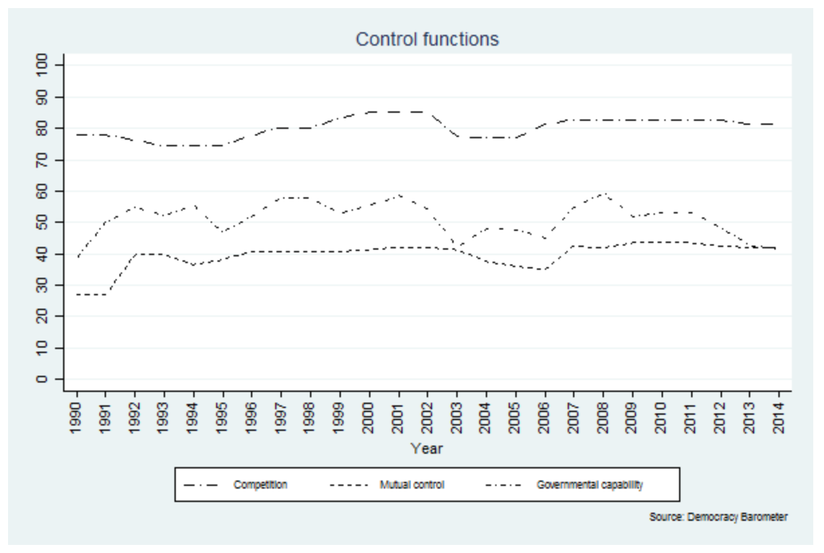
Competition, Mutual Restraints, Gov. Capability

Slide 24
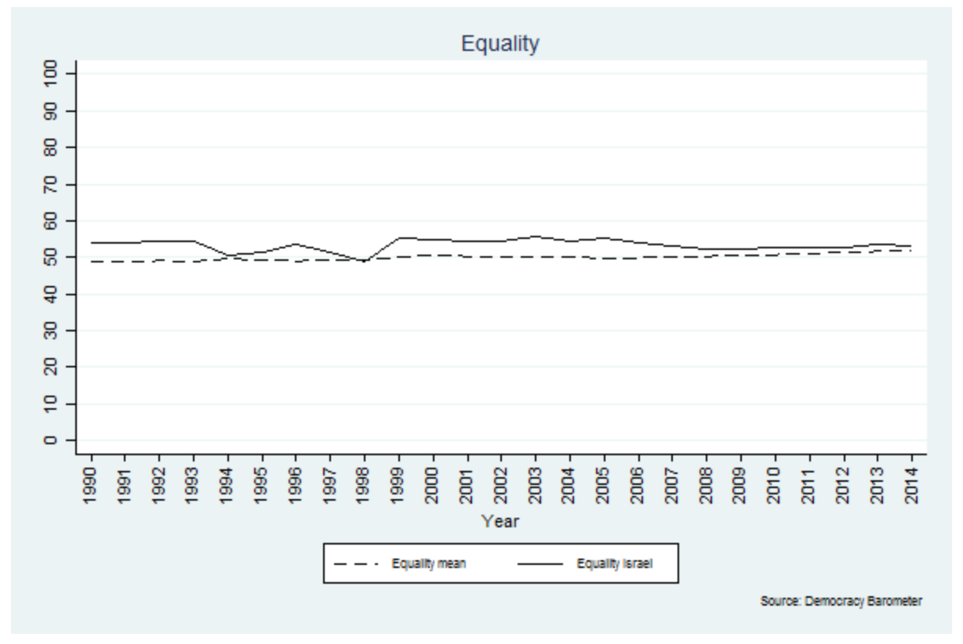

Slide 25
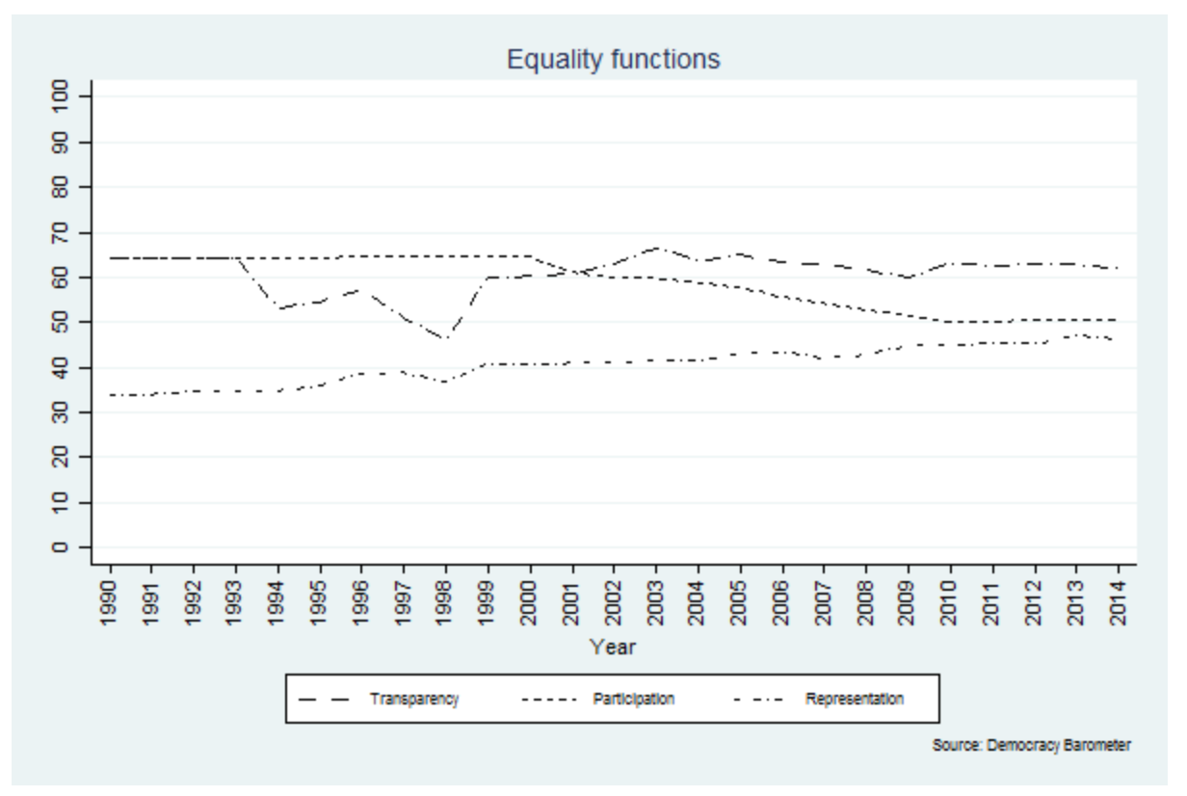
Transparency, Representation, Participation

Slide 26
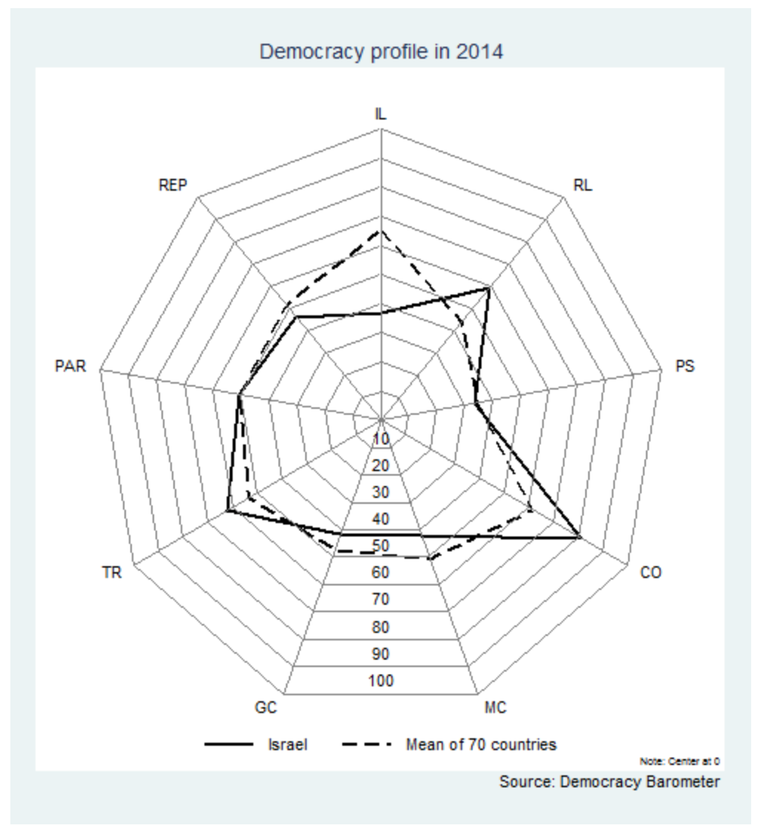

Slide 27
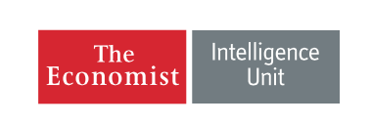
Indicators
Electoral Process and Pluralism 9.17
Functioning of Government 7.50
Political Participation 8.89
Political Culture 7.50
Civil Liberties 6.18

Slide 28
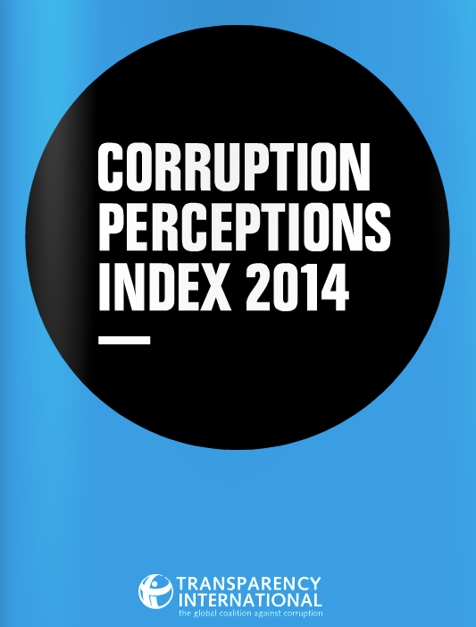
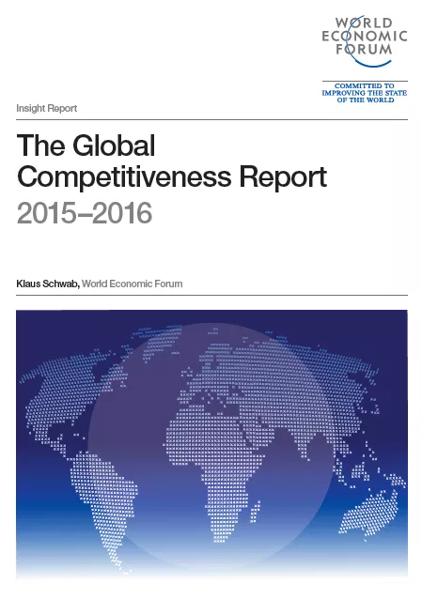


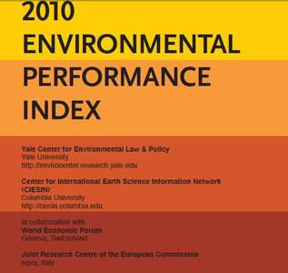

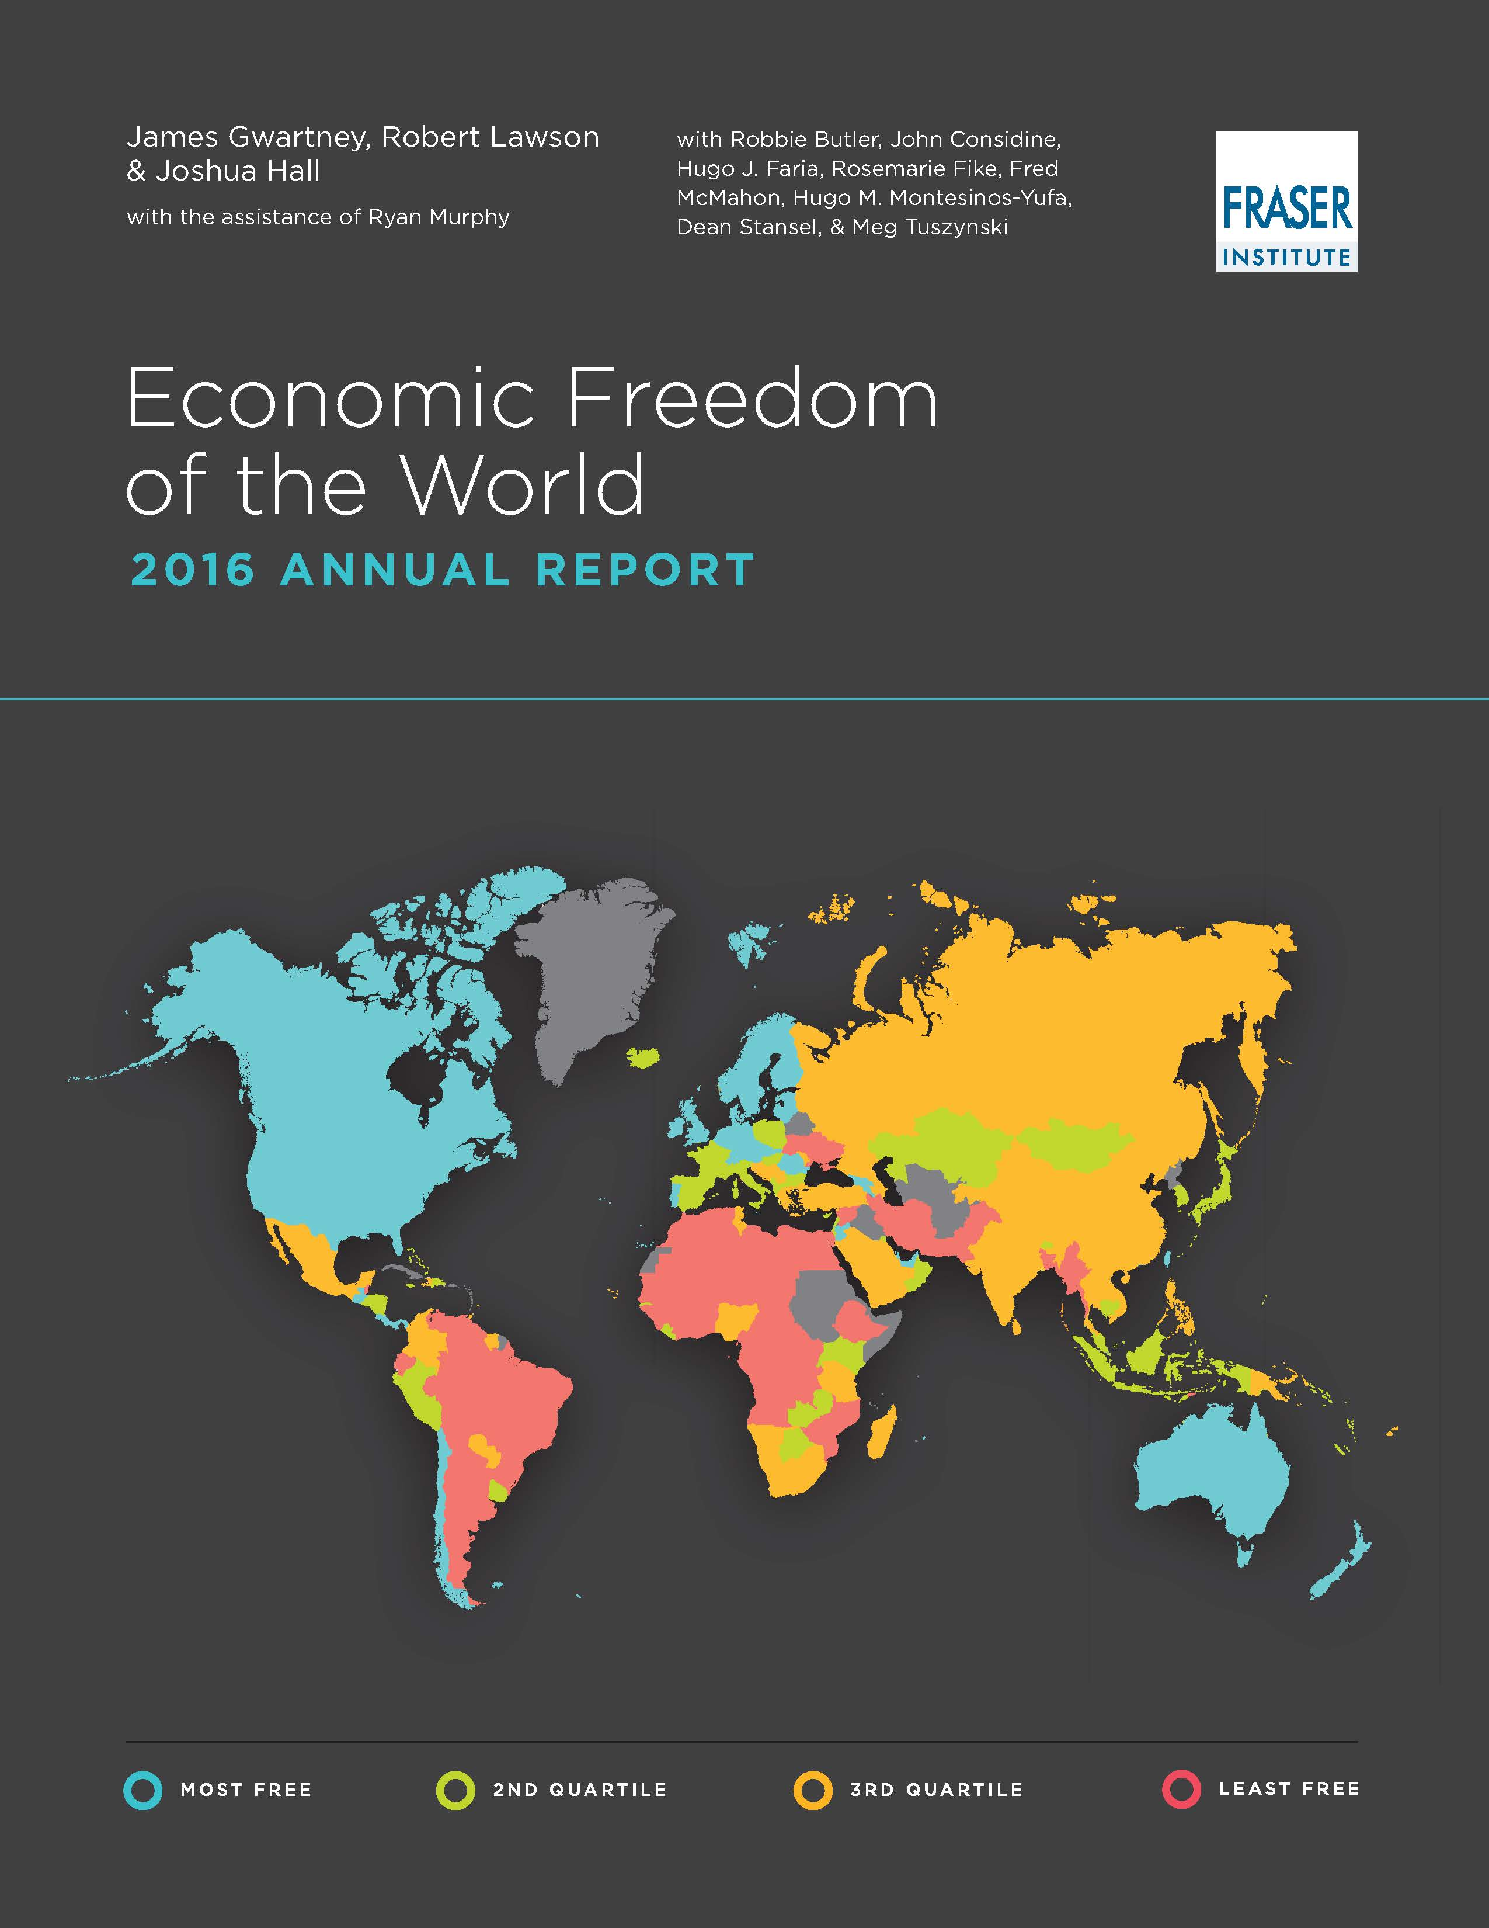

Slide 29
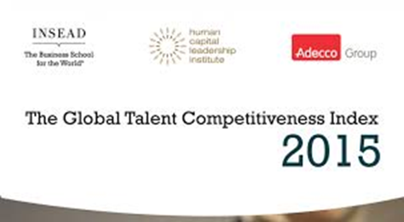
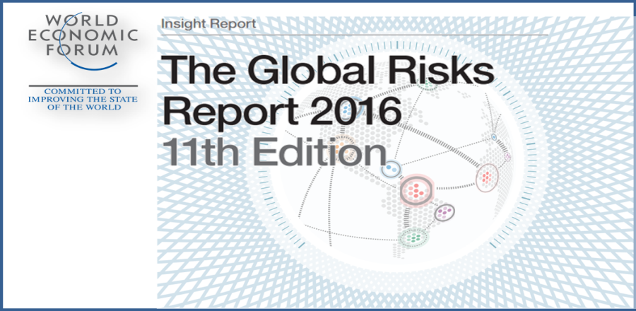


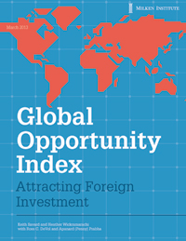
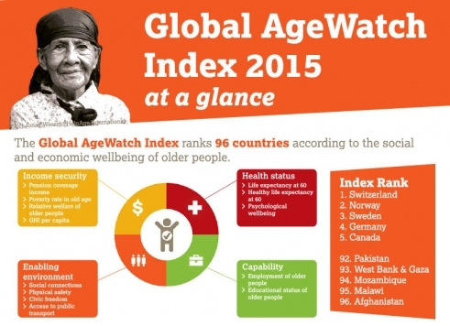

Slide 30
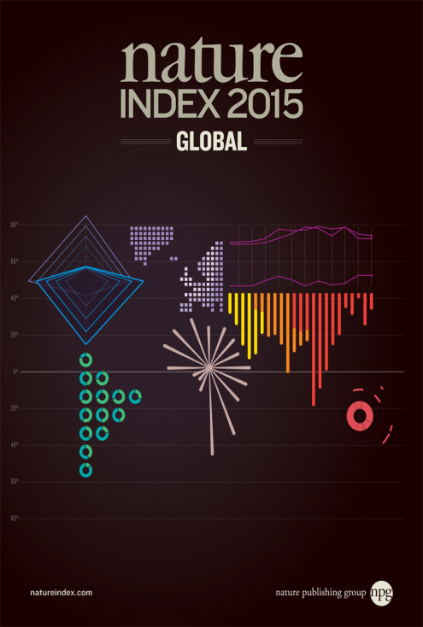
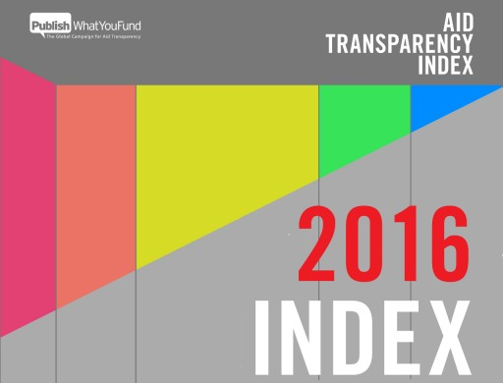
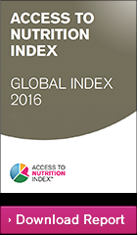
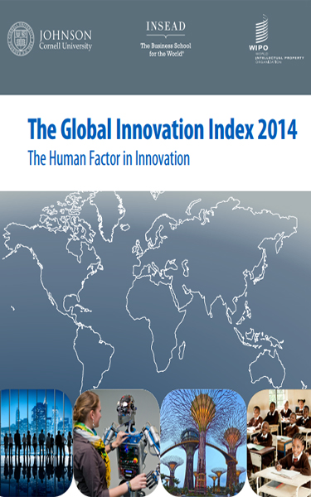
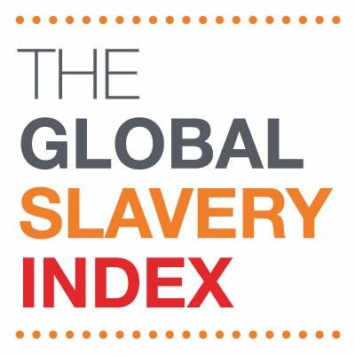


Slide 31
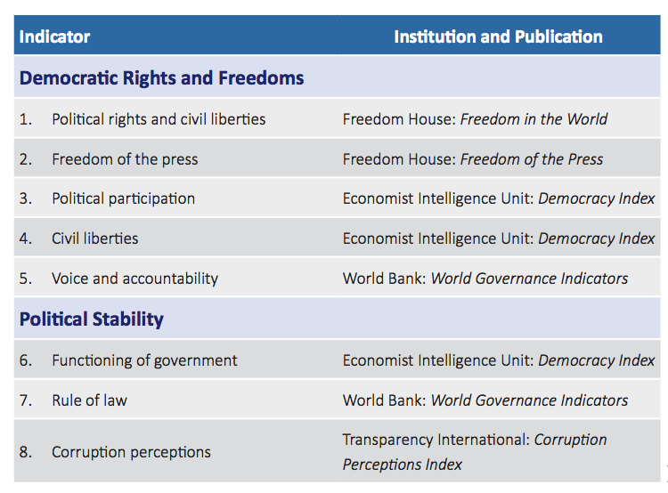
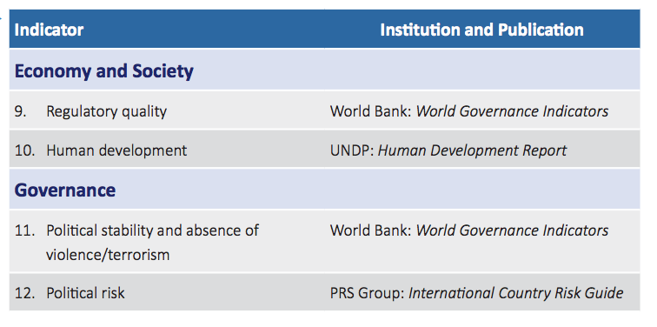
International Indicators by Institution

Slide 32
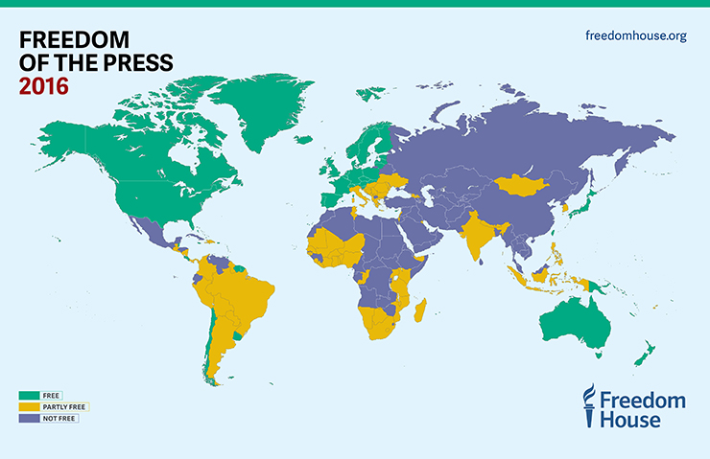

Slide 33
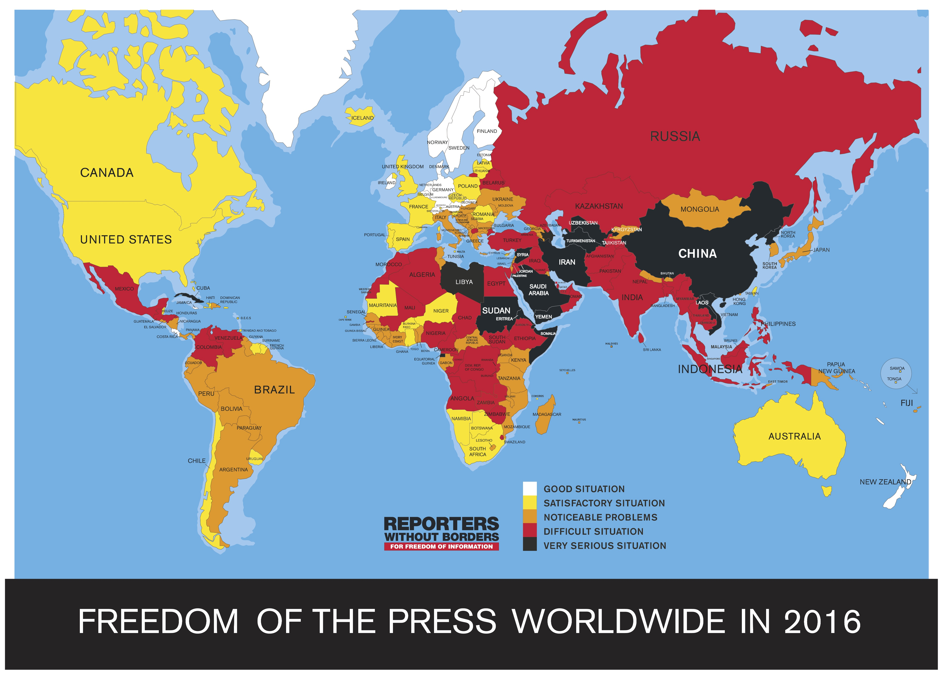

Slide 34
Press Freedom Status: Partly Free
Legal Environment: 7/30
(0= Best, 30= Worst)
Political Environment 14/40
(0= Best, 40= Worst)
Economic Environment 5/30
(0= Best, 30= Worst)
Press Freedom Score 32/100
(0= Best, 100= Worst)

Slide 35
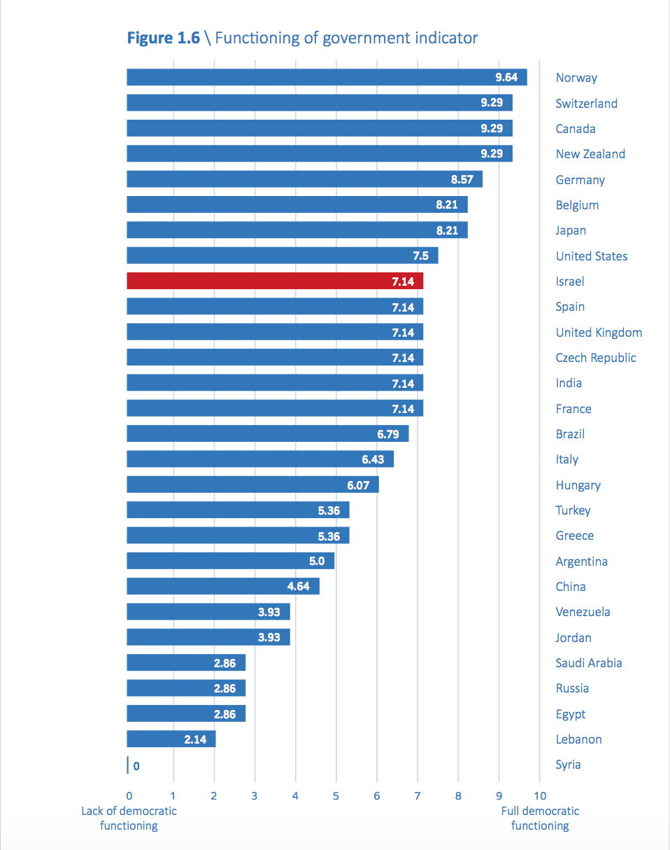

Slide 36
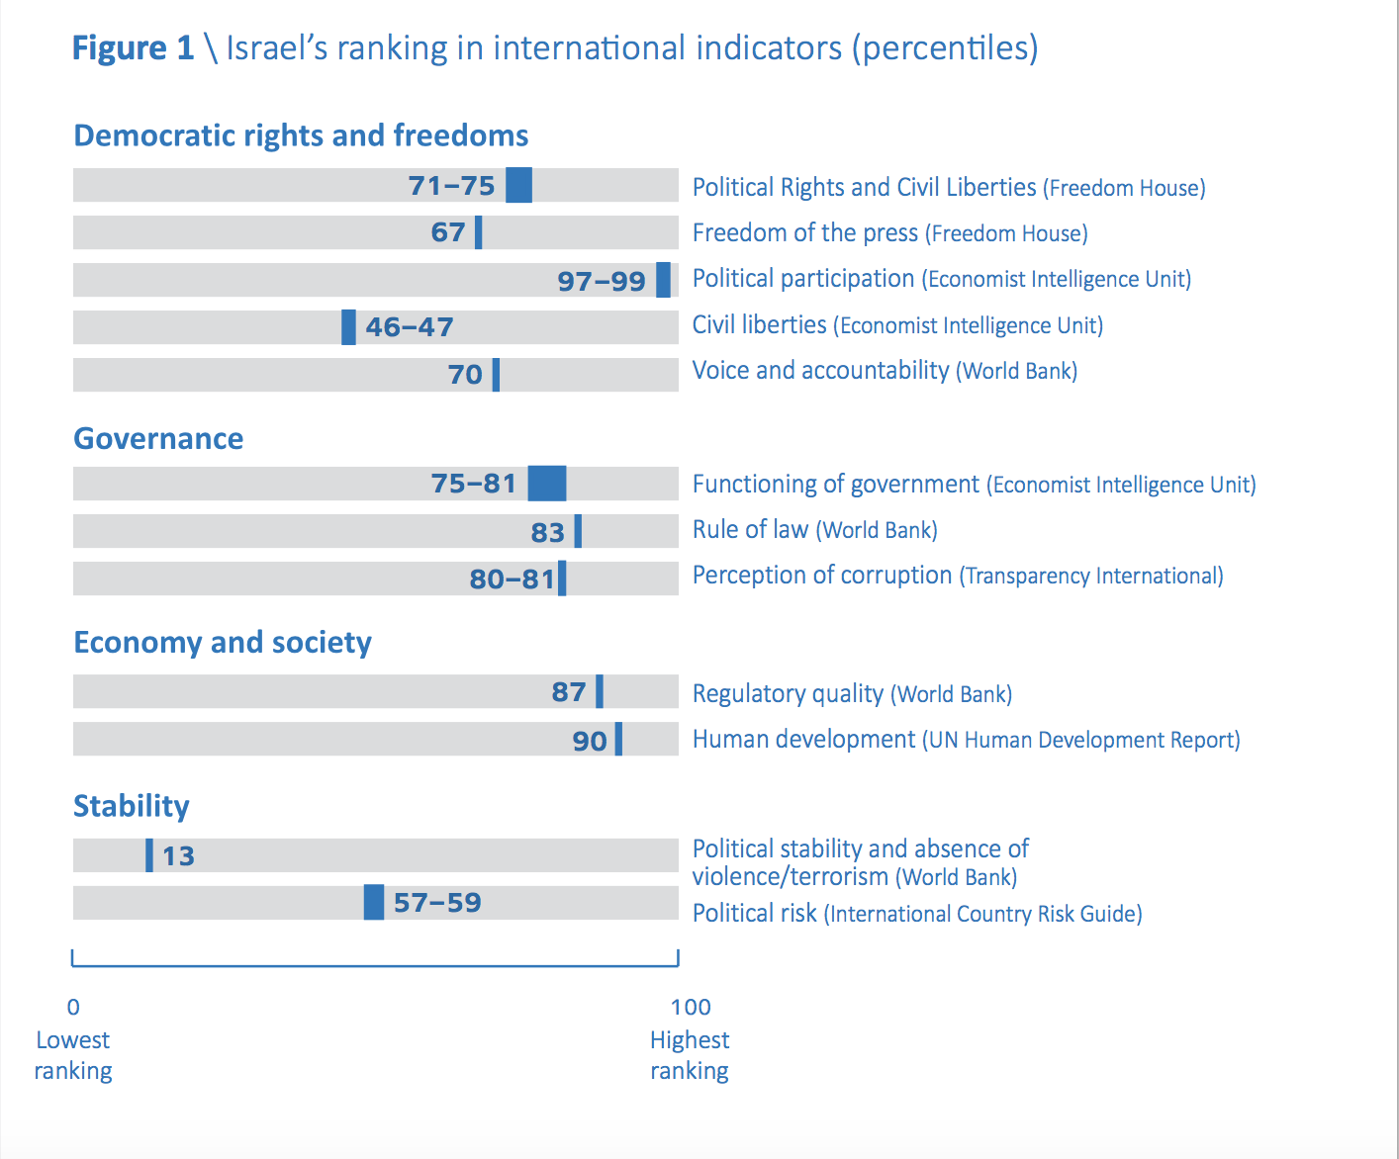

Slide 37


