Slide 1

POPULISM AND CORRUPTION ARE MAIN THREATS TO DEMOCRACY IN SLOVAKIA
Country report on the state and development of democracy in Slovakia: A failure to address problems and abuse of power opens the door to extremism
Peter Goliaš, INEKO, March 22nd 2017, Vienna

Slide 2
Standard, left, populist
Red color shows how the Government coalition was formed
Source: Statistics Office of the SR

Slide 3
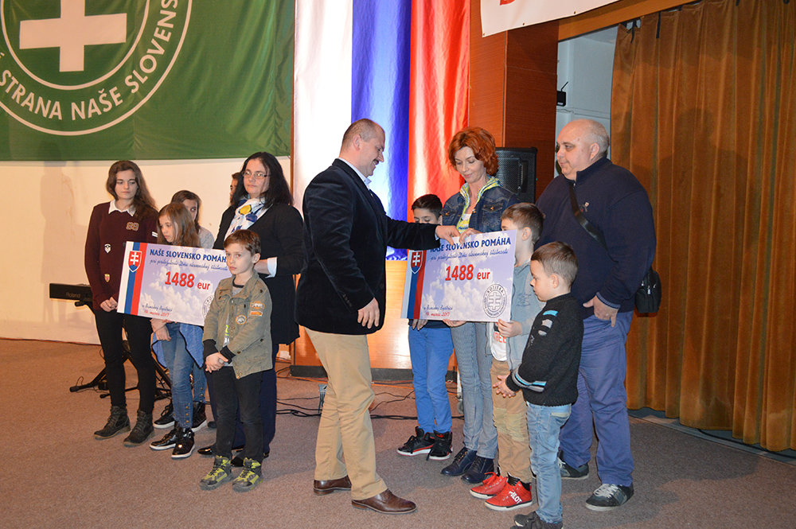

March 14th 2017 – 78th anniversary of the establishment of the Slovak fascist state in 1939
14/88 – neonacist symbol:
14 words written by David Lane, co-founder of neonacist The Order: „We must secure the existence of our people and a future for white children.“
88 – Heil Hitler (H as 8th letter of the alphabet)

Slide 4
Source: INEKO questionnaire survey made among selected public figures in SR, October 2016
Survey participants: 30% NGO activists, 27% business people and economic analysts, 21% people from academy, 12% journalists and other publicists and 10% civil servants and politicians.

Slide 5
Opinions about the quality of democracy
 | Opinion poll | Survey among public figures
Rather good to excellent | 26 % | 25 %
Neither good nor bad | 33 % | 25 %
Rather bad to poor | 40 % | 50 %
Opinions about the change in the quality of democracy in the last 5 years
 | Opinion poll | Survey among public figures
It has rather improved | 18 % | 13 %
It has neither improved nor deteriorated | 36 % | 16 %
It has rather deteriorated | 43 % | 71 %
Source: Representative survey made by Focus for INEKO in November 2016; INEKO questionnaire survey conducted among selected public figures in October 2016

Slide 6
Source: INEKO questionnaire survey made among selected public figures in SR, October 2016

Slide 7
V4 democracy rankings
 | CR | SR | Poland | Hungary | Number of assessed countries
Economist Intelligence Unit, 2015 | 25 | 43 | 48 | 54 | 195
Freedom House, 2016 | 24 | 50 | 33 | 74 | 167
Democracy Ranking Association, 2015 | 29 | 35 | 30 | 38 | 113

Slide 8
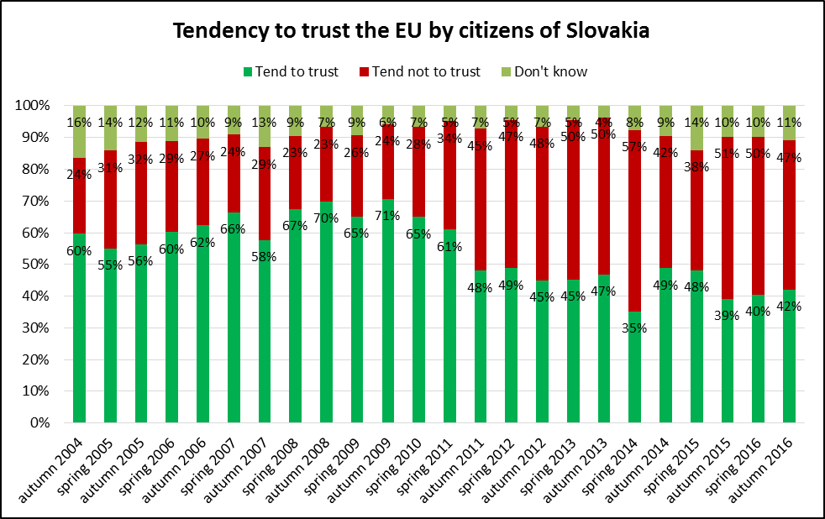
Source: Eurobarometer

Slide 9
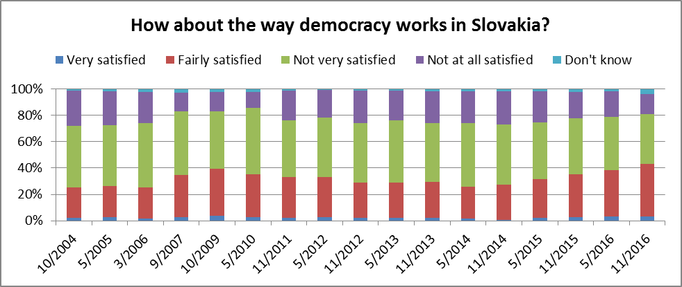
Source: Eurobarometer
 | 2007 | 2008 | 2009 | 2010 | 2011 | 2012 | 2013 | 2014 | 2015 | 2016
Change in real wages | 4.3 | 3.3 | 1.4 | 2.2 | -1.6 | -1.2 | 1.0 | 4.2 | 3.3 | 3.6
Unemployment rate | 11.0 | 9.6 | 12.1 | 14.4 | 13.6 | 14.0 | 14.2 | 13.2 | 11.5 | 9.7
Source: Statistics Office of the SR, 2016: Prognosis of the Institute for Financial Policy, Ministry of Finance

Slide 10
Key issues
Most important issues facing Slovakia (Eurobarometer, November 2016):
  Unemployment (34%)
  Health and social security (33%)
  Rising prices and cost of living (22%)
  Economic situation (19%)
  The corruption was missing among predefined answers
Transparency International Corruption Perception Index:
  Slovakia ranked 54. from among 176 countries in 2016
  Compared to 29. Poland, 47. Czech Republic and 57. Hungary.

Slide 11
Key issues
From among V4 countries, people in Slovakia tend to distrust most the police (50% distrust, the average for other V3 countries was 34%) as well as the justice and legal system (61% distrust, V3 average was 50%).
On the contrary, people in Slovakia tend to distrust least the national parliament (62% distrust, V3 average was 71%) and the government (62%, V3 average was 66%).
Source: Eurobarometer, November 2016

Slide 12
Voice of business
Unequal treatment of businesses
  Manipulated public tenders
  Financial levies on firms that have money
  Access to the EU funds is conditioned on paying "commissions" to the ruling political parties amounting to 30% of the contract amount
The links between the state and the oligarchic structures impede the status of business, enterpreneurs and cheaters are somehow like becoming synonyms
Source: INEKO interviews with 11 business leaders, 2016

Slide 13
Source: INEKO questionnaire survey made among selected public figures in SR, October 2016

Slide 14
Source: INEKO questionnaire survey made among selected public figures in SR, October 2016

Slide 15
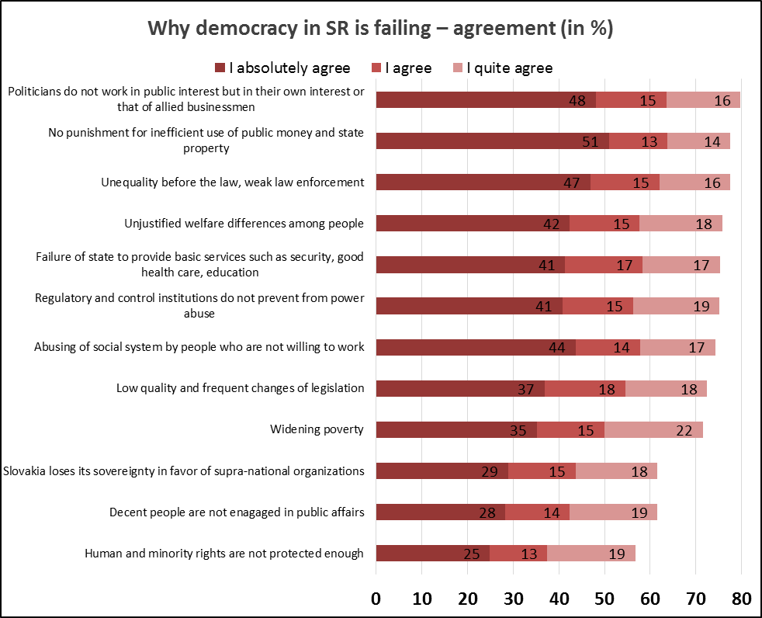
Source: Representative survey of Focus for INEKO, November 2016

Slide 16
Who is most frustrated?
 | The highest agreement
Politicians are not working in the public interest | Kotleba-ĽSNS, KDH
No punishment for inefficient use of public money and state property | Kotleba-ĽSNS
Unequality before the law, weak law enforcement | Kotleba-ĽSNS, undecided
Regulatory and control institutions do not prevent from power abuse | Kotleba-ĽSNS
Unjustified welfare differences among people | Non-voters, Kotleba-ĽSNS
The state is failing to provide basic services such as security, healthcare, etc. | OĽANO-NOVA, Kotleba-ĽSNS
Abusing of social system by people who are not willing to work | Kotleba-ĽSNS
Low quality and frequent changes of legislation | Kotleba-ĽSNS, KDH
Widening poverty | Kotleba-ĽSNS, SME Rodina
Slovakia is losing too much sovereignty for the benefit of supranational organizations | Kotleba-ĽSNS, non-voters
Decent people are not publicly active | Kotleba-ĽSNS, OĽANO-NOVA, non-voters
Human and minority rights are not sufficiently protected and respected | Non-voters, undecided, Kotleba-ĽSNS
Source: Representative survey of Focus for INEKO, November 2016

Slide 17
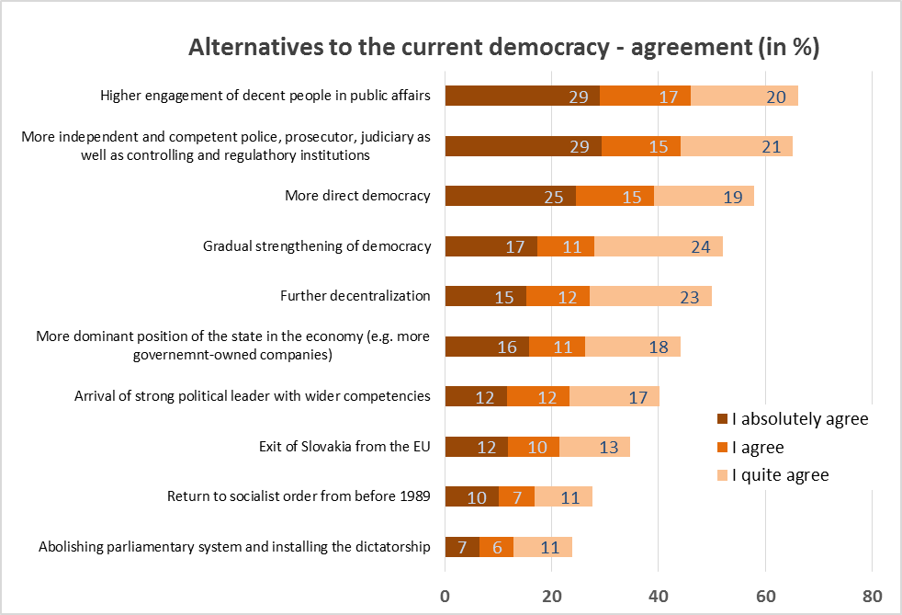
Source: Representative survey of Focus for INEKO, November 2016

Slide 18
Who wants what
 | The highest agreement
Abolishing parliamentary system and installing the dictatorship | SME Rodina, non-voters
Exit of Slovakia from the EU | Kotleba-ĽSNS, non-voters, SME Rodina
Return to socialist order from before 1989 | SME Rodina
Arrival of strong political leader with wider competencies | Kotleba-ĽSNS, SME Rodina, MOST-HÍD, SNS
More dominant position of the state in the economy | KDH
Gradual strengthening of democracy | OĽANO-NOVA, KDH, SaS
More direct democracy | Kotleba-ĽSNS
More independent and competent police, prosecutor, judiciary as well as controlling and regulathory institutions | SNS, Kotleba-ĽSNS, OĽANO-NOVA
Higher engagement of decent people in public affairs | Kotleba-ĽSNS, OĽANO - NOVA
Further decentralization | Kotleba-ĽSNS, KDH
Source: Representative survey of Focus for INEKO, November 2016

Slide 19
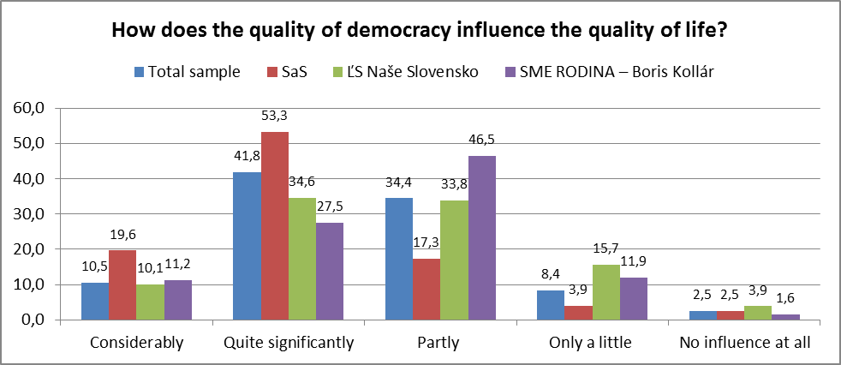
Source: Representative survey of Focus for INEKO, November 2016

Slide 20
Extremism is attractive to young
Kotleba has succeeded in mobilizing almost one quarter of the first-time-voters. Source: Exit poll of the Focus agency from March 2016.
Among secondary-school students, the winners of the simulated elections organized prior to the 2016 elections were the parties Sme rodina–Boris Kollár and Kotleba–ĽSNS. Source: The Youth Council of Bratislava Region in cooperation with the Institute of Public Affairs, with the sample of almost 12 thousand students.

Slide 21
Voice of students
Most of secondary-school students say, democracy in our country functions only "seemingly" because politicians usually do not deliver on their promises, do not pursue the public interest, abuse power, lie and are not punished for that.
A large majority of secondary-school students wants to study and live outside of Slovakia and a major part of them does not even want to come back. Causes: low quality of education, bribery and clientelism, higher standard of living and better work opportunities abroad.
Source: INEKO focus groups with students, 2016

Slide 22
Voice of students
Many believe that Kotleba has basically identified problems correctly (particularly the Roma issue, the need to establish order and the regions which are lagging behind).
Many students (particularly secondary-school students from areas with large Roma populations) mentioned that a vast majority of the Roma were misusing the social system (they do not work and receive social allowances or child allowances or disability allowances).
Source: INEKO focus groups with students, 2016

Slide 23
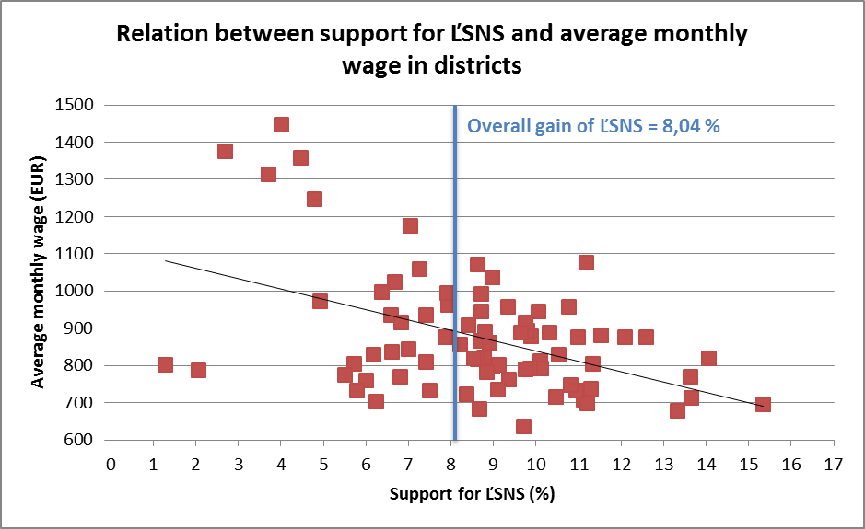
Source: Statistics Office

Slide 24
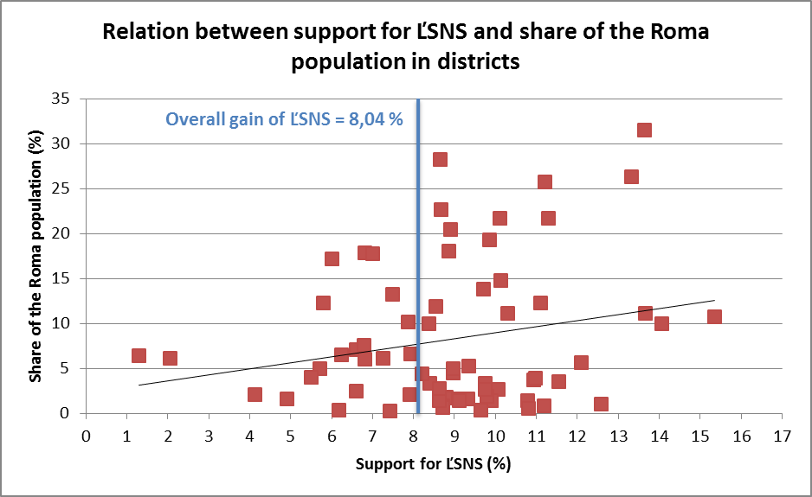
Correlations between support for ĽSNS, poverty indicators and share of the Roma in districts
 | Support for ĽSNS | Poverty index | Rate of unemployment | Average wage
Support for ĽSNS | 1.00 | 0.36 | 0.34 | -0.46
Share of the Roma | 0.22 | 0.78 | 0.84 | -0.48
Source: INEKO
Source: Statistics Office, Atlas of the Roma Communities 2013

Slide 25
Conclusion
The study reveals that a large part of most frustrated people is prone to give up democracy and support even extremist powers. They are mainly people who least realize the connection between the quality of democracy and the quality of life.
Paradoxically, many people consider as weakness of democracy that there is the abuse of power and the government does not address social problems. It is a challenge to explain that not democracy is guilty but, on contrary, that we have not got far enough on our way to functioning democracy.

Slide 26
Thank you for your attention! http://www.ineko.sk/
Populism and corruption are threats to democracy in Slovakia
(Country Report, 28.2.2017)

Slide 27
HOW TO IMPROVE DEMOCRACY IN SLOVAKIA?
Country report on the state and development of democracy in Slovakia
Peter Goliaš, INEKO, March 23rd 2017, Vienna

Slide 28
Why is democracy backsliding
DEMAND SIDE REASONS
People are disappointed:
  With the bribery of standard politicians and their connections to oligarchs and business groups
  Standard politicians have not brought order and justness
  Standard politicians are not enhancing the quality of public services, e.g. in education, healthcare, judiciary, security, etc.
Source: INEKO survey among public figures, October 2016

Slide 29
Why is democracy backsliding
SUPPLY SIDE REASONS
Populism: Politicians are successfully using influential media to spread unreal or false promises/solutions which are insufficiently or only sometimes confronted with reality or the assessment of professionals
There is no decent democratic alternative among political parties
Weak media: Authoritative and non-standard politicians are using the fact that, instead of searching for the truth, most popular media in SR usually content themselves with a political balance in which populism is winning
Source: INEKO survey among public figures, October 2016

Slide 30
Short-term solutions
Trustworthy investigation of the Bašternák case
Monitoring and assessing the efficiency of projects and tenders in areas where the largest public contracts are awarded (e.g. in transport, healthcare, IT, etc.)
Disclosure of detailed declarations of the assets of politicians and high state officials
Source: INEKO survey among public figures, October 2016

Slide 31
Long-term solutions
Children and students at schools should learn to think critically and to understand the importance of democracy
Judicial reform: Strengthening an independent functioning of the police, public prosecution and courts, e.g. by separating them from the executive, establishing an independent inspection of the police and of public prosecution, abolishing the possibility to withdraw the Police President without a reason, opening the Prosecutorial Council to members from outside the prosecutorial environment
Enhancing the quality of public services, e.g. in education, healthcare, judiciary, security, etc. (e.g. by measuring and disclosing results, financial incentives, etc.)
Appearance of trustworthy democratic politicians (e.g. establishment of new political parties which would activate democratic voters)
Source: INEKO survey among public figures, October 2016

Slide 32
Most wanted initiatives
Public control, making the courts, police, public prosecution and other public auditing offices (e.g. Office for Public Procurement, Supreme Audit Office) accountable
Public control of efficient use of public resources, particularly in major projects in IT, transport, healthcare, defence, etc.
Education of young people aimed at democratic citizenship, developing critical thinking and supporting civic and community involvement
Fact-checking the actions and promises of politicians - verifying the truthfulness of politician's statements, verifying the extent of performance/fulfillment of their pre-election programmes
Promoting and educating the media, revealing distorted information in the public area - confronting facts (monitoring the ethics and professionalism of the media)
Source: INEKO survey among public fugures, , October 2016

Slide 33
INEKO recommendations
Around 70 recommendations:
For the government and other public authorities:
  Enhance the quality of public services, e.g. by measuring and disclosing results (higher accountability), financial incentives, exchanging best practices, etc.
  Reduce corruption by enhancing transparency in the public sector, in particular:
    Disclose the political nominations and CVs of high state officials as well as managers in state-owned companies
    Systematically disclose all public data at one location in a machine-processable and user-friendly form
  Eradicate poverty, social exclusion and regional disparities, e.g. by decreasing levies for low-income population

Slide 34
INEKO recommendations
For politicians and political parties:
  Disclose information about sources of financing and about the use of funds in a clear manner and at one location, both for the entire political party and for individual candidates, disclose contracts on the provision of funds
  Disclose detailed declarations of assets, also for close family relatives
  Adopt codes of ethics for political parties obliging them to inform about any conflicts of interest, eliminate bribery, disclose information about sources and use of funds
  Assess and disclose the impact of election programmes on public finances, the labour market and the business environment

Slide 35
INEKO recommendations
For businesses and foreign donors, including the EU:
  Support NGOs focused on systemic changes and vigilance regarding the powerful ones, support projects and provide institutional grants (e.g. such as the Fund for Transparent Slovakia)
For businesses:
  Support democratic politicians and political parties, also at the regional level; support serious opinion-forming media and the independence of their opinions, particularly investigative journalism; disclose information about the form and amount of provided support, including the full wordings of related contracts; publicly declare that the businesses do not expect any counter-value for such support
  Organize themselves in alliances promoting enhancement of the business environment and democracy

Slide 36
INEKO recommendations
For NGOs, civic activists and the media
  Fact-check politicians – continuously verify the truthfulness of statements of politicians, reveal and correct false statements made also in the past (e.g. such as the demagog.sk project)
  Track promises of politicians – continuously check the viability of politicians' promises as well as their fulfilment, assess election programmes, including quantification of their impacts on public finances, the labour market and the business environment
  Monitor and assess the efficiency of projects and tenders primarily in areas where the largest public contracts or subsidies are awarded, including EU funds (e.g. in transport, healthcare, IT, defence, etc.)
  Monitor and assess the work of the courts, police, public prosecution and other public auditing and regulatory offices (e.g. The Office for Public Procurement, Supreme Audit Office, Antimonopoly Office)

Slide 37
INEKO recommendations
For schools and teachers
  Speak with pupils about the functioning and importance of democracy and of the European Union, about current events, social problems and potential solutions
For all citizens
  Be engaged in issues of public interest at both a central and local level or in your immediate surroundings including social networks, be active in politics, also in municipal politics
  Critically assess the information appearing on social networks, take note and ask for the original sources, search for arguments in favor and against, ask questions

Slide 38
Thank you for your attention! http://www.ineko.sk/
Populism and corruption are threats to democracy in Slovakia
(Country Report, 28.2.2017)

