Slide 1

Open local government 2016
Ranking of transparency in 100 largest slovak cities 2016
Transparency International Slovakia, November 2016

Slide 2
WHY THE RANKING?
The fourth transparency ranking of municipalities in Slovakia (2010, 2012, 2014, 2016)
It shows differences in transparency among the various towns and increases the pressure for more open approach
Open access to information makes public oversight possible, the rules of the processes reduce space for arbitrary decisions
However, more transparency does not automatically mean no corruption

Slide 3
WHAT DID WE EVALUATE?
11 categories
5 types of data sources
96 indicators

Slide 4
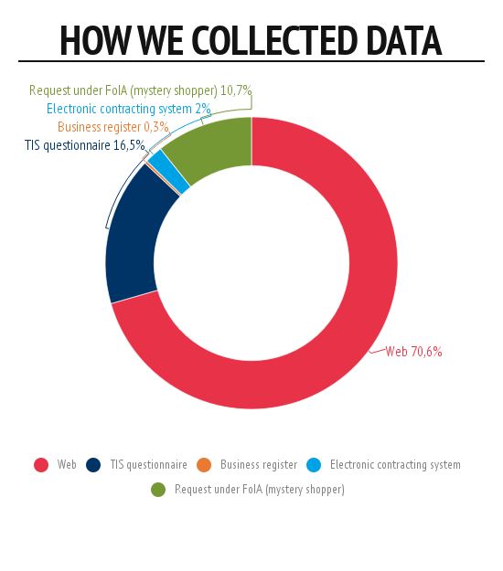
The crucial part of evaluation shifts to webcheck – proactive publishing
The methodology is slightly adjusted every year
Mystery shopping

Slide 5
THE EVALUATED AREAS
POLICY (CATEGORY) | WEIGHT | THE AVERAGE SCORE
Access to Information Policy | 21,0% | 74,2%
Budgeting and public contracts | 17,0% | 69,8%
Public Participation Policy | 15,0% | 54,6%
Public Property Sales and Lease Policy | 9,5% | 13,9%
Public Procurement Policy | 9,0% | 45,2%
Grants Policy | 7,0% | 33,3%
Housing and Social Services | 6,0% | 26,8%
Human Resources | 4,5% | 29,6%
Professional Ethics and Conflict of Interests | 4,5% | 24,4%
Municipal Businesses and Investments | 3,5% | 55,4%
Land Use Planning and Construction Policy | 3,0% | 63,1%
Total | 100,0% | 51,3%

Slide 6
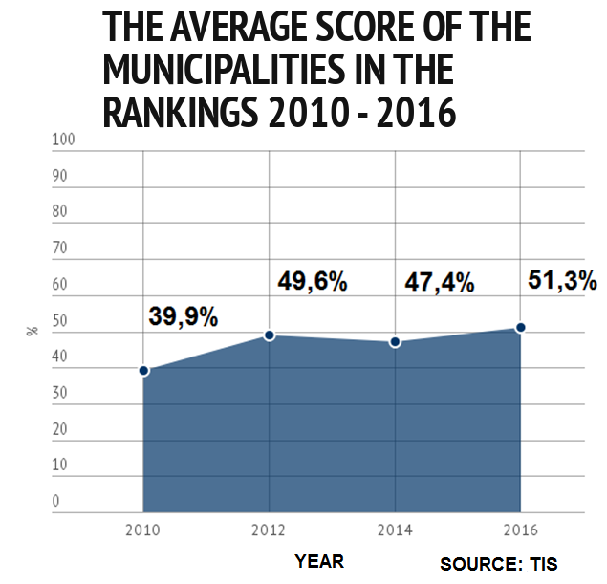
The transparency level has increased slightly in comparison with 2014, 2/3 of towns have became more open
Average result: more than 50%
2014/2016: +4 pp 2010/2016: +11 pp
Average score of regions 2015: 50,2%

Slide 7
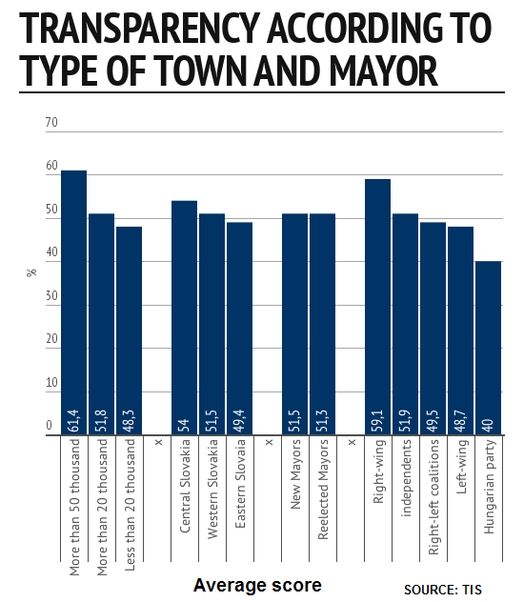
The larger towns are more transparent (bigger apparatus, more journalists and active citizens)
There is no difference between new and re-elected mayors in the average score, however the new mayors have increased transparency in a more significant way compared with 2014 ranking
Notes:
Kým mestá pod 20-tisíc obyvateľov dosiahli v priemere iba 48 percent bodov, Rožňava získala až 75,4 percent. Opačným príkladom je Nitra, ktorá získala výrazne podpriemerný výsledok v kategórii veľkých miest nad 50-tisíc. Kým tie v priemere získali viac ako 61 percent, Nitra iba cez 43.

Slide 8
SOME FINDINGS
Improvement
The share of towns which publish The Code of Conduct of elected representatives has grown from 22 to 28 % since 2014.
62 in 100 towns allow the citizens to announce a problem to the municipality online and follow the resolution (34 in 2014).
The number of towns, which publish video or audio records from the local parliament sessions has increased from 41 to 59 since 2014.
New findings
The participative budgeting is used only by 1 in 10 municipalities.
Only 1 in 10 towns publishes the program of the Mayor online.
Stagnancy or degradation
Only one third of municipalities hires the employees via selection procedure automatically (in comparison with 32 in 2014).
9 in 10 municipalities haven´t used the e-auction for last two years (in comparison with 8 from 10 in 2014).
Only 6 in 100 Mayors publish their declarations of assets online (in comparison with 5 in 2014).
90 % of towns don´t publish the rules for selection of the children to the municipal kindergarten or nursery.

Slide 9
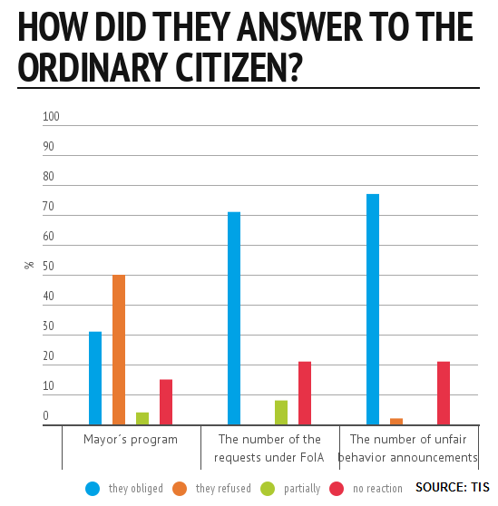
ACCESS TO INFORMATION
Mystery shopping
29 from 100 town halls didn´t react to requests under The Freedom of Information Act
There were also Mayors, who contacted an applicant and tried to find out information about her.

Slide 10
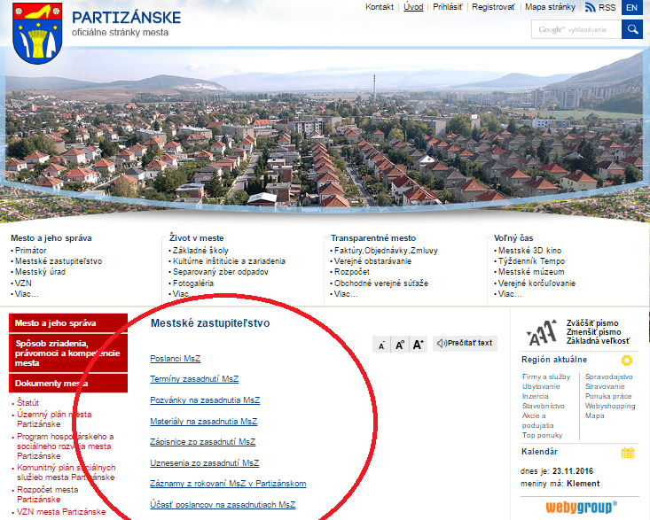
PUBLIC PARTICIPATION
9 in 10 towns publish the minutes from the sessions of local parliament
video records published by 59 % of towns
Partizánske – all information about local parliament sessions in one place (invitations, materials, minutes, decisions, participation of local representatives)

Slide 11
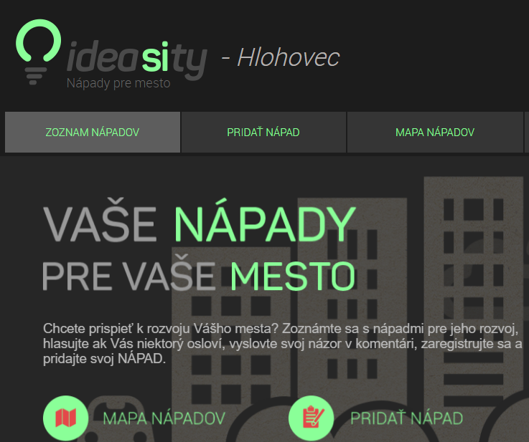
PARTICIPATIVE BUDGETING
Participative budgeting used by 11 from 100 towns
Hlohovec has a special website where public can vote for community projects
List and map of ideas are available on the website

Slide 12
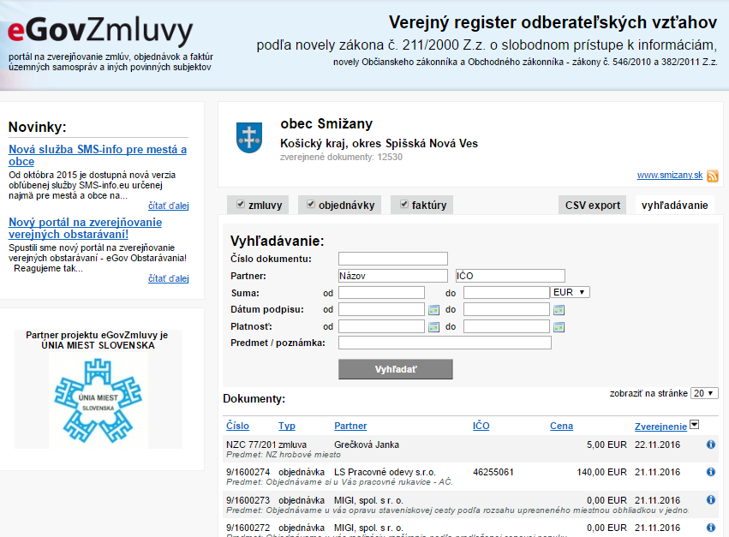
CONTRACTS: GOOD PRACTICE
The quality of contract publishing is 61 % in average
Village Smižany - 99 %
They publish all the contracts with attachments, copying from the documents is possible
They also provide a system for searching of the contracts according to sum, date, company, etc.

Slide 13
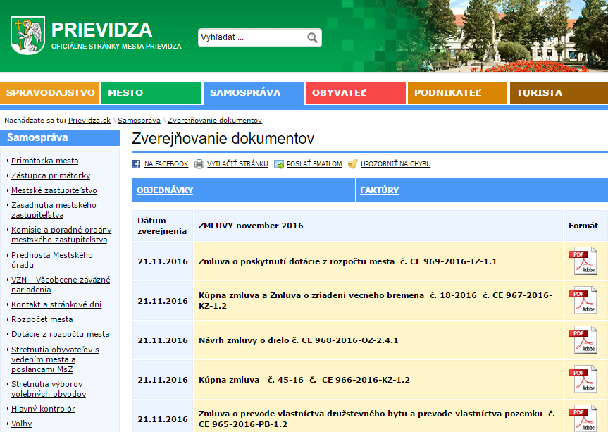
CONTRACTS: BAD PRACTICE
Prievidza (50 thousand inhabitants) – only 15 %
They don´t provide any search engine, the published documents are only scanned images without possibility to copy from them

Slide 14
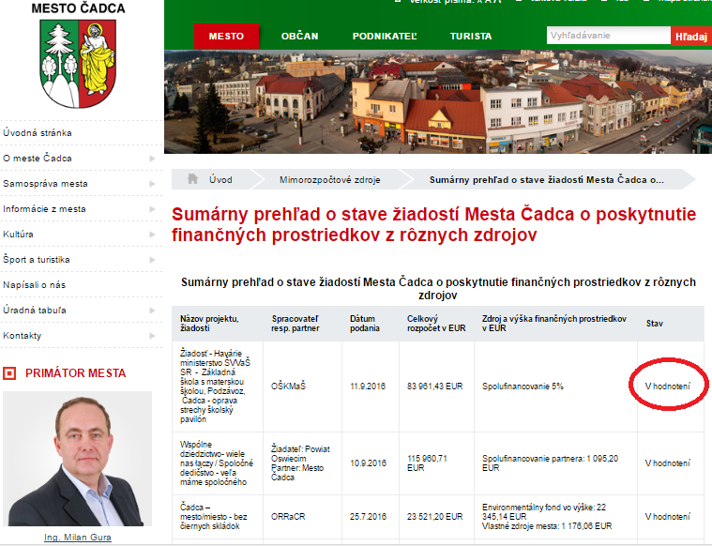
GRANTS POLICY
Only 4 in 10 towns publish information regarding the subjects, which were supported by town grants
Čadca publishes detailed information about the grant policy including the state of a request and an information about co-financing
Notes:
Trenčín 2016: Dotácie na šport 72 500 eur; 104 000 eur

Slide 15
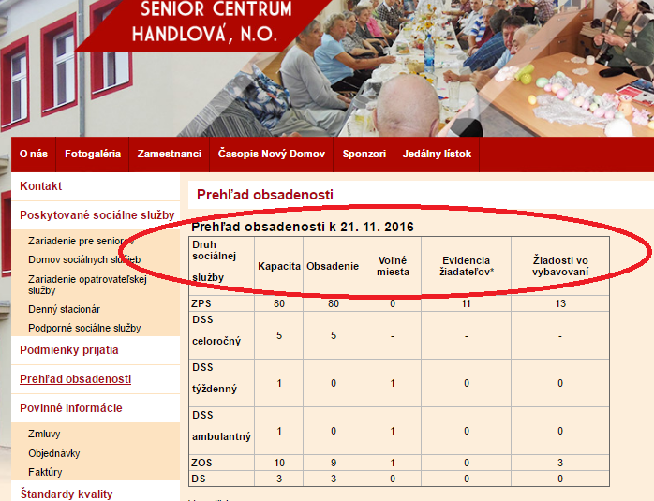
SOCIAL SERVICES
18 towns publish information regarding vacancies (3x more than 2014)
Handlová publishes all the actual data about capacity in social service facilities, vacancies, state of requests and rules for acceptance
Notes:
Zverejňovanie voľných miest a poradníka – nástroj proti korupcii a klientelizmu

Slide 16
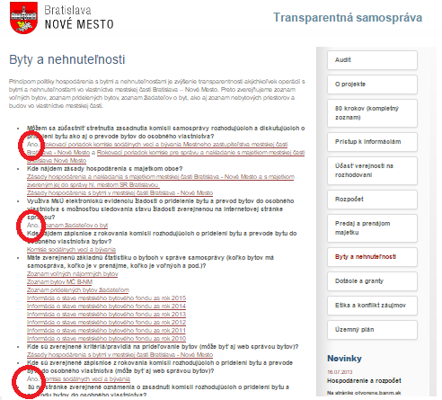
HOUSING
Only quarter of towns publishes a waiting list of municipal flat applicants and 17% publish, who was successful
Bratislava - Nové Mesto has special section about housing policy with all the information about the municipal flats, including lists of applicants, minutes from committee, etc.

Slide 17
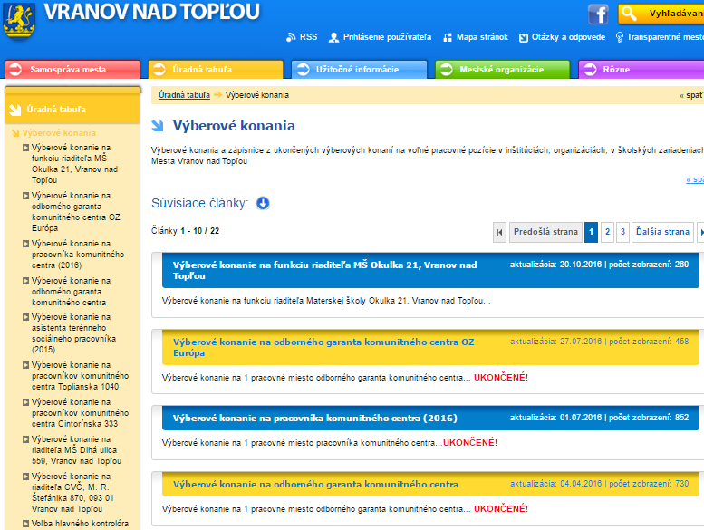
HUMAN RESOURCES
One third organizes selection procedures for all the positions
Vranov publishes complete minutes from HR committee including the numbers of applicants, their names and experiences, and also information regarding committee members

Slide 18
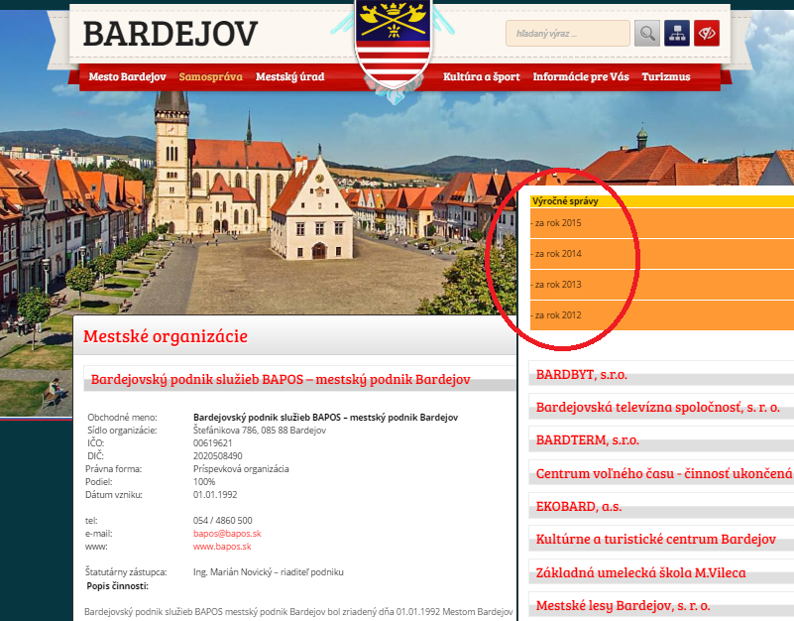
MUNICIPAL BUSINESSES
One third of the towns doesn´t publish information regarding municipal-owned enterprises
Bardejov publishes all the information about the companies and their performance including annual reports
Notes:
politizácia výkonného manažmentu mestských firiem (poslanci sú konateľmi alebo členmi predstavenstiev mestských firiem v 61% mestách).

Slide 19
THE RANKING SHIFTS
+87 positions and 41 pp
Sabinov (from 100. to 13. place)
+52 positions and 20 pp
Nové Zámky (from 86. to 34. place)
-52 positions and 13 pp Kolárovo
(from 36. to 88. place)
-47 positions and 9 pp Tvrdošín
(from 38. to 85. place)

Slide 20
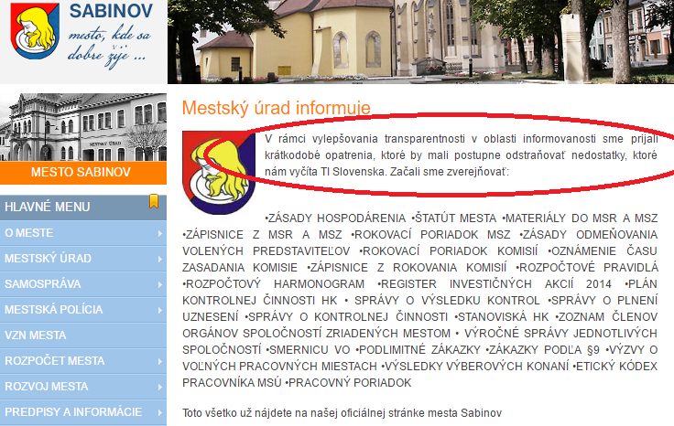
IMPROVEMENT PLAN
Sabinov occupied 100th place in 2014
Afterwards, they informed on the website about their improvement plan
In 2016 ranking they improved to 13th place
Notes:
Podobne Vranov – v roku 2012 posledné 99. miesto spolu s Bytčou.

Slide 21
THE LEAST TRANSPARENT
100th place
Veľký Meder – 27.3 %
2. Miesto
Martin - 76,5%
3. Miesto
Rožňava - 75,4%
Notes:
Posledný Veľký Meder 27,3%

Slide 22
THE MOST TRANSPARENT
1. Miesto
Vranov nad Topľou - 78,7%
2. Miesto
Martin - 76,5%
3rd place
Rožňava – 75.4 %
Notes:
Kým mestá pod 20-tisíc obyvateľov dosiahli v priemere iba 48 percent bodov, Rožňava získala až 75,4 percent. Opačným príkladom je Nitra, ktorá získala výrazne podpriemerný výsledok v kategórii veľkých miest nad 50-tisíc. Kým tie v priemere získali viac ako 61 percent, Nitra iba cez 43.

Slide 23
THE MOST TRANSPARENT
1. Miesto
Vranov nad Topľou - 78,7%
2nd place
Martin – 76.5 %
3rd place
Rožňava – 75.4 %

Slide 24
THE MOST TRANSPARENT
1st place
Vranov nad Topľou – 78.7 %
2nd place
Martin – 76.5 %
3rd place
Rožňava – 75.4 %
Notes:
Posledný Veľký Meder 27,3%

Slide 25
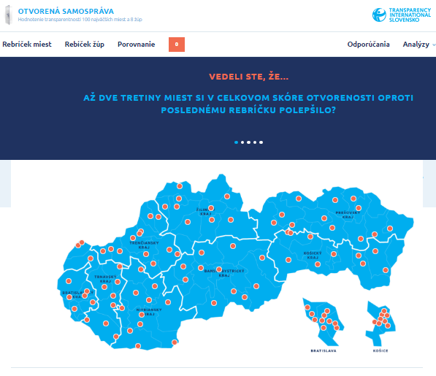
TRANSPARENCY PORTAL
samosprava.transparency.sk
It is possible to click on each town on the portal
You can find information about questions and answers for each town and each category
You can compare the actual answers with the previous ones
Comparison of the municipalities is available

Slide 26

THANK YOU FOR YOUR ATTENTION
samosprava.transparency.sk

