Slide 1

Energy Sector Reforms in Slovakia
Peter Golias
INEKO Director
15th September, 2016
Kyiv, Ukraine

Slide 2
Content
Milestones of the energy sector development
National Energy Regulator
Energy Efficiency Funds/Programmes
Lessons learned
Recommendations for Ukraine

Slide 3
Price liberalization
Goals: Setting right incentives, financial stabilization, partial privatization, increased competition, efficiency
1990-93:
  Electricity: +70-80%
  Natural gas: +130%
  Coal: +240%
  Heat: +320%
1999-2007:
  Electricity: +100%
  Natural gas: +100%

Slide 4
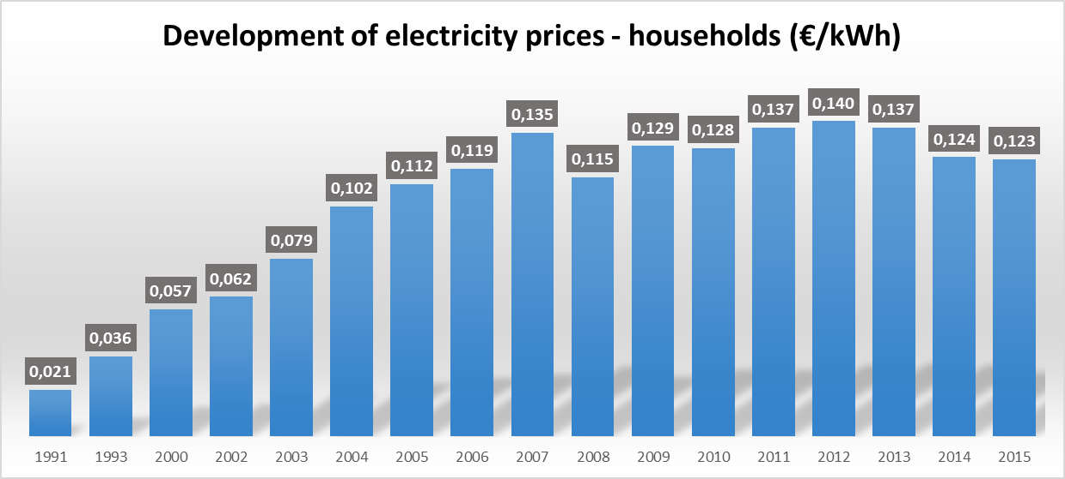
Source: Eurostat, other sources, until 2009 rough conversion local currency/euro

Slide 5
Unbundling
Goals: Eliminating cross-subsidies, partial privatization, trade liberalization, increased competition, efficiency
1990-94:
  Separating three territorial distribution companies from the power generation
  Separating storage and local exploration & production of hydrocarbons from the transmission and distribution of natural gas
2002:
  Separating high-voltage electricity transmission from the power generation
2006:
  Legal separation of gas distribution and transmission
2007:
  Legal separation of electricity trade from distribution

Slide 6
Privatization
Goals: Financial stabilization, state budget revenues, unbiased regulation, increased competition, efficiency
1992-96: Direct non-transparent sales to local investors (almost 100% of shares privatized):
  Oil producer and distributor, gas storage and local exploration & production (both were later re-sold to strategic foreign investors)
  Coal mining company
2001-04: Transparent international tenders (49% of shares with managerial rights)
  Oil transit sold to Russian Yukos; in 2009 re-sold back to the state
  Transmission and distribution of natural gas sold to Gazprom, Gaz de France and Ruhrgas; in 2013-14 re-sold to the Czech company EPH except for the gas trade that was re-sold back to the state
  Three electricity distribution companies sold to E.ON Energie, Elektricité de France International (in 2013 re-sold to EPH) and RWE Plus
  Power production (66% of shares) sold to the Italian company ENEL; in 2015-16 re-sold to the EPH

Slide 7
Opening markets
Goals: Fair access to infrastructure, higher transparency, increased competition, efficiency
2001: Opening markets to large electricity and gas customers
2005: Opening electricity market to all businesses
2008: Opening electricity market to all households
2009: Opening gas market to all businesses
2011: Opening gas market to all households

Slide 8
Source: Regulatory Office for Network Industries

Slide 9
Source: Regulatory Office for Network Industries

Slide 10
Infrastructure development
1992: Gabčíkovo hydropower plant
  10% of the total electrical power generated
  Owned by state
1998-99: Two blocks of the Mochovce nuclear power plant
  25% of the total electrical power generated
  Other two blocks to be launched soon
2006-08: Shutting down two blocks of the Jaslovské Bohunice nuclear power plant
  Due to the EU accession and security requirements
  Loss of 20% of power generation
2009: Gas transit reverse operation due to Ukrainian-Russian controversies
2015: Gas transmission connection between Slovakia and Hungary
2015: Oil pipeline Adria renovated connecting Druzhba

Slide 11
Content
Milestones of the energy sector development
National Energy Regulator
Energy Efficiency Funds/Programmes
Lessons learned
Recommendations for Ukraine

Slide 12
Independent regulation
Goals: Fair prices, fair access to infrastructure, higher transparency and predictability
2001: Setting up the Regulatory Office for Network Industries (RONI)
2003: RONI assumes full responsibility for regulation of energy and legal unbundling
2012: Creation of a Regulatory Council totally independent in adopting regulatory policy
Funded from the state budget

Slide 13
Regulated areas
Electricity
  Generation, transmission, distribution and supply
  Performance of the short-term electricity market administrator´s activities)
Gas
  Production, transport, distribution, storage and supply
Heat
  Production, distribution and supply
Water
  Production, distribution and supply of potable water,
  Abstraction of surface water and energy water from water flows
  Utilization of the hydro-potential of the water flows
  Diversion and purification of sewage through public sewerage system

Slide 14
Key activities
Issuing licenses for performance of regulated activities
Price regulation based on the price cap method
  The regulated entity can appeal against the Office`s decision within 40 days from the notification date
Setting of energy prices for end-consumers in the Slovak Republic
 | Households | Small companies | Large companies
Electricity | regulated | regulated | deregulated
Gas | regulated | regulated | deregulated
Solid fuels | deregulated | deregulated | deregulated
Fuels in transport | deregulated | deregulated | deregulated
Heat - centralized supply | regulated | regulated | regulated

Slide 15
Source: Regulatory Office for Network Industries

Slide 16
Key bodies
Chairman of the Office
  Appointed (for 6-year term) and recalled by the President of the Slovak Republic upon proposal of the Government
  Chairs the Council for Regulation
  Governs the Office; acts on behalf of the Office externally in all matters; appoints and recalls the Vice-Chairman; decides in regulation procedures as the first-level authority; decides on the imposition of penalties in appeal proceedings
Council for Regulation
  Members are appointed (for 6 year term) and recalled by the President of the Slovak Republic upon proposal of the National Council of the Slovak Republic (3 members) and the Government (3 members)
  The Council is renewed by replacing one third of members every two years
  Strategic management; adopts regulation policy; decides in appeal proceedings
Number of employees (2014): 106

Slide 17
Content
Milestones of the energy sector development
National Energy Regulator
Energy Efficiency Funds/Programmes
Lessons learned
Recommendations for Ukraine

Slide 18
Key drivers
Market prices
European Union:
  Directive 2006/32/EC on energy services
  Directive 2012/27/EU on energy efficiency
Own legislation
  2007: Energy Efficiency Policy of the SR
  2007-14: Three Energy Efficiency Action Plans for 2008–2010; 2011–2013; 2014–2016 with an outlook up to 2020
  2014: Energy Efficiency Act

Slide 19
Targets
 | Energy savings based on the recalculated average final energy consumption in 2001–2005
 | [%] | [TJ]
Annual target | 1 % | 3 122
Three-year target up to 2010 | 3 % | 9 366
Medium-term target up to 2013 | 6 % | 18 722
Long-term target up to 2016 | 9 % | 28 098
Long-term target up to 2020 | 11 % | 34 342
Energy efficiency target – to achieve the following level of final energy consumption in 2020 | 105 TWh | 378 PJ
Energy efficiency target – to achieve the following level of primary energy consumption in 2020 | 191 TWh | 686 PJ

Slide 20
Methodology
Defined measures for specific sectors: buildings, industry, public sector, transport, appliances, energy transformation, transmission and distribution
Each sector has its own sub-targets
Measures are structured: specific programs, projects, legislative regulation, information campaigns, etc.
Responsibilities of individual competent ministries are defined
Annual targets are set as total amounts as well as broken down for individual areas
The implementation of measures is evaluated on an ongoing basis (Annual reports) and any deflection relative to sub-targets triggers corrective action

Slide 21
Funding
Public sources:
  State budget, state-owned companies
  Funds of European Union
  Municipalities
Private sources (significant majority):
  Loans from commercial banks
  Voluntary contributions by parties to the agreement
  Special offers from retailers and manufacturers
  Consumer associations
  Consultancy services of energy companies
 | Investment cost |  |  | Total | Average annual amount
Years | 2008 – 2010 | 2011 – 2013 | 2014 – 2020
(EUR thousands) | 3 890 550 | 6 886 333 | 19 589 886 | 30 366 769 | 2 335 905

Slide 22
Content
Milestones of the energy sector development
National Energy Regulator
Energy Efficiency Funds/Programmes
Lessons learned
Recommendations for Ukraine

Slide 23
Lessons learned
Fair/Market prices are the best incentive to increase efficiency
Keeping artificially low prices for a long time leads to steep price increases which is highly unpopular, often harming poor people, impeding political stability and reversing the reforms
Direct non-transparent sales to local investors may create oligarchs capable of capturing the state
Privatizing for low prices may lead to later re-sales to strategic investors for market prices – the state loses privatization revenues, the money pours into private pockets of oligarchs
Privatization through transparent international tenders maximizes state budget revenues and welcomes strategic investors with better culture and know-how
People are important – independent Regulator as well as the Government should employ the best people, who deserve to be well-paid

Slide 24
Content
Milestones of the energy sector development
National Energy Regulator
Energy Efficiency Funds/Programmes
Lessons learned
Recommendations for Ukraine

Slide 25
Recommendations
Pursue solid Energy Policy: Set up long-term plans for market liberalization, unbundling, privatization, independent regulation, energy efficiency
  Long-term, binding policy with a set final targets, concrete measures and programs, systems of interim reviews
Consider the impacts of steep price liberalization
Privatize through transparent international tenders with price as the chief/single winning criteria
Set up a strong Regulator independent from the Government
Install respectable and well-paid individuals in Regulatory and Government institutions

Slide 26
Thank you for your attention!

