Slide 1


Financial transparency and stability of local governments in Slovakia
Peter Golias
INEKO Director
June 30th, 2016
Kyiv, Ukraine
Seminar on “Local Budgets Transparency”

Slide 2
About the project
Title: Transparent, financially healthy and competitive municipalities in Ukraine
Period: October 15th 2015 – March 15th 2017
Funded by: Slovak Aid
Implemented by: INEKO and ICPS
Goal: To support regional development in Ukraine through know-how transfer of successful projects implemented in Slovakia

Slide 3
Projects to be transferred
Portal on financial health of Slovak municipalities – INEKO, http://municipalities.ineko.sk/
Open local government – Transparency International Slovakia, http://mesta2014.transparency.sk/en
Competitive regions 21 – Business Alliance of Slovakia, http://www.regiony21.sk/

Slide 4
Project progress
Finalizing the portal and analysis on financial transparency of the biggest local governments in Ukraine
  Results to be presented in June-July 2016
Starting the trainings on computing transparency ratings of the biggest cities in Ukraine
  Results to be presented in February 2017
Collecting data for computing competitiveness of regions
  Results to be presented in February 2017

Slide 5
Slovak experience
Since 2012: INEKO portal computing financial health of all municipalities and regions: http://www.hospodarenieobci.sk/
Major developments/impact:
  Intensive public attention and pressure to govern finances of local Gvts responsibly
  New legal constraints (penalty, debt brakes, more strict rules on hidden debt)
  Fiscal stabilization of local Gvts

Slide 6
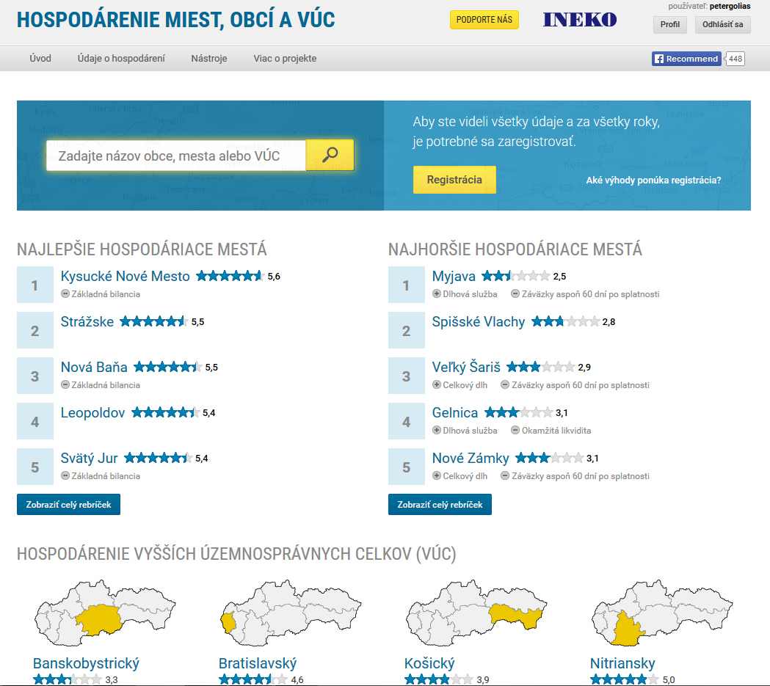
INEKO portal
Main page:

Slide 7
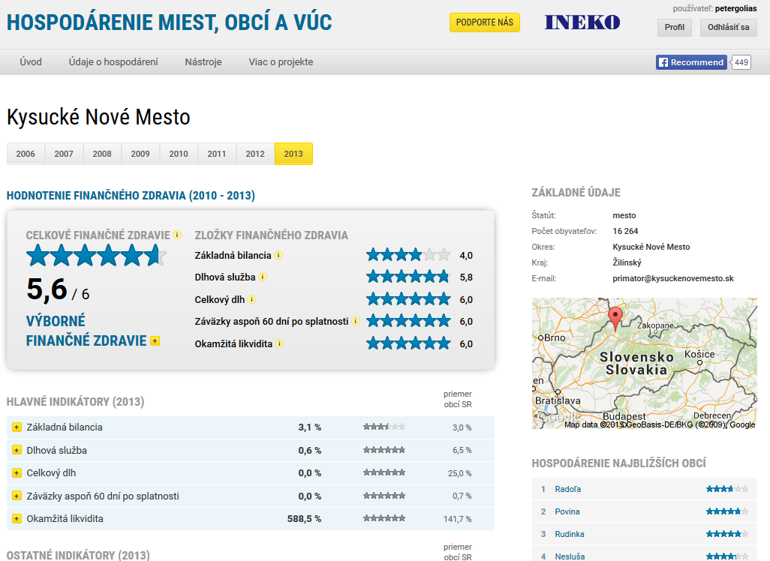
INEKO portal
Profiles of municipalities and HTUs:

Slide 8
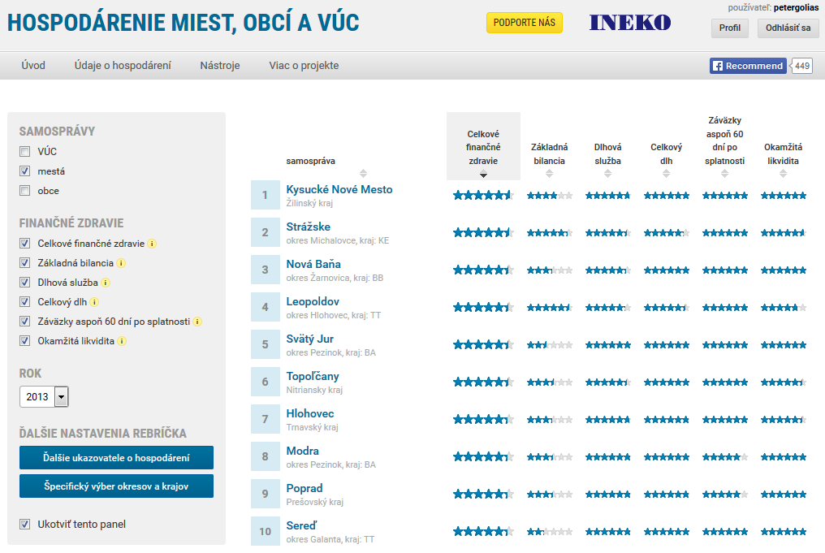
INEKO portal
Financial health rankings:

Slide 9
Financial health indicators
Indicators entering final rating | Weight
Overall debt over current revenues | 2
Debt service (interest plus principle) over current revenues | 1
Current and capital account balance over current and capital revenues | 1
Liabilities overdue at least 60 days over current revenues | 1
Immediate liquidity on financial accounts over short-term liabilities | 1
All indicators are transformed to the scale {0, 6}
Overall debt is computed based on data from the most recent year
Other four indicators are computed based on data from the 4 most recent years with following weights:
  Year t: 4
  Year t-1: 3
  Year t-2: 2
  Year t-1: 1

Slide 10
Underlying data
Current account revenues
Current account expenditures
Capital account revenues
Capital account expenditures
Debt service – principal
Debt service – interest
Short-term liabilities
Long-term liabilities
Bank loans
Loans from the state
Overdue liabilities
Liabilities overdue at least 60 days
Short-term receivables
Financial assets (e.g. cash, bank deposits)
Number of citizens

Slide 11
Legal constraints
Conditions on taking more debt:
  Debt below 60% of current revenues in preceding year
    Exception 1: Debt to state organizations
    Exception 2: Bridging loans for EU funds
  Debt service (interest plus principal) below 25% of current revenues in preceding year
    Exception: One-off preliminary repayment

Slide 12
Legal constraints
Debt brakes: If debt above 50%, corrective measures are necessary:
  If debt under 58%, the mayor has to explain reasons, propose corrective measures to the Council and inform Ministry of Finance
  If debt above 58% but under 60%, revision of budget is necessary to achieve balanced budget by the end of year and balanced budget proposal for next year
  If debt above 60%, the municipality has to pay a penalty of 5% of debt exceeding 60% (this rule is set by Constitutional law)

Slide 13
Legal constraints
Conditions on adopting “corrective process“ (no rewards, new corrective budget, informing MoF):
  Overdue liabilities above 15% of current revenues in preceding year (without revenues from state or EU)
  Any accredited liability overdue of 60 or more days
If “corrective process“ does not lead to improvement after 90 days, the custodian nominated by the Ministry of Finance overtakes the “forced management“ of municipality

Slide 14
Thank you for your attention! http://ineko.sk/; http://www.hospodarenieobci.sk/

