Slide 1
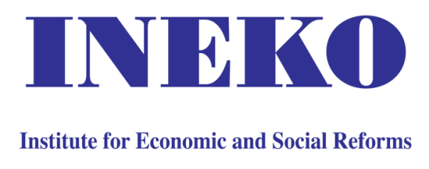
How to counter democratic backsliding in CEE?
Peter Golias
INEKO Director, Slovakia
June 21st 2016
Warsaw, Poland

Slide 2
Root causes
Root causes of democratic backsliding in CEE
Traditional beliefs/values (e.g. preferring authoritarian rule, nationalism, conservativism, trust to Russians/Americans)
Disappointment, low standard of living, corruption
Iron law of oligarchy, extractive institutions
Populism (unrealistic or harmful promises/measures)
Poor education
Russian propaganda

Slide 3
Key solutions
Solutions to democratic backsliding
Traditional beliefs/values Public education Iron law of oligarchy, Disappointment Structural reforms, setting up inclusive institutions Higher transparency, watchdogging big public tenders Mobilizing democratic forces (e.g. ethical businesses, free media, civil activists, NGOs) Disclosing oligarchs‘ links to politicians and public officials; contrasting legal income and property of politicians and high state officials Feedback on populism: Tracking promises, fact-checking, evaluation of Gvt measures, public debt breaks Poor education Formal education reform (more focus on democracy, anti-extremism, success in labor market, etc.) Russian propaganda Monitoring and disclosing suspicious information channels

Slide 4
Trust to Americans
Source: Institute for Public Affairs, Slovakia, spring 2015

Slide 5
Trust to Russians
Source: Institute for Public Affairs, Slovakia, spring 2015

Slide 6
Who is disappointed?
Country | Corruption Perception Index 2015 ranking
Austria | 16.
Estonia | 23.
Poland | 30.
Lithuania | 32.
Czech Republic | 37.
Latvia | 40.
Slovakia | 50.
Hungary | 50.
Romania | 58.
Macedonia | 66.
Bulgaria | 69.
Serbia | 71.
Bosnia and Herzegovina | 76.
Moldova | 103.
Ukraine | 130.
Source: Transparency International

Slide 7
Who is disappointed?
Source: Institute for Public Affairs, Slovakia, spring 2015

Slide 8
Who is disappointed?
Source: Institute for Public Affairs, Slovakia, spring 2015

Slide 9
Who is disappointed?
GDP per capita (in purchasing power parity, as % of EU28 average)
Source: Eurostat

Slide 10
Who is disappointed?
GDP per capita change (in purchasing power parity, as % of EU28 average)
Source: Eurostat, World Bank

Slide 11
Iron law of oligarchy
1911: German sociologist Robert Michels
  The new elite will always acquire power for its own benefit and at the expense of others
2012: American economists Daron Acemoglu and James Robinson (Why Nations Fail)
  To break the Iron law of oligarchy, the country has to have a broad and strong coalition interested in setting up “inclusive” institutions and to distribute political and economic powers in such a way that they cannot be monopolized by narrow elite
  Key members of coalition: Free media, businesses independent from Gvt and monopolies

Slide 12
Inclusive institutions
Political:
  Democratic political system
  Rule of law: Independent justice, regulatory and controlling authorities
  Free media, transparency, etc.
Economic:
  Market economy
  Protection of private property
  Effective anti-monopoly policy
  Level playing field, etc.

Slide 13
Slovak experience
Key success factor: Creating informal coalition of people supporting democracy and reforms
  Civil society: Think-tanks and advocacy NGOs (including INEKO and the Business Alliance of Slovakia)
  Free media
  Experts from think-tanks and bank analysts engaging in public discourse
  Reform-minded politicians and policy makers (often coming from think-tanks)

Slide 14
Who supports democracy?
Slovak experience in foreign funding of NGOs
 | 1990s and early 2000s | Late 2000s and early 2010s | Current situation
US donors | Intensive support | Decreasing activity, almost disappeared | Increased activity of OSI limited to anti-corruption
EU donors | Small support (Embassies) | Minimum support (Embassies) | Minimum direct support; Gvt administrated EU funds
EEA & Norwegian grants | No | Sporadic support (huge administrative burden) | No

Slide 15
Potential funding sources
Local private donors
  Limited potential; private interests
Foreign donors
  Return/Increased activity of US donors
  EEA & Norwegian grants; Swiss grants (need to focus on democracy and decrease administrative burden)
  EU (need to focus on democracy, decrease administrative burden, fund NGOs directly not via Gvt)

Slide 16
Potential cooperation in CEE
Discussion platforms, exchange of best practices about:
  Projects (who is doing what)
  Reforms (what works and what does not work)
  Problems and (potential) solutions
  Funding opportunities, etc.
Common projects
  Transfer of know-how
  Developing new ideas

Slide 17
Thank you for attention! http://www.ineko.sk/

Slide 18
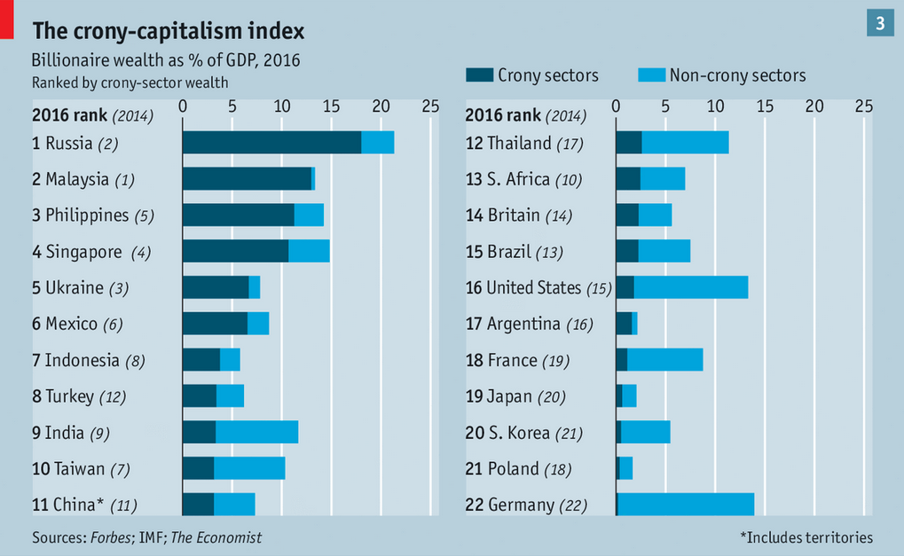
Crony-capitalism
Source: The Economist, May 7th, 2016, The party winds down

