Slide 1

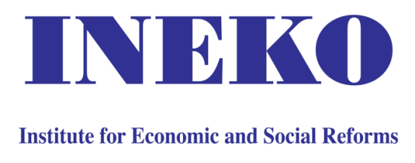
Improving business environment in Albania by transferring Slovak reform know-how
Peter Goliaš
INEKO Director, Slovakia
Conference: “Improving Business Enviroment in Albania“
June 9th 2016, Tirana

Slide 2
Content
Key indicators and rankings
How to break the “Iron law of oligarchy“
Slovak reform experience
  Informal pro-reform coalition
  Structural reforms
  Fiscal stabilization
  Fight against corruption
  Current challenges

Slide 3
Economic convergence
GDP per capita in Visegrad 4 countries and Albania (in purchasing power parity, as % of EU28 average)
Source: INEKO based on data from Eurostat (for V4 and EU28) and the World Bank (for Albania)

Slide 4
Shadow economy
Size of shadow economy in Albania and V4 (in % of GDP)
 | Albania | Czech Republic | Hungary | Poland | Slovakia | EU28
2003 | 34.4 | 19.5 | 25.0 | 27.7 | 18.4 | 22.6
2015 | 32.9 (2007)* | 15.1 | 21.9 | 23.3 | 14.1 | 18.3
Source: Schneider (2015); Boka, Torluccio (2013)
* Most recent estimates: 30-40% of GDP

Slide 5
Economic indicators
 | 2011 | 2012 | 2013 | 2014 | 2015e | 2016f
GDP real growth (%) | 2.6 | 1.6 | 1.4 | 1.9 | 2.7 | 3.4
Unemployment rate (%) | 14.0 | 13.4 | 16.0 | 17.5 | 17.3 | 17.0
Public debt (% of GDP) | 59.4 | 62.0 | 70.1 | 72.5 | 73.3 | 70.2
Public deficit (% of GDP) | -3.5 | -3.4 | -5.2 | -5.4 | -5.1 | -4.2
Current account balance (% of GDP) | -13.2 | -10.2 | -10.7 | -13.0 | -13.2 | -13.5
Source: IMF, World Economic Outlook, October 2015
e = Estimate
f = Forecast

Slide 6
International rankings
 | Corruption Perception Index, 2015 | Doing Business 2016 | World Competitiveness Report, 2015-16 | Shadow Economy Index, 2000-07
Albania | 88. | 97. | 93. | 73.
Greece | 58. | 60. | 81. | 49.
Slovakia | 50. | 29. | 67. | 24.
Germany | 10. | 15. | 4. | 16.
USA | 16. | 7. | 3. | 2.
Source: | Transparency International | World Bank | World Economic Forum | Schneider, Buehn, Montenegro

Slide 7
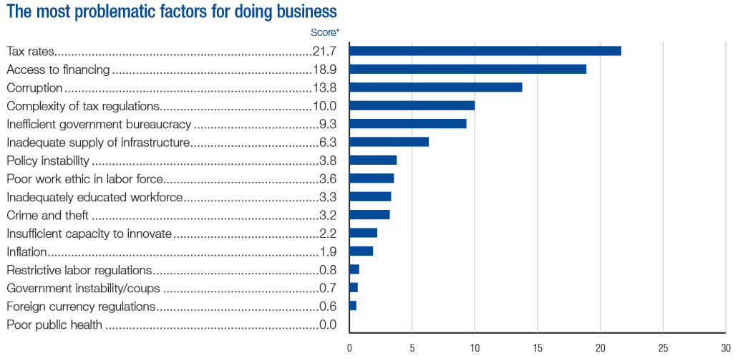
Barriers to doing business
Source: World Economic Forum, Global Competitiveness Report 2015-16

Slide 8
Barriers to doing business
 | Albania ranking
Dealing with construction permits | 189.
Getting electricity | 162.
Paying taxes | 142.
Registering property | 107.
Enforcing contracts | 96.
Source: WB Doing Business 2016

Slide 9
Iron law of oligarchy
1911: German sociologist Robert Michels
  The new elite will always acquire power for its own benefit and at the expense of others
2012: American economists Daron Acemoglu and James Robinson (Why Nations Fail)
  To break the Iron law of oligarchy, the country has to have a broad and strong coalition interested in setting up “inclusive” institutions and to distribute political and economic powers in such a way that they cannot be monopolized by narrow elite
  Key members of coalition: Free media, businesses independent from Gvt and monopolies

Slide 10
Inclusive institutions
Political:
  Democratic political system
  Rule of law: Independent justice, regulatory and controlling authorities
  Free media, transparency, etc.
Economic:
  Market economy
  Protection of private property
  Effective anti-monopoly policy, etc.

Slide 11
Slovak reform experience
Key success factor: Creating informal coalition of people supporting democracy and reforms
  Think-tanks and advocacy NGOs (including INEKO and the Business Alliance of Slovakia)
  Free media
  Experts from think-tanks and bank analysts engaging in public discourse
  Reform-minded politicians and policy makers (e.g. Ivan Mikloš)

Slide 12
Slovak reform experience
Transparent privatization in 1999-2006
  Establishing independent regulatory authorities
  Cleaning-up and full privatization of the banking and insurance sector; energy; telecom; etc.
Tax reform (2004)
  Introducing 19% flat tax
  Radical simplification of the tax code
Labor market reform (2003)
  Introducing more flexible Labor Code

Slide 13
Slovak reform experience
Pension reform (2004-05)
  Linking benefits to contributions
  Introducing fully funded second pillar
  Prolonging retirement age, automatic indexation, etc.
Gross nominal returns of funds in the fully funded second pension pillar (annual weighted averages), Source: INEKO

Slide 14
Slovak reform experience
Fiscal stabilization
  Strengthening analytical capacities at the Ministry of Finance
  2012: Constitutional Act on Budget Responsibility introducing the debt brakes and establishing the Council for Budget Responsibility
    Public debt at 50% of GDP: Gvt proposes measures
    Public debt at 53% of GDP: Freezing Gvt salaries
    Public debt at 55% of GDP: Freezing expenditures
    Public debt at 57% of GDP: Balanced budget
    Public debt at 60% of GDP: Confidence voting in Parliament

Slide 15
Slovak reform experience
Public finance balance in Slovakia (% GDP)
Sources: Ministry of Finance (MF SR), Council for Budget Responsibility (CBR SR)

Slide 16
Slovak reform experience
Public debt in Slovakia (% GDP)
Source: INEKO based on data from the Ministry of Finance (MF SR)

Slide 17
Slovak reform experience
Long-term sustainability GAP indicator in Slovakia (% GDP)
Source: Council for Budget Responsibility (CBR SR)

Slide 18
Slovak reform experience
Fight against corruption
  2000: Free Access to Information Act
  2003: Online business registry (user-friendly, searchable)
  2004: Specialized Court and Prosecutor’s Office
  2007: Online Land Registry
  2011: Publishing all property contracts and invoices of public institutions on internet. The contracts are not valid unless they are published.
  2012: Publishing court rulings on internet

Slide 19
Current challenges
Reducing influence of local oligarchs on politics
  More independent and efficient judiciary, police and prosecutors, etc.
  Anti shell-firms legislation, etc.
“Value for money” project seeking to increase transparency and efficiency of public spending and decision making
  Opening public data
  Measuring quality and efficiency of public expenditure and regulations
Reducing long-term unemployment, etc.

Slide 20
Thank you for attention!
http://www.ineko.sk/

