Slide 1


Transparent, financially healthy and competitive municipalities in Moldova
Peter Golias
INEKO Director
November 26th, 2015
Project kick-off seminar in Chisinau, Moldova

Slide 2
About the project
Title: Transparent, financially healthy and competitive municipalities in Moldova
Period: October 15th 2015 – March 15th 2017
Funded by: Slovak Aid
Implemented by: INEKO and IDIS “Viitorul“
Goal: To support regional development in Moldova through know-how transfer of three successful projects implemented in Slovakia

Slide 3
Projects to be transferred
Open local government – Transparency International Slovakia, http://mesta2014.transparency.sk/en
Portal on financial health of Slovak municipalities – INEKO, http://municipalities.ineko.sk/
Competitive regions 21 – Business Alliance of Slovakia, http://www.regiony21.sk/

Slide 4
Transparent municipalities
Objective: Developing anti-corruption measures pack for self-governments in Moldova and monitoring of its implementation
  Survey and definition of anti-corruption priorities in Moldovan self-governments (November 2015)
  Description of the best Slovak practices, e.g. publishing public contracts on internet, public presence at meetings of self-government bodies, public recording of these meetings (January 2016)
  Developing proposals of anti-corruption measures for Moldovan self-governments (March 2016)
  Monitoring of anti-corruption pack implementation rate in 50 biggest Moldovan towns (May 2016)
  Publishing the measures and transparency rankings of the biggest municipalities (June 2016)

Slide 5
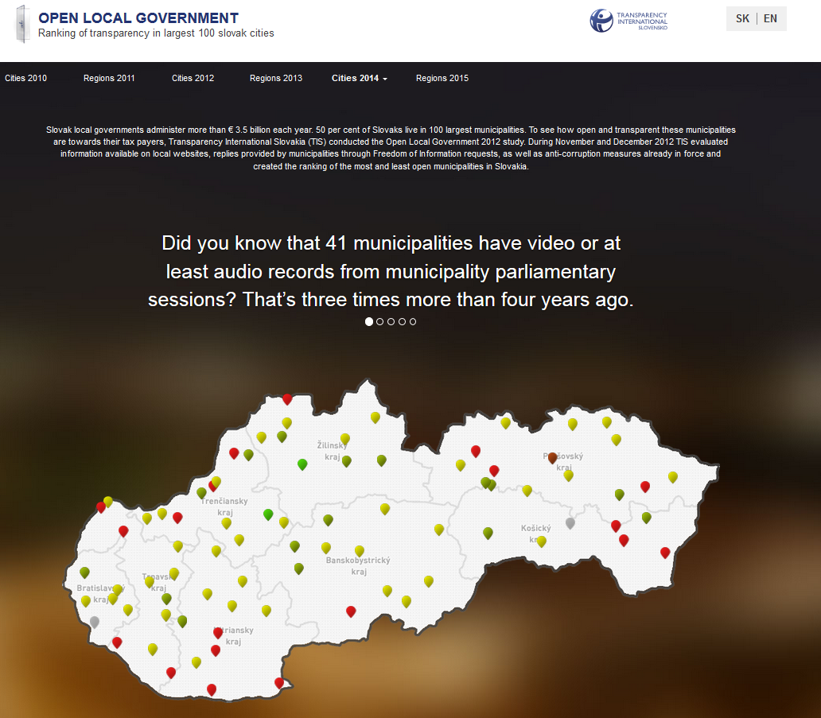
Twin-project in Slovakia (1/3)

Slide 6
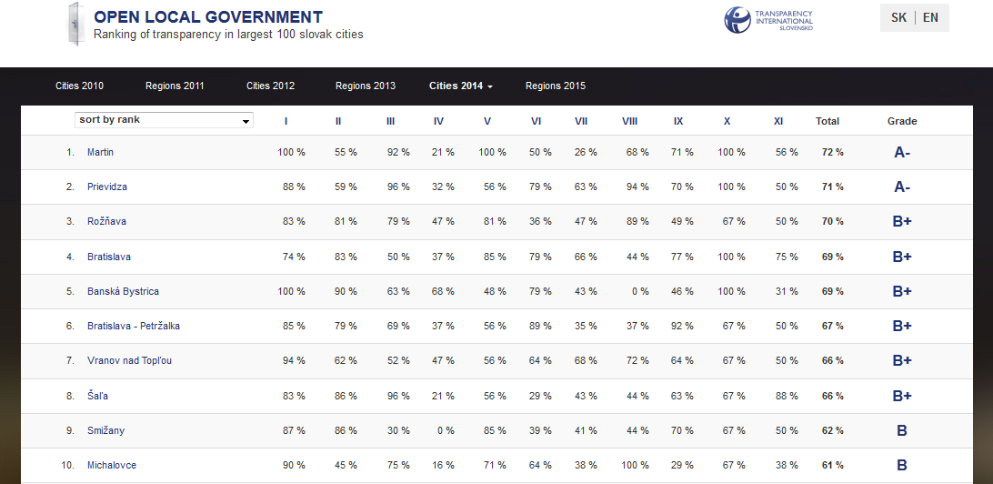
Twin-project in Slovakia (2/3)

Slide 7
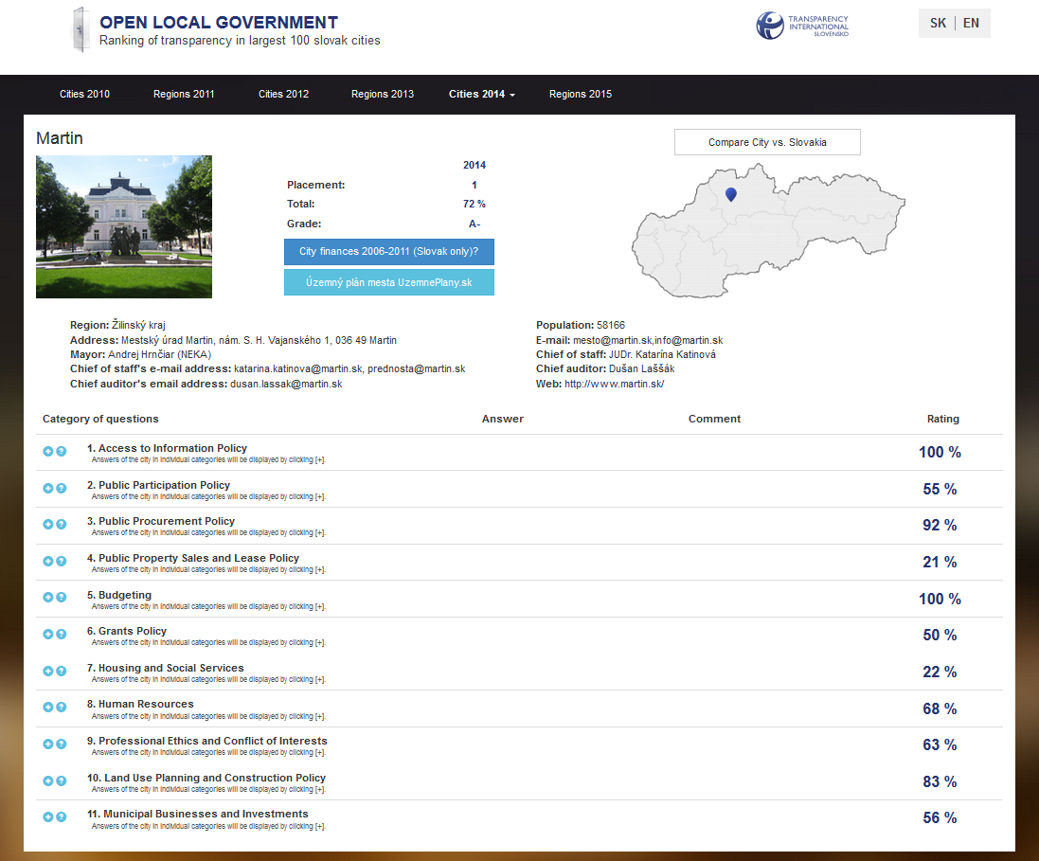
Twin-project in Slovakia (3/3)

Slide 8
Financially healthy municipalities
Co-funded by National Endowment for Democracy (NED)
Objective: Developing online portal on financial management of Moldovan municipalities
  Publishing the analysis of local budgets of Moldovan municipalities (November 2015)
  Creating and launching the portal (January 2016)
    Data: Total revenues, tax revenues, total expenditure, expenditure by functional classification, deficit, number of citizens
  Updating and upgrading the portal (November 2016)

Slide 9
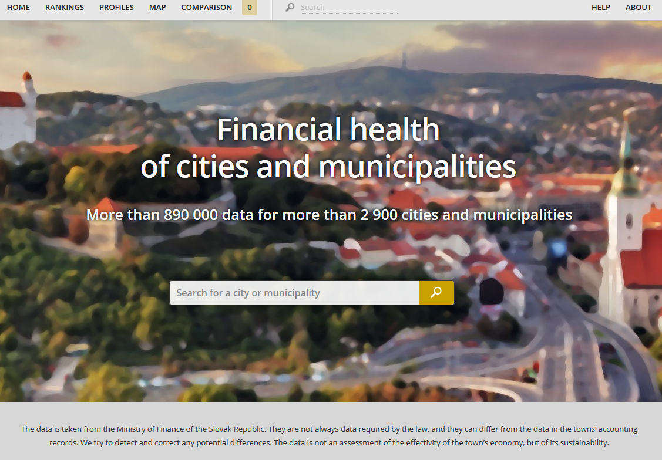
Twin-project in Slovakia (1/3)

Slide 10
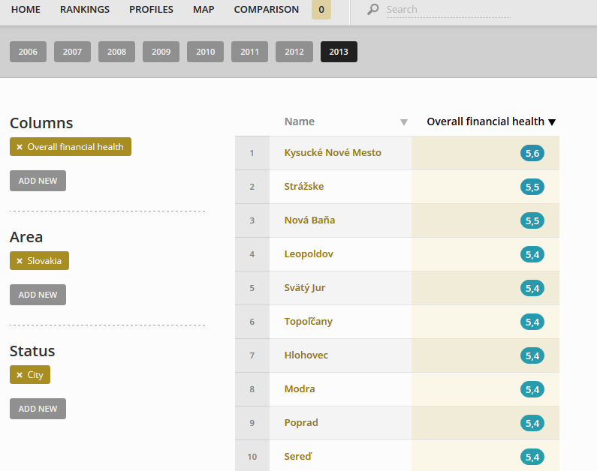
Twin-project in Slovakia (2/3)

Slide 11
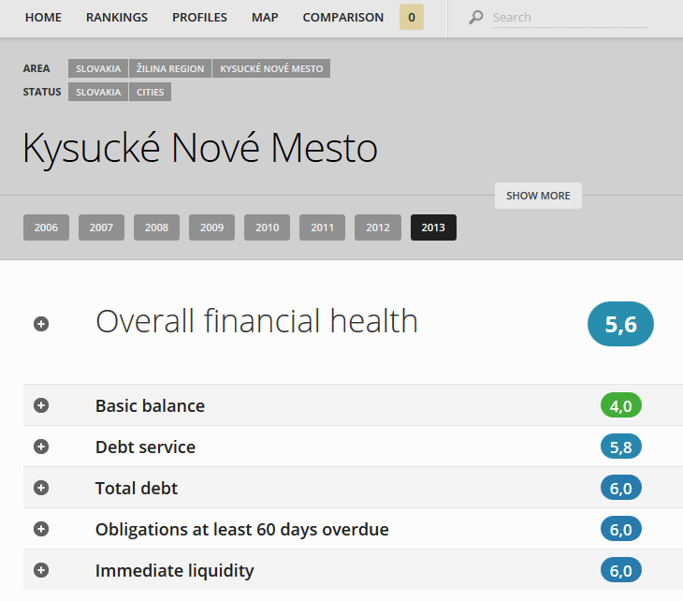
Twin-project in Slovakia (3/3)

Slide 12
Competitive municipalities
Objective: Introducing interactive model of Moldovan regional competitive advantages
  Data identification and availability – statistical indicators concerning the economic activity, infrastructure, human resources and public administration in Moldovan regions (November 2015)
  Developing assessment procedure of region competitiveness (November 2015)
  Survey among businessmen in regions to obtain soft data (February 2016)
  Data collection and their processing by mathematic model of region competitiveness (July 2016)
  Writing a list of competitive advantages and disadvantages of MD regions (December 2016)
  Publishing the results (February 2017)

Slide 13
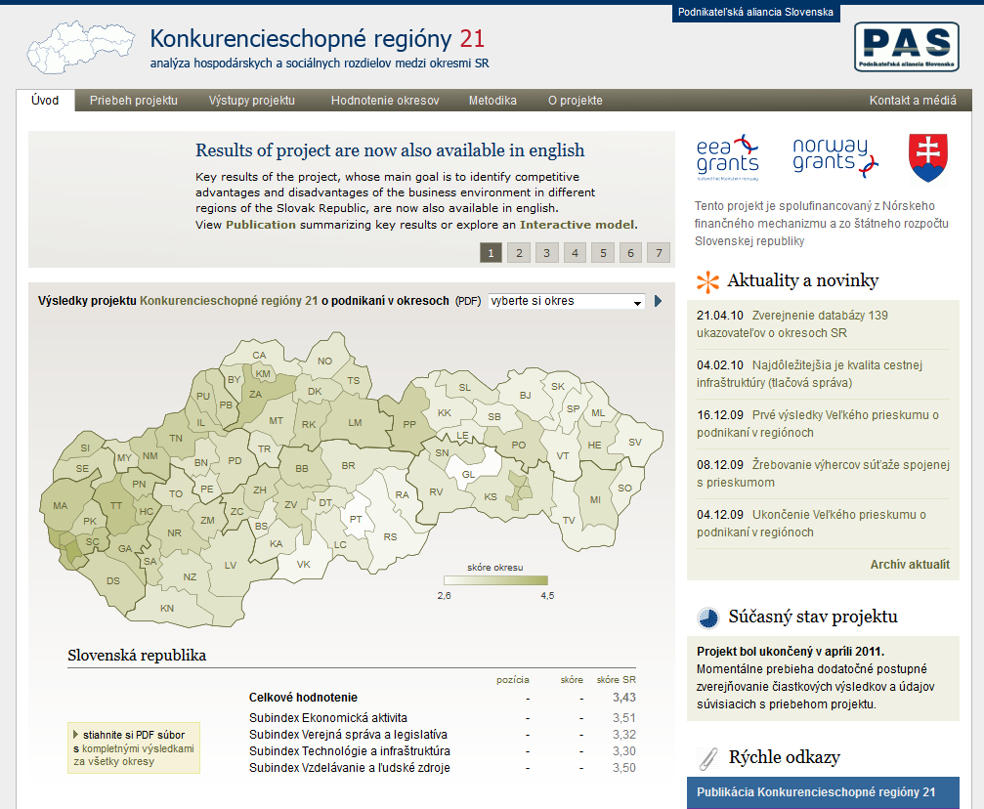
Twin-project in Slovakia (1/2)

Slide 14
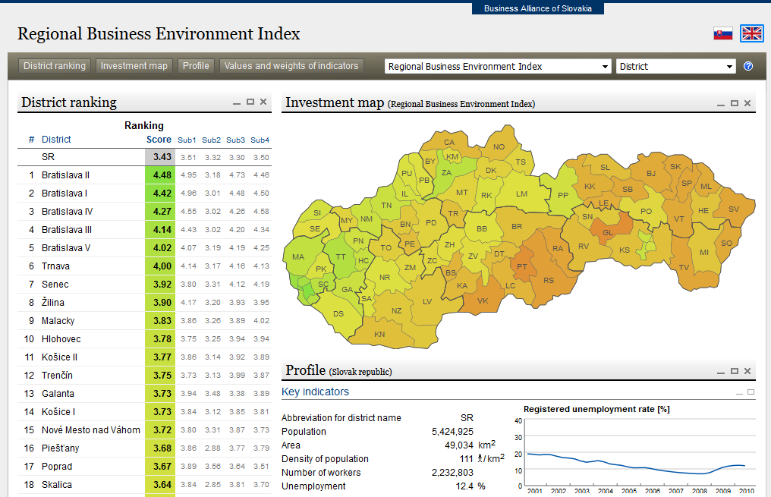
Twin-project in Slovakia (2/2)

Slide 15
Thank you for your attention!

