Slide 1


Supporting democracy, independence and transparency of key public institutions in Moldova
Peter Golias, INEKO Director
October 8th, 2019, Chisinau, Moldova
Project kick-off seminar

Slide 2
About project
Duration: October 2019 – March 2021
Implemented by: INEKO in partnership with ICPS
Funded by: The Official Development Assistance of the Slovak Republic (SlovakAid)
Follow-up on the project „Promoting transparency and financial sustainability of state-owned enterprises and local authorities in Moldova“ running since October 2015

Slide 3
Project goals
Goal: To reduce risk of “state capture” and “power abuse”, to improve democracy in Moldova
Objectives:
  To support public debate about current state of democracy in Moldova
  To strengthen the independence of key regulatory and judiciary institutions in Moldova
  To increase transparency and support implementation of anti-corruption measures in state-owned companies and local governments in Moldova
Transferring know-how from projects implemented in Slovakia

Slide 4
Key outputs
Report on current state and development of democracy in Moldova
Report on independence of key public institutions in Moldova
Updating transparency and financial health ratings of:
  Public enterprises: http://companies.viitorul.org/
  Local governments (cities and regions): http://localbudgets.viitorul.org/ and http://localtransparency.viitorul.org/
Electronic monthly newsletters

Slide 5
Timeline 1/4
Supporting public debate about current state of democracy
  09-12/2019: Methodology
  01-04/2020: Research – data collection and processing
  03-06/2020: Report on current state and development of democracy in Moldova
  06/2020: Conference in Chisinau, publishing results
  09/2020 – 03/2021: At least 10 lectures for students
  03/2020 – 03/2021: Electronic monthly newsletter

Slide 6
Timeline 2/4
Strengthening the independence of key regulatory and judiciary institutions
  10-11/2019: List of institutions and indicators
  10/2019 – 01/2020: Methodology
  01-09/2020: Research – data collection and processing
  07-10/2020: Report on independence of key public institutions in Moldova
  10/2020: Conference in Chisinau, publishing results

Slide 7
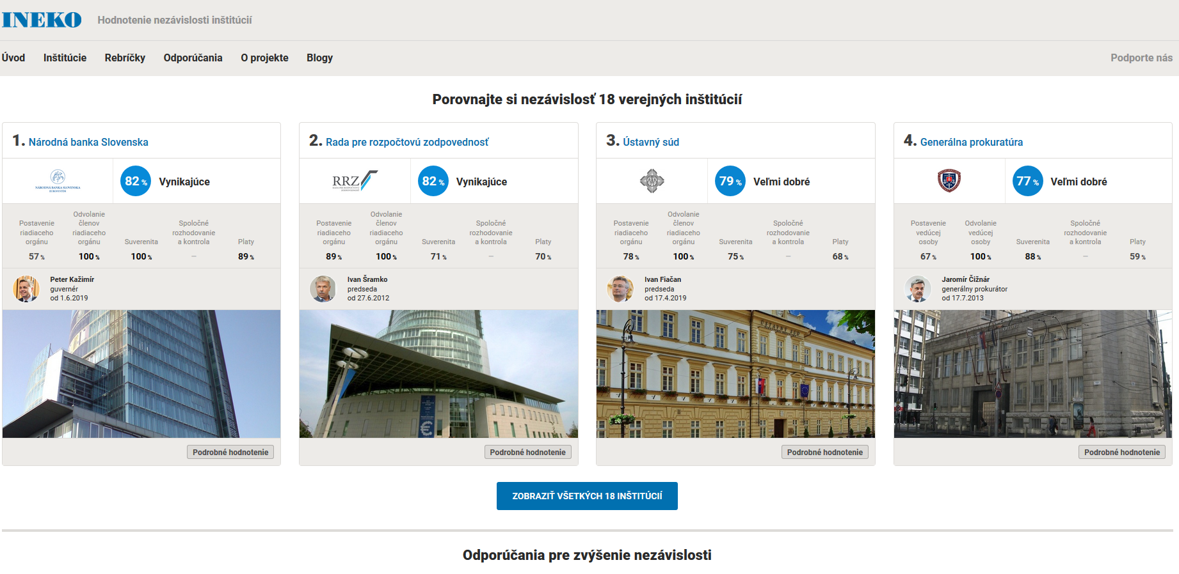
http://www.institucie.ineko.sk/

Slide 8
Timeline 3/4
Updating transparency and financial health ratings of public enterprises
  10/2019 – 02/2020: Collection and processing data
  02-03/2020: Update of internet portal http://companies.viitorul.org/
  03/2020: Conference in Chisinau, publishing results
  10/2020 – 02/2021: Collection and processing data
  02-03/2021: Update of internet portal http://companies.viitorul.org/
  03/2021: Conference in Chisinau, publishing results
  03/2020 – 03/2021: Study visits to at least 10 public enteprises and local governments

Slide 9
Timeline 4/4
Updating transparency rating and financial data of local governments
  01-09/2020: Collection and processing data
  05-06/2020: Update of internet portal http://localtransparency.viitorul.org/
  06/2020: Conference in Chisinau, publishing results
  09-10/2020: Update of internet portal http://localbudgets.viitorul.org/
  10/2020: Conference in Chisinau, publishing results

Slide 10
Key milestones
  03/2020: Conference in Chisinau
  Transparency and financial health rating of public enterprises
  06/2020: Conference in Chisinau:
  Report on current state and development of democracy in Moldova
  Transparency rating of local governments
  10/2020: Conference in Chisinau
  Report on independence of key public institutions in Moldova
  Financial data of local governments
  03/2021: Conference in Chisinau
  Transparency and financial health ratings of public enterprises

Slide 11
IDIS experts‘ engagement
 | 2019 |  |  | 2020 |  |  |  |  |  |  |  |  |  |  |  | 2021
 | 10 | 11 | 12 | 1 | 2 | 3 | 4 | 5 | 6 | 7 | 8 | 9 | 10 | 11 | 12 | 1 | 2 | 3
Viacheslav Ionica (Democracy report) | x | x | x | x | x | x | x | x | x
Viacheslav Ionica (Lectures) |  |  |  |  |  |  |  |  |  |  |  | x | x | x | x | x | x | x
Viorel Pirvan, Tatiana Lariushin (Institutions) | x | x | x | x | x | x | x | x | x | x | x | x | x
Viorel Pirvan (Transparency of public enterprises - PEs) | x | x | x | x | x | x |  |  |  |  |  |  | x | x | x | x | x | x
Viorel Pirvan (Transparency of LGAs) |  |  |  | x | x | x | x | x | x
Olga Chicu, Mihail Manoli (Financial health of PEs) | x | x | x | x | x | x |  |  |  |  |  |  | x | x | x | x | x | x
Olga Chicu, Mihail Manoli (Financial data of LGAs) |  |  |  |  |  |  |  | x | x | x | x | x | x
Ana Maria Covalenco (Newsletter) |  |  |  |  |  | x | x | x | x | x | x | x | x | x | x | x | x | x

Slide 12
Upcoming deadlines
Supporting public debate about current state of democracy
  December 2019: Methodology
Strengthening the independence of key regulatory and judiciary institutions
  November 2019: List of institutions and indicators
  January 2020: Methodology
Updating transparency and financial health ratings of public enterprises
  March 2020: Update of internet portal http://companies.viitorul.org/, conference in Chisinau
    Transparency: Data for 2019
    Financial health: Data for 2017, 2018

Slide 13
Measurable indicators 1/4
At least 50 participants in every conference (4x50)
At least 12 issues of an electronic monthly newsletter informing about project results
At least 10 lectures for students of secondary and tertiary schools informing about democracy in Moldova
Media releases, readership of project webpage, portals, FB posts

Slide 14
Measurable indicators 2/4
Report on current state and development of democracy in Moldova
  Methodology document of at least 15 pages
  Research: Survey among at least 40 local experts, internet survey among emigrants, at least 5 focus groups among students and/or business people, representative public opinion poll
  Electronic report of at least 25 pages
  At least 40 media releases, readership of FB posts

Slide 15
Measurable indicators 3/4
Report on independence of key public institutions in Moldova
  List of institutions and indicators (5 pages)
  Methodology (5 pages)
  At least 15 key public institutions evaluated based on at least 10 indicators, and consultations with at least 10 experts
  Electronic report of at least 25 pages with at least 20 recommendations
  At least 20 media releases, readership of FB posts

Slide 16
Measurable indicators 4/4
Updating transparency and financial health ratings of public enterprises and local governments
  Updated portals
  At least 80 media releases, readership of FB posts and web portals
  At least 50 public enterprises, all regions and 50 municipalities evaluated
  Study visits to at least 10 public enteprises and local governments

Slide 17
Report on democracy

Slide 18
Research methods
Desk research
Survey among at least 40 local experts
Internet survey among emigrants
At least 5 focus groups among students and/or business people
Representative public opinion poll

Slide 19
Desk research
Description of political landscape
History of parliamentary elections
Domestic and international indicators of quality of democracy in Moldova
  Public opinion surveys
  Economist Intelligence Unit: Democracy Index
  Freedom House
  Democracy Ranking Association
  Etc.

Slide 20
Survey among local experts
Experts: Well respected and non-partisan opinion leaders
  Journalists, NGO experts, sociologists, politologists, economists, business people
Topics for questions:
  Quality of democracy in MD compared to neighbours
  Trend in MD over past 5 years
  Rating of political parties, key institutions
  Key events in past 5 years influencing democracy
  What is working well and what is not (fight against corruption, media freedom, quality of NGOs, political competition, public watchdog institutions, rule of law, etc.)
  Why people vote for non-democratic leaders (demand, supply)
  What would help in short/long-time

Slide 21
Survey among emigrants
Google? Facebook?
Topics for questions:
  Identification: Name, place of living, how long abroad
  Why moved abroad?
  Quality of democracy in MD compared to neighbours
  Trend in MD over past 5 years
  What is working well and what is not
  Why people vote for non-democratic leaders (demand, supply)
  What would help in short/long-time
  Plans to come back? Under what circumstances?

Slide 22
Focus groups
Students at secondary and/or tertiary schools
Business leaders
Topics for questions:
  Quality of democracy in MD compared to neighbours
  Trend in MD over past 5 years
  What is working well and what is not
  Why people vote for non-democratic leaders (demand, supply)
  What would help in short/long-time
  For business leaders: Quality of business climate (pros and cons)

Slide 23
Public opinion poll
Representative, professional
Topics for questions
  Quality of democracy in MD
  Trend in MD over past 5 years
  Link between quality of democracy and quality of life
  What is working well and what is not
  What would you prefer
    Good things: More decent people in politics, more independent institutions (police, courts, media), entering EU
    Bad things: Acceptability of dictatorship, stronger leader, back to communism

Slide 24
Time for discussion

