Slide 1


independence of public institutions in Moldova
Chisinau, October 2019
Michal Piško

Slide 2

State capture

Slide 3
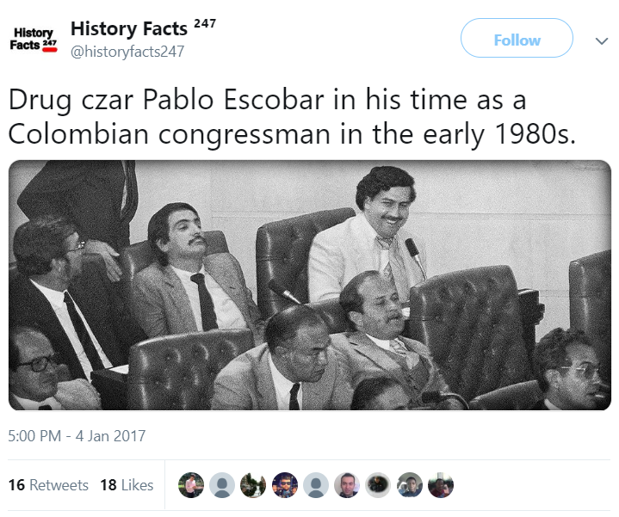
State capture

Slide 4
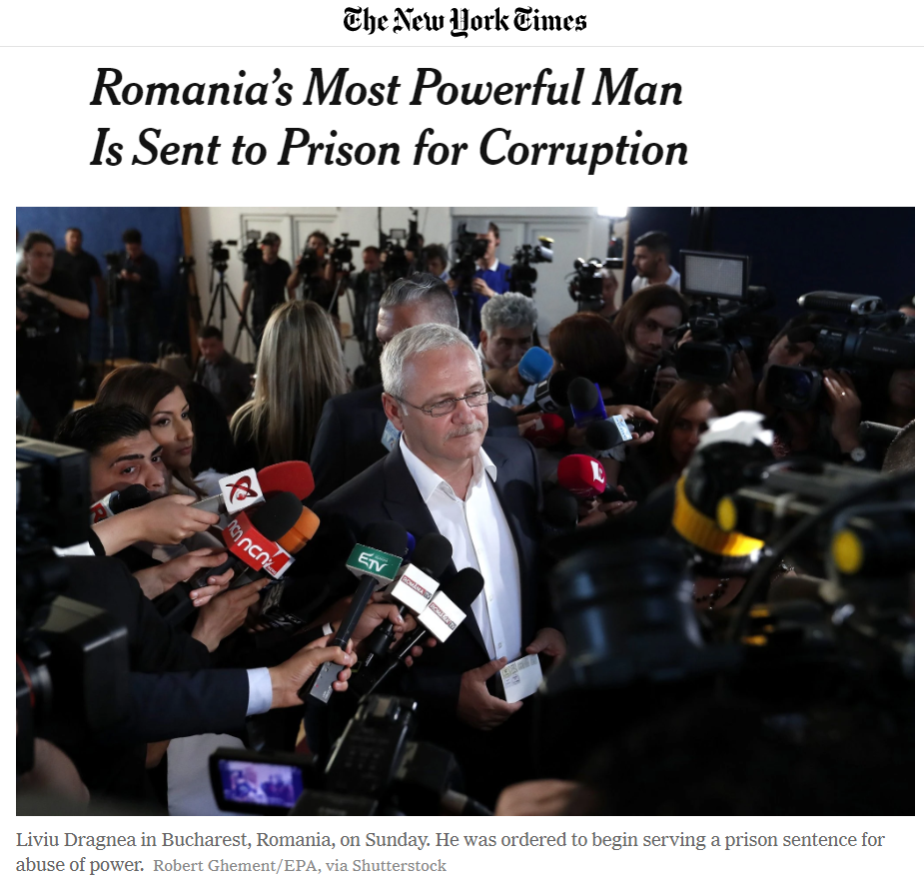
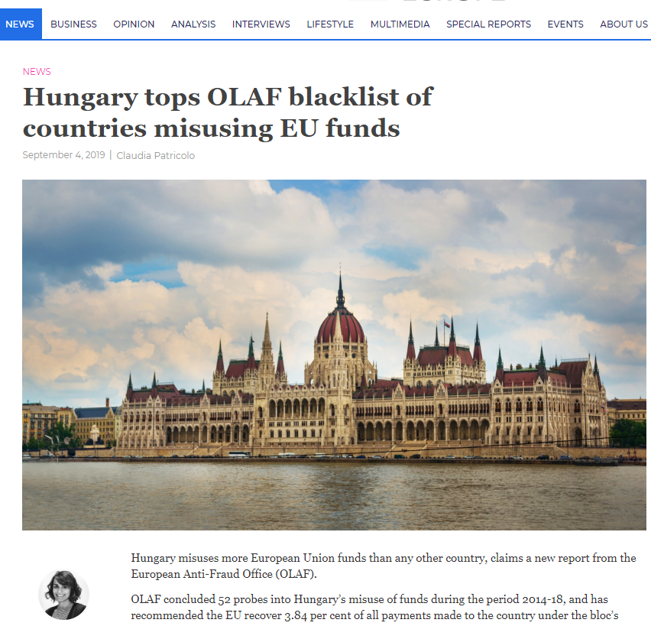
Checks and balances
Notes:
Liviu Dragnea

Slide 5
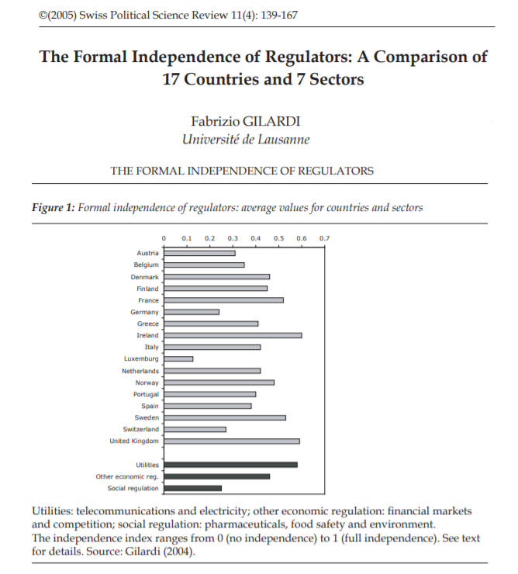
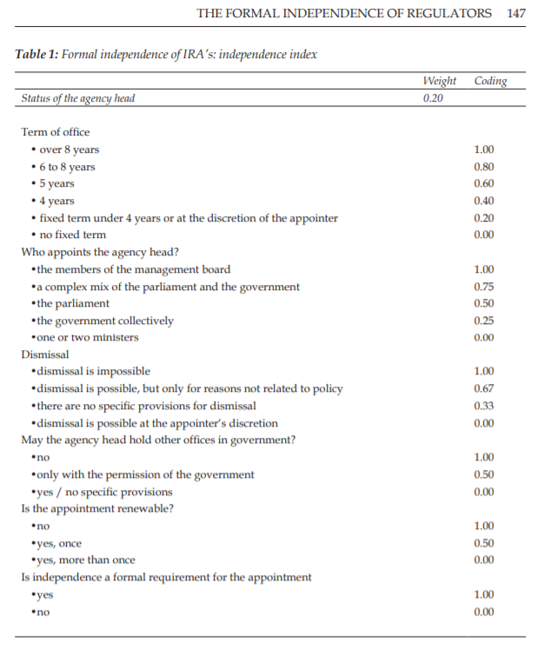
Independence of Regulators

Slide 6
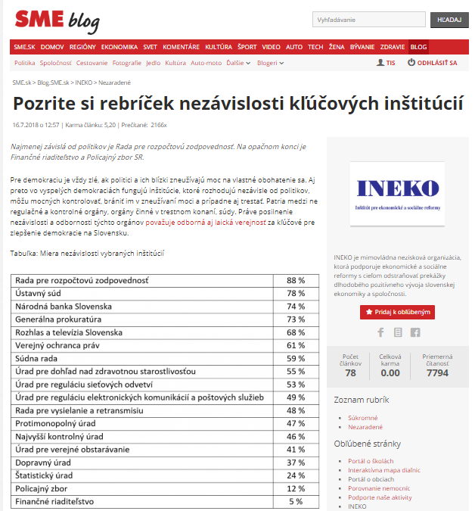
Independence index
It is always harmful for democracy if politicians and their nominees use power to enrich themselves. Therefore, in advanced democracies there are independent decision-making institutions with competencies to control the powerful, prevent them from abusing power, and if necessary, even punish them. These include regulatory and supervisory bodies, law enforcement authorities or courts. The strengthening the independence and level of expertise of these institutions is one of the key recommendations of the experts in order to improve democracy in Slovakia.

Slide 7
Independence index
4 categories, approx. 34 indicators
1. Appointment of the Governing Body and Board Members
  The governing body is composed of multiple persons
  Members of the governing body are appointed by different authorities
  Candidates for the governing body position must meet specific requirements (education / work experience / political independence)
  Term of office of the governing body members is limited
  Public hearing is part of the selection procedures for governing body positions
2. Dismissal of Appointees
  - Dismissal of agency's head is possible for reasons related to policy, at regulator's discretion, if the appointed head of agency has been convicted of a crime or if he no longer meets the political independence criteria

Slide 8
Independence index
3. Sovereignty and Constitutional Basis
  The agency has a legal basis in the Constitution or in the Constitutional Act
  Constitutional majority is required for the election of the agency's head or a member of the body
  The agency is sovereign in its decisions
  The agency is funded from multiple sources (excluding EU funds)
4. Income of Appointees and Employees
  Average gross monthly wage of agency's head
  Average gross monthly wage of employees
Notes:
sovrenti / sovrin

Slide 9
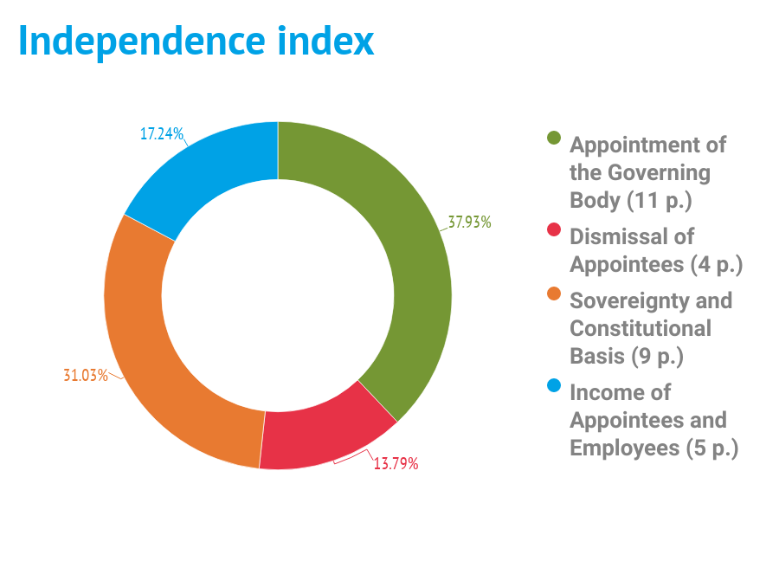
Independence index

Slide 10
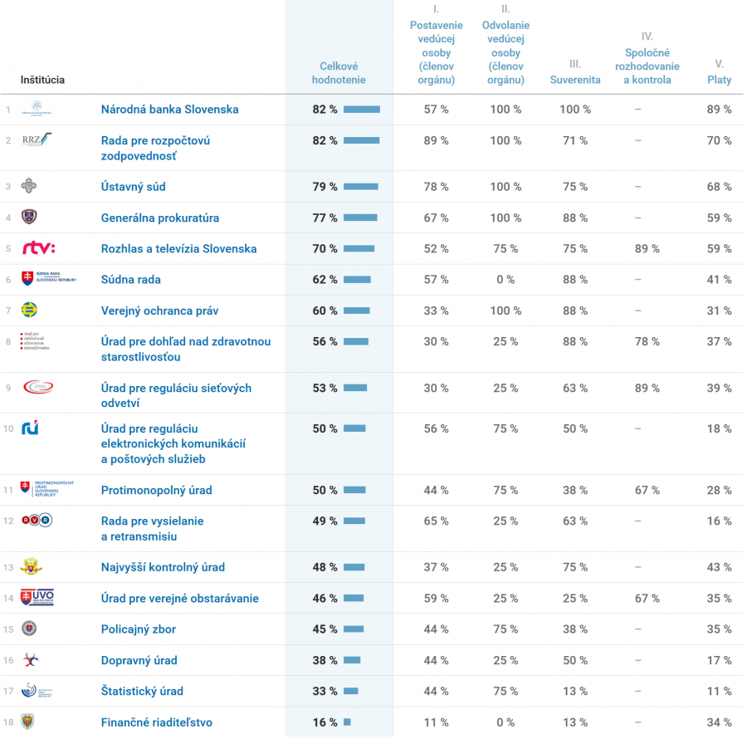
Independence index
Sources:
Collection of Laws
- (e.g. Members of the governing body are appointed by different authorities)
Official website of the agency, google search, or official information request
- (e.g. CVs of members of the governing body are publicly available
Constitution, constitutional laws
- (e.g. The agency has a legal basis in the Constitution or in the Constitutional Act)
Official information request, Annual report
- (e.g. Average gross monthly wage of agency's head)

Slide 11
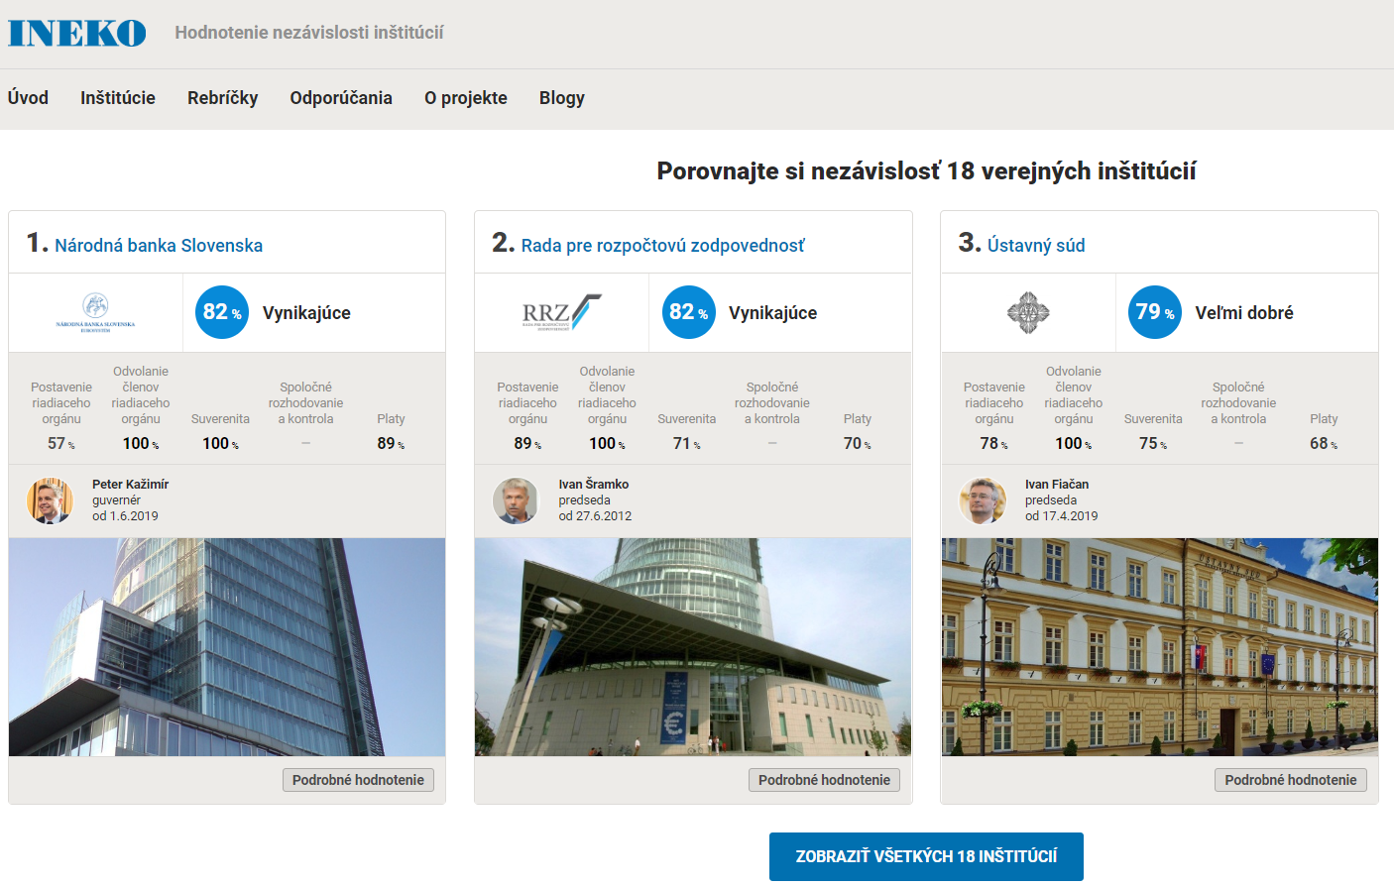
Independence Index

Slide 12
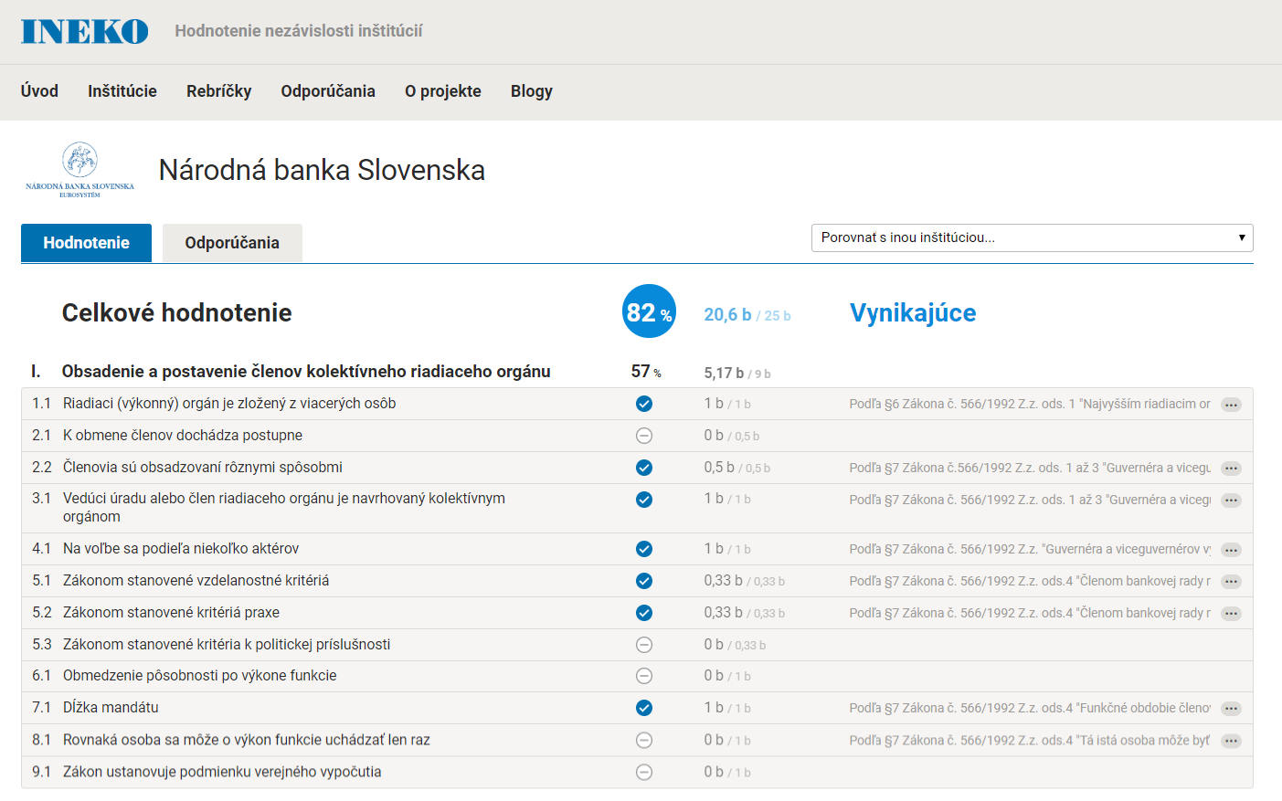

Slide 13
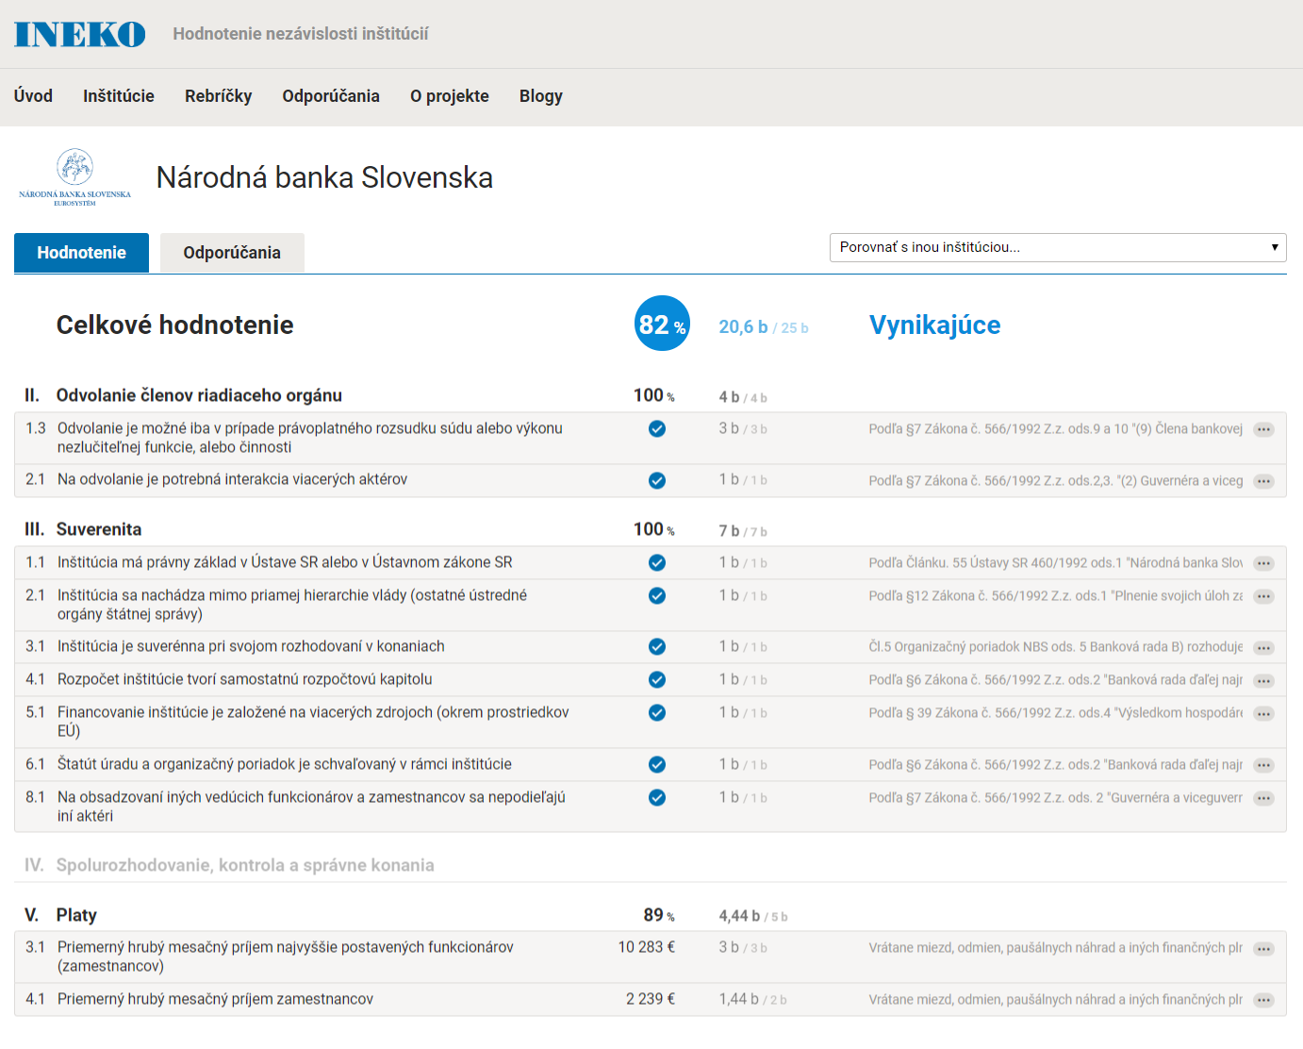

Slide 14
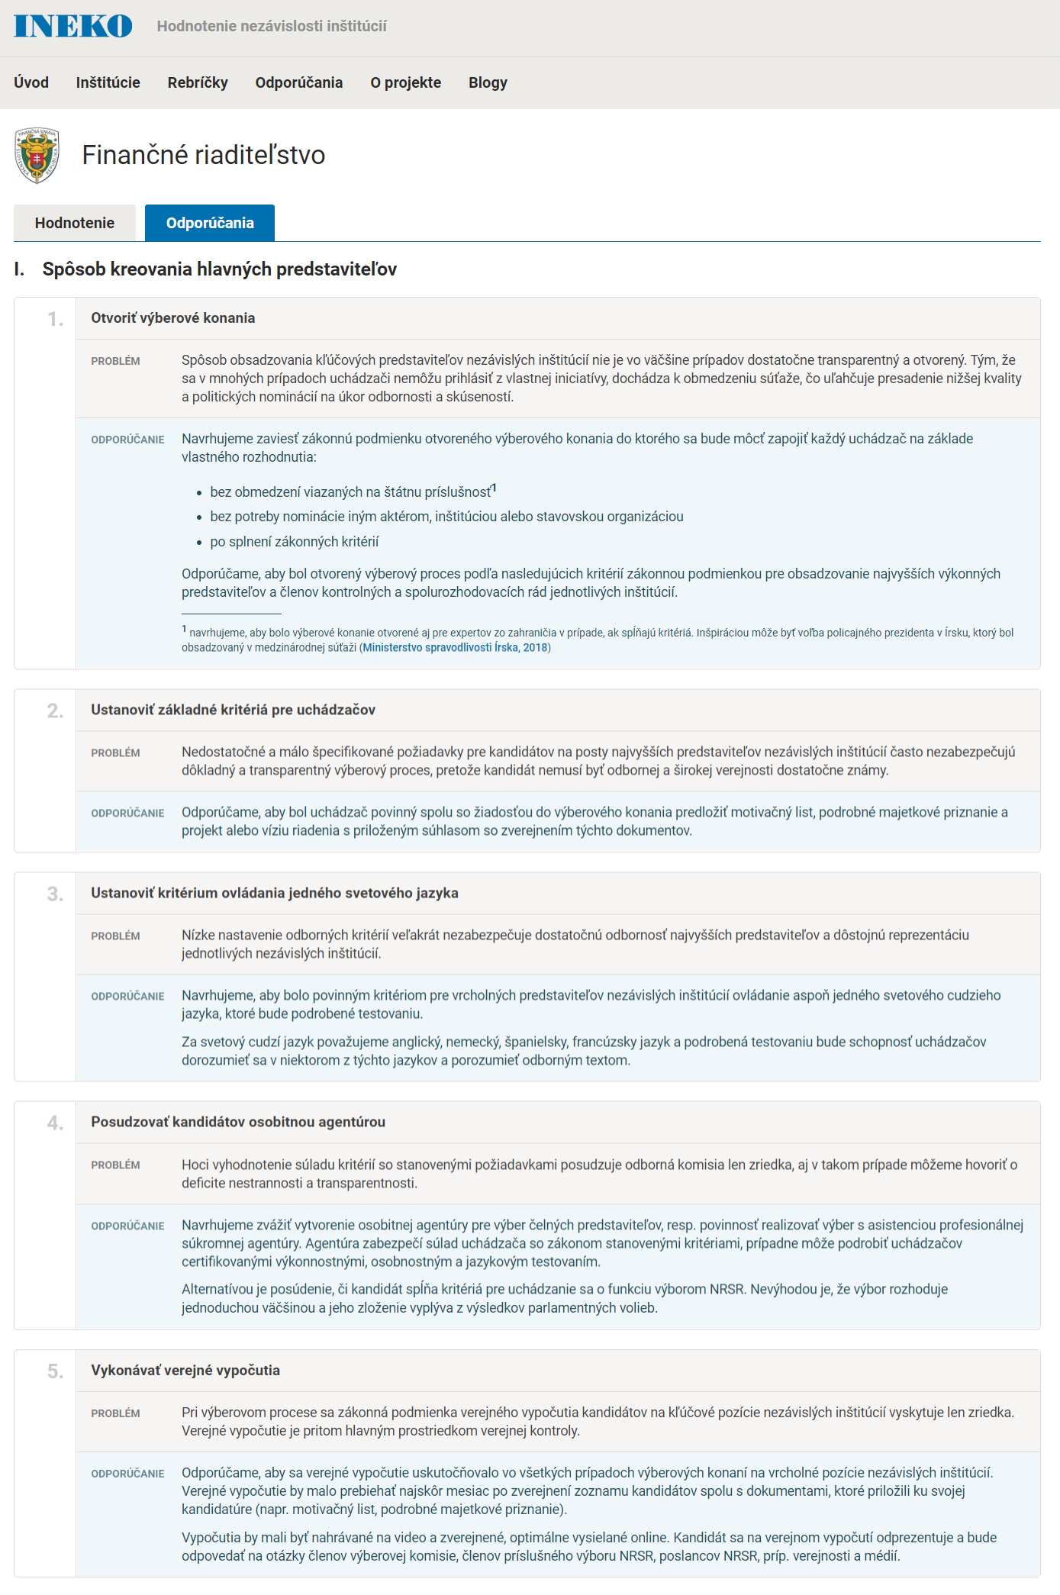
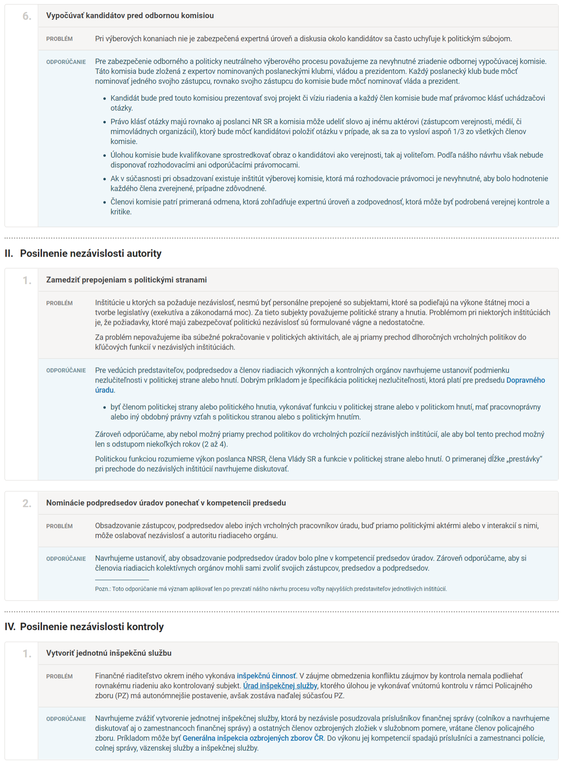
Recommendations
Notes:
Financial Administration

Slide 15
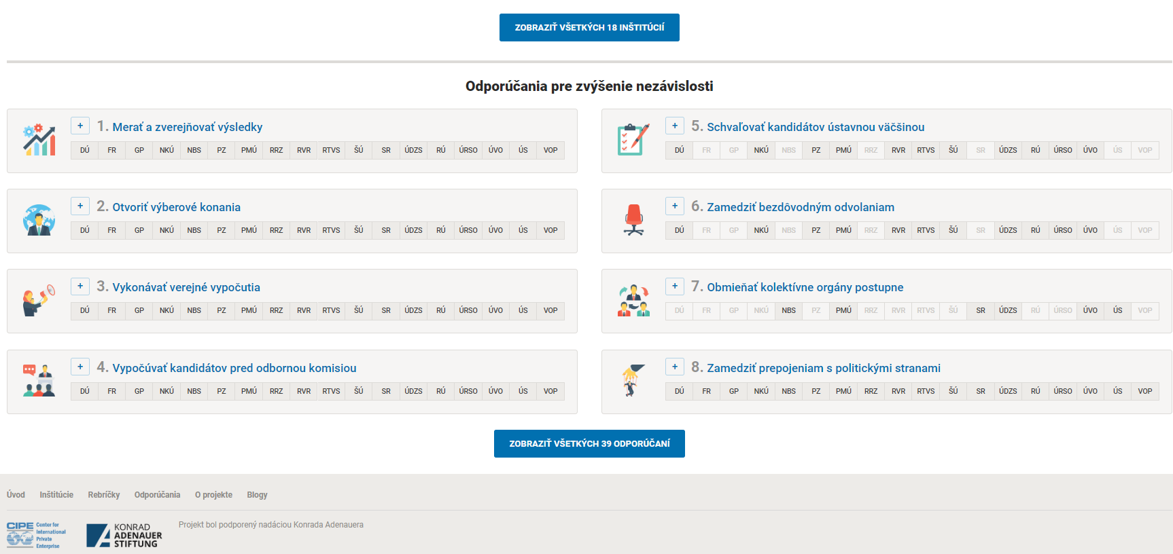
Recommendations

Slide 16
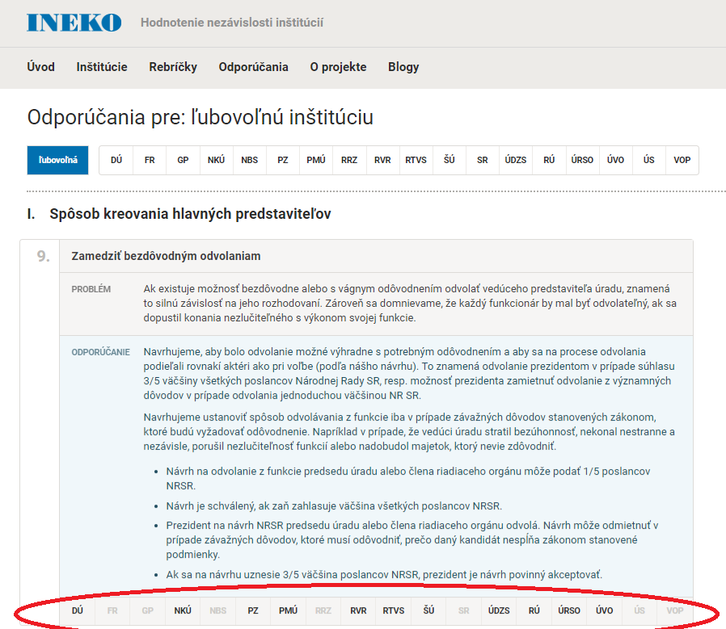

Slide 17
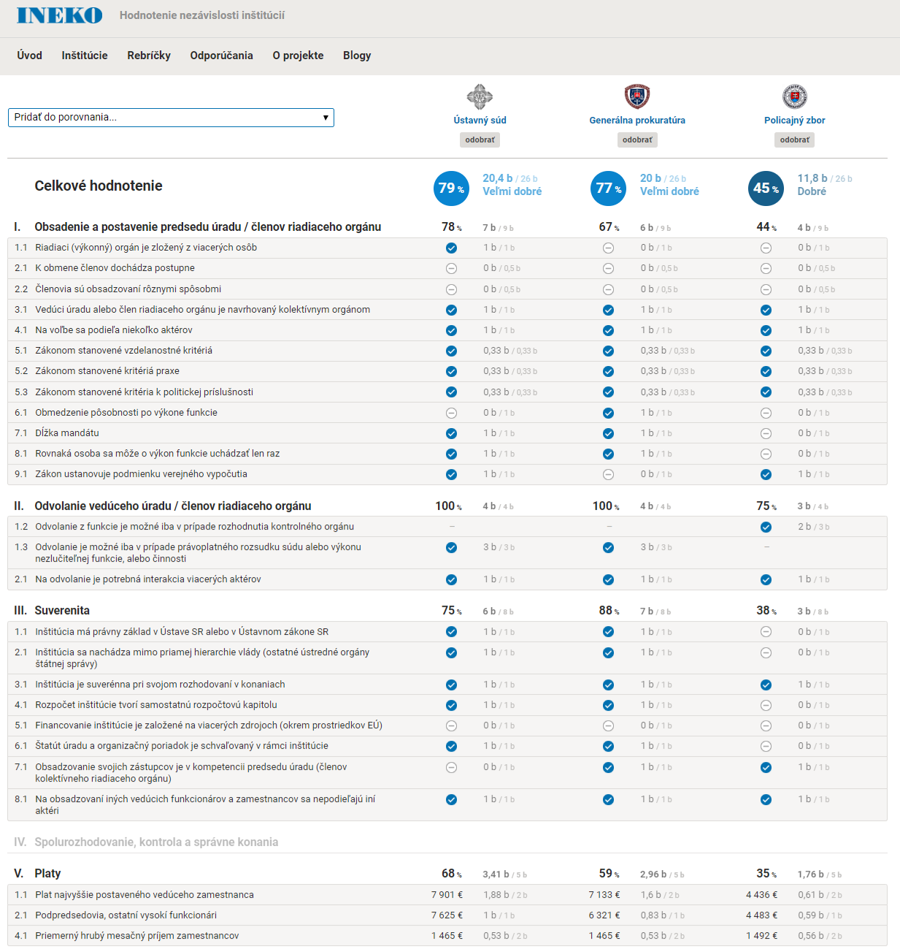

Slide 18
Findings
Good practice
Council for Budget Responsibility (an independent body for monitoring and evaluating the fiscal performance of the Slovak Republic)
Collective body elected by the parliament (nominated by The President of Slovak Republic and The Governor of the National Bank of Slovakia)
The Head of the Council - constitutional majority needed
Seven-year term of office, only one-term mandate
Limited possibilities for dismissal of a board member (e.g. final criminal conviction)

Slide 19
Findings
Bad practice
The Office for Public Procurement / The Antimonopoly Office of the Slovak Republic
Formally independent institutions
The heads of the bodies and their deputies – proposed by the Government
Secretary General of the Office – governmental nominees
Secretary General of the Office – HR competencies
HR policy of the office is indirectly controlled by government
The Establishment Plan and The Statute of the offices, salaries and business trips of agencies’ head – approved by the government
Notes:
stačjut

Slide 20
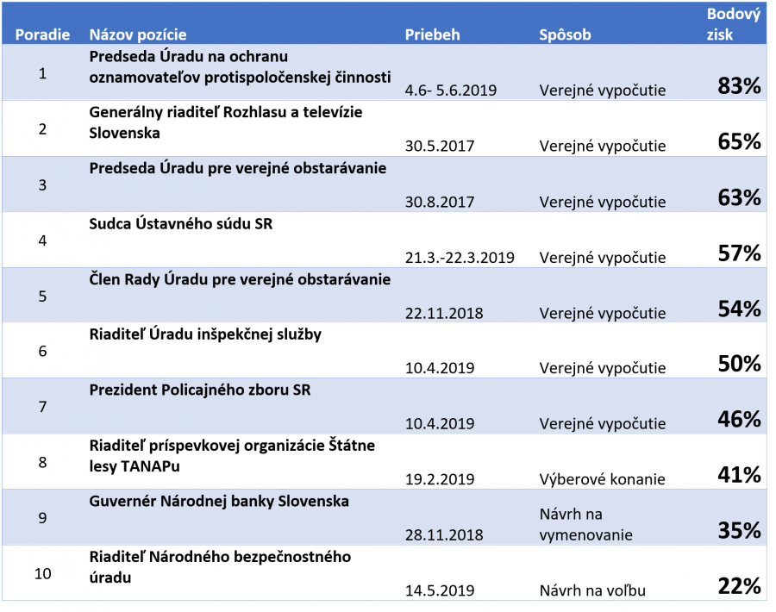
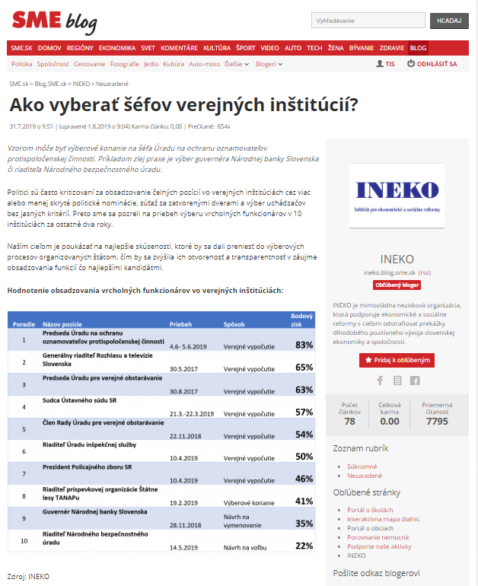
Public hearings evaluation

Slide 21
Moldovan Independence Index
Objective – To evaluate and publish independence rating of at least 15 regulatory and judiciary institutions
The methodology for the evaluation will be based on the Slovak know-how (developed by INEKO) and consultations with local experts. It will include following steps:
Selection of key regulatory, judiciary and audit (public watchdog) institutions in Moldova
Development of methodology and assessment of independence of selected institutions
Writing summary analysis including recommendations how to increase the independence
Publishing results

Slide 22
Objective and timeline
October 2019 – January 2020:
- Preparation of research on independence of key public institutions.
- By November 2019, writing and publishing an electronic document of at least 5 pages with a list of institutions and indicators to be evaluated including sources of information.
- By January 2020, writing and publishing an electronic document of at least 5 pages describing methodology of evaluation including ways of data collection, calculation of indices and timing.
January 2020 – September 2020:
- Realization of research on independence of at least 15 key public institutions: collection and processing of data for at least 10 indicators, consultations with at least 10 experts, evaluation of independence. Writing a draft document summarizing research results.

Slide 23
Objective and timeline
July 2020 – October 2020:
- Writing and publishing an electronic Report on independence of key public institutions in Moldova; document of at least 25 pages summarizing research results including the ranking of independence of evaluated institutions and at least 20 recommendations to increase their independence. Informing media via press report, the goal is to have at least 20 media releases.
October 2020:
- Organizing a conference in Chisinau with at least 50 participants informing about a Report on independence of key public institutions in Moldova

Slide 24
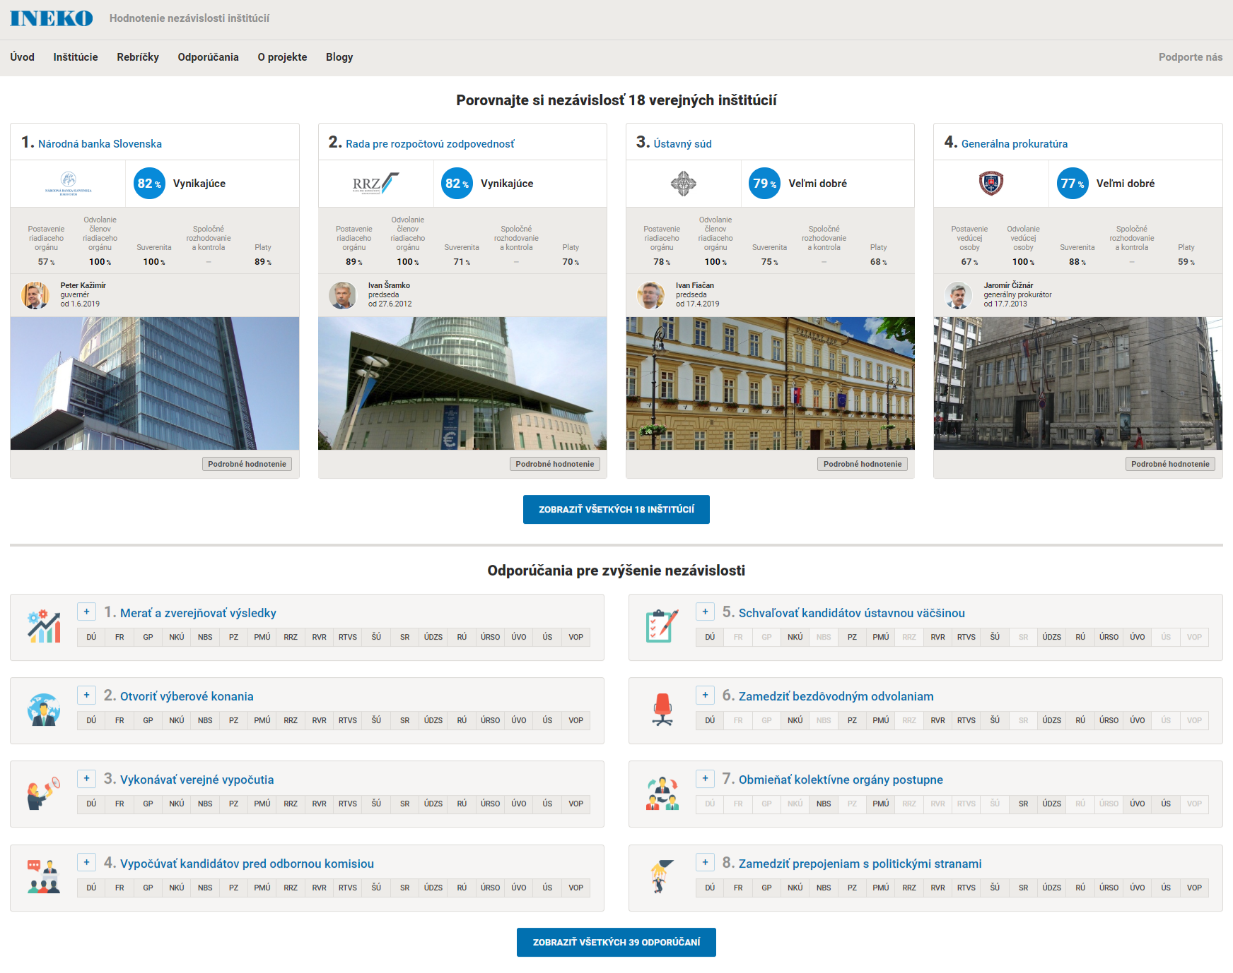
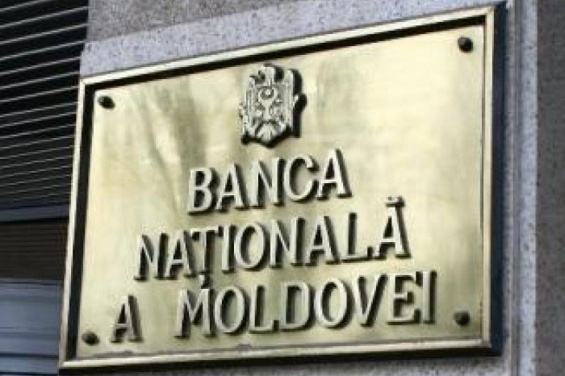
Online portal?
?

Slide 25
Thank you for your attention
http://www.institucie.ineko.sk/
www.ineko.sk

