Slide 1


Transparency of state, city and county owned companies in Slovakia
Transparency ranking of Slovak Public-owned companies
Transparency International Slovakia, October 2017

Slide 2
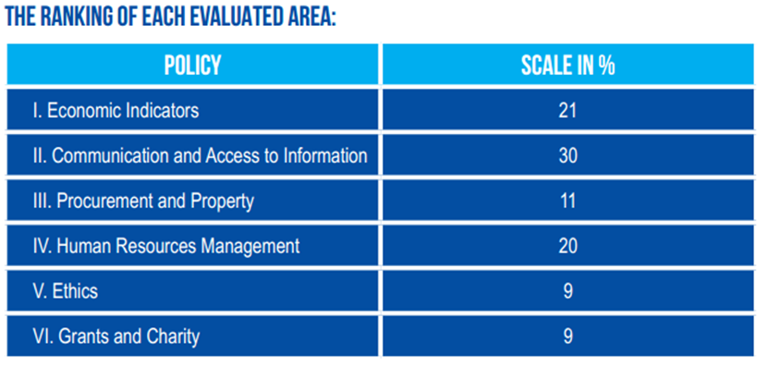
Transparency rankings
Transparency rankings of companies fully owned by public sector: 2012, 2015 (81 companies – 46 SOEs; 31 MOEs; 4 ROEs)
Total revenues – 9,5 billion € (equivalent to ½ of all state budget in 2015)

Slide 3
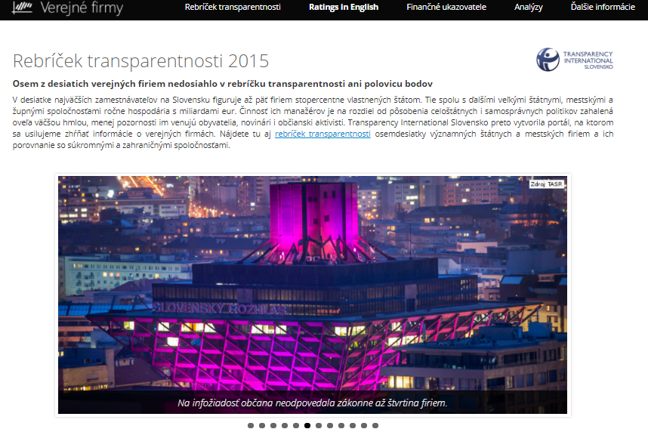
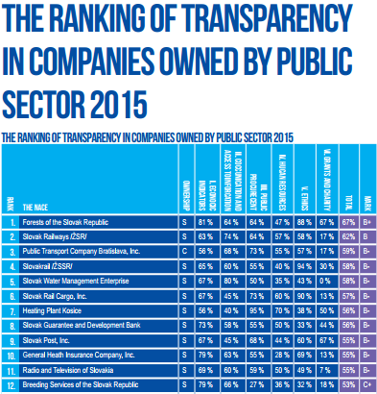
Transparency rankings

Slide 4
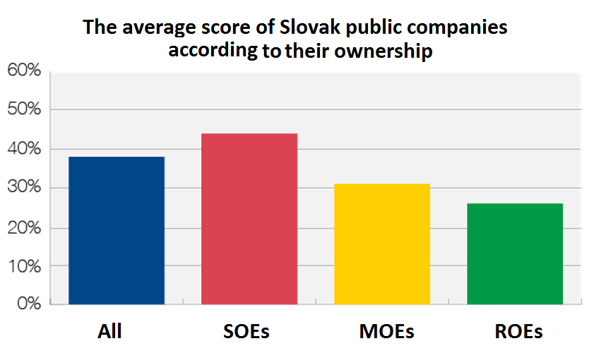
Transparency rankings

Slide 5
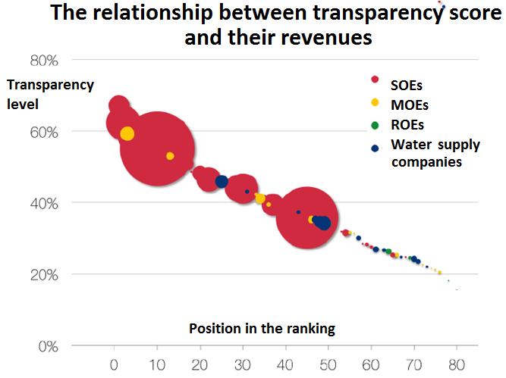
Transparency rankings

Slide 6
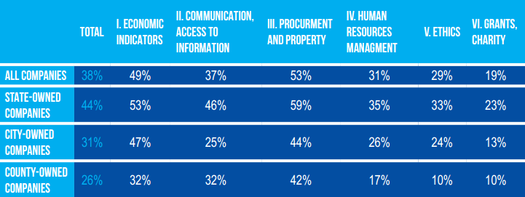
Transparency rankings
The best category: public procurement – 53%
The worst one: Grants and Charity Policy – 19%

Slide 7
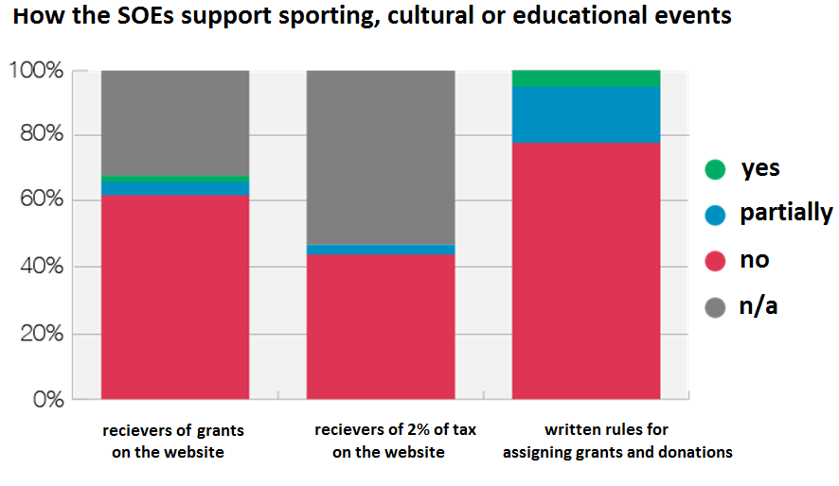
Grants and Charity Policy

Slide 8
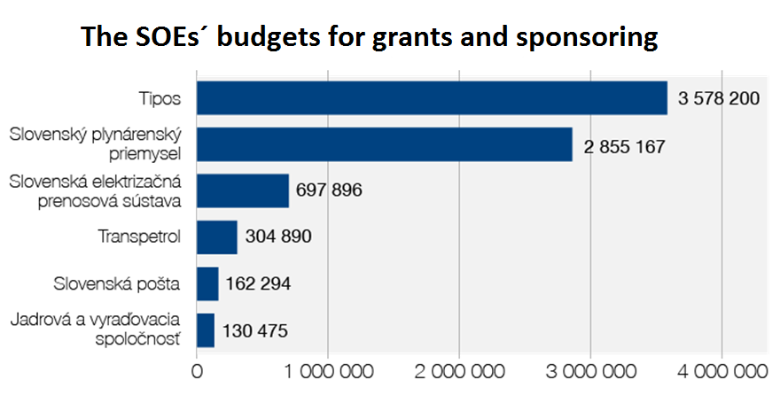
Grants and Charity Policy

Slide 9
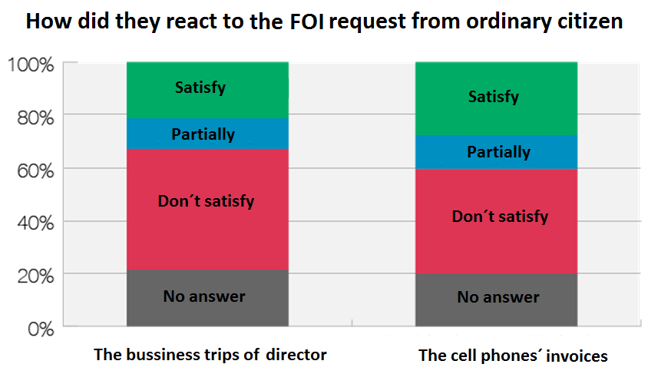
Transparency rankings

Slide 10
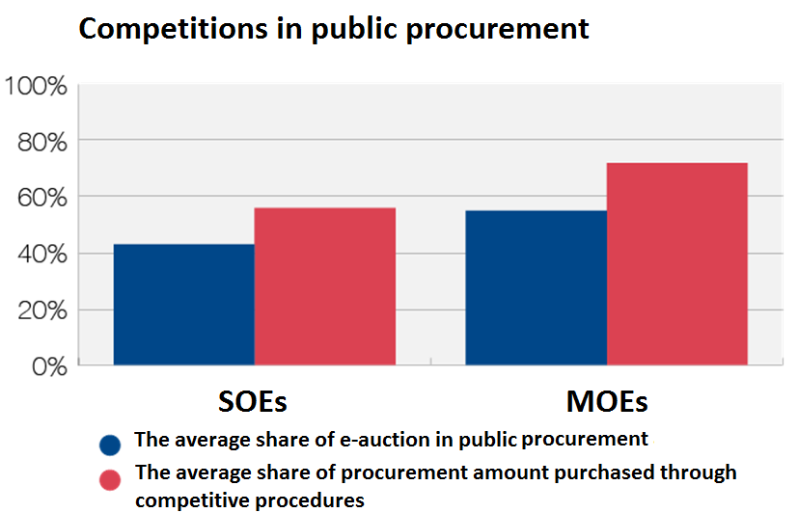
Public procurement

Slide 11
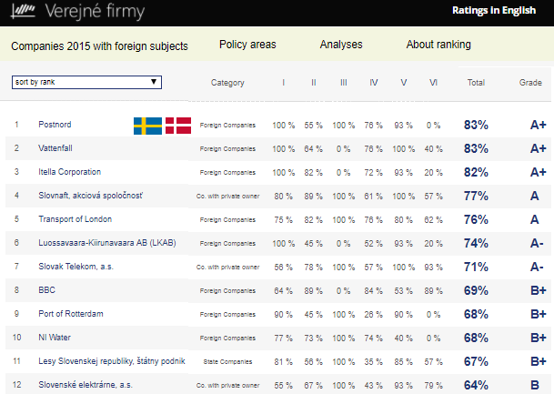
International comparison
International comparison
5 Slovak private or half private companies
15 foreign SOEs
5 Czech SOEs
30 indicators (only webcheck)

Slide 12
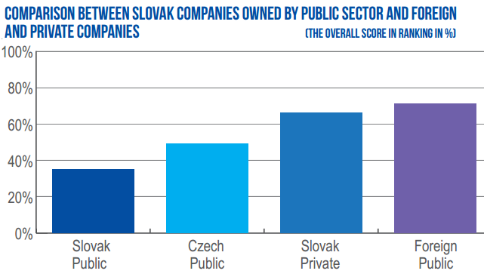
International comparison

Slide 13
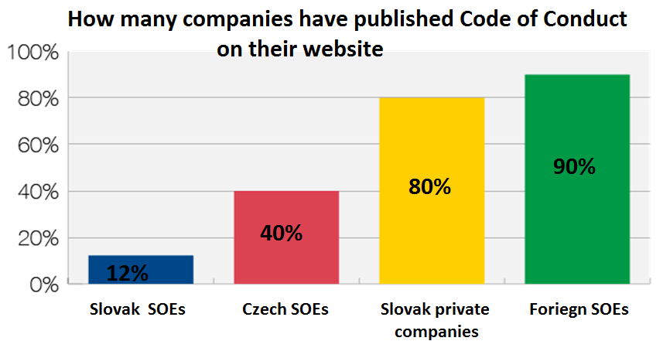
ETHICS

Slide 14
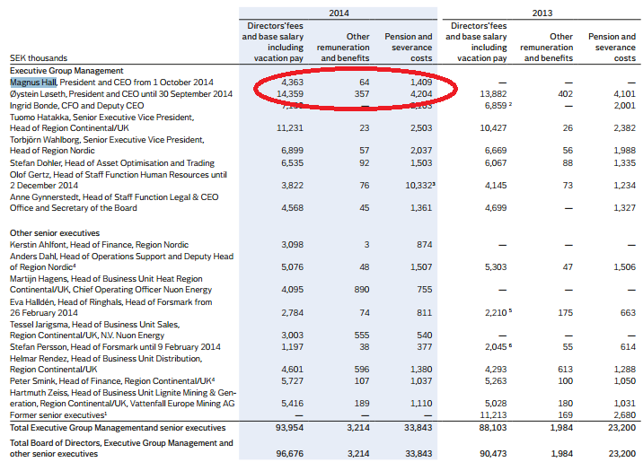
No secrets
Swedish energetic SOE Vattenfall: Managers´ salaries, benefits and pensions are published
BBC have publish also information related to costs and gifts of their managers

Slide 15
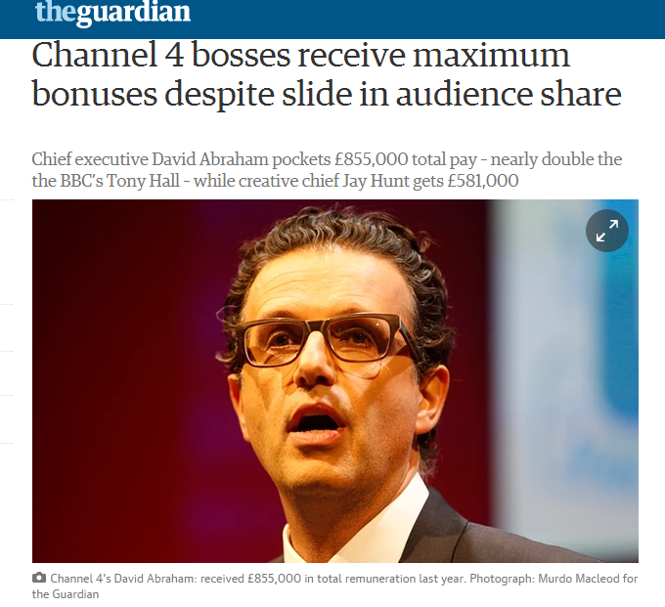
performance criteria
2015: British Newspaper the Guardian published an article about discrepancy between the salary/benefits of the TV Chief (855 thousand £ - six times more than the British Prime Minister) and company performance
decreasing number of television viewers and insufficient
revenues from advertising.

Slide 16
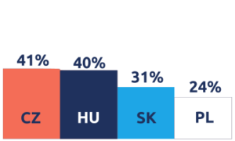
MOEs transparency IN V4
2017: Visegrad initiative for transparent municipal-owned enterprises
36 MOEs from SK, HU, CZ, PL; 30 web check indicators
Criteria: 100% MOEs; total revenues more than 4 million €; variously developed regions; mainly related to public transport, waste disposal and water supply sectors (The Case Study Public Transport Company BA)
The overall average score for all 36 companies reached only 34 %

Slide 17
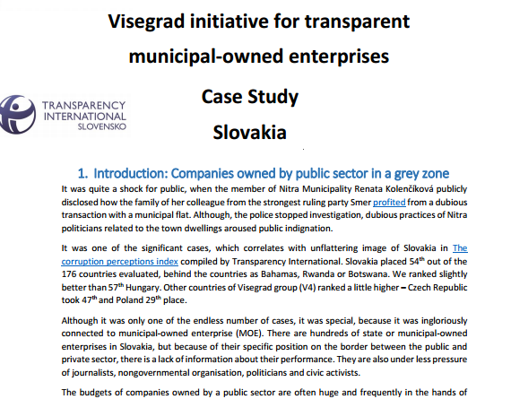
MOEs´ transparency IN V4
The company with the most open approach is the Prague Public Transport Company (60,4%)
The Public Transport Company Bratislava, Inc. Placed third (54,2%)
Best / Shortages

Slide 18
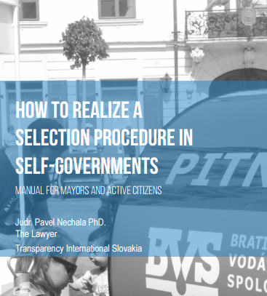
Hiring manager manual
May 2015: TIS was asked for help with the selection procedures aimed to choose the directors of four important town-owned companies
We proposed how to carry out the process and The Mayor invited us as observers to the committee for selection procedures
The procedure was accompanied by doubts about backstage agreements among the politicians. But still, public knew about the candidates much more than in the past, (published professional CVs, business development plan, public hearing, background-check of the candidates
Valuable experience – we created the manual for mayors and active citizens: How to carry out selection procedures in self-governments

Slide 19
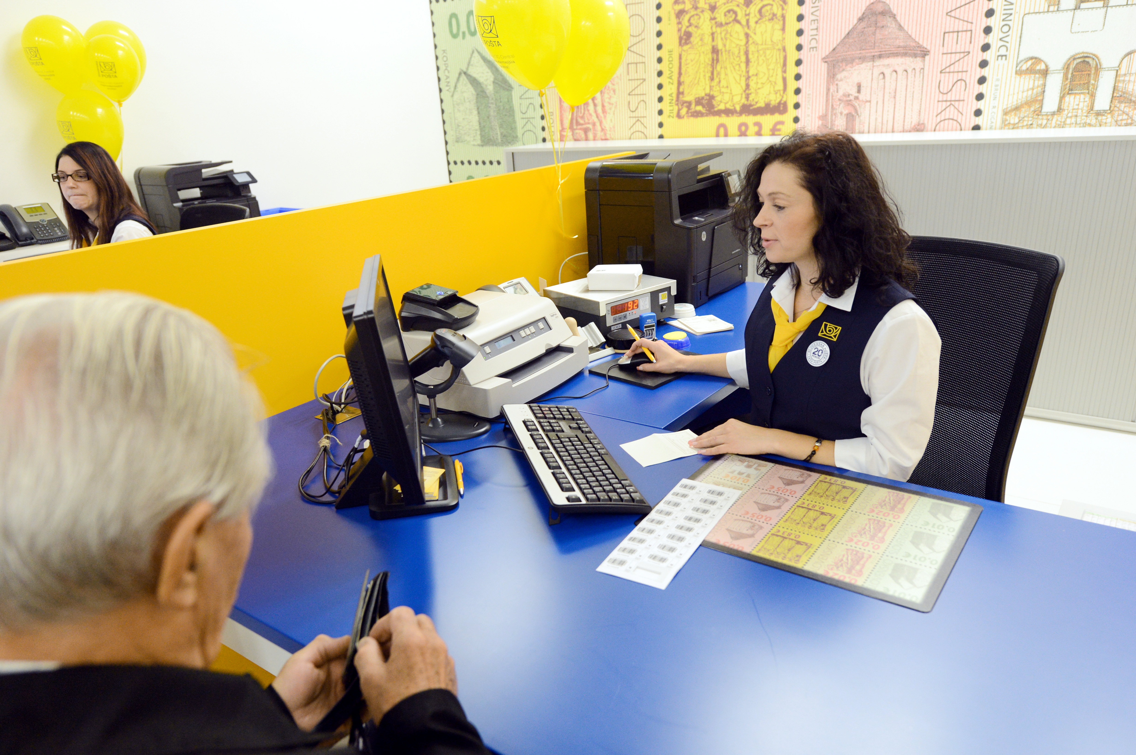
Anticorruption strategy
2015 – cooperation with Slovak Post (13 500 employees)
Identifying of weakness in 8 areas
The Best practices transfer / recommendations

Slide 20
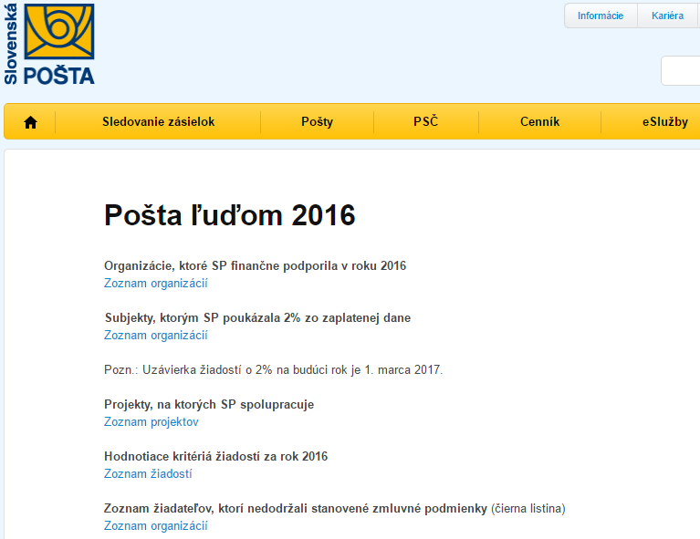
the best practice
The Post for the people
granted organizations
organizations supported from the taxes
The criteria for the donations
The black list
Members of the committee are known

Slide 21
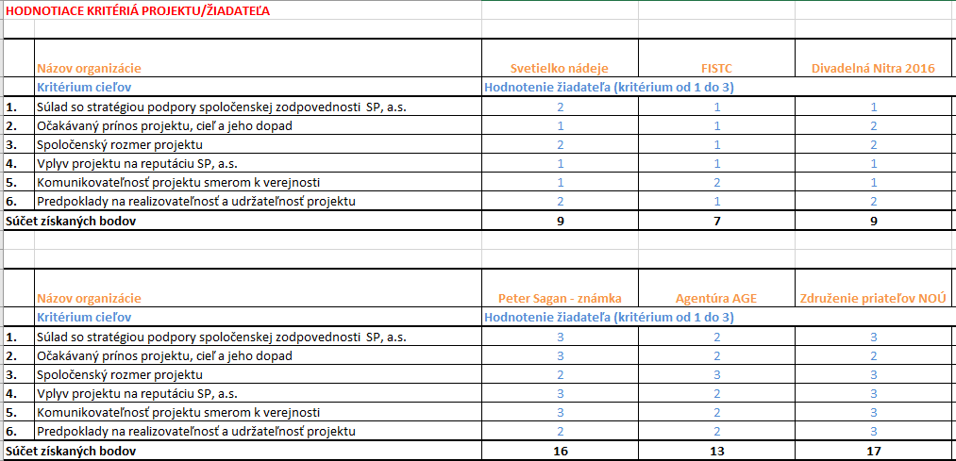
The best practice
Social responsibility, PR impact, sustainability....

Slide 22
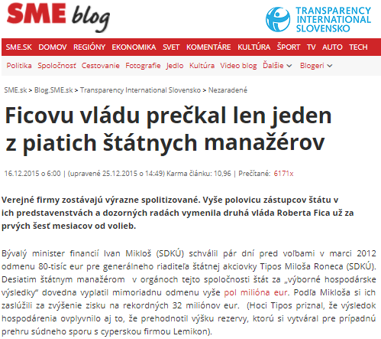
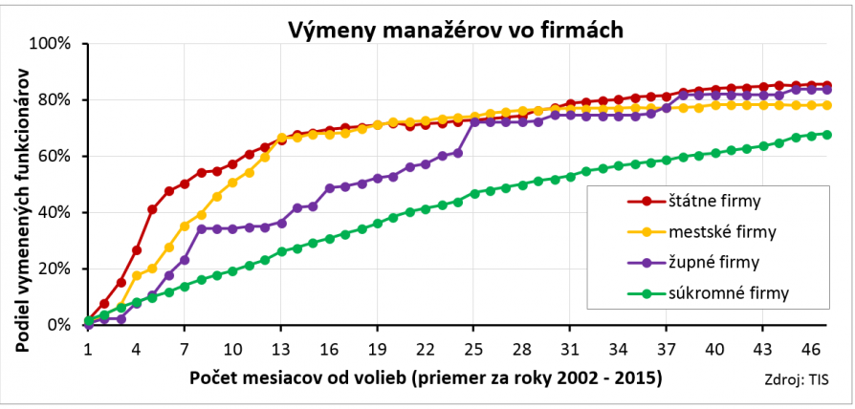
political earthquake
2/3 managers in the state-owned managers don´t survive the first year after election (analysis)

Slide 23
Thank you for your attention
www.transparency.sk
facebook.com/transparencysk
twitter.com/transparencysk
transparency.blog.sme.sk
https://transparency.blog.sme.sk/
© 2017 Transparency International Slovakia

